Slide 1
Coordination Chemistry-II (part-2)
Dr. Semanti Basu
Assistant Professor
Department of Chemistry
Bejoy Narayan Mahavidyalaya,
Itachuna, Hooghly, W. B., India

Slide 2
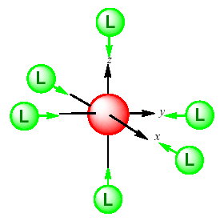
Octahedral Field

Slide 3
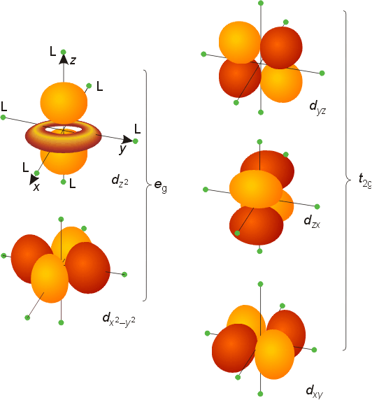
In Octahedral Field
^{d}yz
^{d}z²
^{d}xz
^{d}x²-y²
^{d}xy

Slide 4
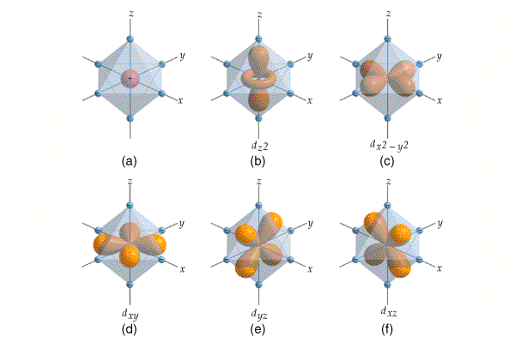

Slide 5
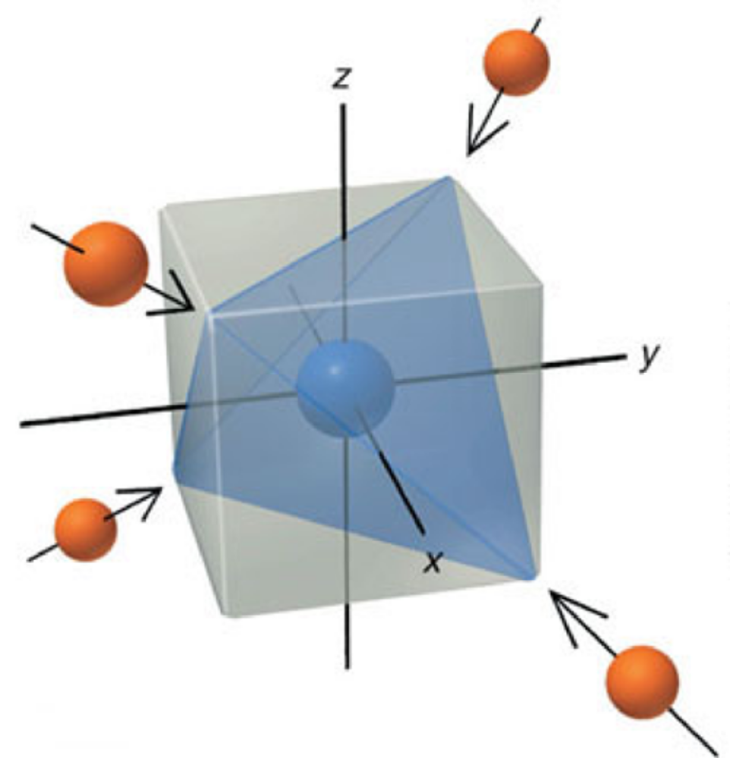
In Tetrahedral Field

Slide 6
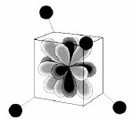
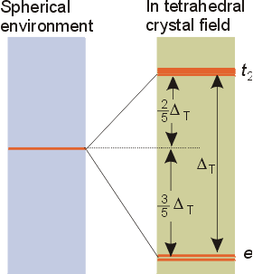

Slide 7
We assume an octahedral array of negative charges placed around the metal ion (which is positive).
The ligand and orbitals lie on the same axes as negative charges.
  Therefore, there is a large, unfavorable interaction between ligand (-) and these orbitals.
  These orbitals form the degenerate high energy pair of energy levels.
The d_{xy}, d_{yz}, and d_{xz} orbitals bisect the negative charges.
  Therefore, there is a smaller repulsion between ligand and metal for these orbitals.
  These orbitals form the degenerate low energy set of energy levels.

Slide 8
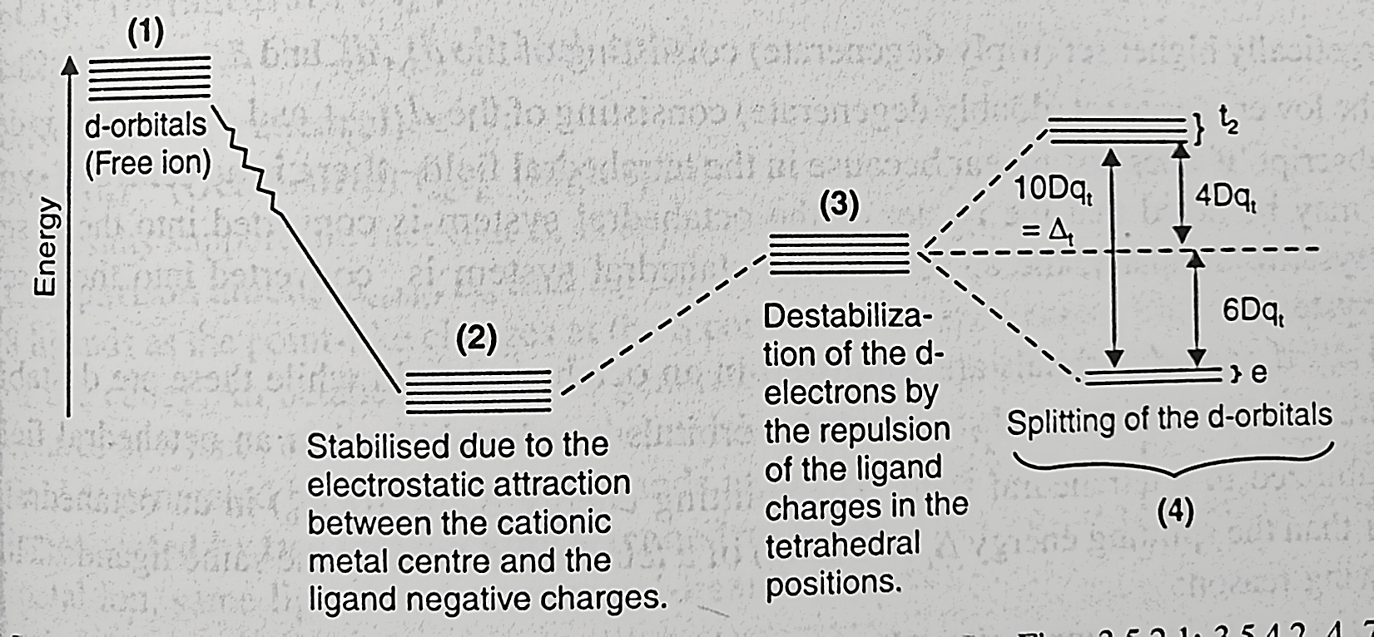

Splitting of $d^{n}$ configuration in tetraherdal field

Slide 9
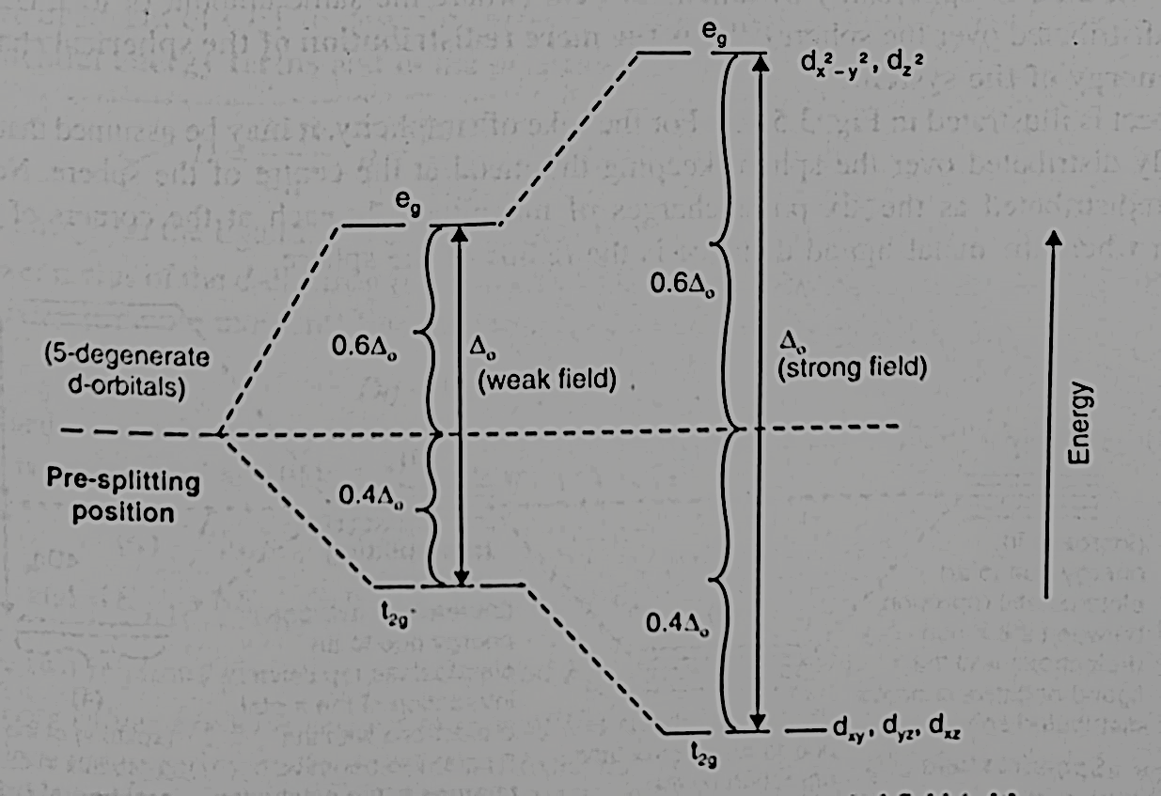
Splitting of $d^{n}$ configuration in octahedral field

Slide 10
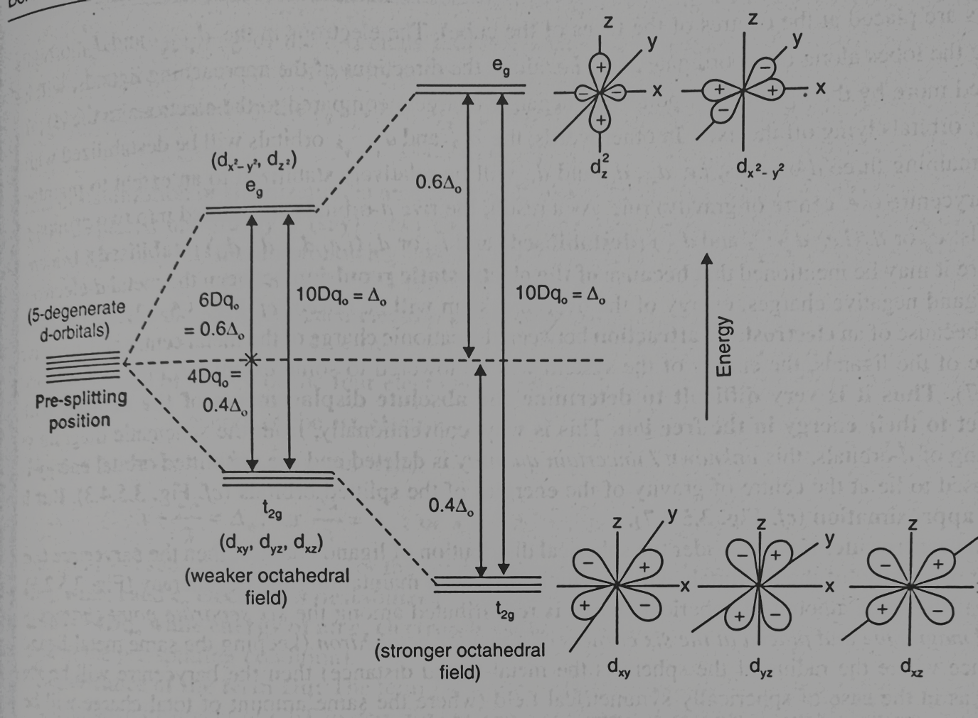
Splitting of $d^{n}$ configuration in octahedral field

Slide 11
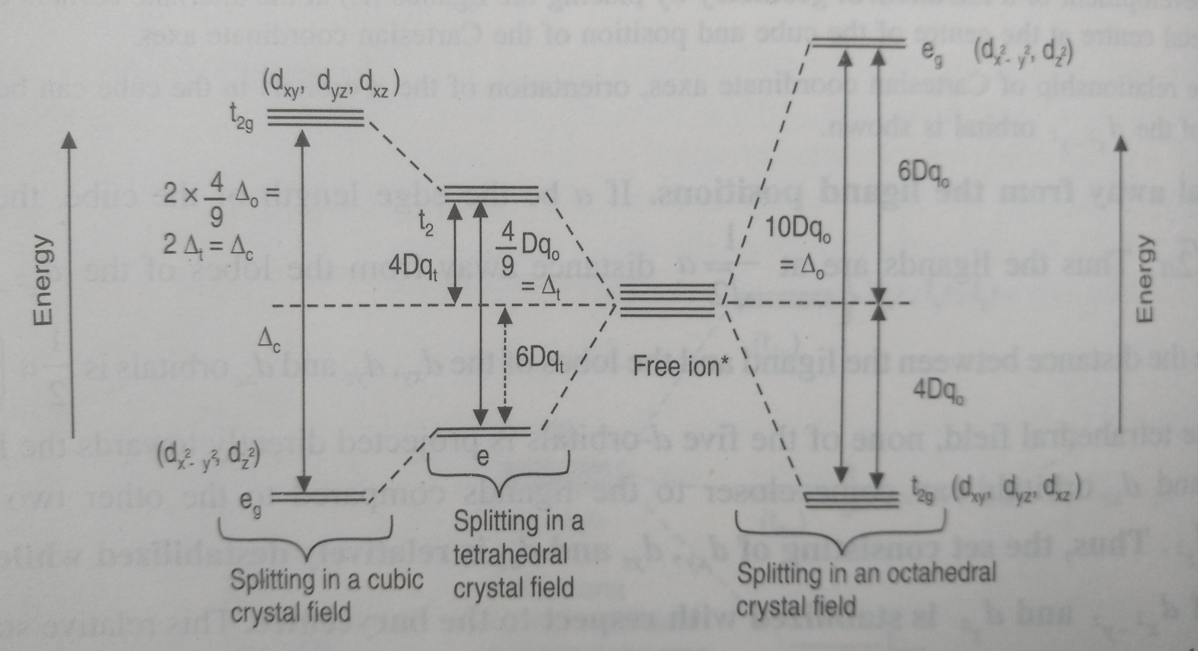
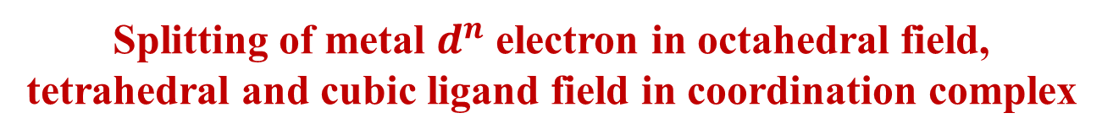
Splitting of metal $d^{n}$ electron in octahedral field, tetrahedral and cubic ligand field in coordination complex

Slide 12
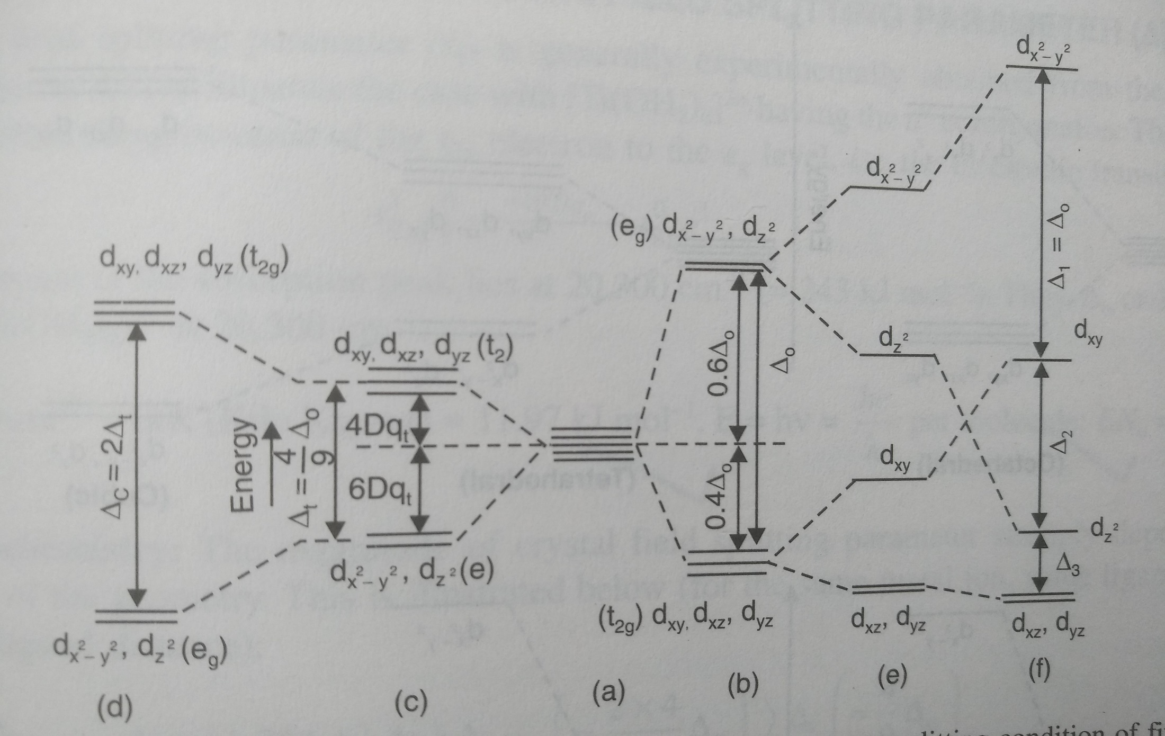
Crystal field splitting of d-orbitals in different geometries. (a) 5 degenerate metal d orbital for free metal ions (b) Octahedral field (Oh) (c) Tetrahedral field (Td) (d) Cubic field (e) Square pyramidal (tetragonal elongation, Z-out distortion) (f) Square planner field

Slide 13
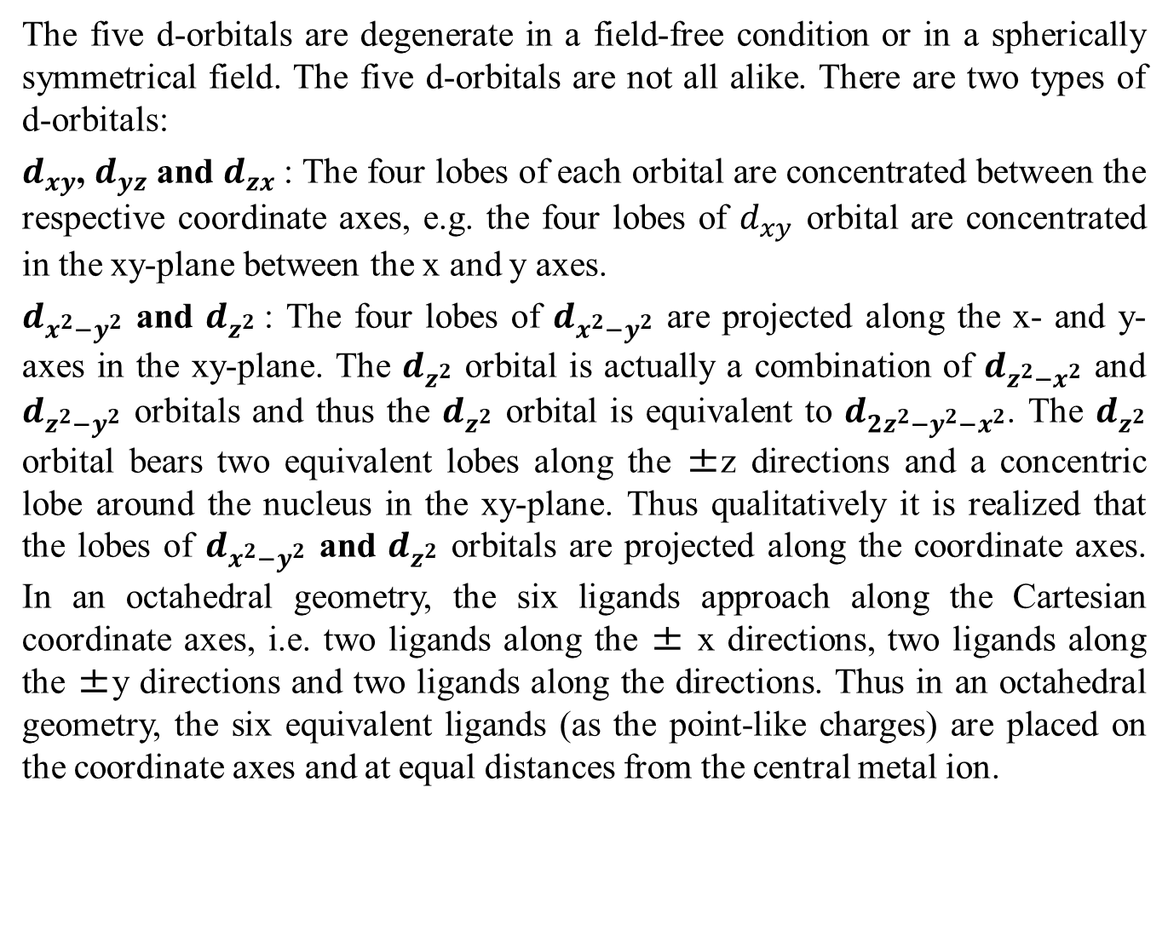
Splitting of $d^{n}$ configuration in octahedral field

Slide 14
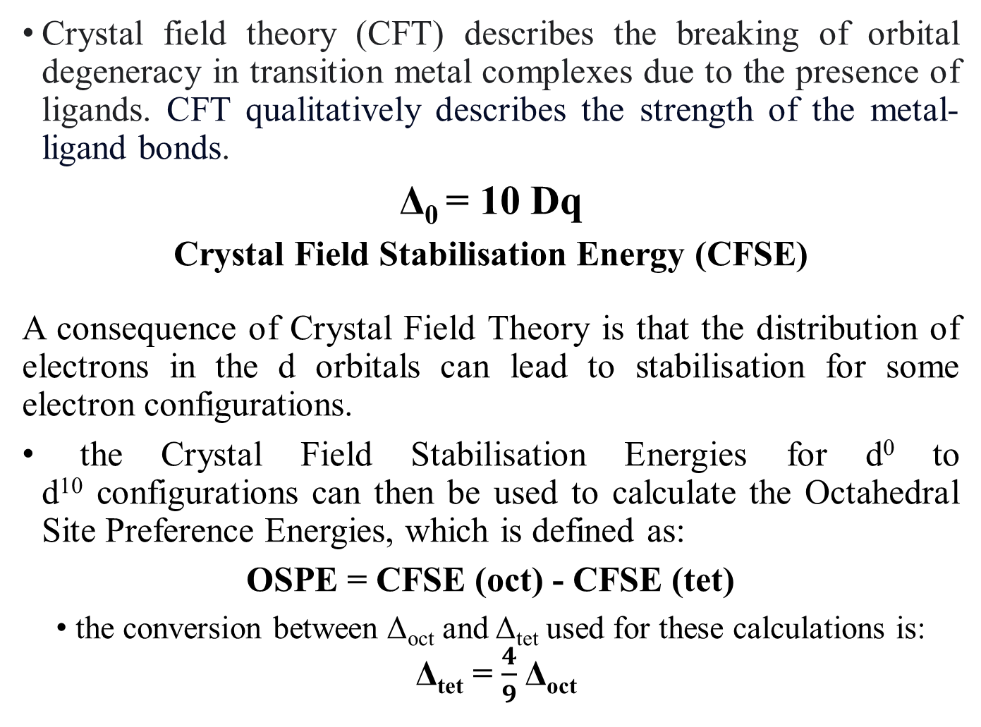
Crystal Field Strength (CFSE)
Crystal field theory (CFT) describes the breaking of orbital degeneracy in transition metal complexes due to the presence of ligands. CFT qualitatively describes the strength of the metal-ligand bonds.
Δ₀ = 10 Dq
Crystal Field Stabilisation Energy (CFSE)
A consequence of Crystal Field Theory is that the distribution of electrons in the d orbitals can lead to stabilisation for some electron configurations.
the Crystal Field Stabilisation Energies for d⁰ to d¹⁰ configurations can then be used to calculate the Octahedral Site Preference Energies, which is defined as:
OSPE = CFSE (oct) - CFSE (tet)
the conversion between Δ_{oct} and Δ_{tet} used for these calculations is:
Δ_{tet} = $\frac{4}{9}$Δ_{oct}

Slide 15
Crystal Field Stabelization Energy (CFSE)
In Octahedral field, configuration is: t_{2g}^{x} e_{g}^{y}
Net energy of the configuration relative to the average energy of the orbitals is:
= (-0.4x + 0.6y)Δ_{O}
Δ_{O} = 10 Dq
For d⁴ to d⁷ in Octahedral field both high spin & low spin states are possible
In weak field: Δ_{O} < P, e.g. t_{2g}³e_{g}¹
In strong field Δ_{O} > P, e.g. t_{2g}⁴
P - paring energy

Slide 16
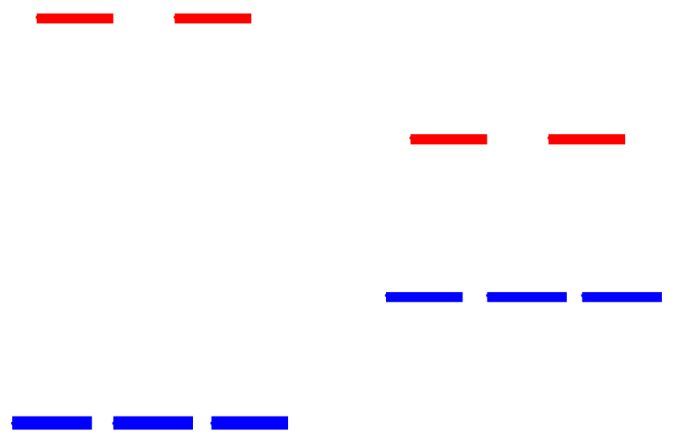
When the 4th electron is assigned it will either go into the higher energy e_{g} orbital at an energy cost of Δ_{o} or be paired at an energy cost of P, the pairing energy.
d⁴
Strong field =
Low spin
(2 unpaired)
Weak field =
High spin
(4 unpaired)
P < Δ_{o}
P > Δ_{o}
Coulombic repulsion energy and exchange energy

Slide 17
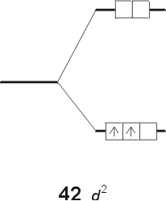
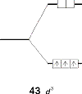
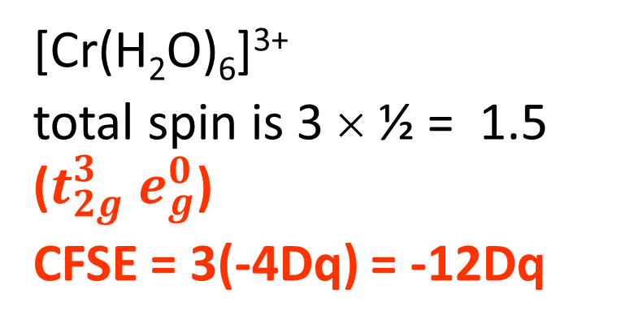
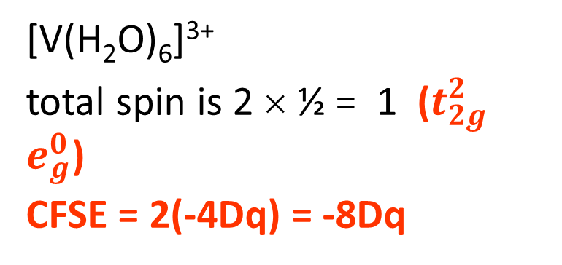
CFSE
[V(H₂O)₆]³⁺
total spin is 2 × ½ = 1 ($t_{2g}^{2}$ $e_{g}^{0}$)
CFSE = 2(-4Dq) = -8Dq
[Cr(H₂O)₆]³⁺
total spin is 3 × ½ = 1.5 ($t_{2g}^{3}$ $e_{g}^{0}$)
CFSE = 3(-4Dq) = -12Dq

Slide 18
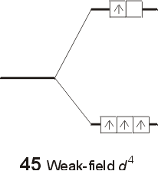
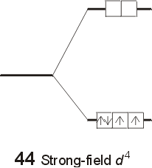
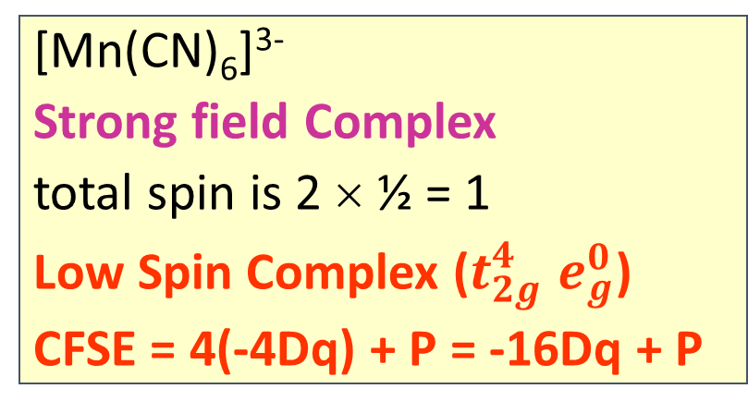
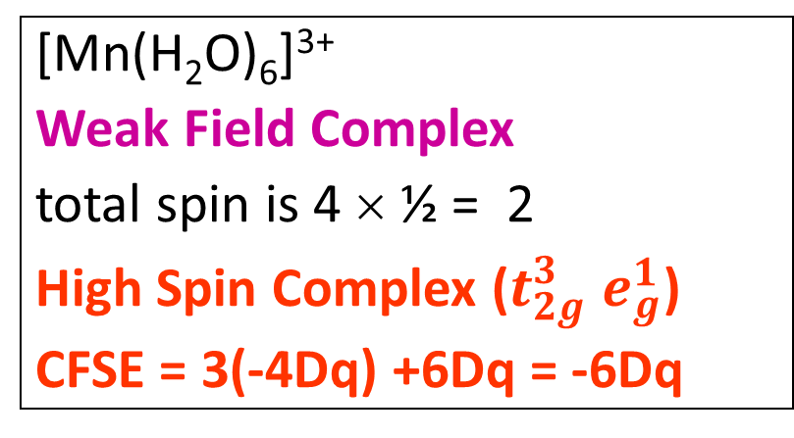
CFSE
[Mn(H₂O)₆]³⁺
Weak Field Complex
total spin is 4 × ½ = 2
High Spin Complex ($t_{2g}^{3}$ $e_{g}^{1}$)
CFSE = 3(-4Dq) +6Dq = -6Dq
[Mn(CN)₆]³⁻
Strong field Complex
total spin is 2 × ½ = 1
Low Spin Complex ($t_{2g}^{4}$ $e_{g}^{0}$)
CFSE = 4(-4Dq) + P = -16Dq + P

Slide 19
Placing electrons in d orbitals
d⁵
d⁶
d⁷
1 u.e.
5 u.e.
0 u.e.
4 u.e.
1 u.e.
3 u.e.
d⁸
d⁹
d¹⁰
2 u.e.
2 u.e.
1 u.e.
1 u.e.
0 u.e.
0 u.e.

Slide 20
Crystal Field Stabilisation Energies (CFSE) &
 | Strong field ligand (Δ_{O} > P) low spin complex |  |  | Weak field ligand (Δ_{O} < P) high spin complex
Total d-electrons | Octahedral configuration | CFSE | No. of unpaired e | Octahedral configuration | CFSE | No. of unpaired e
d¹ | t_{2g}¹e_{g}⁰ | -4 Dq | 1 | t_{2g}¹ | -4Dq or -2/5 Δo | 1
d² | t_{2g}²e_{g}⁰ | -8 Dq | 2 | t_{2g}² | -8Dq or -4/5 Δo | 2
d³ | t_{2g}³e_{g}⁰ | -12 Dq | 3 | t_{2g}³ | -12Dq or -6/5 Δo | 3
d⁴ | t_{2g}⁴e_{g}⁰ | -16 Dq+P | 2 | t_{2g}³e_{g}¹ | -6Dq or -3/5 Δo | 4
d⁵ | t_{2g}⁵e_{g}⁰ | -20 Dq +2P | 1 | t_{2g}³e_{g}² | 0 Δo | 5
d⁶ | t_{2g}⁶e_{g}⁰ | -24 Dq +2P | 0 | t_{2g}⁴e_{g}² | -4 Dq or -2/5 Δo | 4
d⁷ | t_{2g}⁶e_{g}¹ | -18 Dq +1P | 1 | t_{2g}⁵e_{g}² | -8 Dq or -4/5 Δo | 3
d⁸ | t_{2g}⁶e_{g}² | -12 Dq | 2 | t_{2g}⁶e_{g}² | -12 Dq or -6/5 Δo | 2
d⁹ | t_{2g}⁶e_{g}³ | -6 Dq | 1 | t_{2g}⁶e_{g}³ | -6 Dq or -3/5 Δo | 1
d¹⁰ | t_{2g}⁶e_{g}⁴ | 0 Dq | 0 | t_{2g}⁶e_{g}⁴ | 0 Dq | 0

Slide 21
Crystal Field Stabilisation Energies (CFSE) &
Octahedral Site Preference Energies (OSPE)
Total d-electrons | Octahedral configuration | CFSE | Tetrahedral configuration | CFSE | OSPE
d⁰ | t_{2g}⁰ | 0 Δo | e⁰ | 0 Δt | 0 Δo
d¹ | t_{2g}¹ | -2/5 Δo or -4Dq | e¹ | -3/5 Δt | -6/45 Δo
d² | t_{2g}² | -4/5 Δo or -8Dq | e² | -6/5 Δt | -12/45 Δo
d³ | t_{2g}³ | -6/5 Δo or -12Dq | e²t₂¹ | -4/5 Δt | -38/45 Δo
d⁴ (h.s.) | t_{2g}³e_{g}¹ | -3/5 Δo or -6Dq | e²t₂² | -2/5 Δt | -19/45 Δo
d⁵ (h.s.) | t_{2g}³e_{g}² | 0 Δo | e²t₂³ | 0 Δt | 0 Δo
d⁶ (h.s.) | t_{2g}⁴e_{g}² | -2/5 Δo + P | e³t₂³ | -3/5 Δt + P | -6/45 Δo
d⁷ (h.s.) | t_{2g}⁵e_{g}² | -4/5 Δo + 2P | e⁴t₂³ | -6/5 Δt + 2P | -12/45 Δo
d⁸ | t_{2g}⁶e_{g}² | -6/5 Δo + 3P | e⁴t₂⁴ | -4/5 Δt + 3P | -38/45 Δo
d⁹ | t_{2g}⁶e_{g}³ | -3/5 Δo + 4P | e⁴t₂⁵ | -2/5 Δt + 4P | -19/45 Δo
d¹⁰ | t_{2g}⁶e_{g}⁴ | 0 Δo | e⁴t₂⁶ | 0 Δt | 0 Δo

Slide 22
Magnitude of Δ
Oxidation state of the metal ion
[Ru(H₂O)₆]²⁺ 19800 cm⁻¹
[Ru(H₂O)₆]³⁺ 28600 cm⁻¹
2. Number of ligands and geometry
Δ_{t}< Δ_{o} 9Δ_{t}= 4Δ_{o} 8Δ_{o} = 9Δ_{c} = 18Δ_{t} (Δ_{c} = Δ_{cubic})
Number of ligand α Magnitude of Δ
3. Nature of the ligand
I⁻<S²⁻<SCN⁻<Cl⁻<NO₃⁻<N₃⁻<F⁻<OH⁻<C₂O₄²⁻<H₂O<…..CN⁻<CO

Slide 23
Limitations of CFT
The crystal field theory could explain the formation, structure, optical, and magnetic properties of the coordination compound quite satisfactorily. But the crystal field theory could not explain the following factors.
The existence of covalent bonding in some transition metal complexes.
The order of ligands in the spectrochemical series. As ligands are considered as point charges, the anionic ligands should exert a greater splitting effect. However, the anionic ligands are placed at the lower end of the spectrochemical series.

Slide 24
Limitations of CFT
Considers Ligand as Point charge/dipole only
Does not take into account of the overlap of ligand and metal orbitals
Consequence
e.g. Fails to explain why CO is stronger ligand than CN⁻ in complexes having metal in low oxidation state

Slide 25
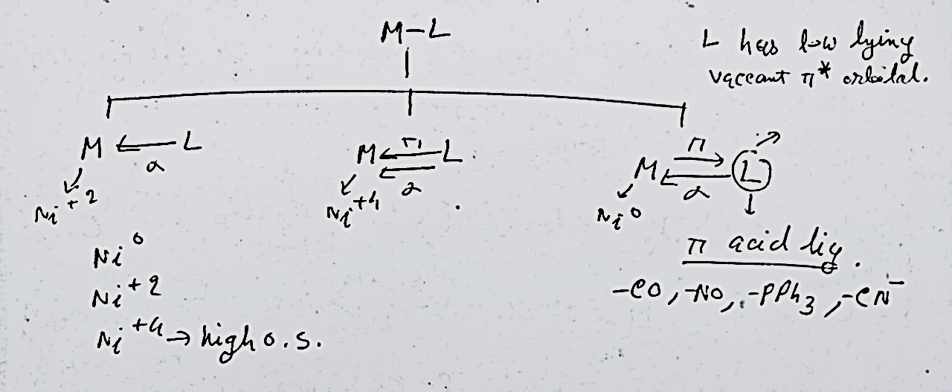

Slide 26
Metals in Low Oxidation States
In low oxidation states, the electron density on the metal ion is very high.
To stabilize low oxidation states, we require ligands, which can simultaneously bind the metal center and also withdraw electron density from it.

Slide 27
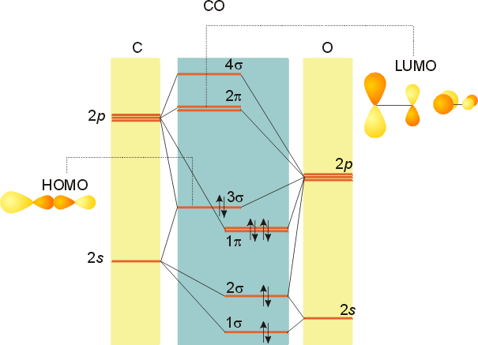
Stabilizing Low Oxidation State: e.g. CO

Slide 28
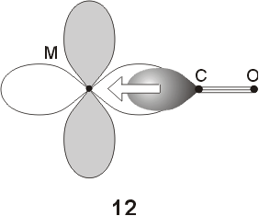
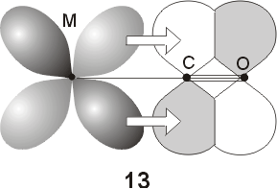
Stabilizing Low Oxidation State: e.g. CO
Ni(CO)₄], [Fe(CO)₅], [Cr(CO)₆], [Mn₂(CO)₁₀], [Co₂(CO)₈], Na₂[Fe(CO)₄], Na[Mn(CO)₅]

Slide 29
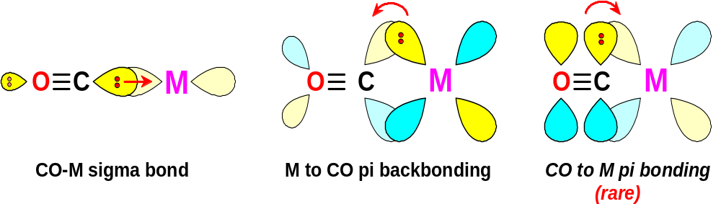
O
C
M
σ orbital serves as a very weak donor to a metal atom

Slide 30
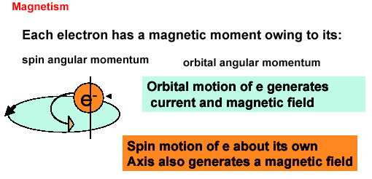

Slide 31
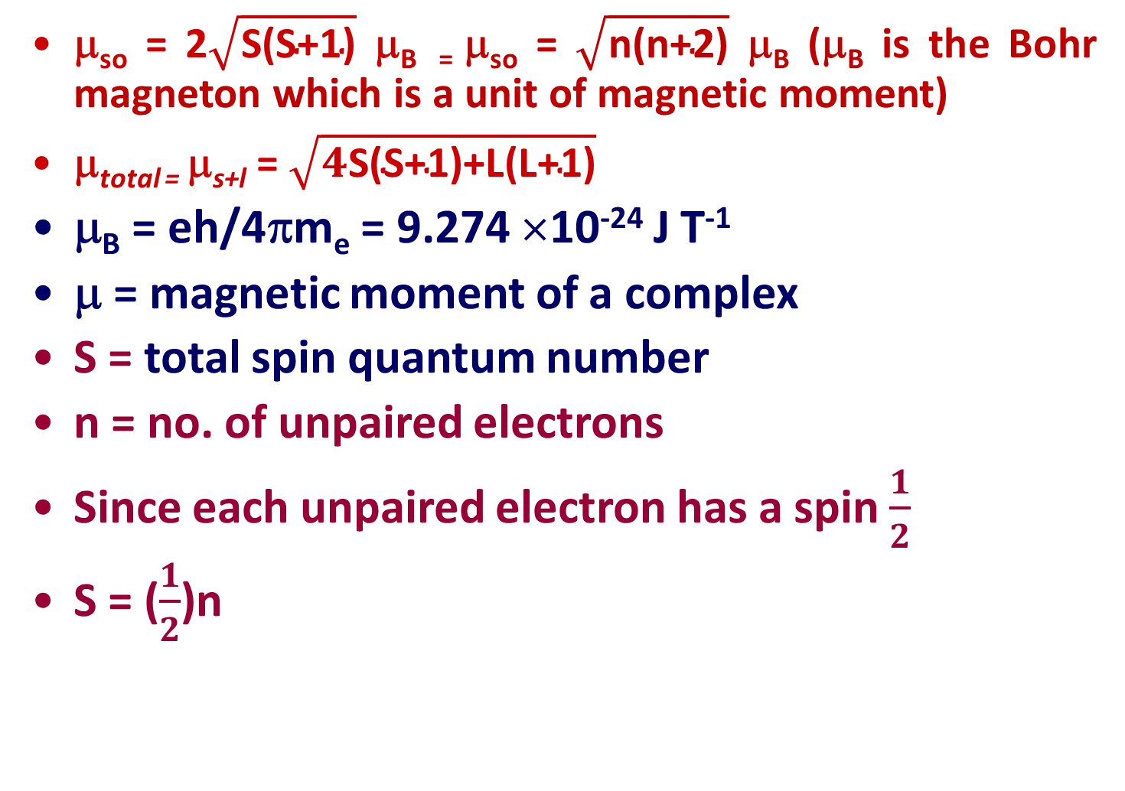
μ_{so} = 2$\sqrt{\text{S}\text{(}\text{S}\text{+1)}}$ μ_{B =} μ_{so} = $\sqrt{\text{n}\text{(}\text{n}\text{+2)}}$ μ_{B} (μ_{B} is the Bohr magneton which is a unit of magnetic moment)
μ_{total =} μ_{s+l} = $\sqrt{4\text{S}\text{(}\text{S}\text{+1)}\text{+}\text{L}\text{(}\text{L}\text{+1)}}$
μ_{B} = eh/4πm_{e} = 9.274 ×10⁻²⁴ J T⁻¹
μ = magnetic moment of a complex
S = total spin quantum number
n = no. of unpaired electrons
Since each unpaired electron has a spin $\frac{1}{2}$
S = ($\frac{1}{2}$)n

Slide 32
In d⁴, d⁵, d⁶, and d⁷ octahedral complexes, magnetic measurements can very easily predict weak versus strong field.
Tetrahedral complexes - only high spin complexes result, for Δ_{t} << Δ_{O}.

Slide 33
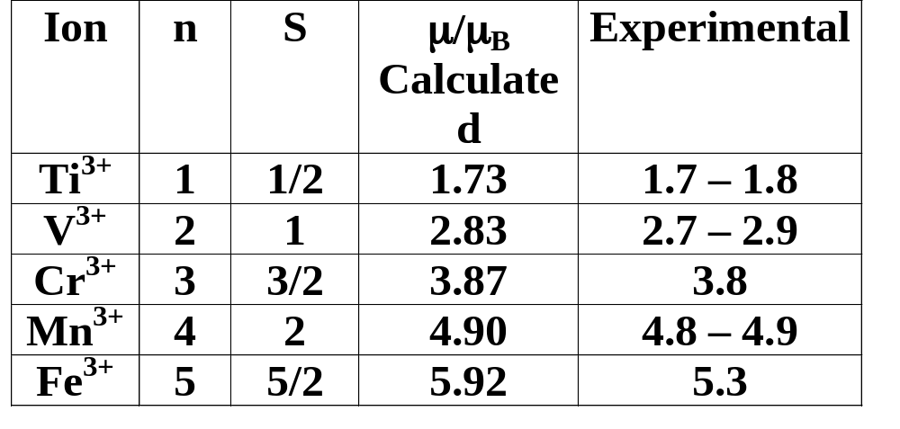

n = no. of unpaired electrons
μ = $\sqrt{\text{n}\text{(}\text{n}\text{+2)}}$μ_{B}
Similar Calculation can be done
for Low-spin Complex

Slide 34
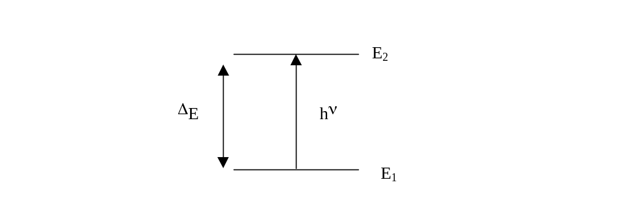
The origin of the color of the transition metal compounds
Ligands influence Δ_{O}, therefore the colour

Slide 35
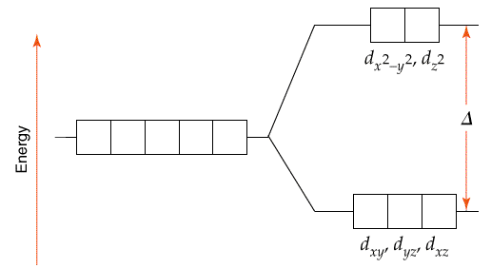
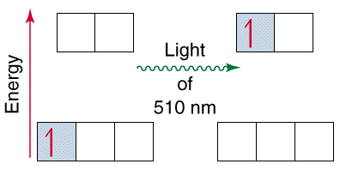

Slide 36
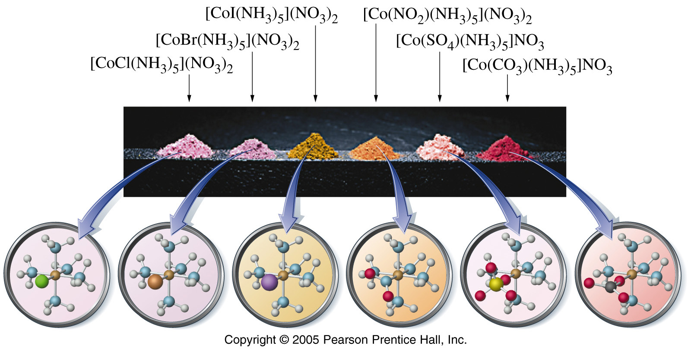
The colour can change depending on a number of factors e.g.
1. Metal charge
2. Ligand strength

Slide 37
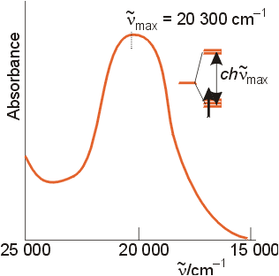
The optical absorption spectrum of [Ti(H₂O)₆]³⁺
Assigned transition: e_{g} t_{2g}
This corresponds to the energy gap
Δ_{O} = 243 kJ mol⁻¹

Slide 38
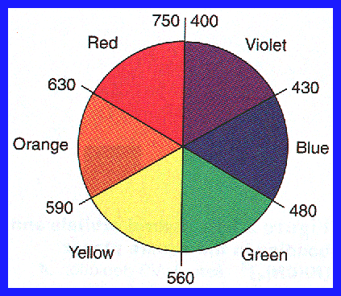
absorbed color
observed color

Slide 39
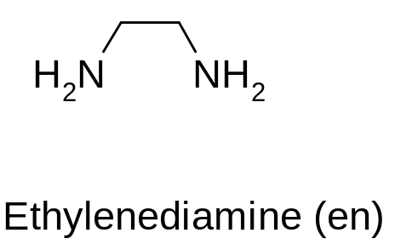
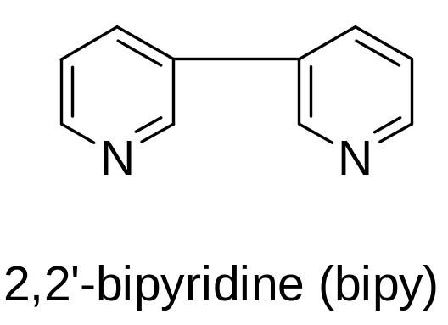
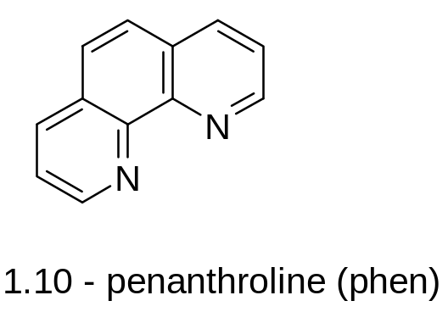
Spectrochemical Series: An order of ligand field strength based on experiment:
Weak Field
I⁻ < Br⁻< S²⁻< SCN⁻< Cl⁻< NO₃⁻< F⁻ < C₂O₄²⁻< H₂O< NCS⁻< CH₃CN< NH₃< en < bipy< phen< NO₂⁻< PPh₃< CN⁻< CO
Strong Field

Slide 40
Spectrochemical Series of Ligand
The crystal field splitting depends upon the nature of the ligand. The ligands which cause only a small crystal field splitting are called weak field ligands. The ligands which cause a large crystal field splitting are called strong field ligands.
The arrangement of common ligands in the ascending order of crystal field splitting (Δ) is called spectrochemical series.
The spectrochemical series in the increasing order of crystal field splitting is:
I–<Br–<S2–<Cl–<NO–3<F–<OH–<EtOH–<C2O2–4<H2O<<EDTA<NH3<Py<Ethylenediamine<dipyridyl<0–phenanthroline<NO2-<CN–<CO

Slide 41
Spectrochemical Series of Metal
Like the ligands, different metal ions can also be ordered in increasing Δ under the circumstances with the same ligands which is called the spectrochemical series of metals
The spectrochemical series of metals, are used and that it is in an octahedral coordination, is given by:
Mn2+ < Ni2+ < Co2+ < Fe2+ < V2+ < Fe3+ < V3+ < Co3+ < Mn4+ < Mo3+ < Rh3+ < Ru3+ < Pd4+ < Ir3+ < Pt4+
Magnitude of Δ increase with increasing the oxidation number of the metal ion.
Magnitude of Δ increase as we move down the group.

Slide 42
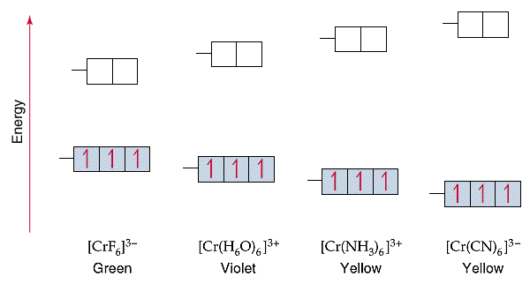
[CrF₆]³⁻
[Cr(H₂O)₆]³⁺
[Cr(NH₃)₆]³⁺
[Cr(CN)₆]³⁻
As Cr³⁺ goes from being attached to a weak field ligand to a strong field ligand, Δ increases and the color of the complex changes from green to yellow.

Slide 43
Reference
Ashim K Das & Mahua Das, Fundamental Concept of Inorganic Chemistry, CBC Publishers & Distributors, Volume 2, First Edition, 2000
Ashim K Das, Fundamental Concept of Inorganic Chemistry, CBC Publishers & Distributors, Volume 4, Second Edition, 2014

Slide 44
Thank you

