Slide 1
Coordination Chemistry-I (part-3)
Dr. Semanti Basu
Assistant Professor
Department of Chemistry
Bejoy Narayan Mahavidyalaya,
Itachuna, Hooghly, W. B., India

Slide 2
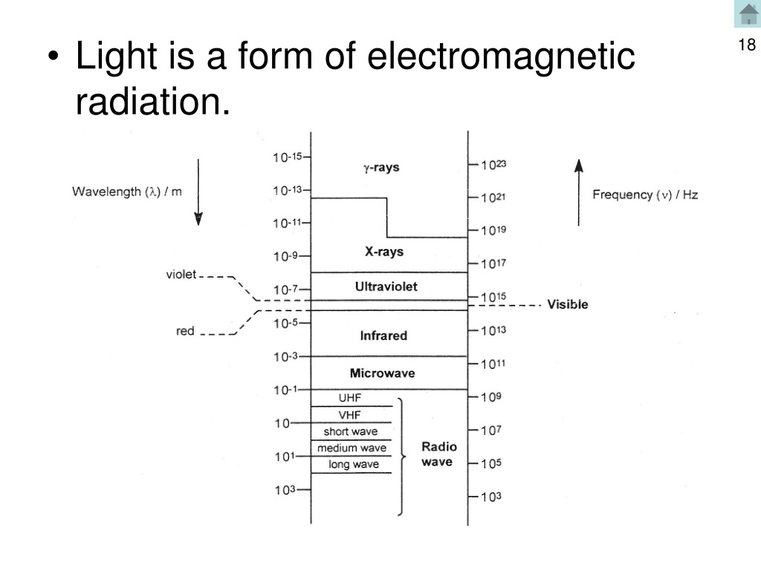

Slide 3
OPTICAL OR MIRROR-IMAGE ISOMERISM

Slide 4
OPTICAL ISOMERISM

Slide 6
OPTICAL ISOMERISM

Slide 7
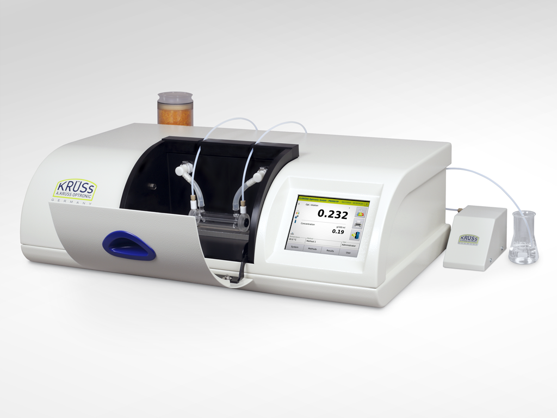
Optical Activity
Optical activity is measured using an instrument called Polarimeter.
A polarimeter allows polarized light to travel through a sample tube containing an sample and the degree of rotation of plane polarized light is measured.

Slide 8
OPTICAL ISOMERISM
When the solutions of certain complex compounds are placed in the path of a plane-polarised light (the waves of the plane- polarised light vibrate only in one direction; vibrations in other directions are cut off), they rotate its plane through a certain angle which may be either to the left or to the right. This property of a complex of rotating the plane of polarised light is called its optical activity and the complex possessing this property is said to be optically active.
Optically active complexes are said to exist in the following forms:
One which rotates the plane of polarised light towards right (i.e. in clockwise direction) is said to be dextro-rotatory or d-form. d-form is also represented by placing (+) sign before its name or formula.
One which rotates the plane of polarised light towards left (i.e. in anti-clockwise direction) is called laevo-rotatory or l-form. l-form is also represented by putting (-) sign before its name or formula.
(+), dextro, and (-), laevo, refer to the sign of rotation of the optical isomer at the sodium D line wavelength.

Slide 9
OPTICAL ISOMERISM
The d- and l-forms have the following characteristics :
Since d- and l-forms are capable of rotating the plane of polarised light, these are said to be optically active forms or optical isomers and this phenomena is called optical activity or optical isomerism.
These two forms have exactly identical physical and chemical properties, although they differ in their action on polarised light.
d- and l-forms are mirror images to each other just as left hand is the mirror image of the right hand. Thus d- and l-forms can not be superimposed on each other. Since these forms are related to each other as mirror-images, they are commonly called enantiomorphs (Latin: enantio opposite, morphs = forms) or enantiomers.
Thus optical isomerism is now often referred to as enantiomerism.
(c) One which is not capable of rotating the plane of polarised light is called optically inactive. Such an isomer is called racemic-, dl-or (±)form. A recemic substance is composed of 50% d- and 50% l-form. The solution of a recemic (dl-mixture) form in a solvent which contains equimolecular recenic and forms is inactive, because the rotation (of the plane of polarised light) produced by one isomer, say d-isomer, is balanced or compensated by equal but opposite rotation produced by the other l-isomer). inactivity produced in dl-mixture is said to be due to external compensation.

Slide 10
OPTICAL ISOMERISM
Conditions for a molecule to show optical isomerism.
A molecule in which the grouping of the atoms in the molecule in asymmetric is called an asymmetric or dissymmetric molecule.
An asymmetric molecule has the following features:
An asymmetric molecule never has a plane of symmetry (also called mirror-image plane) which is defined as an imaginary plane which divides the molecule in such a way that the part of it on one side of the plane is the mirror image of that on the other side of the plane. The molecules possessing such a plane of symmetry are always inactive while those having no plane of symmetry are optically active and hence show optical isomerism.
An asymmetric molecule cannot be superimposed on its mirror image.
Thus the most necessary and sufficient condition for a molecule to show optical isomerism (i.e. to exist in d- and d l-forms) is that
the molecule should be asymmetric, i.e. it should have no plane of sym- metry, and
the molecule should not be superimposable on its mirror image.

Slide 11
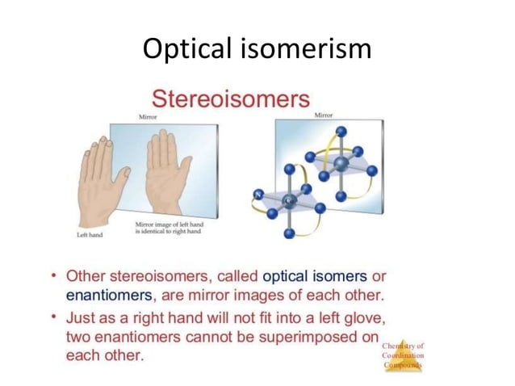

Slide 12
OPTICAL ISOMERISM
OPTICAL ISOMERISM IN 4-AND 6-COORDINATION COMPOUNDS
No optical isomerism is possible with tetrahedral and square planar complexes of the type: [Ma₄], [Ma₃b] and [Mab₃] because all the possible arrangements of the ligands round the central metal ion, M are exactly equivalent.
Square planar Complexes
Optical isomerism rarely occurs in square planar complexes, since they have all the four ligands and the central metal ion in the same plane and hence contain a plane or axis of symmetry. Thus these complexes are optically inactive, they cannot show optical isomerism even if all the four ligands are different. Although, as mentioned above, square planar complexes seldom show optical isomerism, yet a four-coordinated complex of of Pt (II) viz. iso-butylenediamine-meso stilbenediamine platinum (II) cation, [P(ll) (NH₂ CH (C₆H₅) CH (C₆H₅). NH2) (NH₂.CH₂.C(CH₃)₂.NH₂)]²⁺ which has square-planar shape has resolved into two forms by Mills and Quibell is 1935.

Slide 13
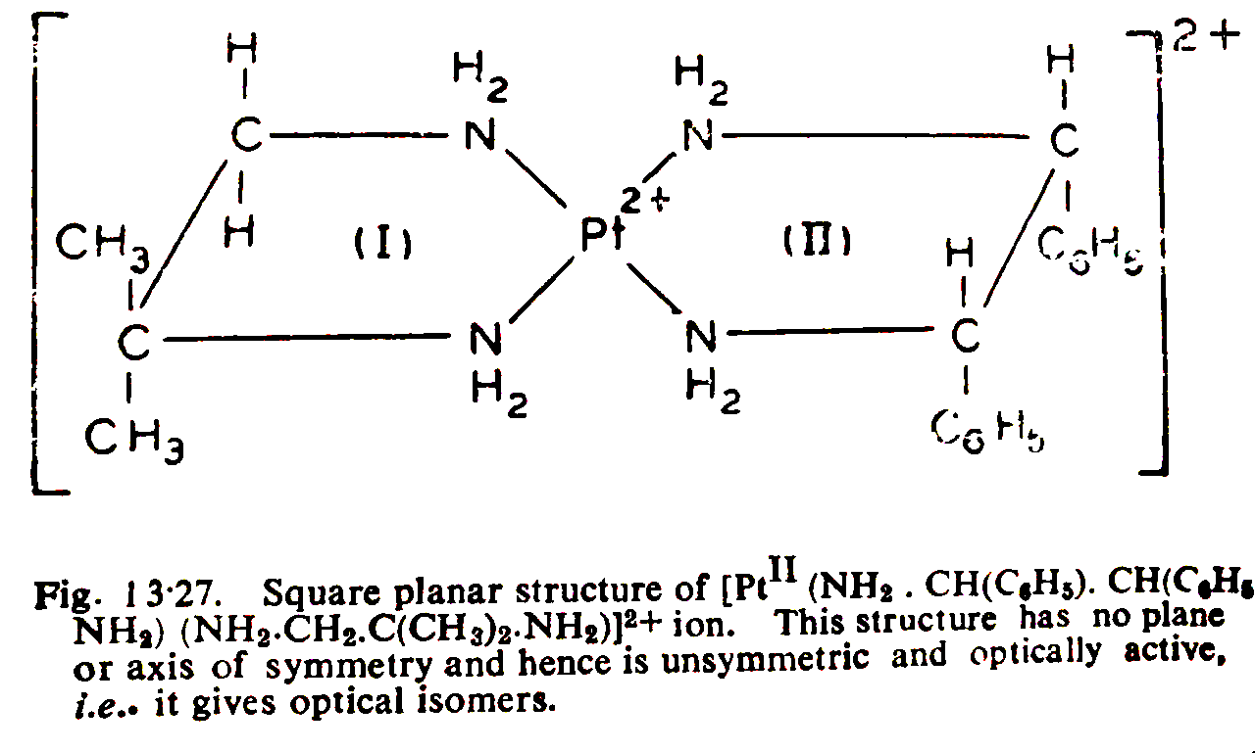
Proof of square planner geometry
square planner complex is optically active

Slide 14
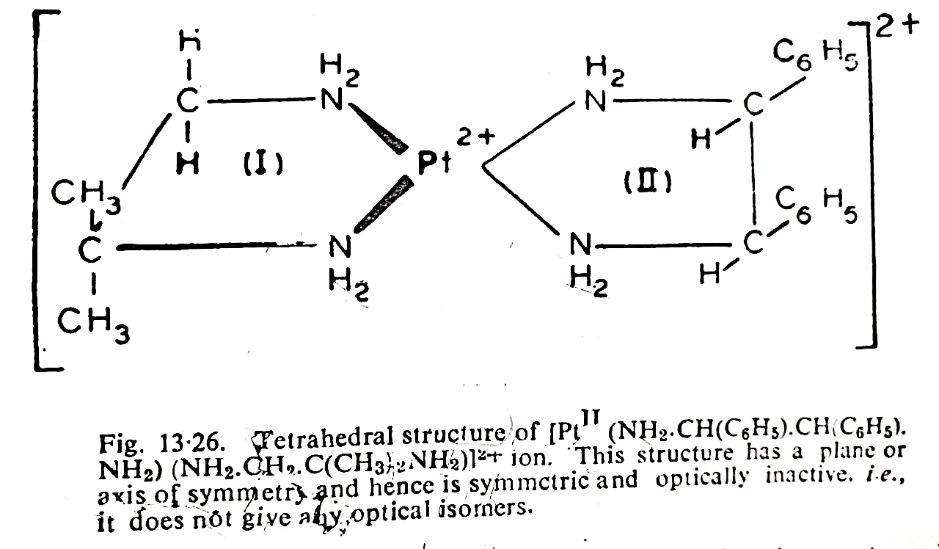
Proof of square planner geometry
Tetrahedral complex is optically inactive
Actually molecule is o. active, therefore square planner

Slide 15
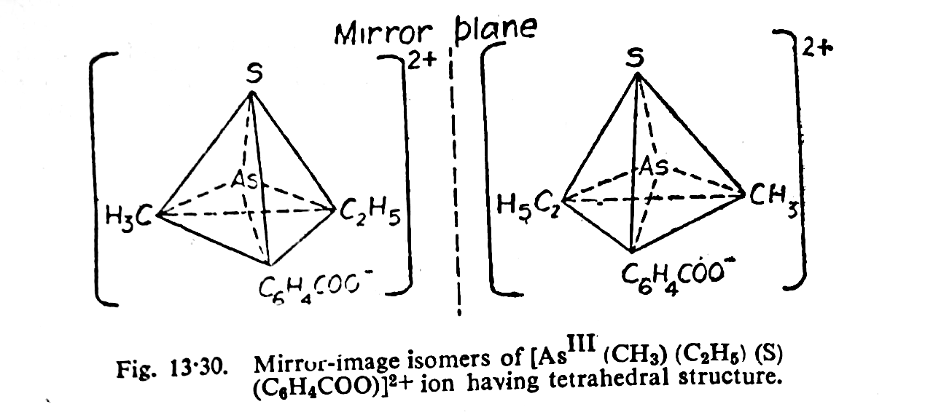
(B) Tetrahedral Complexes
(i) A tetrahedral complex of [Mabcd] type occurs in two optical isomers. Here it may be noted that 4 different groups round the central metal ion are not the only requirement to make the complex to show mirror-image isomerism. All that is required is that the molecule should be asymmetric (i.e., unsymmetrical), i.e. it should have no plane of symmetry so that it can exist in two mirror-image forms

Slide 16
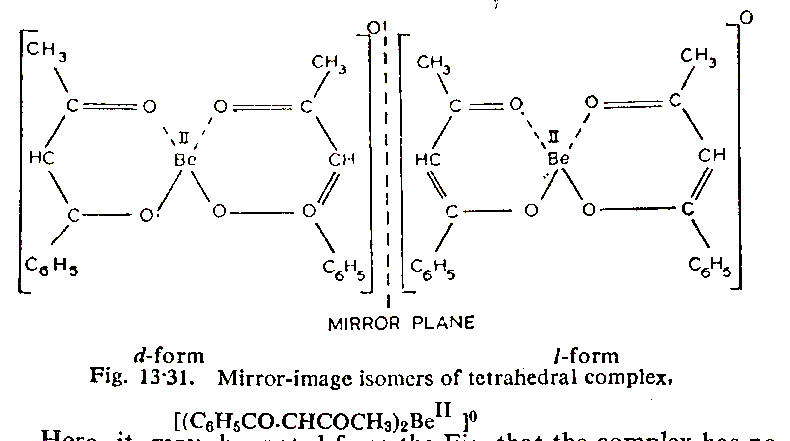
(B) Tetrahedral Complexes
(ii) Tetrahedral complexes of Be(II), B(III) and Zn(II) with unsymmetrical bidentate ligands have been made and they are optically active. An example is bis(benzoylacetonato) beryllium (II) complex, which has 2 optical isomers. Here it may be noted from the Fig. that the complex has no centre or plane of symmetry and the two forms are not superimpos- able on each other. This explains the resolution of the complex into d- and l-forms.

Slide 17
Geometrical & Optical isomers for Coordination Number 4
Complex | Square planar geometry | Tetrahedral geometry
[MA₄] | No isomerism | No isomerism
[MA₃B] | No isomerism | No isomerism
[MA₂B₂] | Cis and trans isomers | No isomerism
[MA₃BC] | Cis and trans isomers | No isomerism
[MABCD] | 3 geometrical isomers but no optical isomerism | 2 optical isomers but no geometrical isomerism

Slide 18
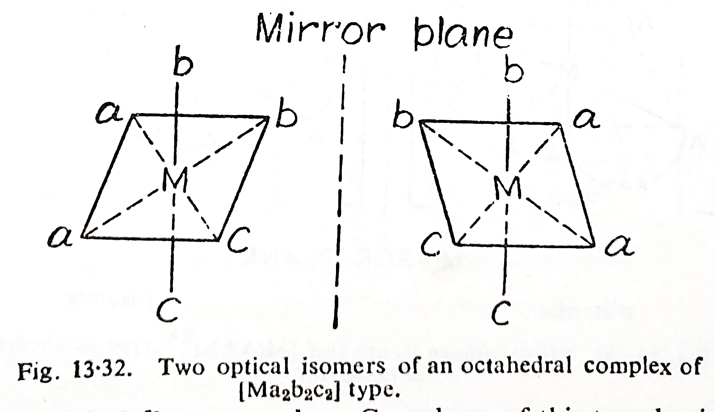
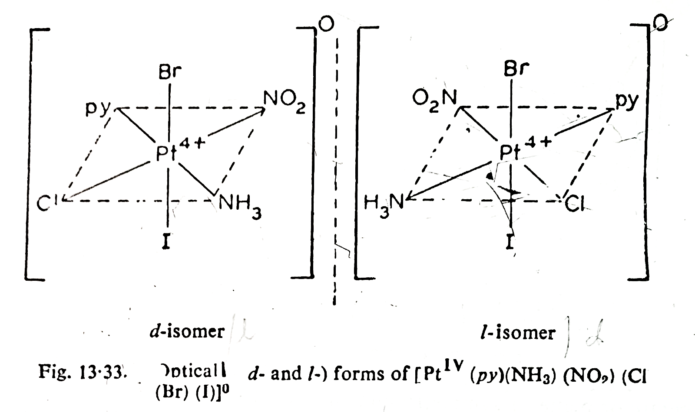
(C) Octahedral Complexes.
Optical isomerism is very common in the following types of octahedral complexes:
Octahedral complexes containing only monodentate ligands.
The following of octahedral complexes have optical isomers:[Ma2b2c2], [Ma2b2cd], [Ma₂bcde] and [Mabcdef].
(i) [Ma2b2c2] type complex: It has two optical isomers as shown below in Fig.
(ii) [Mabcdef] type complex: Complexes of this type having six different monodentate ligands have been prepared only for Pt(IV). Only a few isomers have been isolated, but there could be 15 geometrical isomers, each of which could exist in d- and l-forms to give a total of 30 optical isomers.

Slide 19
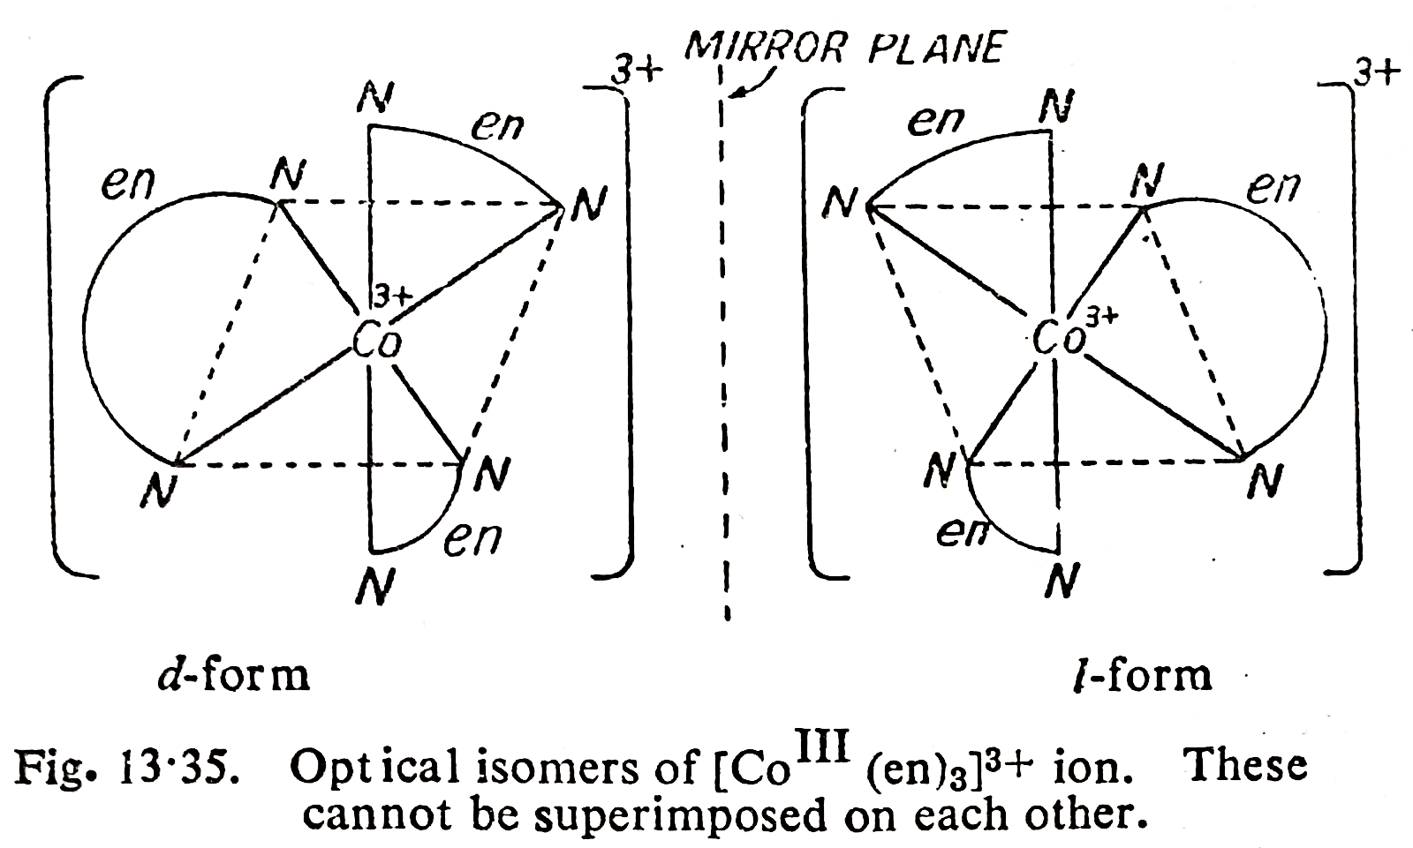
(b) Octahedral complexes containing only symmetrical bidentate chelating ligands.
Such complexes may be of the following types:
(i) [M(AA)₃]^{n} type complexes: Here (AA) is a symmetrical bidentate chelating ligand which may be a neutral molecule or a negative ion. The optical isomers of this type of complexes are shown below in Fig.
Examples: [Co(lll) (en)3]3+, [Co(lll) (pn)3]3+, [Pt(IV) (en)3]4+, [PIV (pn)], [Cdll (pn)]*+, [Fell (diph)]+ [Fell (diph)]+, [RLIV (en),], [IrIV (pn),]+, [ZnI (en),]+, [MIII (C₂O) where MIII Alt+, Co³+, Fe3+, Rh+, Cr+-and Ir

Slide 20
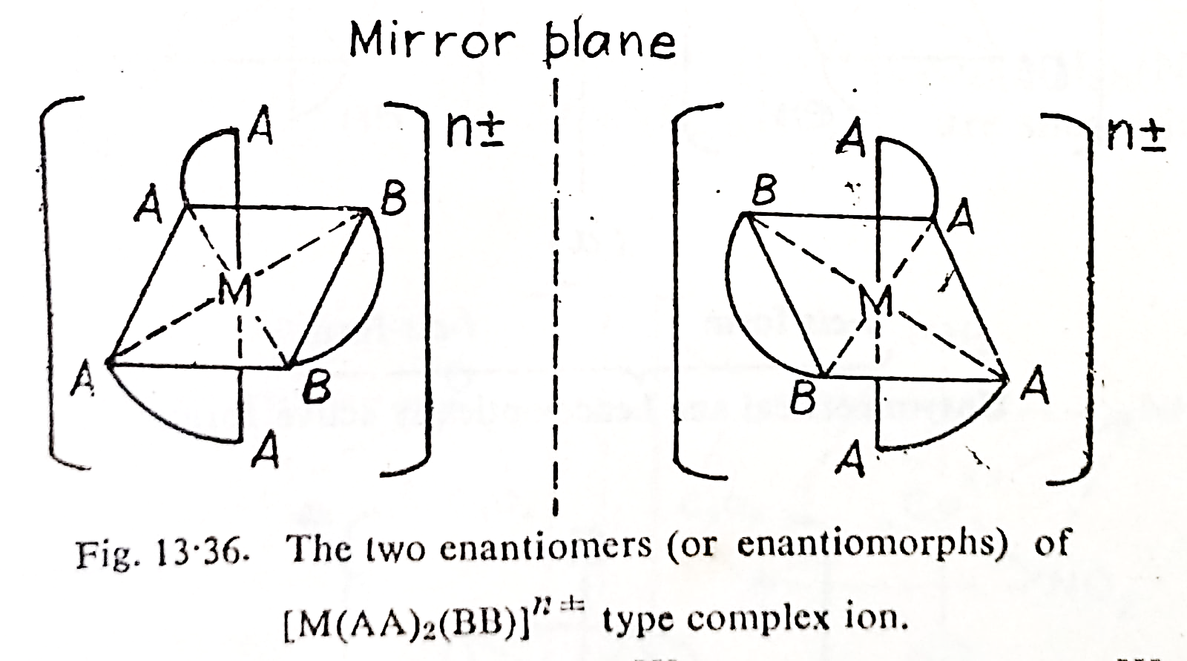
(ii) [M(AA)₂(BB)] ^{n±} type complexes.
Here (AA) and (BB) are two different symmetrical bidentate chelating ligands. Note that (AA) is a neutral ligand while (BB) is an anionic ligand. The two enantiomers (or enantiomorphs) of [M(AA)2(BB)] ^{n±} type complexes are shown below in Fig.
Examples: The ions namely [Co(lll)(en)₂(CO₃)]⁺ and [Co(lll)(en)₂(C₂O₄)]⁺ belong to this class of complexes.

Slide 21
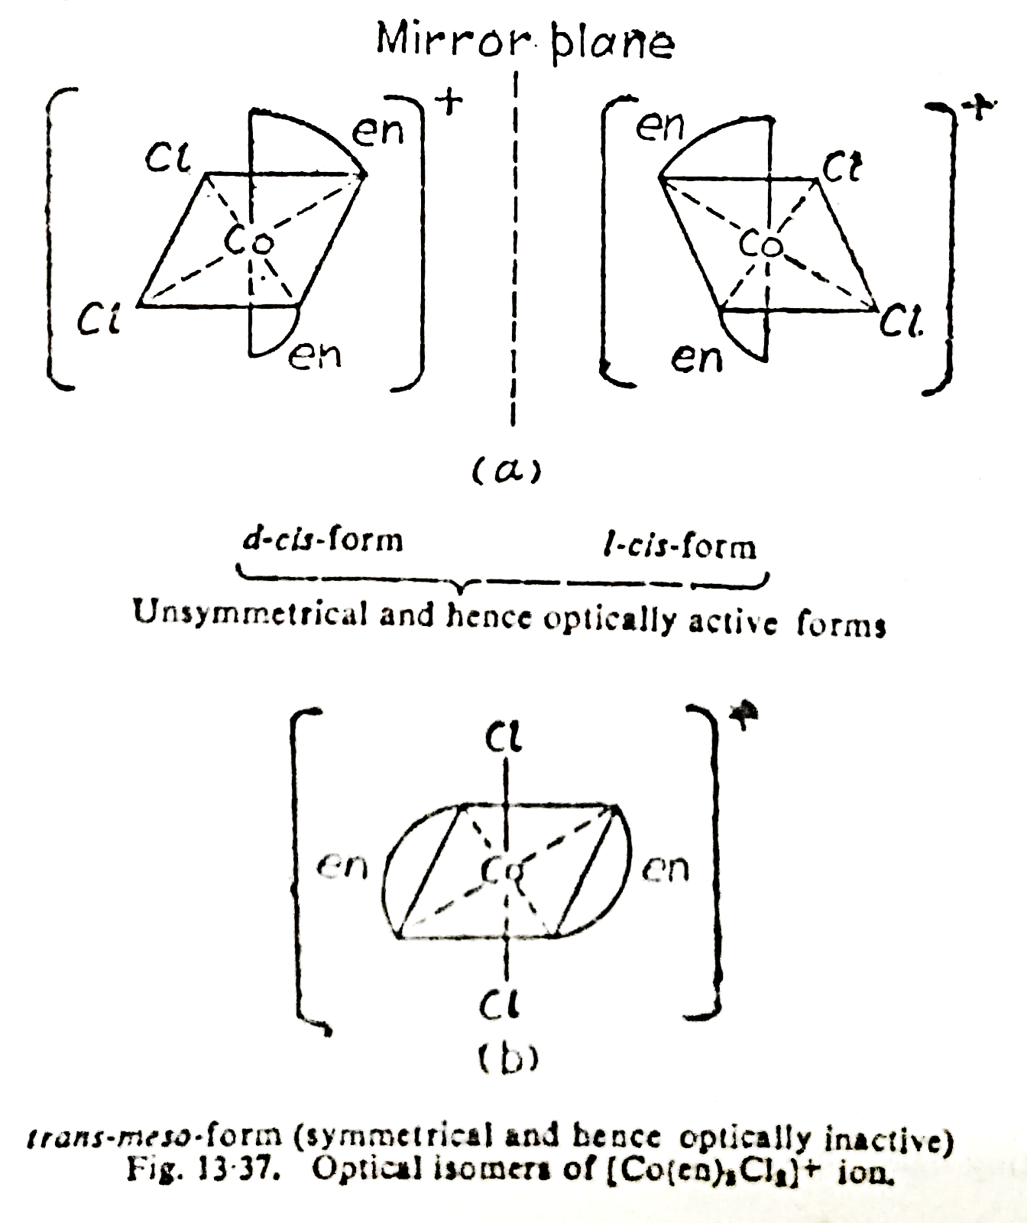
(c) Octahedral complexes containing monodentate and symmetrical bidentate chelating ligands.
Such complexes may be of the following types:
(i) [M(AA)₂a₂]^{n±} type complexes.
Here (AA) is a chelating ligand and a is a unidentate (i.e. mono-dentate) ligand.

Slide 22
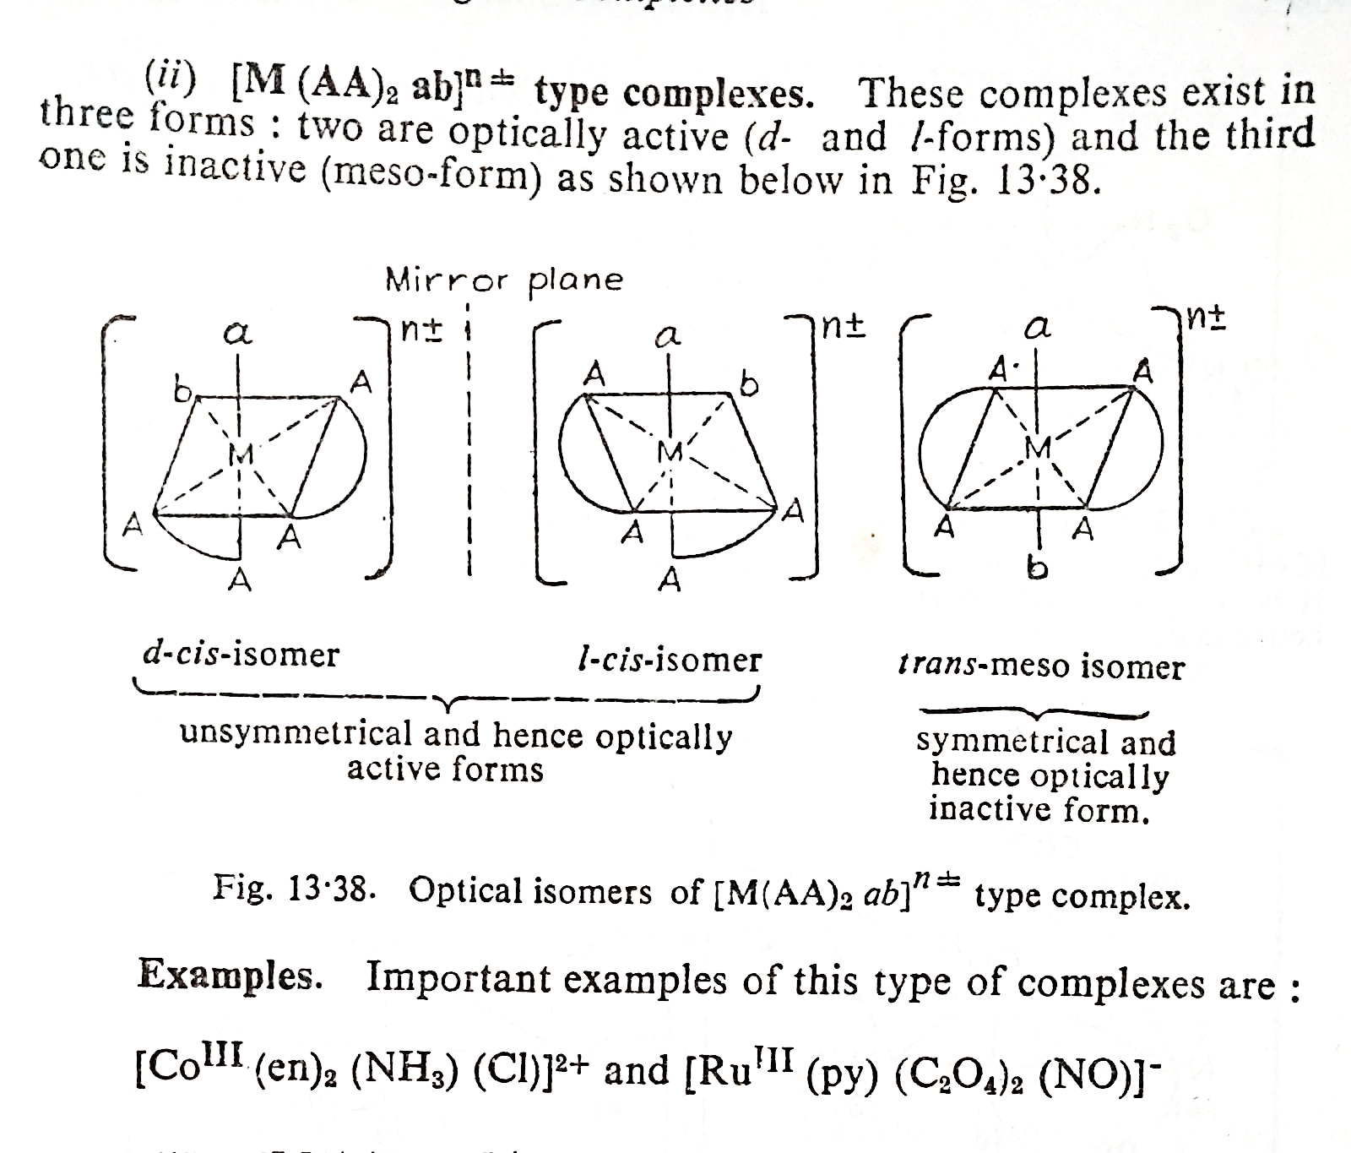

Slide 23
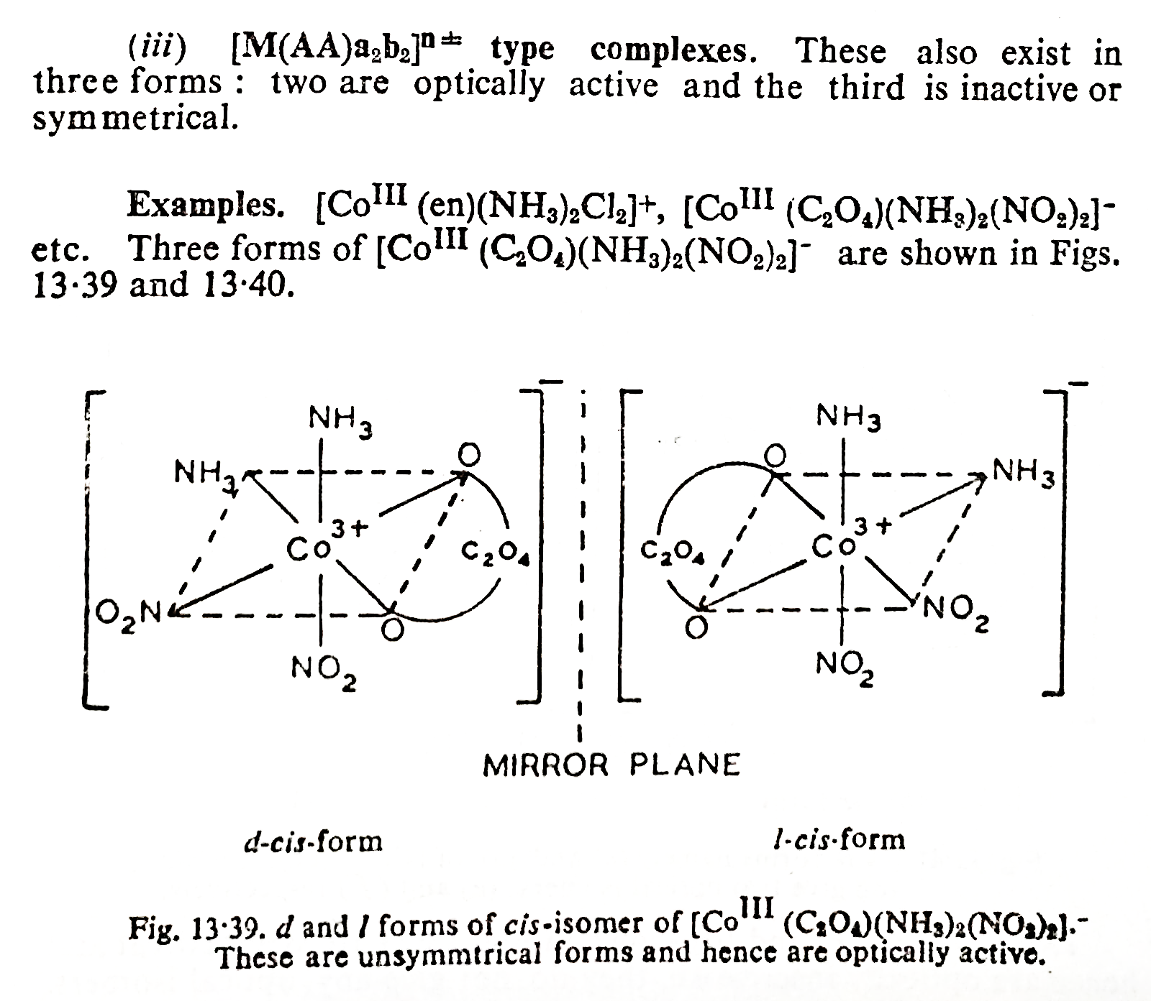

Slide 24
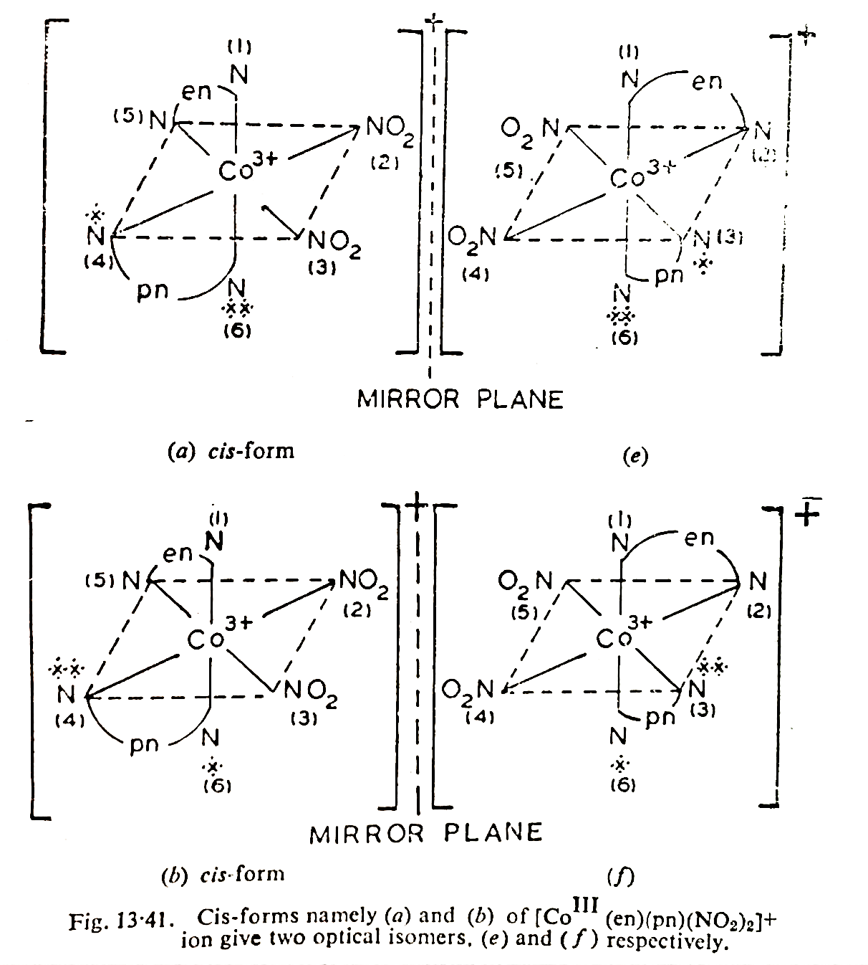
(d) Octahedral complexes containing optically active ligands.
[Co(III)(en)(pn)(NO₂)₂]⁺ ion is an important example of such type of octahedral complexes. Here pn is optically active ligand. We have already seen that this complex exists in two cis and two trans isomers (see Fig.). Each of the two cis- forms namely (a) and (b) shown below gives its corresponding optical isomer (e) and (f) respectively as shown below in Fig. 13.41.
Trans isomers (c) & (d) are symmetrical and hence are optically inactive, i.e. they do not give any optical isomers

Slide 25
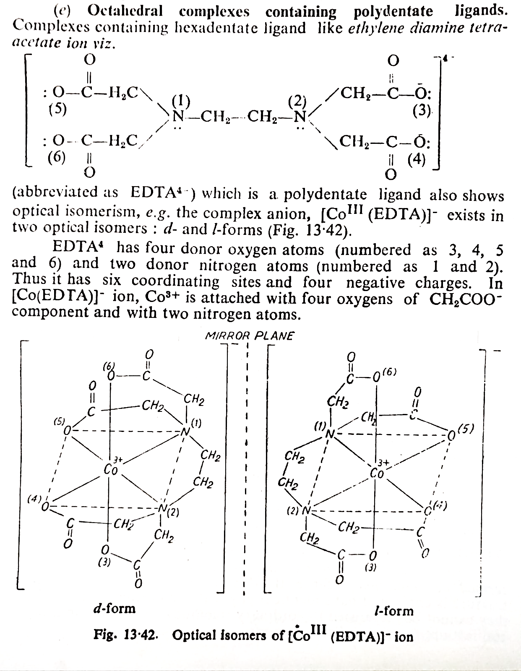

Slide 26
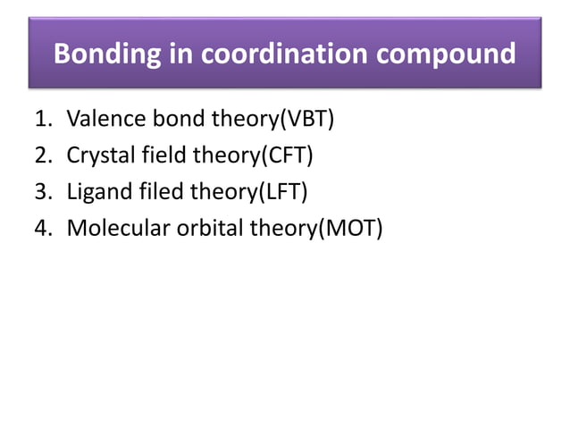

Slide 27
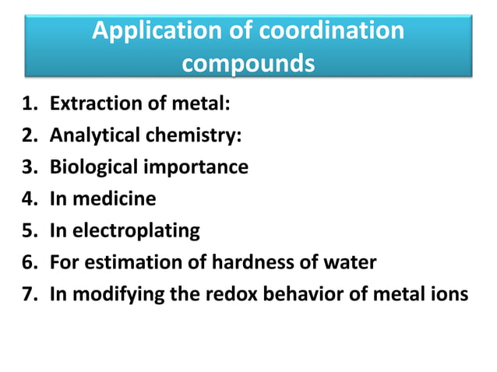

Slide 28
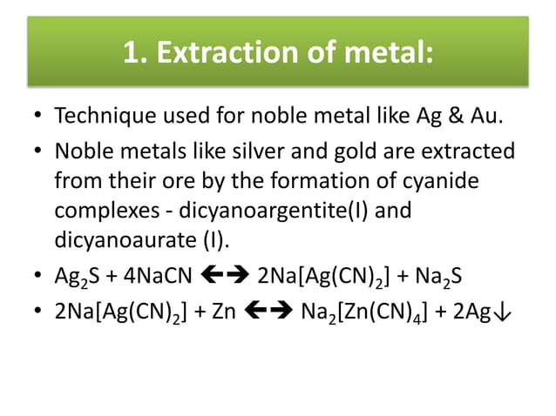

Slide 29
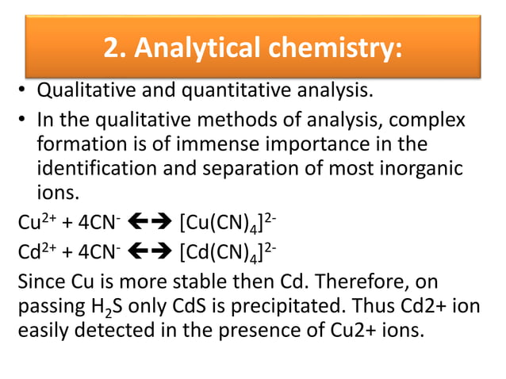

Slide 30
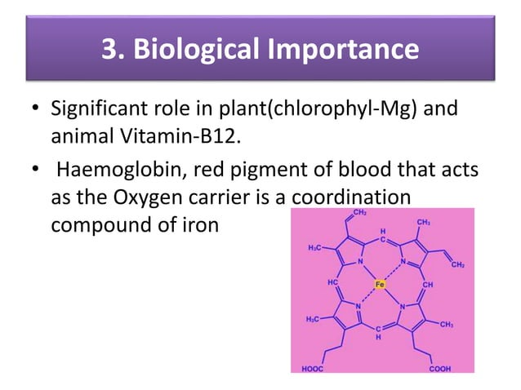

Slide 31
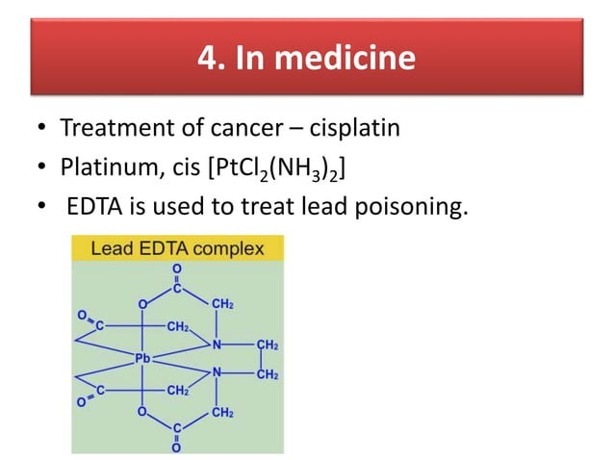

Slide 32
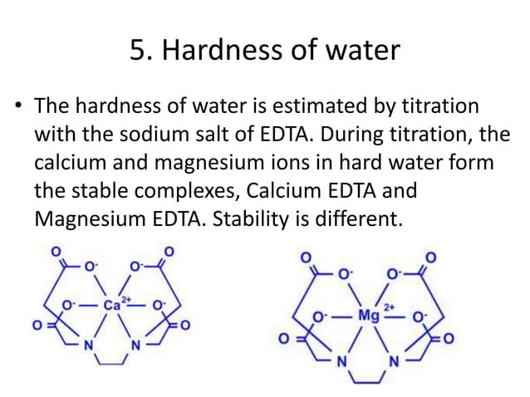

Slide 33
Reference
W.U. Malik, G.D. Tuli & R.D. Madan, Selected Topics in Inorganic Chemistry, S. Chand & Company Ltd.
Ashim K Das & Mahua Das, Fundamental Concept of Inorganic Chemistry, CBC Publishers & Distributors, Volume 4, First Edition, 2014
R.L. Dutta & G.S. De, Inorganic Chemistry, Part-1, The New Book Stall, 6th Edition 2009

Slide 34
Thank you

