Slide 1
Lanthanoids and Actinoids- II
Dr. Semanti Basu
Assistant Professor
Department of Chemistry
Bejoy Narayan Mahavidyalaya Itachuna, Hooghly, W.B., India

Slide 2
Table: Colour of Lanthanide, Ln³⁺ ion
The colour of lanthanides originate from f-f transition
F-f transition are much weaker & narrower than d-d transition
This makes the colour of lanthanide conplexes far fainter than transition complexes.

Slide 3
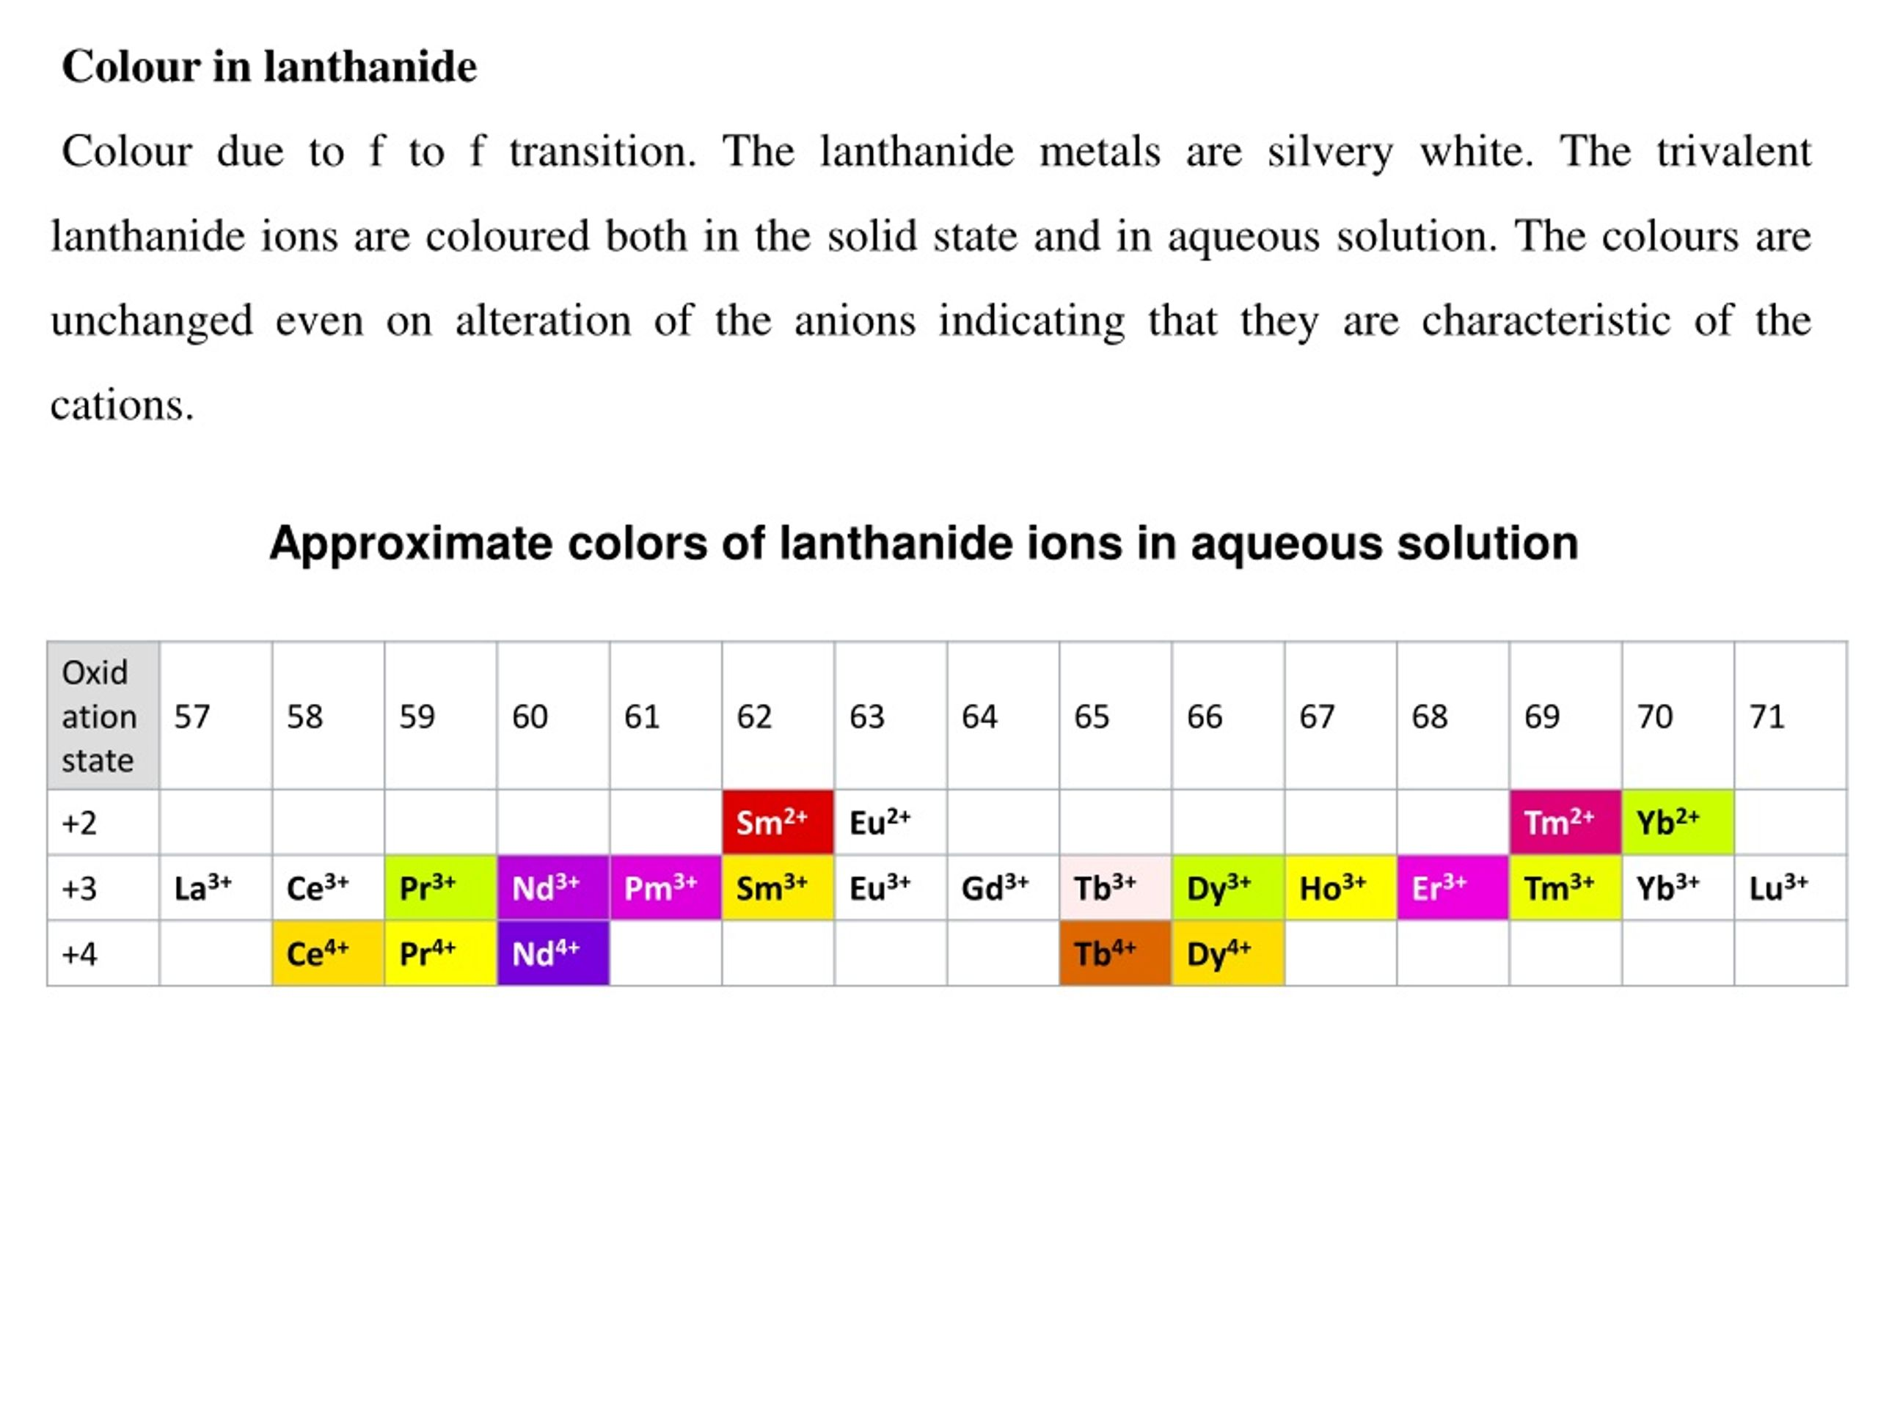
Table: Colour of Lanthanide, Ln³⁺ ion

Slide 4
Table: Colour of Lanthanide, Ln³⁺ ion
The lanthanide metals are silvery white but the trivalent lanthanide ions show different colours. Colour of the ions depends on the number of unpaired electrons because the elements with If electrons often have a similar colour to those of (14-x) f electrons. This is evident from the following Table. The colour of lanthanide ions is due to the presence of partly filled f-orbitals. As a result it is possible to absorb certain wavelength from the visible region of the spectrum. This results in transition from one 4f orbital to another 4f orbital known as f-f transition. The colour transmitted is the colour shown by the substance.

Slide 5
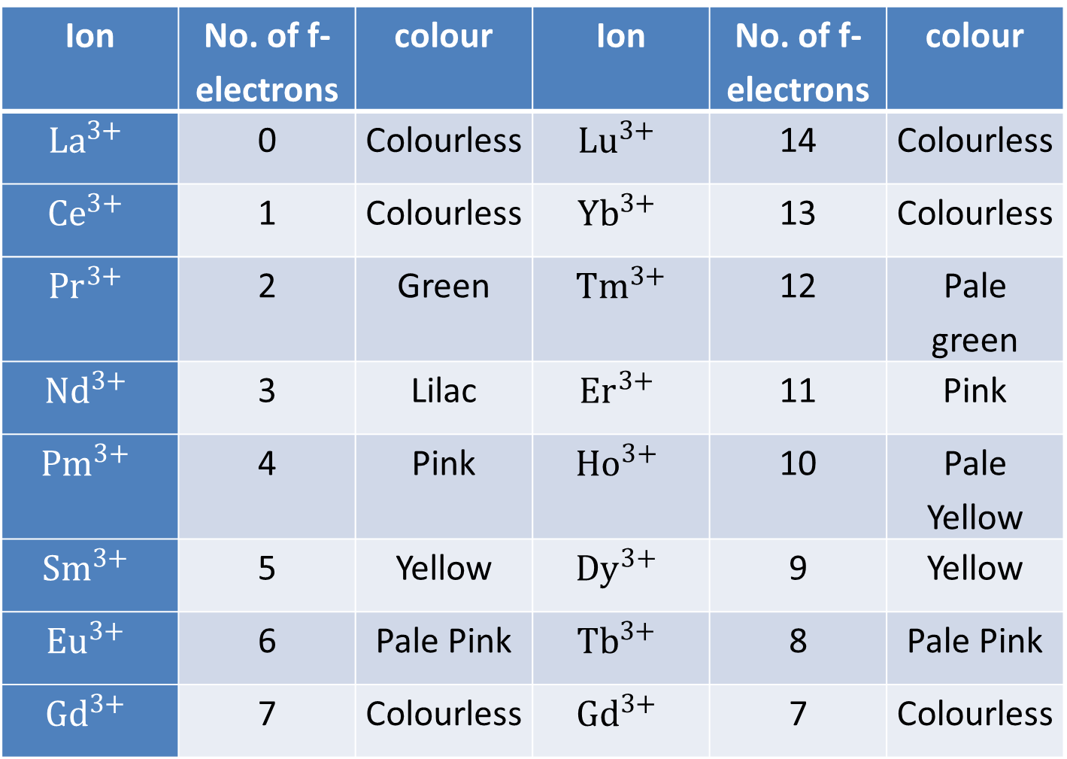
Table: Colour of Lanthanide, Ln³⁺ ion
Ion | No. of f-electrons | colour | Ion | No. of f-electrons | colour
$${La}^{3+}$$ | 0 | Colourless | $${Lu}^{3+}$$ | 14 | Colourless
$${Ce}^{3+}$$ | 1 | Colourless | $${Yb}^{3+}$$ | 13 | Colourless
$${Pr}^{3+}$$ | 2 | Green | $${Tm}^{3+}$$ | 12 | Pale green
$${Nd}^{3+}$$ | 3 | Lilac | $${Er}^{3+}$$ | 11 | Pink
$${Pm}^{3+}$$ | 4 | Pink | $${Ho}^{3+}$$ | 10 | Pale Yellow
$${Sm}^{3+}$$ | 5 | Yellow | $${Dy}^{3+}$$ | 9 | Yellow
$${Eu}^{3+}$$ | 6 | Pale Pink | $${Tb}^{3+}$$ | 8 | Pale Pink
$${Gd}^{3+}$$ | 7 | Colourless | $${Gd}^{3+}$$ | 7 | Colourless

Slide 6
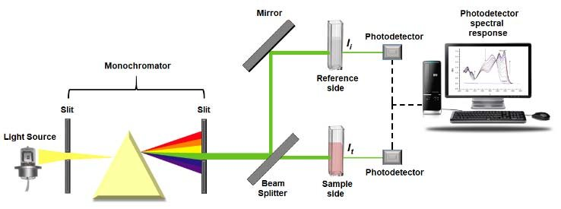
Double beam UV-Visible Spectro photometer

Slide 7
SPECTRAL PROPERTIES OF LANTHANIDE
The absorption spectra of the compounds of trivalent lanthanide ions show very sharp line like bands in the ultraviolet, visible or near infrared regions. These sharp bands obtained as a result of transitions in the partly filled 4f subshell electrons are known as f-f transitions. The bands of lanthanide ions are so sharp that they are very useful for characterising the lanthanides and for their quantitative estimations.Since 4f orbitals lie deep in the atoms of these elements, therefore they are shielded from by agents. Thus the complexing

Slide 8
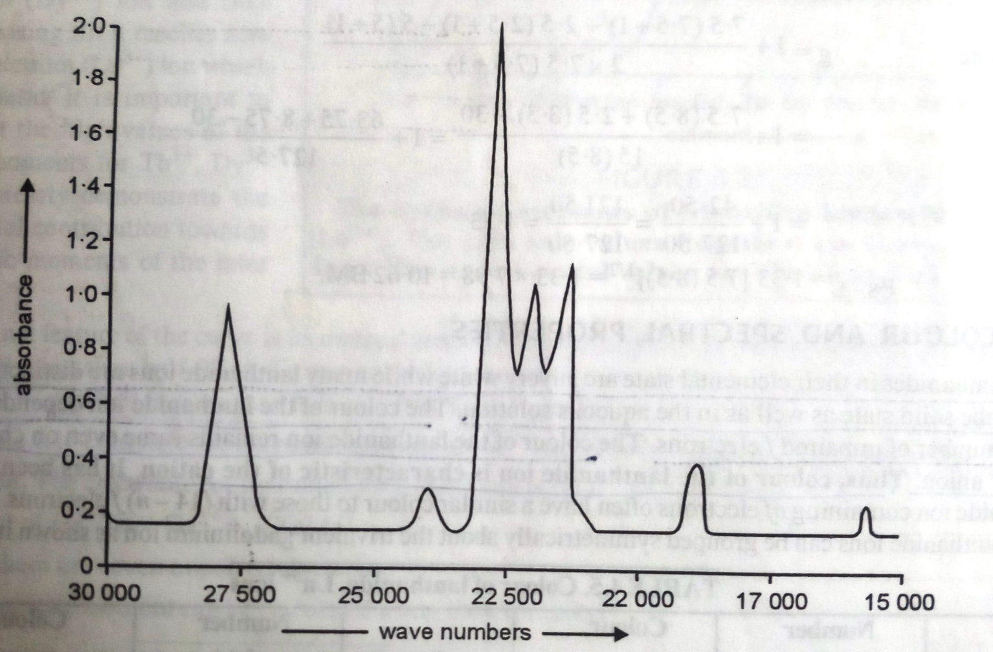
SPECTRAL PROPERTIES OF LANTHANIDE
Fig. UV-Vis spectrum of Ho³⁺ ion

Slide 9
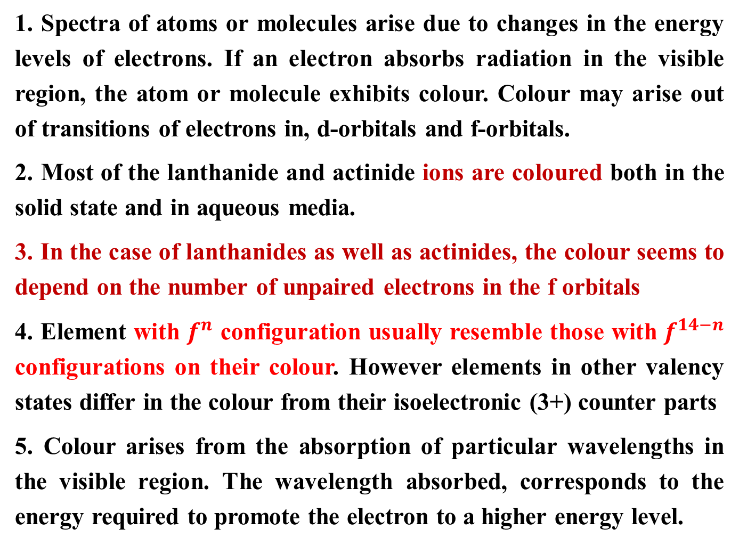
COLOUR AND SPECTRAL PROPERTIES
1. Spectra of atoms or molecules arise due to changes in the energy levels of electrons. If an electron absorbs radiation in the visible region, the atom or molecule exhibits colour. Colour may arise out of transitions of electrons in, d-orbitals and f-orbitals.
2. Most of the lanthanide and actinide ions are coloured both in the solid state and in aqueous media.
3. In the case of lanthanides as well as actinides, the colour seems to depend on the number of unpaired electrons in the f orbitals
4. Element with $f^{n}$ configuration usually resemble those with $f^{14−n}$ configurations on their colour. However elements in other valency states differ in the colour from their isoelectronic (3+) counter parts
5. Colour arises from the absorption of particular wavelengths in the visible region. The wavelength absorbed, corresponds to the energy required to promote the electron to a higher energy level.

Slide 10
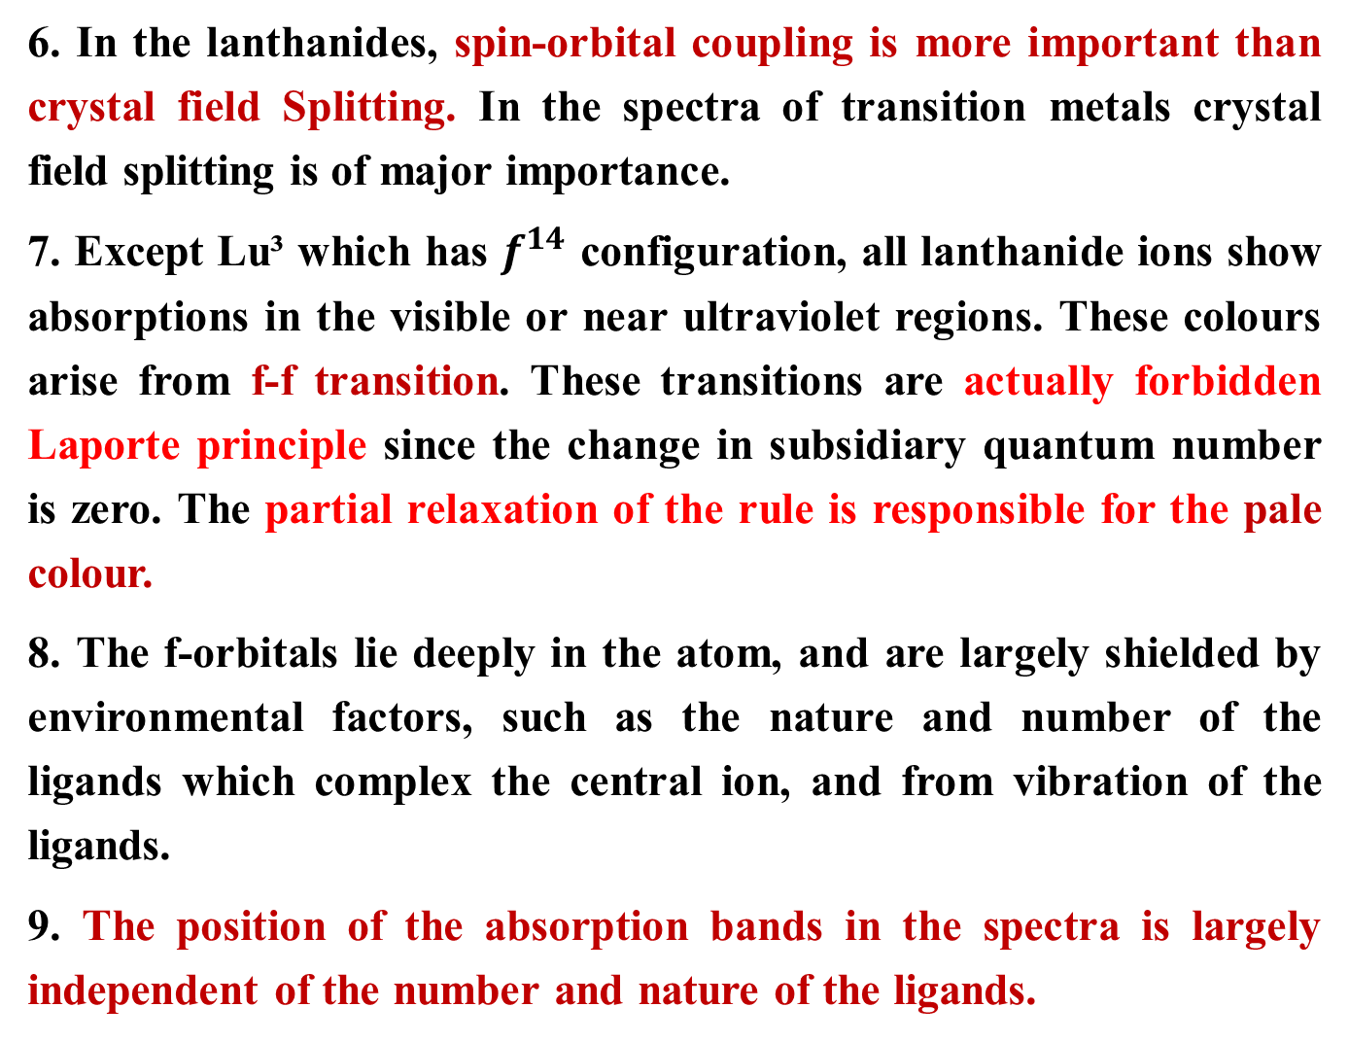
COLOUR AND SPECTRAL PROPERTIES
6. In the lanthanides, spin-orbital coupling is more important than crystal field Splitting. In the spectra of transition metals crystal field splitting is of major importance.
7. Except Lu³ which has $f^{14}$ configuration, all lanthanide ions show absorptions in the visible or near ultraviolet regions. These colours arise from f-f transition. These transitions are actually forbidden Laporte principle since the change in subsidiary quantum number is zero. The partial relaxation of the rule is responsible for the pale colour.
8. The f-orbitals lie deeply in the atom, and are largely shielded by environmental factors, such as the nature and number of the ligands which complex the central ion, and from vibration of the ligands.
9. The position of the absorption bands in the spectra is largely independent of the number and nature of the ligands.

Slide 11
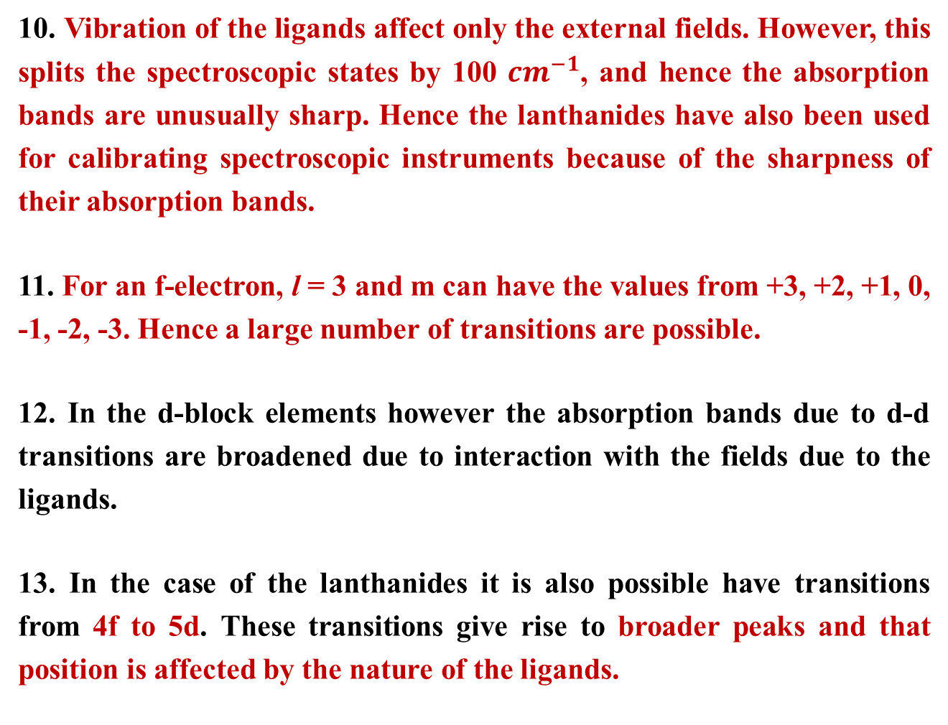
COLOUR AND SPECTRAL PROPERTIES
10. Vibration of the ligands affect only the external fields. However, this splits the spectroscopic states by 100 ${cm}^{−1}$, and hence the absorption bands are unusually sharp. Hence the lanthanides have also been used for calibrating spectroscopic instruments because of the sharpness of their absorption bands.
11. For an f-electron, l = 3 and m can have the values from +3, +2, +1, 0, -1, -2, -3. Hence a large number of transitions are possible.
12. In the d-block elements however the absorption bands due to d-d transitions are broadened due to interaction with the fields due to the ligands.
13. In the case of the lanthanides it is also possible have transitions from 4f to 5d. These transitions give rise to broader peaks and that position is affected by the nature of the ligands.

Slide 12
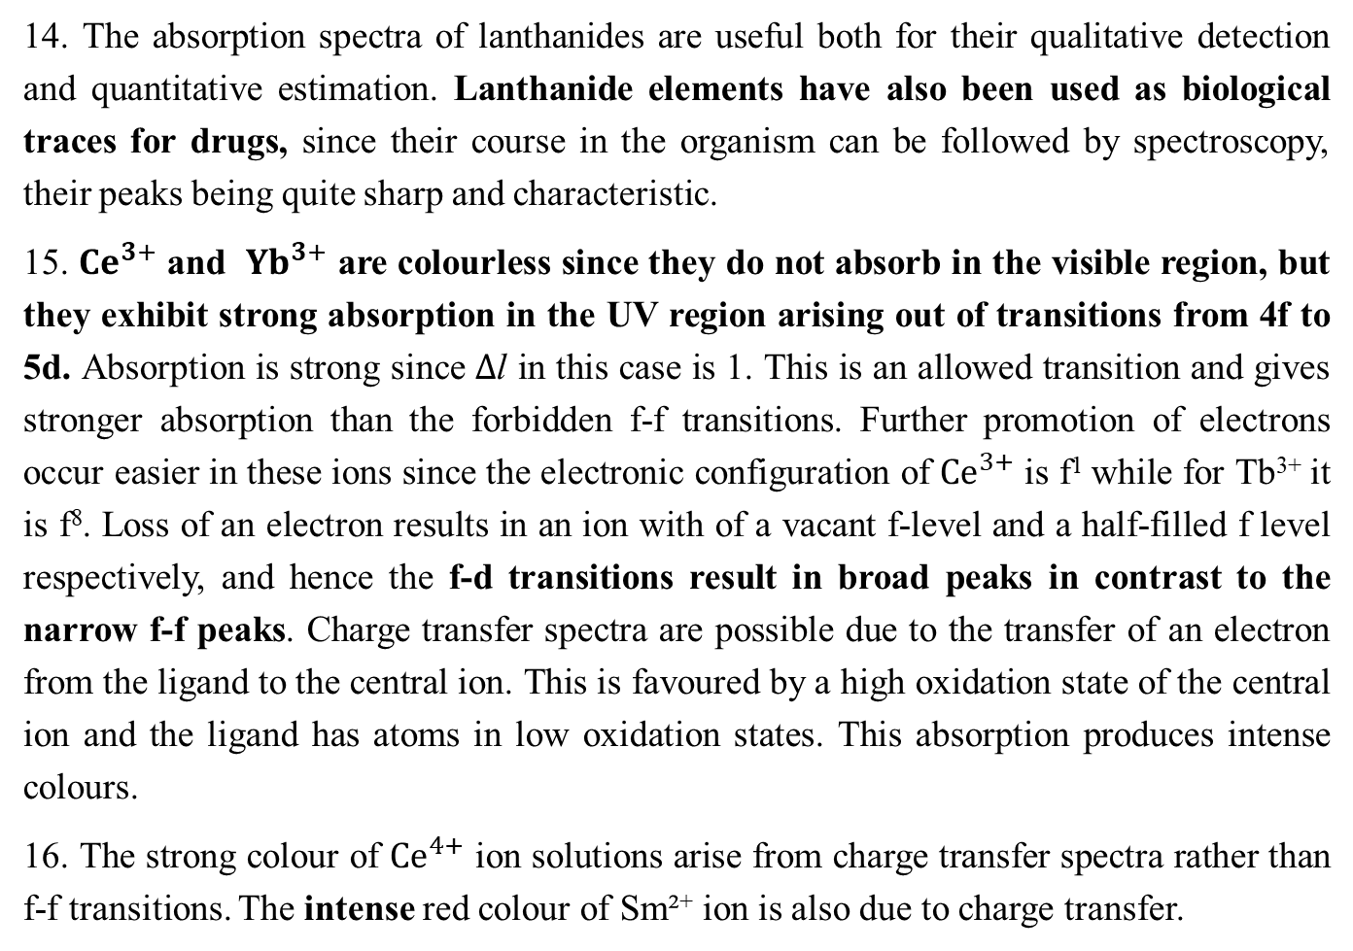
COLOUR AND SPECTRAL PROPERTIES
14. The absorption spectra of lanthanides are useful both for their qualitative detection and quantitative estimation. Lanthanide elements have also been used as biological traces for drugs, since their course in the organism can be followed by spectroscopy, their peaks being quite sharp and characteristic.
15. ${Ce}^{3+}$ and ${Yb}^{3+}$ are colourless since they do not absorb in the visible region, but they exhibit strong absorption in the UV region arising out of transitions from 4f to 5d. Absorption is strong since $∆$l in this case is 1. This is an allowed transition and gives stronger absorption than the forbidden f-f transitions. Further promotion of electrons occur easier in these ions since the electronic configuration of ${Ce}^{3+}$ is f¹ while for Tb³⁺ it is f⁸. Loss of an electron results in an ion with of a vacant f-level and a half-filled f level respectively, and hence the f-d transitions result in broad peaks in contrast to the narrow f-f peaks. Charge transfer spectra are possible due to the transfer of an electron from the ligand to the central ion. This is favoured by a high oxidation state of the central ion and the ligand has atoms in low oxidation states. This absorption produces intense colours.
16. The strong colour of ${Ce}^{4+}$ ion solutions arise from charge transfer spectra rather than f-f transitions. The intense red colour of Sm²⁺ ion is also due to charge transfer.

Slide 13
COLOUR AND SPECTRAL PROPERTIES
The colour of lanthanide ion depends on the number of unpaired f electrons.
Lanthanide ion containing nf electrons often have a similar colour to those with
(14-n)f electrons.
The colour of the lanthanide ion is due to the absorption of light from the visible region of the spectrum that results in the electronic transition within the 4f-level. This type of transition is called f-f transition.
The f-f absorption of lanthanides ions have low intensity because these transition are not allowed.
Sometimes, the colour of the lanthanide ion is due to f-d transition, f-d transition is allowed, thus, they show very intense absorption bands. Example: Ce³⁺ and Tb³⁺ show very intense f-d absorption band.
Transition due to f-d bands are broad in contrast to narrow f-f bands.
The colour of some of the lanthanide ions is due to charge transfer. This transfer of charge occurs from the ligand to the metal, when the metal is in high oxidation state or the ligand has strong reducing properties. Charge transfer usually produce intense colours. Eg. Strong yellow colour of Ce⁴⁺ solutions arises due to charge transfer. The blood red colour of Sm²⁺ is also due to charge transfer.

Slide 14
UNIQUE FEATURE OF SPECTRA OF TRIPOSITIVE LANTHANIDES IONS
In the case of lanthanide ions, the absorption bands are sharp line like bands in the UV, Visible or near IR regions.
The bands of lanthanide ions are very sharp that they are used for characterizing lanthanides.
The reason for very sharp absorption band is that the 4f orbitals are located deep inside the atom. Thus, they are effectively shielded from environment factors such as the nature and number of ligands which form the complexes, and from vibrations of the liagands. Thus, the colour of lanthanide ion does not change with different ligands, it shows little dependence on the nature of ligand.
In contrast with transition elements, d-d transition give absorption bands whose position changes from ligand to ligand, and width of the peak is greatly broadened because of the vibrations of the ligands.

Slide 15
Complexes -Lanthanides are moderate in their complex forming ability which increases to the right . Although tri-positive cations have a high charge equal to +3 on them, their size is so large, their charge to radius ratio becomes so small that these ions have less tendency to form complexes, e.g.: Stable complexes are known with chelating oxygen containing ligands like EDTA, oxalic acid, acetylacetone. There is a general decrease in complex formation with a specific ligands from Ln⁴⁺> Ln³⁺>Ln²⁺ as charge decreases.

Slide 16
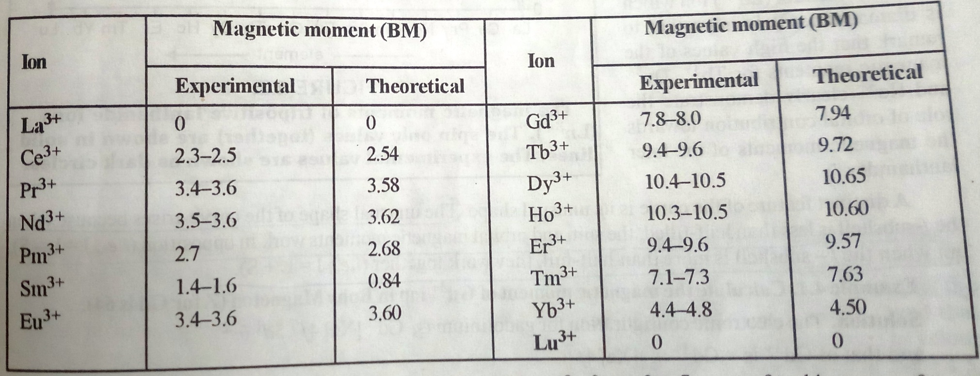
MAGNETIC PROPERTIES OF LANTHANIDES
Most of the Lanthanide ions are paramagnetic because of the presence of unpaired electrons in their 4f- sub shell.
The ions La³⁺, Lu³⁺, Ce⁴⁺ and Yb²⁺ are diamagnetic because hey have no unpaired electrons.
Table : Magnetic moment of Ln³⁺ ions

Slide 17
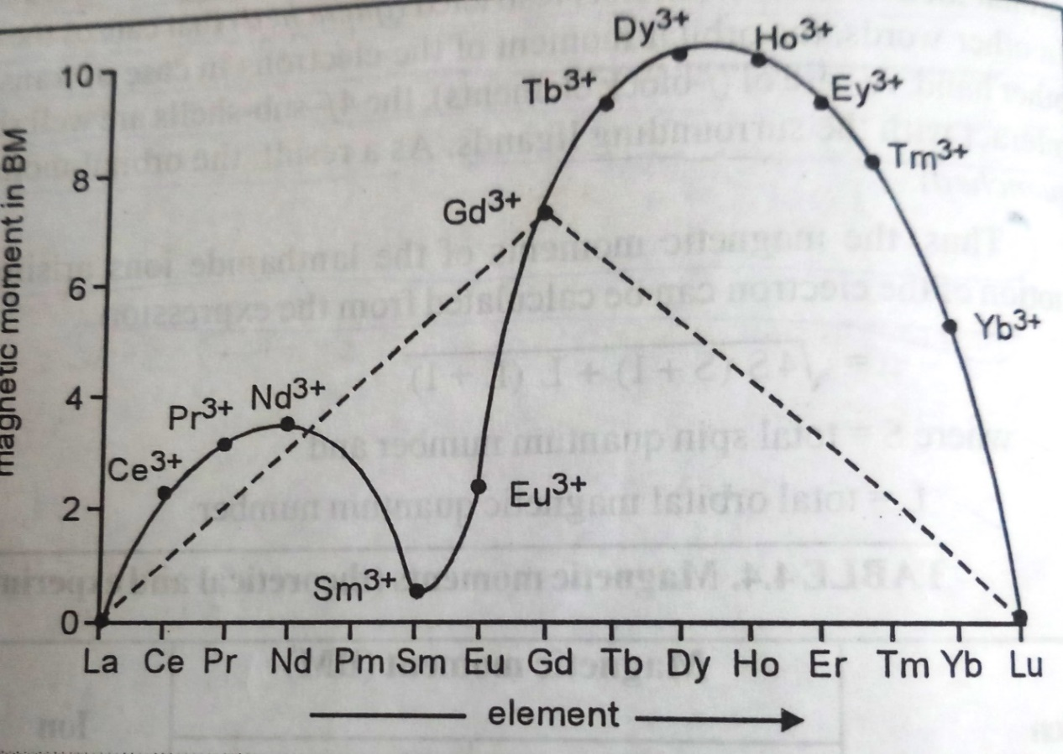
Magnetic Properties
Fig. The magnetic moments of tri-positive lanthanide ions (Ln³⁺).
The calculated spin only values are shown by doted lines.
The experimental values are shown as curve line.
This unusual shape of the curve arises because when the f-subshell is less than half filled, the spin and orbital magnetic moments work in opposition (i.e. J=L-S), but when the f-subshell is more than half-filled, they work together (i.e. J=L+S)
The magnetic moment value of d-block elements (transition elements) is spin only value.

Slide 18
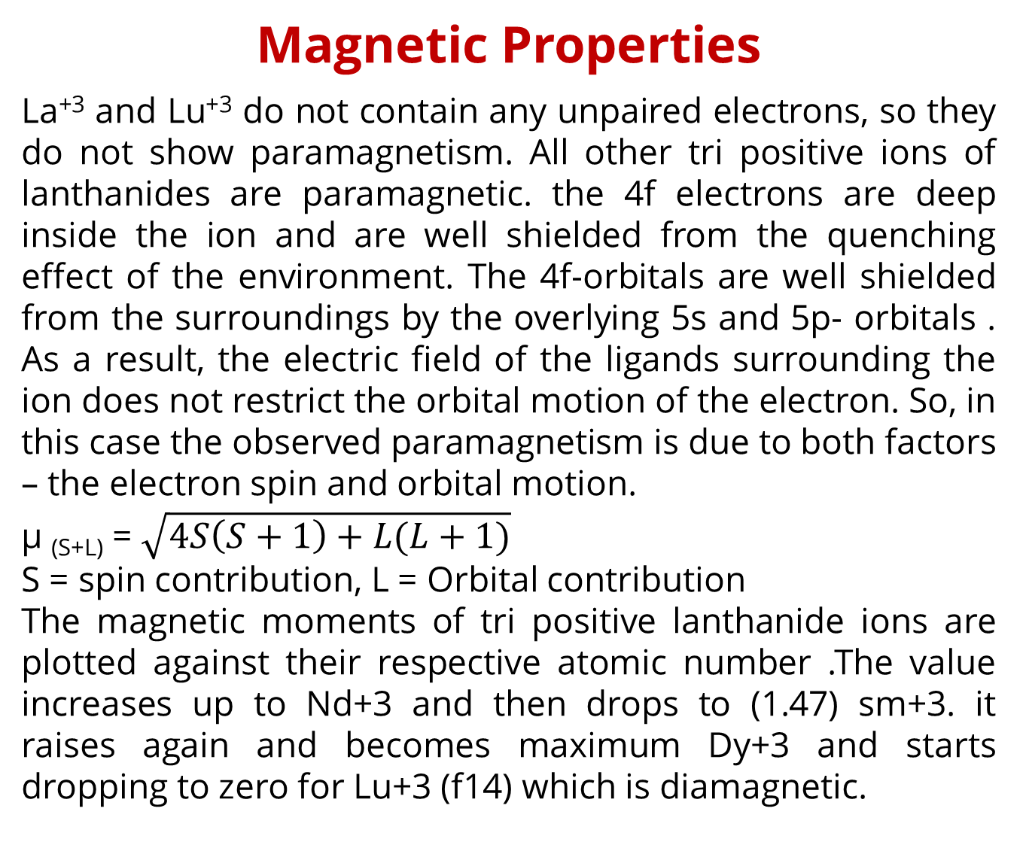
Magnetic Properties
La⁺³ and Lu⁺³ do not contain any unpaired electrons, so they do not show paramagnetism. All other tri positive ions of lanthanides are paramagnetic. the 4f electrons are deep inside the ion and are well shielded from the quenching effect of the environment. The 4f-orbitals are well shielded from the surroundings by the overlying 5s and 5p- orbitals . As a result, the electric field of the ligands surrounding the ion does not restrict the orbital motion of the electron. So, in this case the observed paramagnetism is due to both factors – the electron spin and orbital motion.
µ _{(S+L)} = $\sqrt{4S\left(S+1\right)+L(L+1)}$
S = spin contribution, L = Orbital contribution
The magnetic moments of tri positive lanthanide ions are plotted against their respective atomic number .The value increases up to Nd+3 and then drops to (1.47) sm+3. it raises again and becomes maximum Dy+3 and starts dropping to zero for Lu+3 (f14) which is diamagnetic.

Slide 19
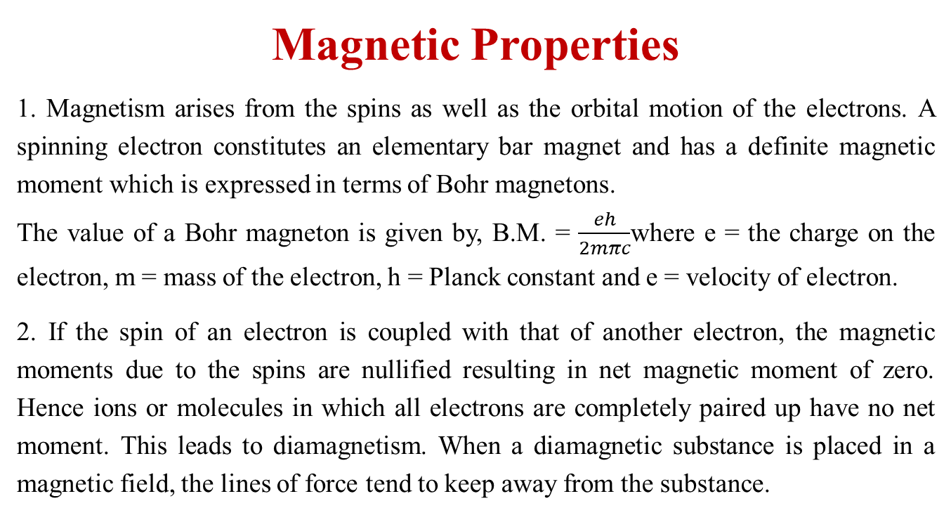
Magnetic Properties
1. Magnetism arises from the spins as well as the orbital motion of the electrons. A spinning electron constitutes an elementary bar magnet and has a definite magnetic moment which is expressed in terms of Bohr magnetons.
The value of a Bohr magneton is given by, B.M. = $\frac{eh}{2mπc}$where e = the charge on the electron, m = mass of the electron, h = Planck constant and e = velocity of electron.
2. If the spin of an electron is coupled with that of another electron, the magnetic moments due to the spins are nullified resulting in net magnetic moment of zero. Hence ions or molecules in which all electrons are completely paired up have no net moment. This leads to diamagnetism. When a diamagnetic substance is placed in a magnetic field, the lines of force tend to keep away from the substance.

Slide 20
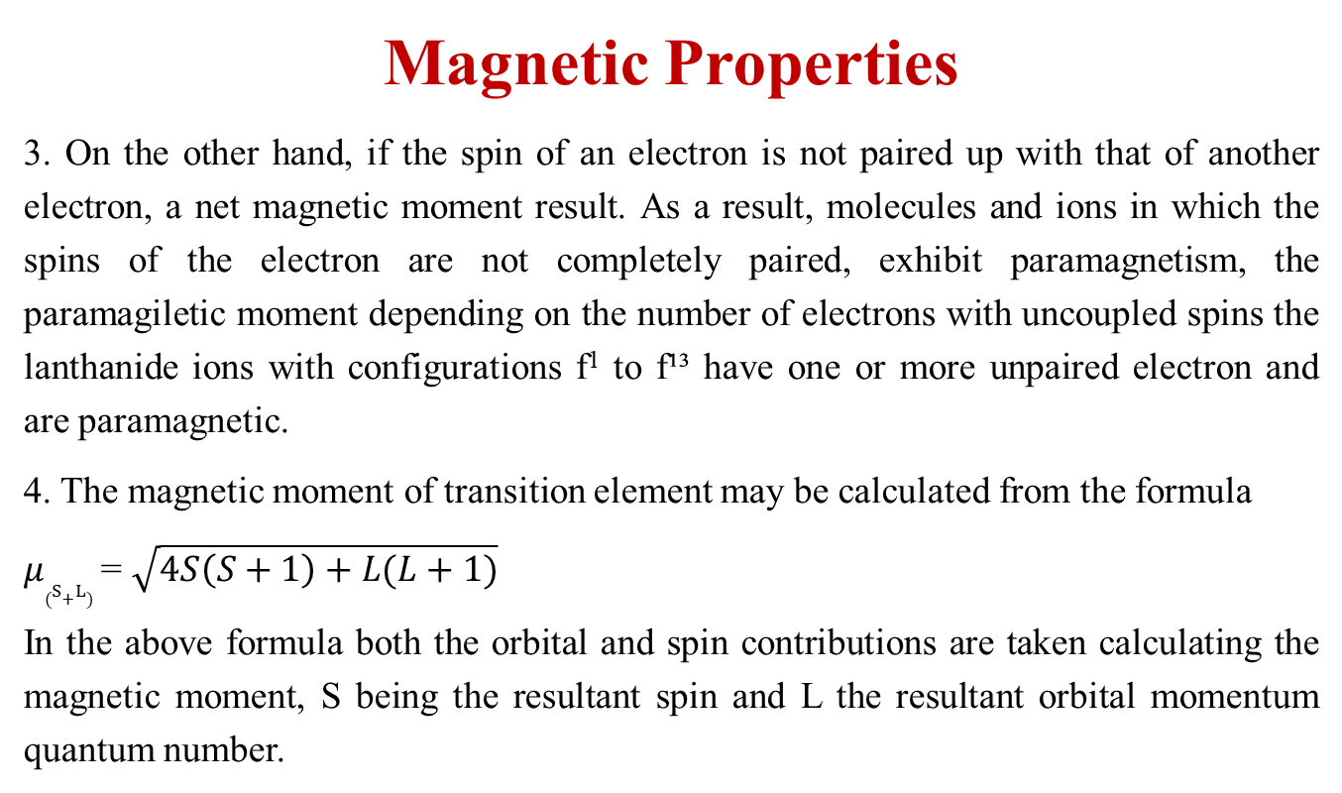
Magnetic Properties
3. On the other hand, if the spin of an electron is not paired up with that of another electron, a net magnetic moment result. As a result, molecules and ions in which the spins of the electron are not completely paired, exhibit paramagnetism, the paramagiletic moment depending on the number of electrons with uncoupled spins the lanthanide ions with configurations f¹ to f¹³ have one or more unpaired electron and are paramagnetic.
4. The magnetic moment of transition element may be calculated from the formula
$μ_{(S+L)}$ = $\sqrt{4S\left(S+1\right)+L(L+1)}$
In the above formula both the orbital and spin contributions are taken calculating the magnetic moment, S being the resultant spin and L the resultant orbital momentum quantum number.

Slide 21
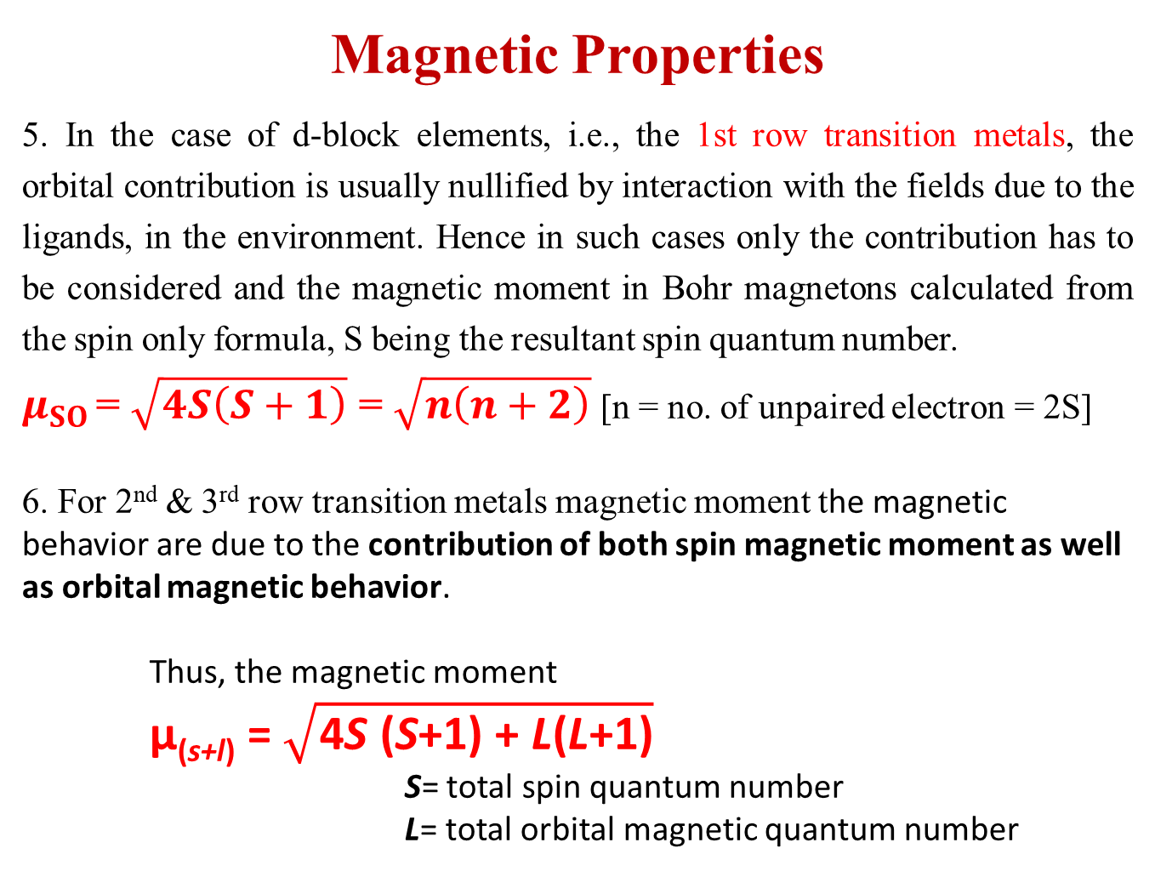
Magnetic Properties
5. In the case of d-block elements, i.e., the 1st row transition metals, the orbital contribution is usually nullified by interaction with the fields due to the ligands, in the environment. Hence in such cases only the contribution has to be considered and the magnetic moment in Bohr magnetons calculated from the spin only formula, S being the resultant spin quantum number.
$μ_{SO}$ = $\sqrt{4S\left(S+1\right)}$ = $\sqrt{n\left(n+2\right)}$ [n = no. of unpaired electron = 2S]
6. For 2nd & 3rd row transition metals magnetic moment the magnetic behavior are due to the contribution of both spin magnetic moment as well as orbital magnetic behavior.
Thus, the magnetic moment
μ_{(s+l)} = $\sqrt{\text{4}\text{S}\text{ (}\text{S}\text{+1) + }\text{L}\text{(}\text{L}\text{+1)}}$
S= total spin quantum number
L= total orbital magnetic quantum number

Slide 22
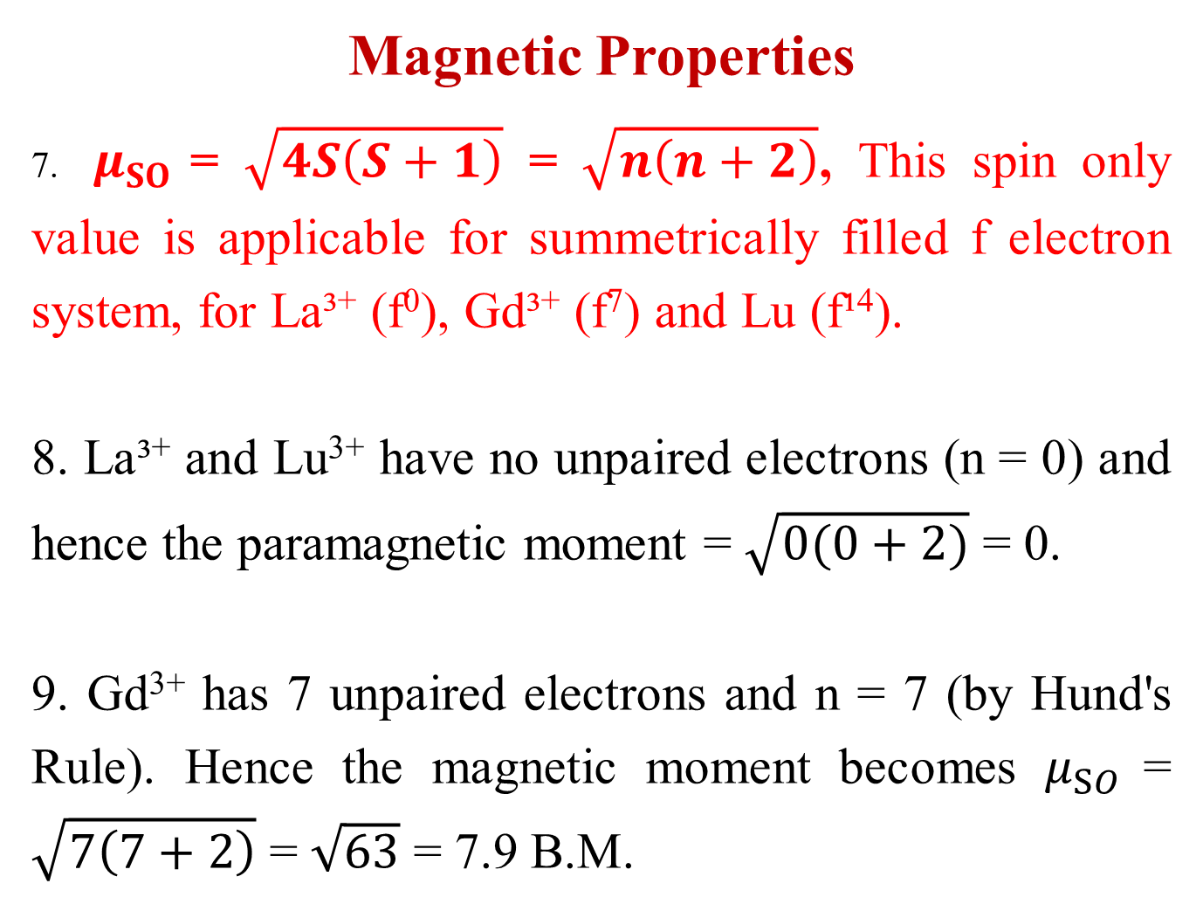
Magnetic Properties
7. $μ_{SO}$ = $\sqrt{4S\left(S+1\right)}$ = $\sqrt{n\left(n+2\right)}$, This spin only value is applicable for summetrically filled f electron system, for La³⁺ (f⁰), Gd³⁺ (f⁷) and Lu (f¹⁴).
8. La³⁺ and Lu³⁺ have no unpaired electrons (n = 0) and hence the paramagnetic moment = $\sqrt{0(0+2)}$ = 0.
9. Gd³⁺ has 7 unpaired electrons and n = 7 (by Hund's Rule). Hence the magnetic moment becomes $μ_{SO}$ = $\sqrt{7\left(7+2\right)}$ = $\sqrt{63}$ = 7.9 B.M.

Slide 23
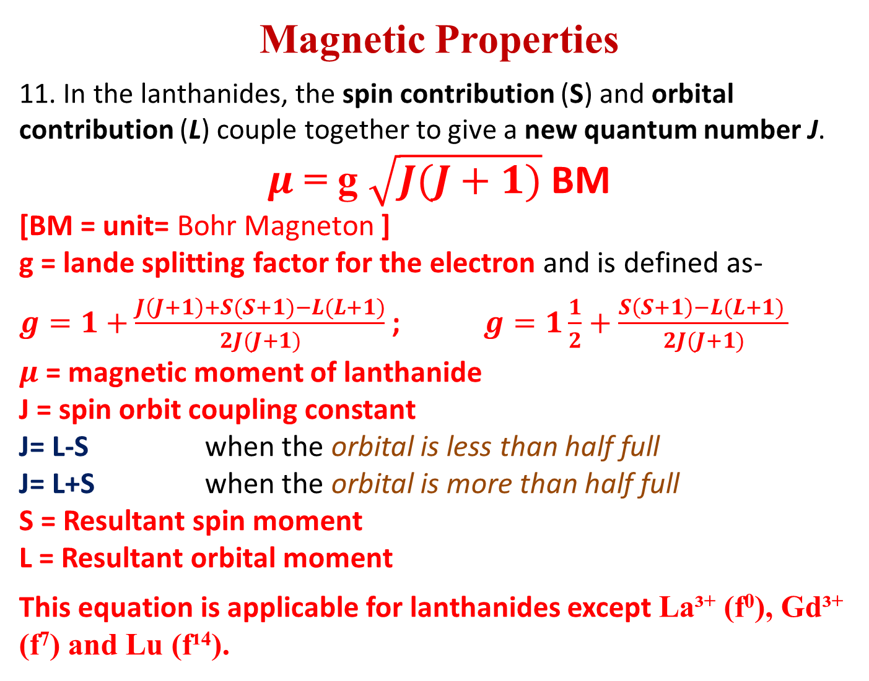
Magnetic Properties
11. In the lanthanides, the spin contribution (S) and orbital contribution (L) couple together to give a new quantum number J.
$μ$ = g $\sqrt{J(J+1)}$BM
[BM = unit= Bohr Magneton ]
    g = lande splitting factor for the electron and is defined as-
    $g=1+\frac{J\left(J+1\right)+S(S+1)−L(L+1)}{2J(J+1)}$ ; $g=1\frac{1}{2}+\frac{S\left(S+1\right)−L(L+1) }{2J(J+1)}$
    $μ$ = magnetic moment of lanthanide
    J = spin orbit coupling constant
    J= L-S when the orbital is less than half full
    J= L+S when the orbital is more than half full
    S = Resultant spin moment
    L = Resultant orbital moment
    This equation is applicable for lanthanides except La³⁺ (f⁰), Gd³⁺ (f⁷) and Lu (f¹⁴).

Slide 24
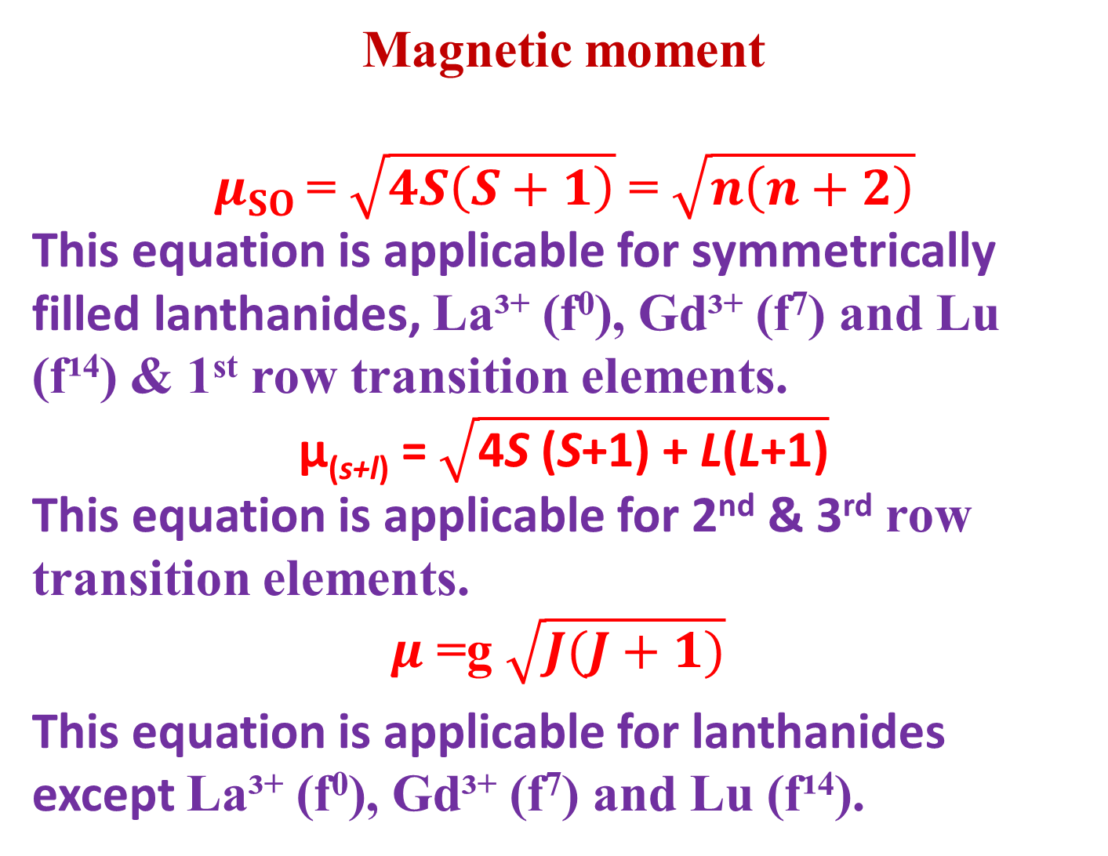
Magnetic moment
$$μ_{SO} \text{= }\sqrt{4S\left(S+1\right)}\text{ = }\sqrt{n\left(n+2\right)}$$
This equation is applicable for symmetrically filled lanthanides, La³⁺ (f⁰), Gd³⁺ (f⁷) and Lu (f¹⁴) & 1st row transition elements.
$\text{μ}\text{(}\text{s}\text{+}\text{l}\text{)} \text{= }\sqrt{\text{4}\text{S}\text{ (}\text{S}\text{+1) + }\text{L}\text{(}\text{L}\text{+1)}}$
This equation is applicable for 2nd & 3rd row transition elements.
$μ$ =g $\sqrt{J(J+1)}$
    This equation is applicable for lanthanides except La³⁺ (f⁰), Gd³⁺ (f⁷) and Lu (f¹⁴).

Slide 25
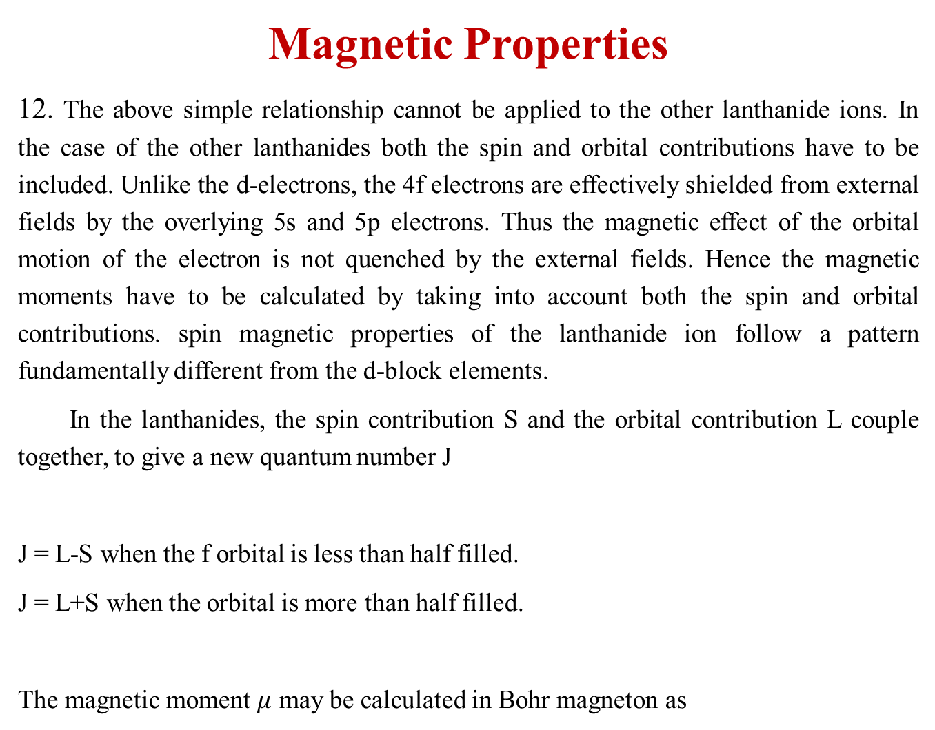
Magnetic Properties
12. The above simple relationship cannot be applied to the other lanthanide ions. In the case of the other lanthanides both the spin and orbital contributions have to be included. Unlike the d-electrons, the 4f electrons are effectively shielded from external fields by the overlying 5s and 5p electrons. Thus the magnetic effect of the orbital motion of the electron is not quenched by the external fields. Hence the magnetic moments have to be calculated by taking into account both the spin and orbital contributions. spin magnetic properties of the lanthanide ion follow a pattern fundamentally different from the d-block elements.
In the lanthanides, the spin contribution S and the orbital contribution L couple together, to give a new quantum number J
J = L-S when the f orbital is less than half filled.
J = L+S when the orbital is more than half filled.
The magnetic moment $μ$ may be calculated in Bohr magneton as

Slide 26
Magnetic Properties
13. The magnetic moments of lanthanide ions are in good agreement with the formula taken into account both the spin and orbital factors. The coupling constant (J) for Eu³⁺ is only about 300 cm⁻¹. This indicates that the difference between the ground state and next excited state is small. The energy of thermal motion is sufficient to cause the transition and partially populate the higher state. Because of this, the magnetic properties are not solely determined by the ground state configuration. Measure of magnetic moments at low temperature eliminates the thermal factor by preventing the population in the higher energy level. The magnetic moment of Eu³⁺ is close to zero as expected.)

Slide 27
Magnetic Properties
14. The unusual shape of the curve obtained by plotting the magnetic susceptibility against the atomic number of the lanthanide ions, arises on account of Hund's third rule. When the f level is less than half filled, the spin and orbital moment a work in opposition, (J = L-S). When the f-shell is more than half full the spin and orbital contribution work together, J = L + S.

Slide 28
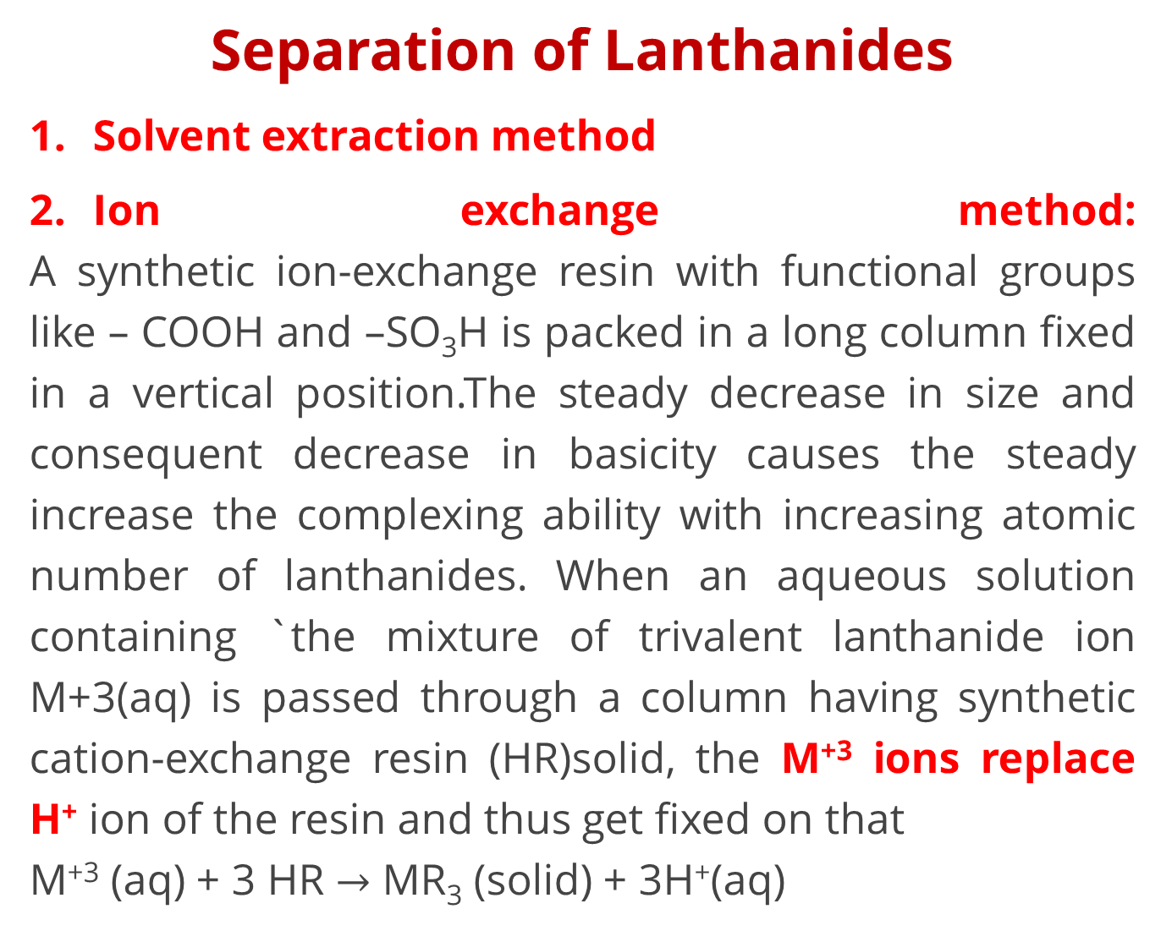
Separation of Lanthanides
Solvent extraction method
Ion exchange method:
A synthetic ion-exchange resin with functional groups like – COOH and –SO₃H is packed in a long column fixed in a vertical position.The steady decrease in size and consequent decrease in basicity causes the steady increase the complexing ability with increasing atomic number of lanthanides. When an aqueous solution containing `the mixture of trivalent lanthanide ion M+3(aq) is passed through a column having synthetic cation-exchange resin (HR)solid, the M⁺³ ions replace H⁺ ion of the resin and thus get fixed on that
M⁺³ (aq) + 3 HR $→$ MR₃ (solid) + 3H⁺(aq)

Slide 29
Separation of Lanthanides
Small Lu 3+ gets more hydrated than La 3+ and is bigger in size
Small Lu 3+ gets more hydrated than La 3+ and is bigger in size. So La(aq) 3+ gets strongly bound to the resin column than others.In order to recover M3+ ions fixed on the resin, the column is eluted with a citric acid – ammonium citrate solution (eluant). During elution process NH4+ ions replace M+3 ion and M- citrate complexes are formed.The bigger aquated ion is least strongly held and comes out first. Other ions remain on the column and can be separated by repeated elution.R – M3+ + NH R - NH M3+ - citrate

Slide 30
Electronic Configuration of Actinides
Element | Seaborg view | Dawson View | Oxidation States
Ac | [Rd] 5f0 6d1 7s2 | [Rd] 5f0 6d1 7s2 | +3, +2
Th | [Rd] 5f1 6d1 7s2 | [Rd] 5f0 6d2 7s2 | +4
Pa | [Rd] 5f2 6d1 7s2 | [Rd] 5f0 6d3 7s2 | +4, +5
U | [Rd] 5f3 6d1 7s2 | [Rd] 5f0 6d4 7s2 | +4, +5, +6
Np | [Rd] 5f4 6d1 7s2 |  | +4, +5, +6, +7
Pu | [Rd] 5f5 6d1 7s2 |  | +4 , +5 , +6
Am | [Rd] 5f6 6d1 7s2 |  | +3, +4, +5, +6
Cm | [Rd] 5f7 6d1 7s2 |  | +3
Bk | [Rd] 5f8 6d1 7s2 |  | +3
Cf | [Rd] 5f9 6d1 7s2 |  | +3
Es | [Rd] 5f10 6d1 7s2 |  | +3
Fm | [Rd] 5f11 6d1 7s2 |  | +3
Md | [Rd] 5f12 6d1 7s2 |  | +3
No | [Rd] 5f13 6d1 7s2 |  | +2 (f14)
Lr | [Rd] 5f14 6d1 7s2 |  | +3

Slide 31
Actinides
1.Atomic Radii:
Steady decrease from Ac to Lr due to imperfect shielding by f- orbitals due to their diffused shape is known as Actinide contraction.
2. Oxidation States:
–+3 is most common stable O.S.
Higher oxidation states are more common for elements upto Np.
O. S. upto +6 are stable.
3. Colour:
Metals, ions are coloured due to f-f transitions and intense change transfer transitions.
fº, f⁷, f¹⁴ –ions are colour less.

Slide 32
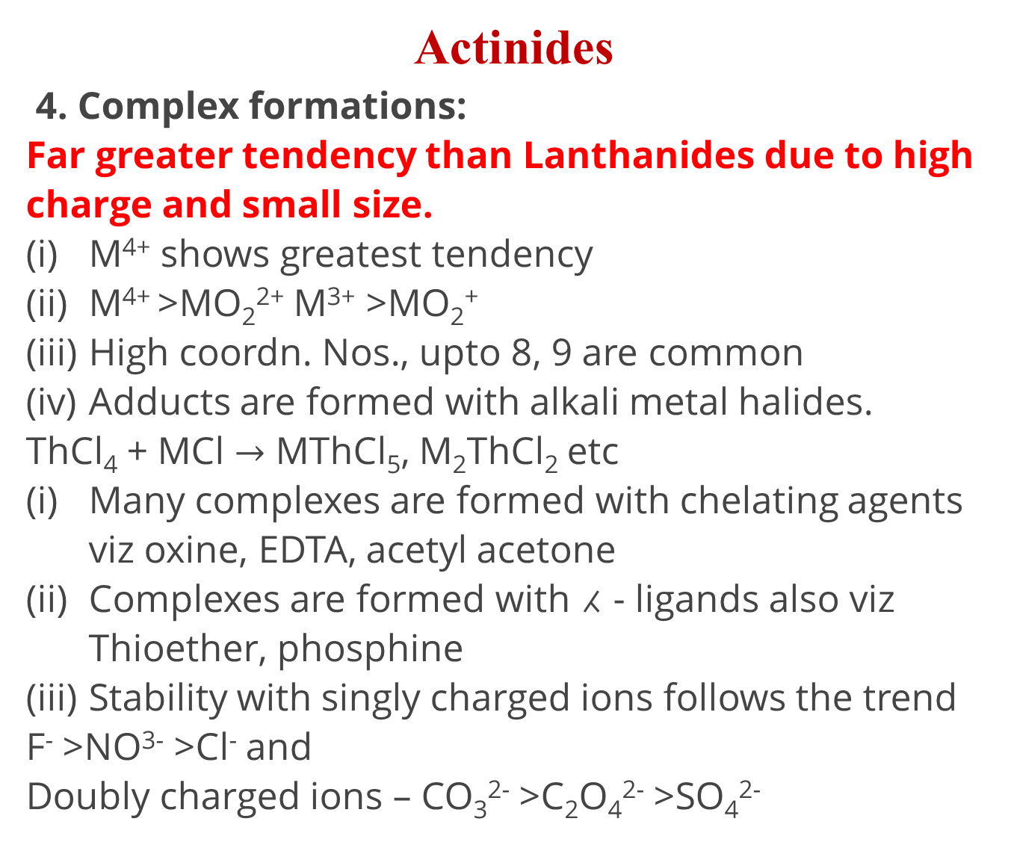
Actinides
4. Complex formations:
Far greater tendency than Lanthanides due to high charge and small size.
M⁴⁺ shows greatest tendency
M⁴⁺ >MO₂²⁺ M³⁺ >MO₂⁺
High coordn. Nos., upto 8, 9 are common
Adducts are formed with alkali metal halides.
ThCl₄ + MCl $→$ MThCl₅, M₂ThCl₂ etc
Many complexes are formed with chelating agents viz oxine, EDTA, acetyl acetone
Complexes are formed with ⁁ - ligands also viz Thioether, phosphine
Stability with singly charged ions follows the trend
F⁻ >NO³⁻ >Cl⁻ and
Doubly charged ions – CO₃²⁻ >C₂O₄²⁻ >SO₄²⁻

Slide 33
Comparison between lanthanides and actinides
Similarities
Oxidation state of +3 dominates in both the series.
In both the series forbitals are being progressively filled.
Just like lanthanide contraction we have actinide contraction.
The nitrates, perchlorates and sulphates of trivalent actinides as well as lanthanides are soluble while the hydroxides, fluorides and carbonates are insoluble.
In the absorption spectra of the elements of both the series sharp line-like bands appear due toff transitions.

Slide 34
Comparison between lanthanides and actinides
Difference
Lanthanides | Actinides
Binding energy of 4f are higher. 4f electrons have greater shielding effect. Maximum oxidation state exhibited bylanthanides is +4, e.g., Ce²+. They don't form oxocations. Except prometheium they are non-radioactive. They do not form complexes easily. Their complexes with π-bonding ligands are not known. They are paramagnetic but magnetic properties can be easily explained. | Binding energies of 5f are lower. 5 felectrons have poor shielding effect. Due to lower binding energies they show higher oxidation states such as +4, +5 and +6. They form oxocations such as UO2+, NpO, PuO. All of them are radioactive. They form complexes even with π- bonding ligands such as alkyl phosphines. thioethers etc. They are also paramagnetic but it is difficult to explain magnetic properties.

Slide 35
Reference
Ashim K Das , Fundamental Concept of Inorganic Chemistry, CBC Publishers & Distributors, Volume 1

Slide 36
Thank you

