Slide 1
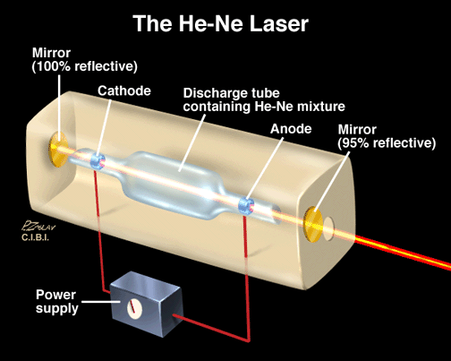
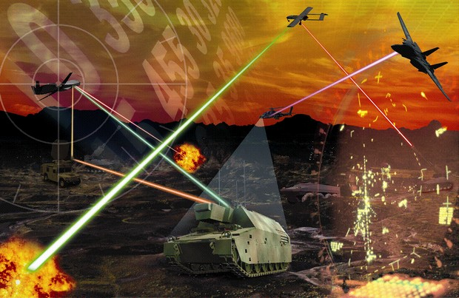
LASERS Fundamentals

Slide 2
What is a laser?
Laser = Light Amplification by Stimulated Emission of Radiation
A laser is a device that generates light by a process called
STIMULATED EMISSION.

Slide 3
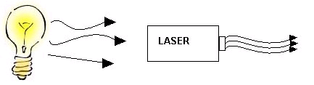
Incandescent vs. Laser Light
Many wavelengths
Multidirectional
Incoherent
Monochromatic
Directional
Coherent

Slide 4
Laser Fundamentals
The light emitted from a laser is monochromatic, that is, it is of one color/wavelength. In contrast, ordinary white light is a combination of many colors (or wavelengths) of light.
Lasers emit light that is highly directional, that is, laser light is emitted as a relatively narrow beam in a specific direction. Ordinary light, such as from a light bulb, is emitted in many directions away from the source.
The light from a laser is said to be coherent, which means that the wavelengths of the laser light are in phase in space and time. Ordinary light can be a mixture of many wavelengths.
These three properties of laser light are what can make it more hazardous than ordinary light. Laser light can deposit a lot of energy within a small area.

Slide 5
The Idea of stimulated Emission
In 1917 Einstein predicted that:
  under certain circumstances a photon incident upon a material can generate a second photon of
    Exactly the same energy (frequency)
    Phase
    Polarisation
    Direction of propagation
  In other word, a coherent beam resulted.
Charles Townes took the advantage of this stimulated emission process as an amplifier by conceiving and fabricating the first maser.
Extending the maser principle to optical wavelengths, Townes along with Arthur Leonard Schawlow developed the concept of laser.
TH Maiman of the Hughes Research Laboratory, experimentally demonstrated laser by flashing light through a ruby crystal, in 1960.

Slide 6
3 Mechanisms of Light Emission
For atomic systems in thermal equilibrium with their surrounding, the emission of light is the result of:
Absorption
And subsequently, spontaneous emission of energy
There is another process whereby the atom in an upper energy level can be triggered or stimulated in phase with the an incoming photon. This process is:
Stimulated emission
It is an important process for laser action
Therefore 3 process of light emission:
Absorption
Spontaneous Emission
Stimulated Emission

Slide 7
Absorption
Spontaneous Emission
E₂
E₁
Stimulated Emission

Slide 8
Induced absorption (stimulated absorption)
The process in which an atom sized system in lower energy state is raised in to higher energy state by electro magnetic radiation which is quanta of energy is equal to the difference of energy of the two states is called stimulated absorption.
i.e.,
hν=E2-E1
E2
E2
E1
E1
Before
After

Slide 9
Spontaneous emission
In the atom initially at upper state E2, it can brought to E1 by emitting photon of energy hν.This is known as spontaneous emission.
Before
After emission
During
E2
E1
Atom in excited state
Atom in ground state

Slide 10

Stimulated emission
According to Einstein's, under certain condition it is possible to force an excited atom emit a photon by another photon and the incident light wave must be in same phase .hence we get an enhance beam of coherent light
Excited state
After emission
E2
E1
Ground state
ie,

Slide 11
Population inversion
population inversion occurs when a system (such as a group of atoms or molecules) exists in a state with more members in an excited state than in lower energy states. The concept is of fundamental importance in laser science because the production of a population inversion is a necessary step in the workings of a standard laser.

Slide 12

Lasing Action Diagram
Excited State
Spontaneous Energy Emission
Energy Introduction
Metastable State
Stimulated Emission of Radiation
Ground State

Slide 13
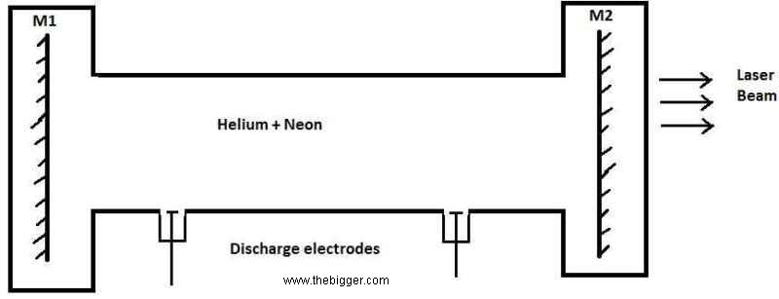
Common Components of all Lasers
Active medium or working substance:
This is the basic material in which atomic and molecular transitions as well as stimulated emission take place.
Depending the active medium lasers are classified in to different types like solid, gas, dye or liquid, semiconductor laser
Pumping source or energy source
With the help of energy source the no. of atoms in higher energy state may be increased and hence the population inversion is achieved.

Slide 14
Optical resonator
Optical Resonator consists of a Set of mirrors at the two ends active medium which are silvered. one end being completely silvered and the other is partially silvered.
Photons are emitted parallel to the axis of the active medium undergo multiple reflections between them
So, the light intensity can be increased
Energy source
Working
substance
Fully silvered
Partially silvered

Slide 15
Three level and four level laser
The simplest kind is three level laser which uses and assembly of atom or molecules that have three energy states E1,E2,E3.
Where, E1-> ground state
E2->meta stable state
E3->higher excited state
E3
Excited state
E2
Pumping active
Meta stable state
E1
Ground state

Slide 16
Four level laser
E1->ground state,E2->intermediate,E3->metastable,E4->excited state
Excited state
E4
E3
Meta stable state
Pumping active
E2
Intermediate
E1
Ground state

Slide 17
Different types of lasers
There are basically four types of lasers
Solid state laser
Gas laser
Liquid laser or dye laser
Semi conductor laser

Slide 18
Applications
Modulated laser beam have been used for communication
In medical field
High power laser have been used for cutting & drilling holes in hard metal and diamonds
They have been used in the production and research with holograms, they are also used in high speed photography and fiber optics

Slide 19
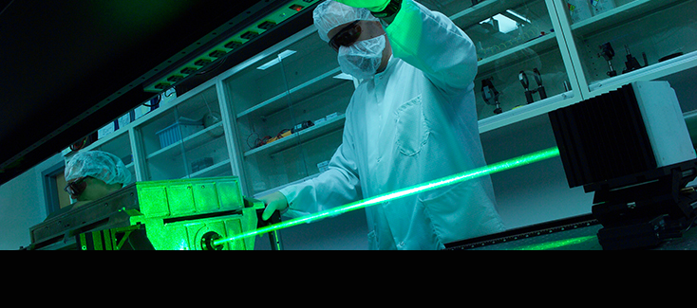
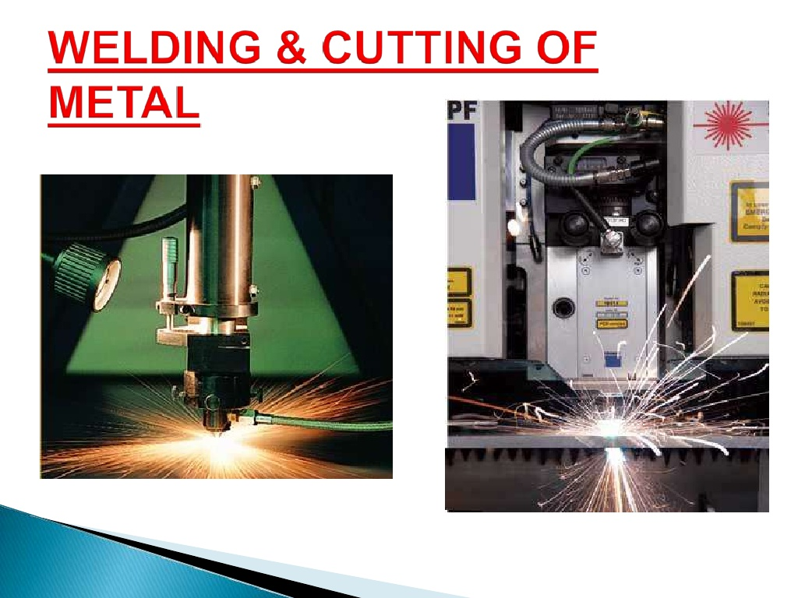
IN INDUSTRY: Lasers are widely used in for cutting, drilling, welding, cladding, soldering (brazing), hardening, surface treatment, marking, engraving, micromachining, pulsed laser deposition, lithography, alignment, etc.

Slide 20
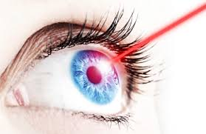
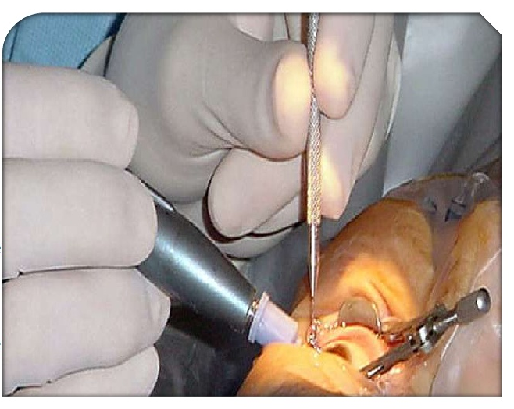
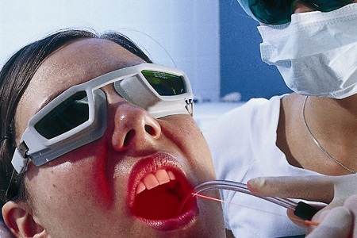
IN MEDICAL:
For the treatment of detached retinas.
In performing bloodless surgery.
For the treatment of human and animal cancers and skin tumtors.

Slide 21
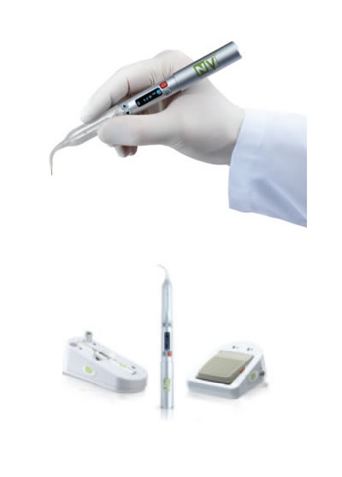
ADVANTAGES
Painless, Bloodless & Clean surgical field.
No or minimal need for anesthesia.
Laser kills bacteria, risk of infection is reduced
No postoperative discomfort, and swelling.
Superior and faster healing
LASER

Slide 22
Lasers in beauty therapy
Lasers application in beauty therapy are based on:
selective absorption of absorbing components.
photo-vaporization process for removal of the treated components.
pulsed lasers are used.

Slide 23
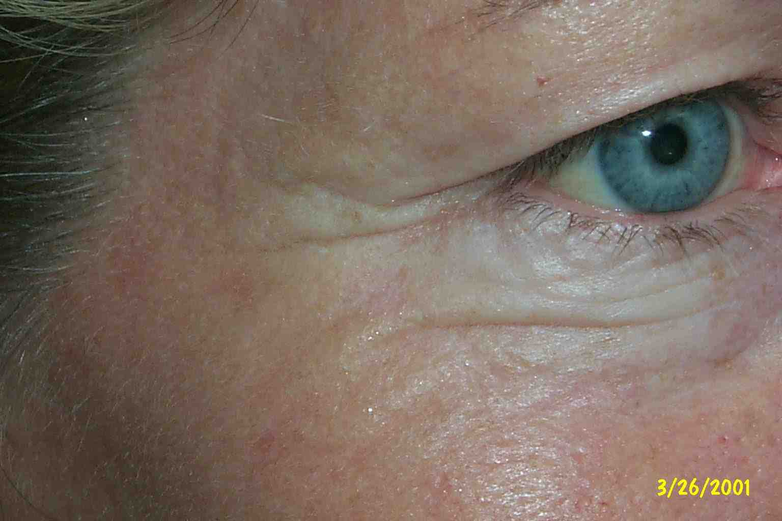
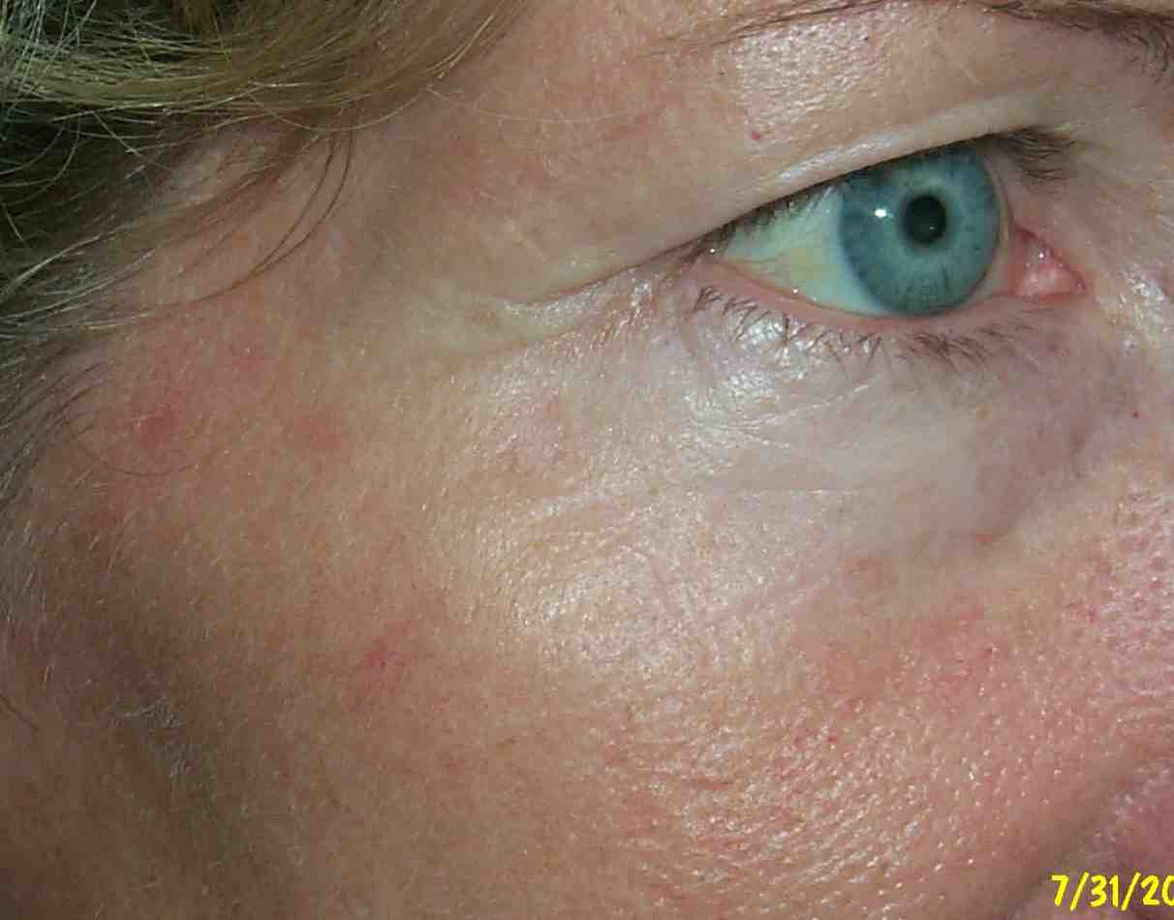
Laser skin rejuvenation
IR lasers are used to remove extremely thin layer of skin
(<0.1 mm). In the absence of pigment in general, they take advantage of the presence of water in the skin to provide an ability to remove skin and body tissue.

Slide 24
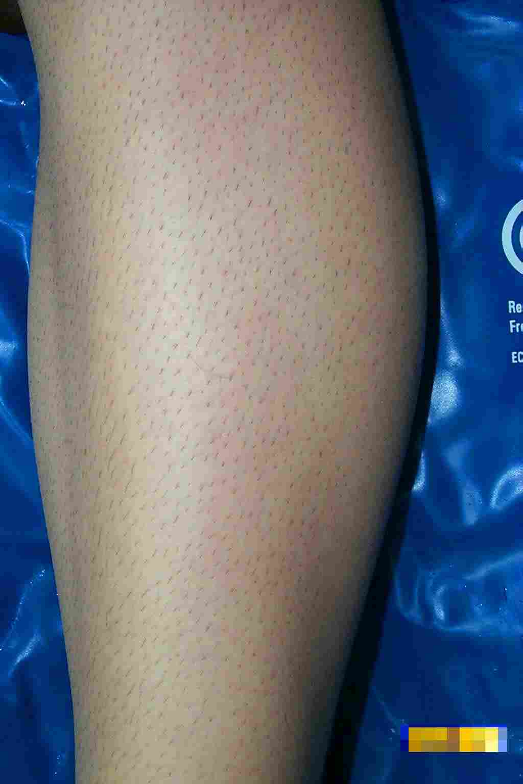
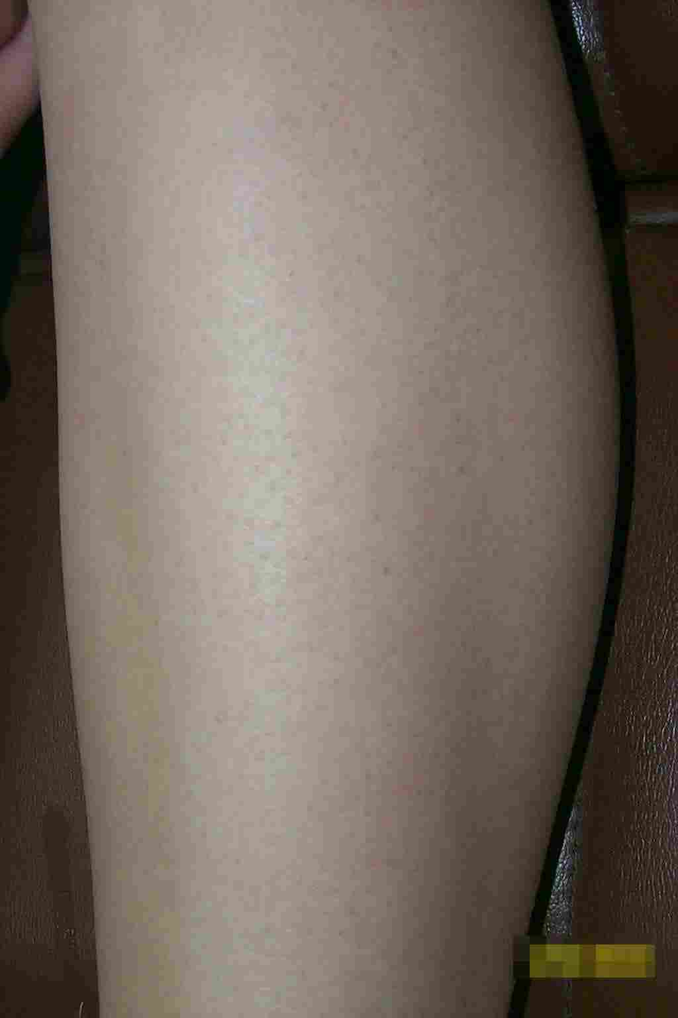
Laser hair removal
selective absorption : absorbing component being melanin pigment in hair and follicle, it is best worked with a red light ruby laser. White hair can not be treated with any laser due to the lack of absorbing component.

Slide 25
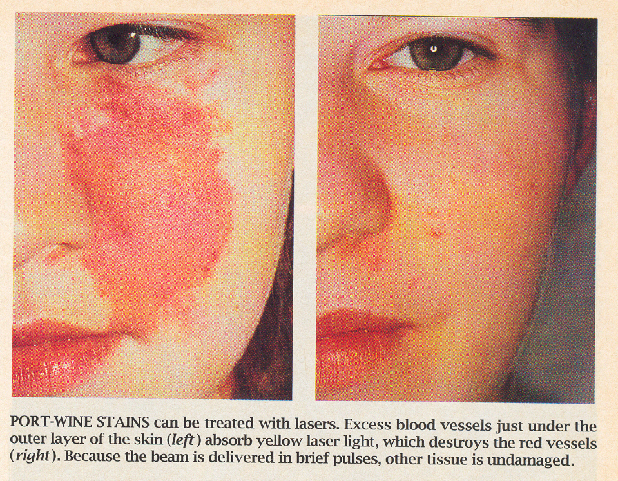
Laser removal of port-wine stain
Yellow laser is absorbed by the presence of hemoglobin in blood vessels.

Slide 26
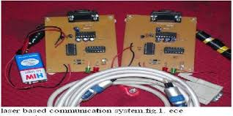
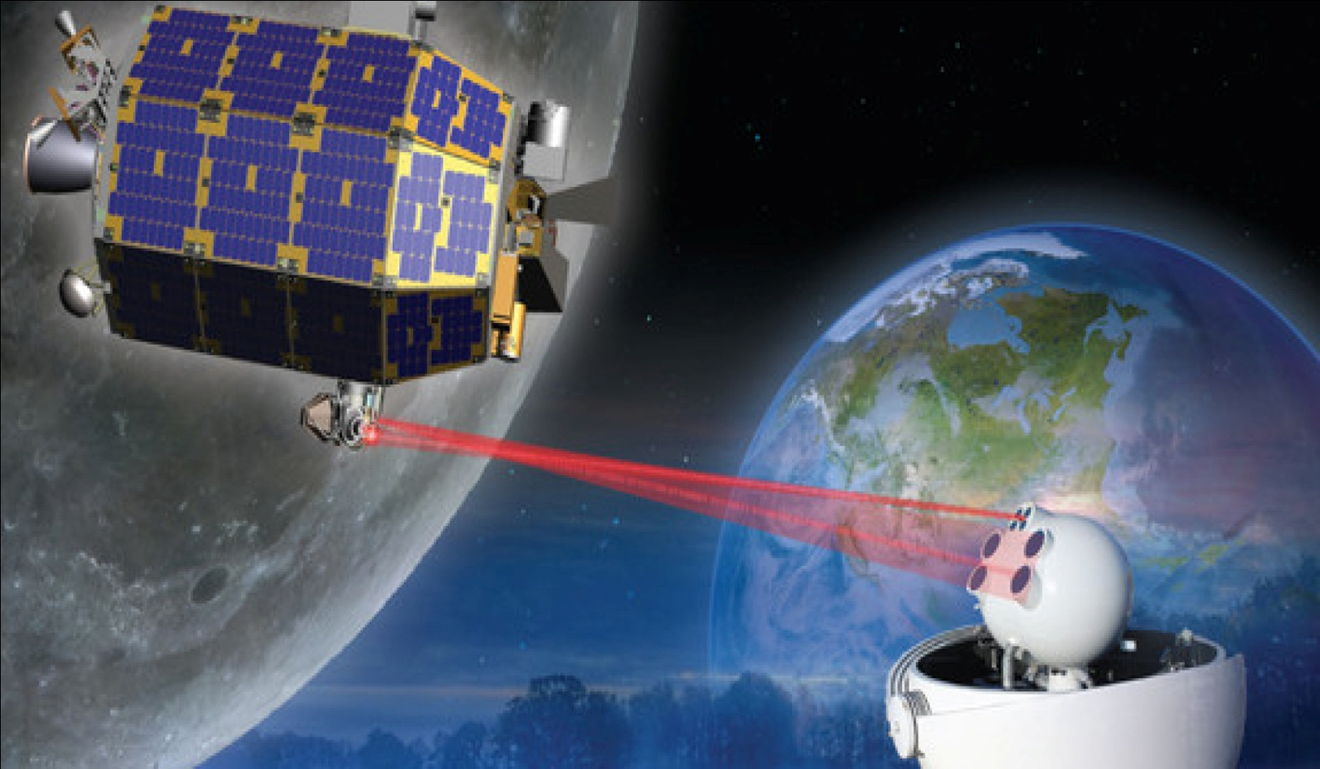
Laser communication:
Optical fiber communication, extensively used particularly for long-distance optical data transmission.
Free-space optical communications: e.g. for inter-satellite communications, is based on higher-power lasers, generating collimated laser beams which propagate over large distances with small beam divergence

Slide 27
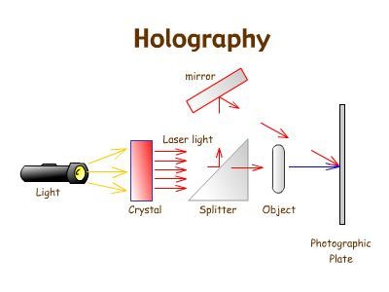

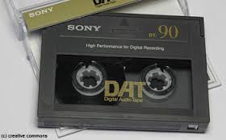
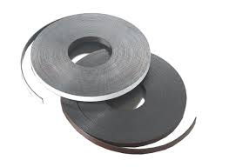
Data Storage

Slide 28
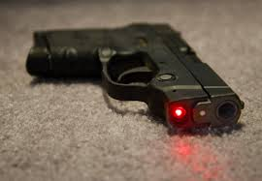
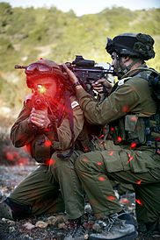
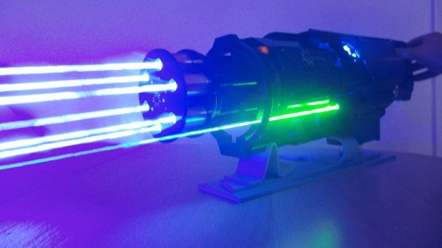
In Military
1.Some high-power lasers are currently developed for potential use as directed energy weapons on the battle field, or for destroying missiles, projectiles and mines.
2.In range finding, LIDAR, and optical communications.
3. lasers function as target designators (essentially laser pointers emitting visible or invisible laser beams), or as irritating or blinding countermeasures e.g. against heat-seeking anti-aircraft missiles.

Slide 29
Laser Hazards

Slide 30
Types of Laser Hazards
Eye : Acute exposure of the eye to lasers of certain wavelengths and power can cause corneal or retinal burns (or both). Chronic exposure to excessive levels may cause corneal or lenticular opacities (cataracts) or retinal injury.
Skin : Acute exposure to high levels of optical radiation may cause skin burns; while carcinogenesis may occur for ultraviolet wavelengths (290-320 nm).
Chemical : Some lasers require hazardous or toxic substances to operate (i.e., chemical dye, Excimer lasers).
Electrical : Most lasers utilize high voltages that can be lethal.
Fire : The solvents used in dye lasers are flammable. High voltage pulse or flash lamps may cause ignition. Flammable materials may be ignited by direct beams or specular reflections from high power continuous wave (CW) infrared lasers.

Slide 31
Reference
www.google.com
www.wikipedia.com
www.studymafia.org
www.pptplanet.com
www.pdfclass.com

Slide 32


