Slide 1
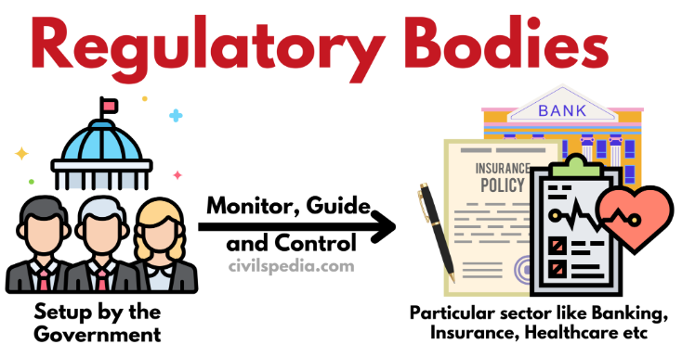
Figure: Regulatory Bodies (Source: civilspedia.com)

Slide 2
In the case of Natural Monopoly
A natural monopoly is a condition when an entire market is more efficiently served by one firm than by two or more firms.
In the case of a natural monopoly, regulation is necessary to protect consumer interests, control prices, and ensure the quality of service, as there is no competition in the market.
In India, the sectors such as transmission and distribution of electricity and railways are still natural monopolies.
Asymmetric Information
It is a situation when one party has more information than another. In India, asymmetric information is a significant reason for government intervention.
Presence of Externalities
Negative externalities refer to the costs or harms imposed on third parties not directly involved in a transaction or activity. When negative externalities exist, market forces alone may not be adequate to address the issue. In India, regulation is often implemented to address negative externalities in various sectors.

Slide 3
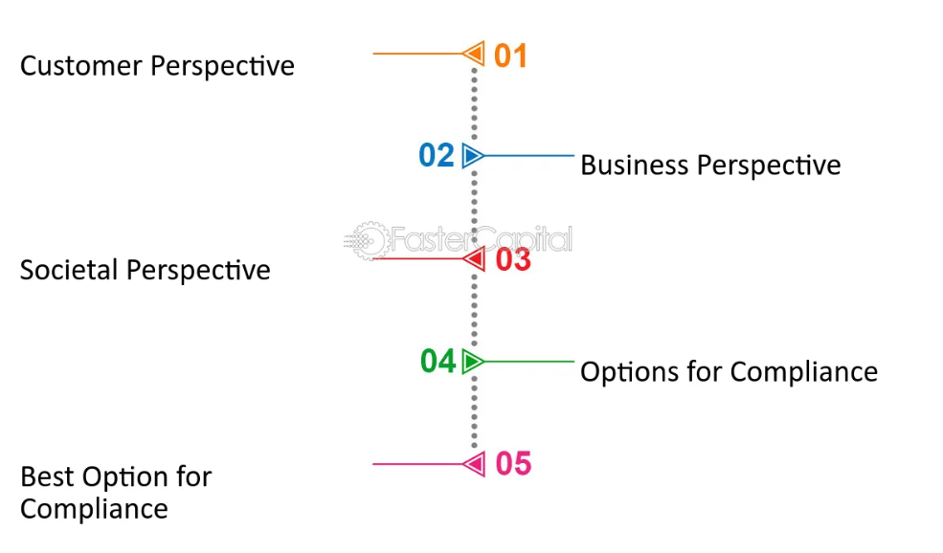
Figure: Perspectives of society in terms of regulatory bodies
(Source: https://fastercapital.com/content/Regulatory-bodies--Behind-the-Scenes--Regulatory-Bodies-and-their-Impact.html)

Slide 4
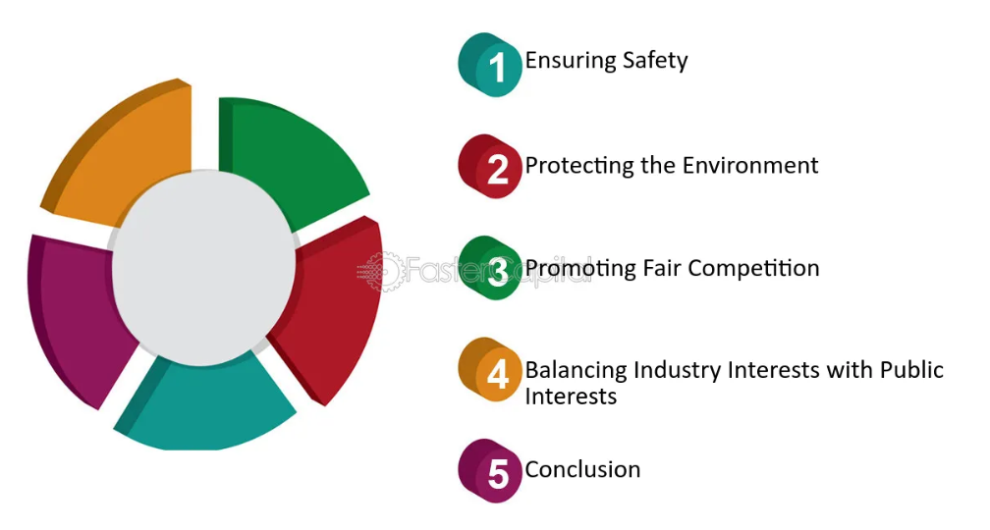
Figure: Industry interests with respect to Public interests
(Source: https://fastercapital.com/content/Regulatory-bodies--Behind-the-Scenes--Regulatory-Bodies-and-their-Impact.html)

Slide 5

Figure: Role of ISO

Slide 6
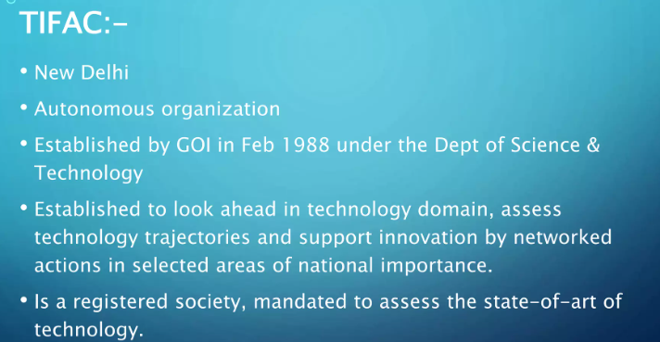
Technology Information, Forecasting and Assessment Council

Slide 7
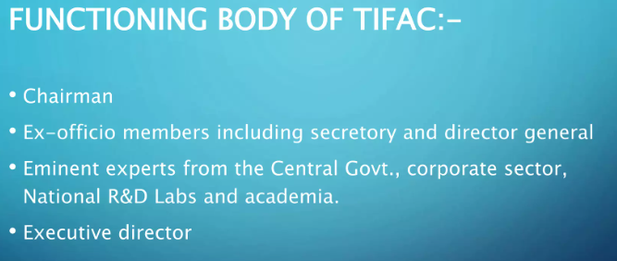

Slide 8
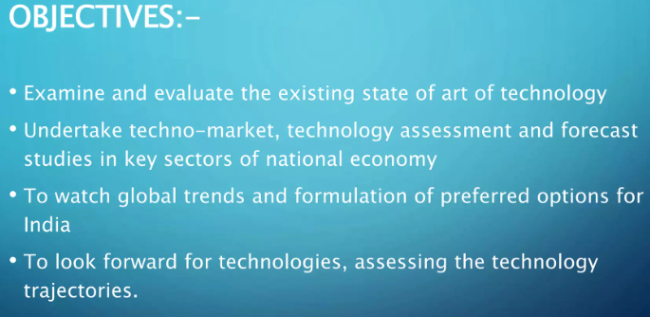

Slide 9
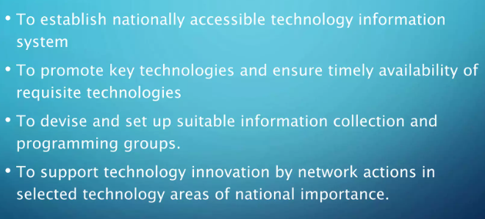

Slide 10
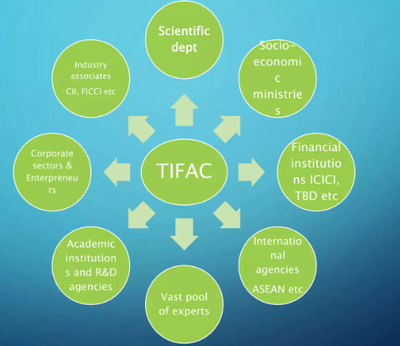
Figure: Network of TIFAC with other organizations

Slide 11


