Slide 1
IT Enabled Medical Sales Representative
Module 1
Course Code:-MSR3021
TOPIC:-
Understanding the ROLE of msr and regulations for medical sales representative
Practice of soft communication skill

Slide 2
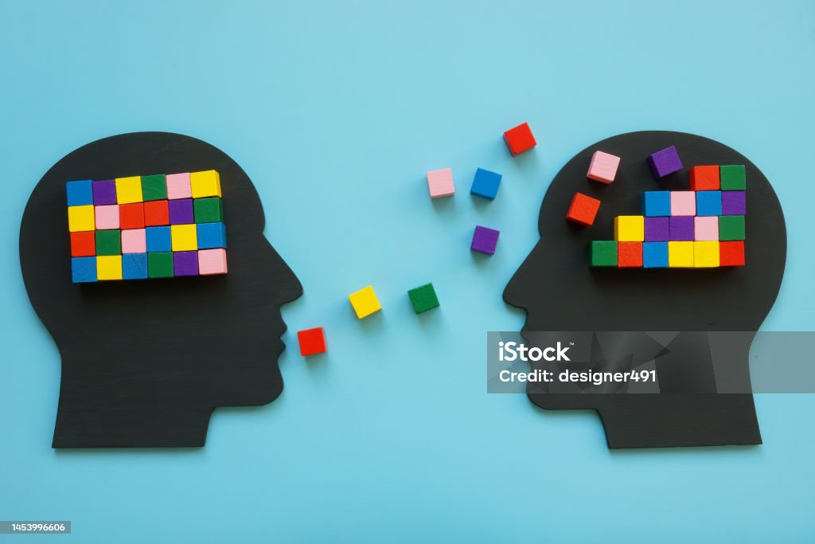
COMMUNICATION
Communication is simply the act of transferring of information, ideas ,thought and feelings from one place, person or group to another.
Every communication involves
(at least) one sender,
message and
(at least) recipient.

Slide 3
Process of communication
SENDER ENCODING MEDIUM D deCODING RECEIVER
FEEDBACK

Slide 4
Types of Communication:-
Verbal communication:
Communication occurs through verbal, verbal or written communication that conveys or conveys a message to others is called oral communication. Verbal communication is the use of language to convey information verbally or in sign language. Verbal communication is important because it works well. It can be helpful to support verbal Non-verbal communication .
Non-verbal communication:
It occurs with signs, symbols, colours, touches, body or facial features. Insignificant communication is using body language, body and facial expressions to convey information to others. It can be used both intentionally and deliberately. For example, you may have a smile on your face when you hear an idea or a piece of interesting or exciting information.

Slide 5
Mode Of Communication:-
Formal Communication:
Formal Communication refers to communication that takes place through legal channels in an organization. That kind of communication takes place between managers or employees of the same class or between high and low and vice versa. It may be oral or written but a complete record of that communication is kept in the organization.
Informal Communication:
Informal communication is defined as any communication that occurs outside of the official channels of communication. Informal communication is often referred to as the ‘grapevine’ as it spreads throughout the organization and on all sides regardless of the level of authority.

Slide 6

Non-verbal communication:
1.Facial Expressions
Facial expressions are responsible for a huge proportion of nonverbal communication. Consider how much information can be conveyed with a smile or a frown. The look on a person's face is often the first thing we see, even before we hear what they have to say.
While nonverbal communication and behaviour can vary dramatically between cultures, the facial expressions for happiness, sadness, anger, and fear are similar throughout the world.

Slide 7
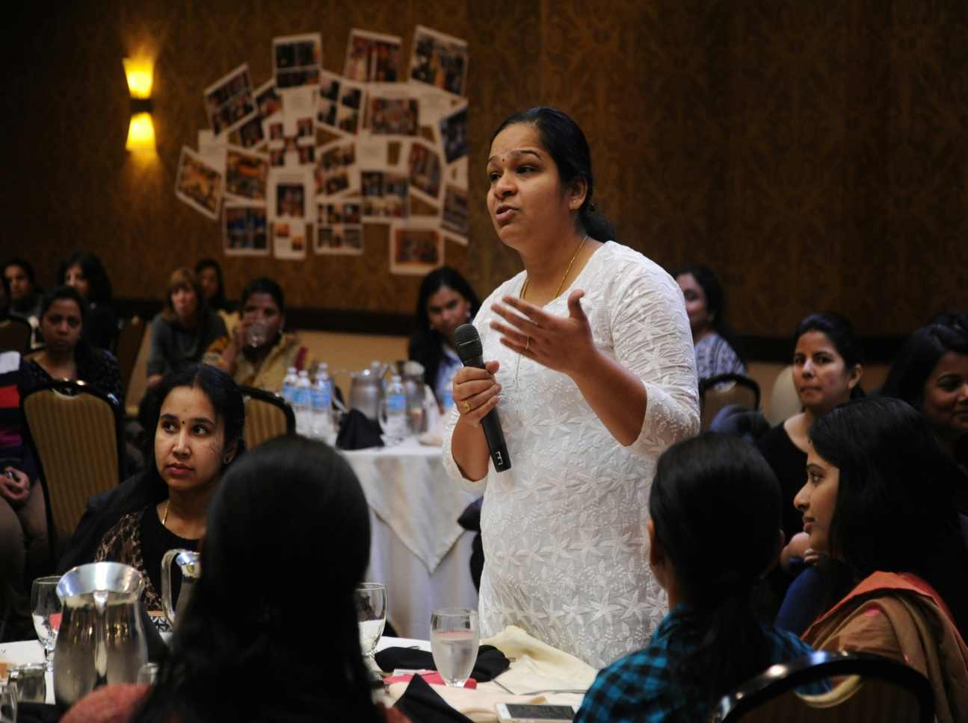
2.Gestures
2.Gestures
Deliberate movements and signals are an important way to communicate meaning without words. Common gestures include waving, pointing, and giving a "thumbs up" sign. Other gestures are arbitrary and related to culture.
An advocate might glance at their watch to suggest that the opposing lawyer's argument is tedious, for instance. Or they may roll their eyes during a witness's testimony in an attempt to undermine that person's credibility.

Slide 8

3.Para linguistics
Para linguistics refers to vocal communication that is separate from actual language. This form of nonverbal communication includes factors such as tone of voice, loudness, inflection, and pitch.
For example, consider the powerful effect that tone of voice can have on the meaning of a sentence. When said in a strong tone of voice, listeners might interpret a statement as approval and enthusiasm. The same words said in a hesitant tone can convey disapproval and a lack of interest.

Slide 9
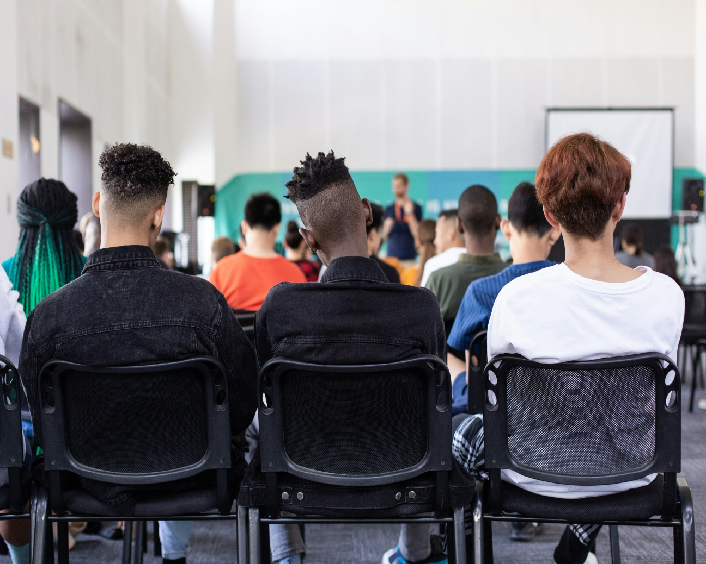
Body Language and Posture
Posture and movement can also provide a great deal of information.
Research on body language has grown significantly since the 1970s, with popular media focusing on the over-interpretation of defensive postures such as arm-crossing and leg-crossing, especially after the publication of Julius Fast's book Body Language.

Slide 10

Proxemics
People often refer to their need for "personal space." This is known as proxemics and is another important type of nonverbal communication.
The amount of distance we need and the amount of space we perceive as belonging to us are influenced by several factors. Among them are social norms, cultural expectations, situational factors, personality characteristics, and level of familiarity.

Slide 11

Eye Gaze
The eyes play a role in nonverbal communication, with such things as looking, staring, and blinking being important cues. For example, when you encounter people or things that you like, your rate of blinking increases and your pupils dilate.
People's eyes can indicate a range of emotions, including hostility, interest, and attraction.
People also often utilize eye gaze cues to gauge a person's honesty. Normal, steady eye contact is often taken as a sign that a person is telling the truth and is trustworthy. Shifty eyes and an inability to maintain eye contact, on the other hand, is frequently seen as an indicator that someone is lying or being deceptive.

Slide 12

Haptics
Communicating through touch is another important nonverbal communication behaviour. Touch can be used to communicate affection, familiarity, sympathy, and other emotion.
Gender differences also play a role in how people utilize touch to communicate meaning.
Example, Women tend to use touch to convey care, concern, and nurturance. Men, on the other hand, are more likely to use touch to assert power or control over others.

Slide 13
Communication Barriers
.
A communication barrier is anything that comes in the way of receiving and understanding messages that one sends to another to convey his ideas, thoughts, or any other kind of information. These various barriers of communication block or interfere with the message that someone is trying to send.
Medical words(e,g Prescription)
Language differences
Cultural differences
Disabilities and other challenges
Low health literacy
Complexity of health topics
Lack of time

Slide 14
Examples
Lack of proper style, feedback.
Content is not related to customer requirements.
Failure to maintain dual communication.
Bad weather.
Availability of technical coordinators.
Lack of leadership.
Lack of enthusiasm.
Lack of support from heads of institutions.

Slide 15
USE OF COMMUNICATION IN PHARMACEUTICAL INDUSTRY
Pharmaceutical detailing is a 1:1 marketing technique pharmaceutical companies use to educate a physician about a vendor's products, hoping that the physician will prescribe the company's products more often.
OR in other words, Detailing can be defined as the presentation of selling point in the most logical sequence.
Pharmaceutical RETAILING can be defined as the activities performed at Retailers level to generate information to make our presentation effective and to make our sales call successful.
Detailing
Retailing

Slide 16
THANK YOU

