Slide 1
Noble Gases Chemistry (Group-18)
Dr. Semanti Basu
Assistant Professor
Department of Chemistry
Bejoy Narayan Mahavidyalaya Itachuna, Hooghly, W.B., India

Slide 2
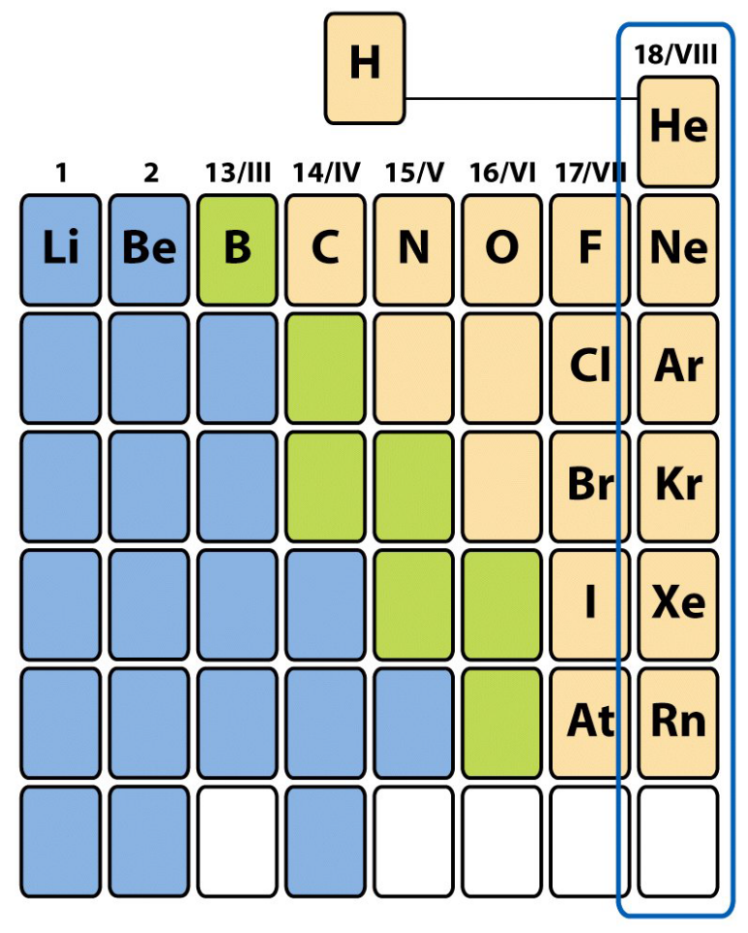
Group 18: The Noble gases
The noble gases, also known as the inert gases or rare gases, are located in Group 18 of the periodic table.
They are non-metals.
The noble gases are; helium (He), neon (Ne), argon (Ar), krypton (Kr), xenon (Xe) , radon (Rn) and Oganesson (Og).
The elements have a [core]ns² np⁶ electron configuration with a complete octet. (n is the period number) except He
Their closed shell stable electron configuration makes them have a very low reactivity.

Slide 3
Group 18: The Noble gases
Noble gases have a full valence shell.
The noble gases are the smallest elements in their respective periods, with the highest ionization energies.
Noble gases have very low melting and boiling points.
Only Kr, Xe, and Rn are known to form compounds.
Xe is the most reactive noble gas and exhibits all even oxidation states from +2 to +8.
Very low electronegativities
No color, odor, or flavor under ordinary conditions
Nonflammable
At low pressure, they will conduct electricity and fluoresce

Slide 4
Occurrence of the Noble Gases
All the noble gases occur in the atmosphere as monatomic gases.
They are monatomic, which means they exist as individual atoms. Most other gases are diatomic.
Together they make up 1% (by mass) of the atmosphere.
Argon is the third most abundant gas in the atmosphere after N and O.
All of the noble gases except He and Rn are obtained by the fractional distillation of liquid air.
The major source of helium is from the cryogenic separation of natural gas.
Radon, a radioactive noble gas, is produced from the radioactive decay of heavier elements, including radium, thorium, and uranium.
Element 118 (Og) is a man-made radioactive element, produced by striking a target with accelerated particles.

Slide 5
Uses of Noble Gases
The noble gases are used to form inert atmospheres, to protect specimens, and to prevent chemical reactions (to prevent oxidation).
Argon is also used to fill some types of light bulbs, where it conducts heat away from the filament.
Krypton gives an intense white light when an electrical current is passed through it and it is used in airports for there runway lights used:
  In lasers for eye surgery, to stop bleeding on the retina.
  In lighthouses and other types of lamps.
Xenon is used:
  In various types of electron tubes, lamps, lasers and in high speed photographic flash tubes
Radon is used:
  To treat cancer by radiotherapy, because it is radioactive.
  However, because radon is radioactive, it is also an environmental hazard.

Slide 6
The Atomic and Physical Properties of the noble gases
Atomic mass, boiling point, and atomic radii INCREASE down a group in the periodic table.
The first ionization energy DECREASES down a group in the periodic table.
The noble gases have the largest ionization energies, reflecting their chemical inertness.
Down Group 18, atomic radius and interatomic forces INCREASE resulting in an INCREASED melting point, boiling point, energy of vaporization, and solubility.
The INCREASE in density down the group is correlated with the INCREASE in atomic mass.
Because noble gases’ outer shells are full, they are extremely stable, tending not to form chemical bonds and having a small tendency to gain or lose electrons.

Slide 7
The Atomic and Physical Properties of the noble gases
Under standard conditions all members of the noble gas group behave similarly.
All are monoatomic gases under standard conditions.
Noble gas atoms, like the atoms in other groups, INCREASE steadily in atomic radius from one period to the next due to the INCREASING number of electrons.
The size of the atom is positively correlated to several properties of noble gases. The ionization potential DECREASES with an INCREASING radius, because the valence electrons in the larger noble gases are further away from the nucleus; they are therefore held less tightly by the atom.
The attractive force INCREASES with the size of the atom as a result of an INCREASE in polarizability and thus a DECREASE in ionization potential.
Overall, noble gases have weak interatomic forces, and therefore very low boiling and melting points compared with elements of other groups.

Slide 8
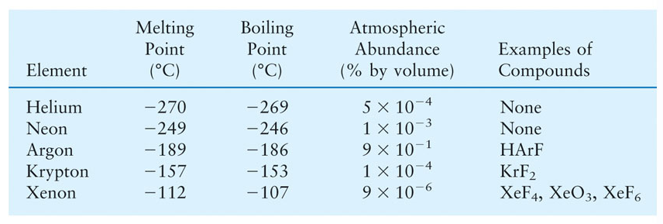
Selected Properties The noble gases

Slide 9
Compounds of the noble Gases (Reactivity)
The elements have a complete octet, predict that there would be no chemistry for the noble gases.
However, numerous group 18 compounds are known, although they may be very unstable and explosive.
He and Ne are chemically inert and they do not form any compounds.
  Their chemical inertness is due to very high ionization energy, zero electron affinity and the absence of vacant d-orbitals in valence shell.
Ar, Kr and Xe will show some reactivity
  due to low ionization potentials and presence of vacant d-orbitals in valence shell.

Slide 10
Compounds of the noble Gases (Reactivity)
Xe is more reactive than Ar and Kr
  due to it's low ionisation energy.
Radon is radioactive and it will not show chemical reactivity.
Krypton forms only one known stable neutral molecule KrF₂.
Xe shows tendency to lose electrons in many of it's reactions. Therefore, Xe combines with only more electronegative elements like F and O or electronegative groups.
Xe does not combine with less electronegative elements like Cl₂ or N₂.

Slide 11
The Element Helium
Helium (He) is the second most abundant element in the universe after hydrogen.
However it is rare on earth because Its density is very low, so that it can reach the high speeds needed to escape from the atmosphere.
It is the least reactive of all elements; it does not react with any other elements or ions, so there are no helium-bearing minerals in nature.
He is colorless, odorless, and tasteless and extremely light.
He was first observed by studying the sun, and was named after the Greek word for the sun, Helios.
The density of He is very low and it is non-flammable therefore it is used to provide resistance in aircrafts.
He is the only element known to have more than one liquid phase.

Slide 12
The Elements Xenon
Xenon is unique for being the first noble gas element to be synthesized into a compound.
Discovered on 1898 by Sir William Ramsay.
Xenon is present to a small extent in the atmosphere (less than one ppm by volume).
Metallic xenon is produced by applying several hundred kilobars of pressure.
In 1962 the first noble gas compound was produced by Neil Bartlett, combining xenon, platinum and fluorine.
It is now possible to produce xenon compounds in which the oxidation states range from +2 to +8.
Most of the known xenon compounds contain the strongly reducing fluorine or oxygen atoms.

Slide 13
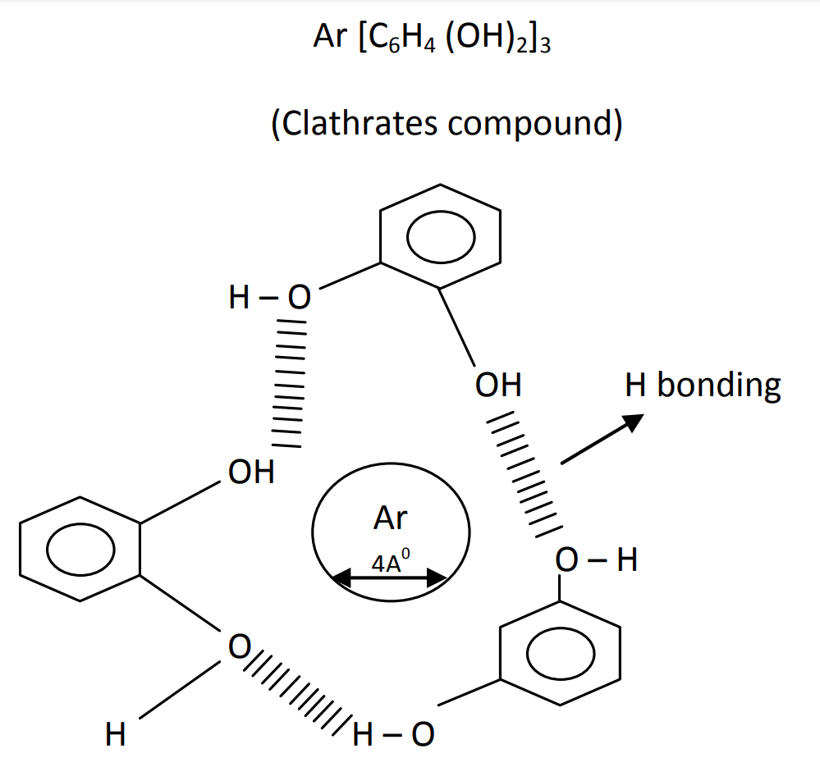
Clathrates Compounds
Clathrates compounds are the compounds in which some atoms or molecules (e.g. inert gas) which are capable of independent existence are trapped in the cavities of the crystal structure of some organic or inorganic compounds. The atom or molecules are purely physically trapped and no chemical bonding or interaction except weak the Vander Waal's force is present in the crystal structure. The atoms or molecules which are trapped are called guest moieties and the compound whose crystal structure provides the of guest moieties are called host moieties.
ESSENTIAL CONDITION FOR FORMATION:
Presence of cavities of appropriate size in the crystal lattice of the host.
2. Size of the guest particle should be such as to fit in the cavities of the host.

Slide 14
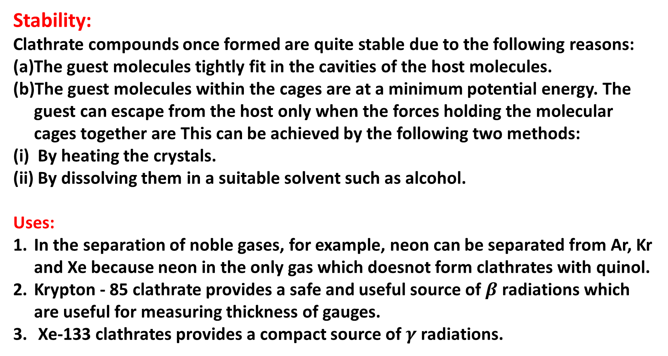
Clathrates Compounds
Stability:
Clathrate compounds once formed are quite stable due to the following reasons:
The guest molecules tightly fit in the cavities of the host molecules.
The guest molecules within the cages are at a minimum potential energy. The guest can escape from the host only when the forces holding the molecular cages together are This can be achieved by the following two methods:
By heating the crystals.
By dissolving them in a suitable solvent such as alcohol.
Uses:
In the separation of noble gases, for example, neon can be separated from Ar, Kr and Xe because neon in the only gas which doesnot form clathrates with quinol.
Krypton - 85 clathrate provides a safe and useful source of $β$ radiations which are useful for measuring thickness of gauges.
Xe-133 clathrates provides a compact source of $γ$ radiations.

Slide 15
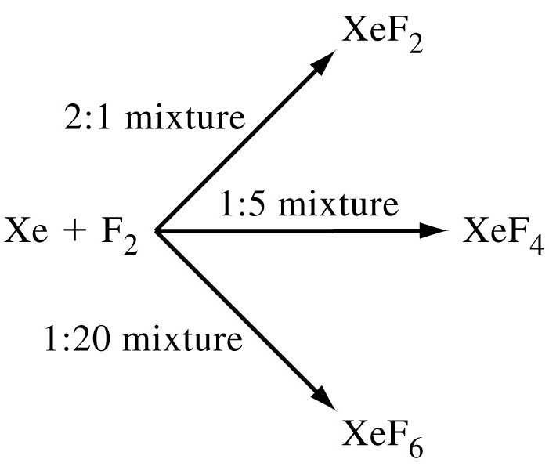
Preparation, structures (VSEPR theory) and properties of XeF₂, XeF₄ and XeF₆
Fluorine is the only element that directly reacts with Xenon.
Xenon-fluorine compounds
XeF₂, XeF₄ and XeF₆
Preparation : By the direct reaction of elements under appropriate experimental conditions.
Properties: They are readily hydrolysed even by traces of water.
673K, 1bar
873K, 7bar
573K, 60-70bar

Slide 16
properties of XeF₂, XeF₄ and XeF₆
Xenon Difluoride (XeF₂)
Xe+F₂→XeF₂
White crystallized solid
Covalent inorganic fluorides
Stable compound
Decomposes on contact with light or water vapor
Linear structure
Moister sensitive
Xenon Tetrafluoride (XeF₄)
Xe+2F₂→XeF₄
Colorless Crystals
Square planar structure
Xenon Hexafluoride (XeF₆)
Xe+3F₂→XeF₆
Strongest fluorinating agent
Colorless solid
Exergonic and stable at normal temperatures
Sublimates into yellow vapors
Structure lacks perfect octahedral symmetry

Slide 17
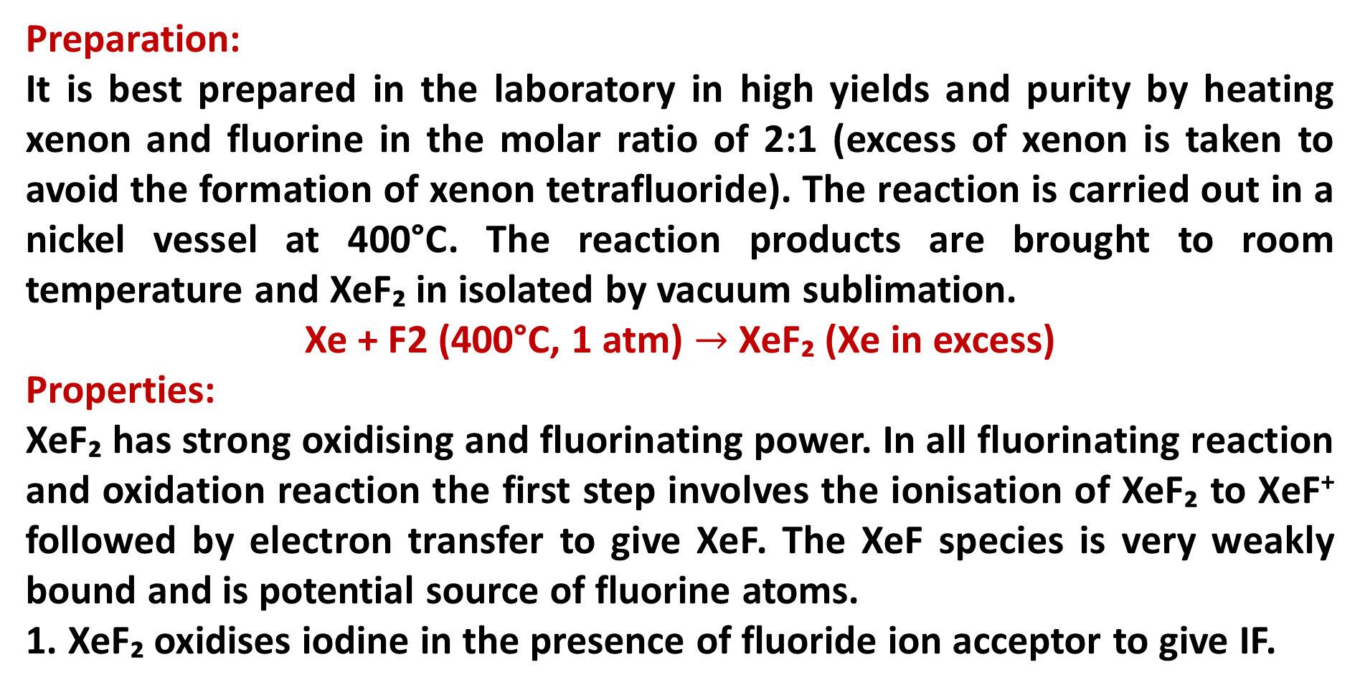
XeF₂
Preparation:
It is best prepared in the laboratory in high yields and purity by heating xenon and fluorine in the molar ratio of 2:1 (excess of xenon is taken to avoid the formation of xenon tetrafluoride). The reaction is carried out in a nickel vessel at 400°C. The reaction products are brought to room temperature and XeF₂ in isolated by vacuum sublimation.
Xe + F2 (400°C, 1 atm) $→$ XeF₂ (Xe in excess)
Properties:
XeF₂ has strong oxidising and fluorinating power. In all fluorinating reaction and oxidation reaction the first step involves the ionisation of XeF₂ to XeF⁺ followed by electron transfer to give XeF. The XeF species is very weakly bound and is potential source of fluorine atoms.
1. XeF₂ oxidises iodine in the presence of fluoride ion acceptor to give IF.

Slide 18
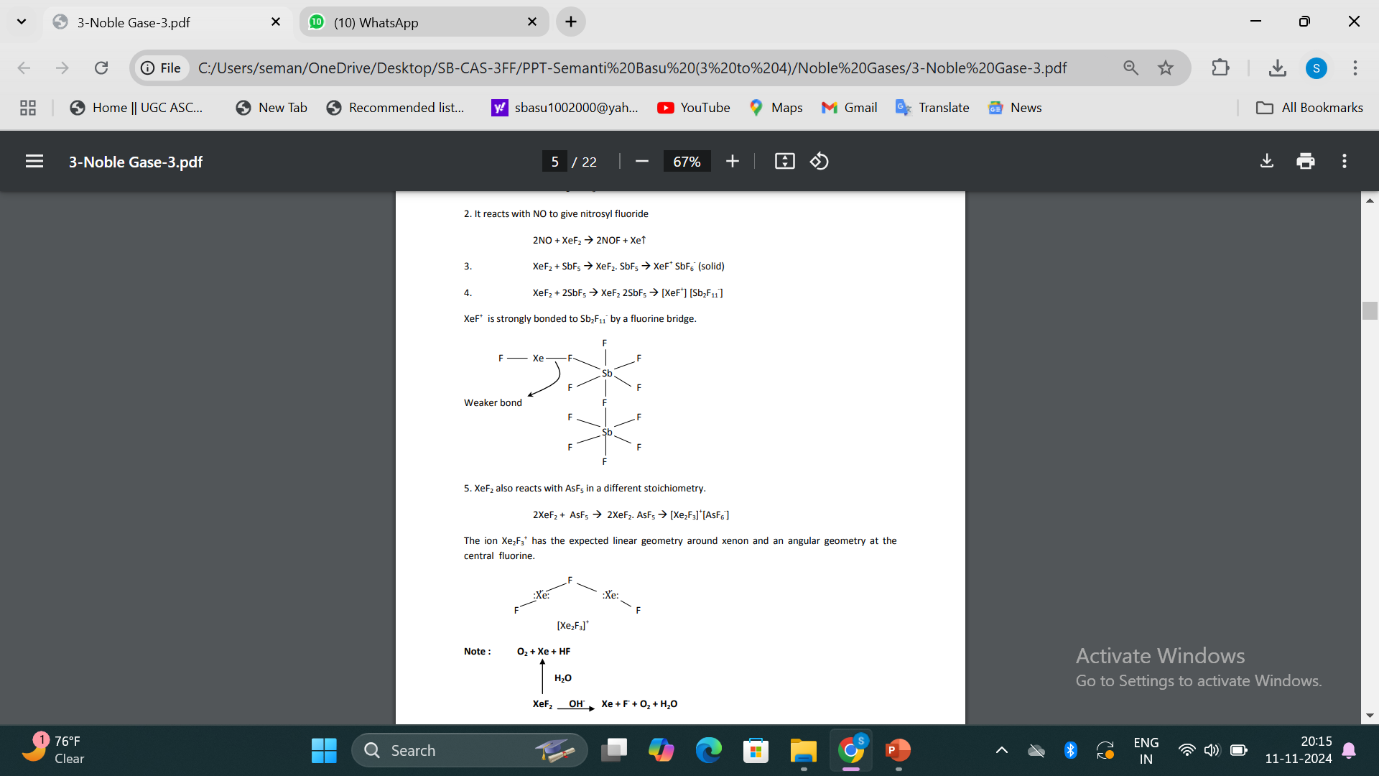
Properties of XeF₂

Slide 19
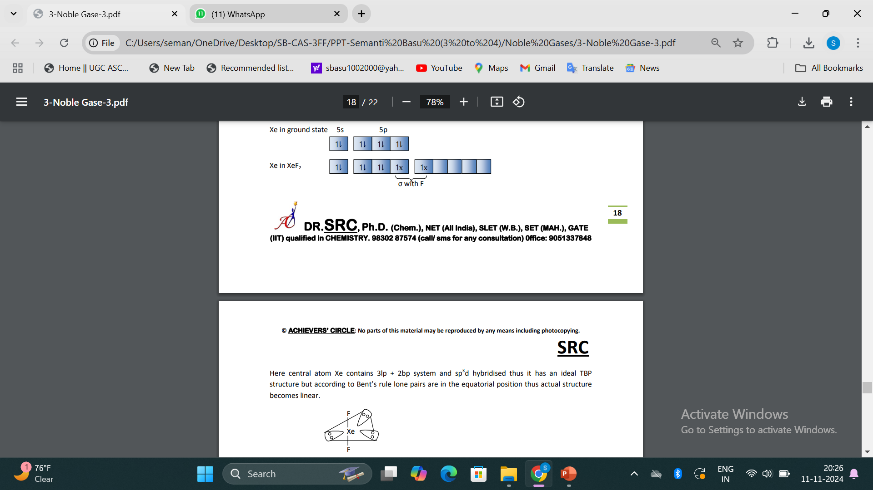
Structure & Bonding (VSEPR theory) of XeF₂
Here central atom Xe contains 3 lp + 2 bp system and sp³d hybridised thus it has an ideal TBP structure but according to Bent's rule lone pairs are in the equatorial position thus actual structure becomes linear.

Slide 20
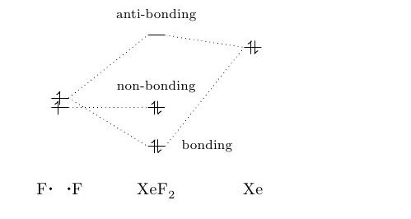
Nature of Bonding: MO treatment for XeF₂

Slide 21
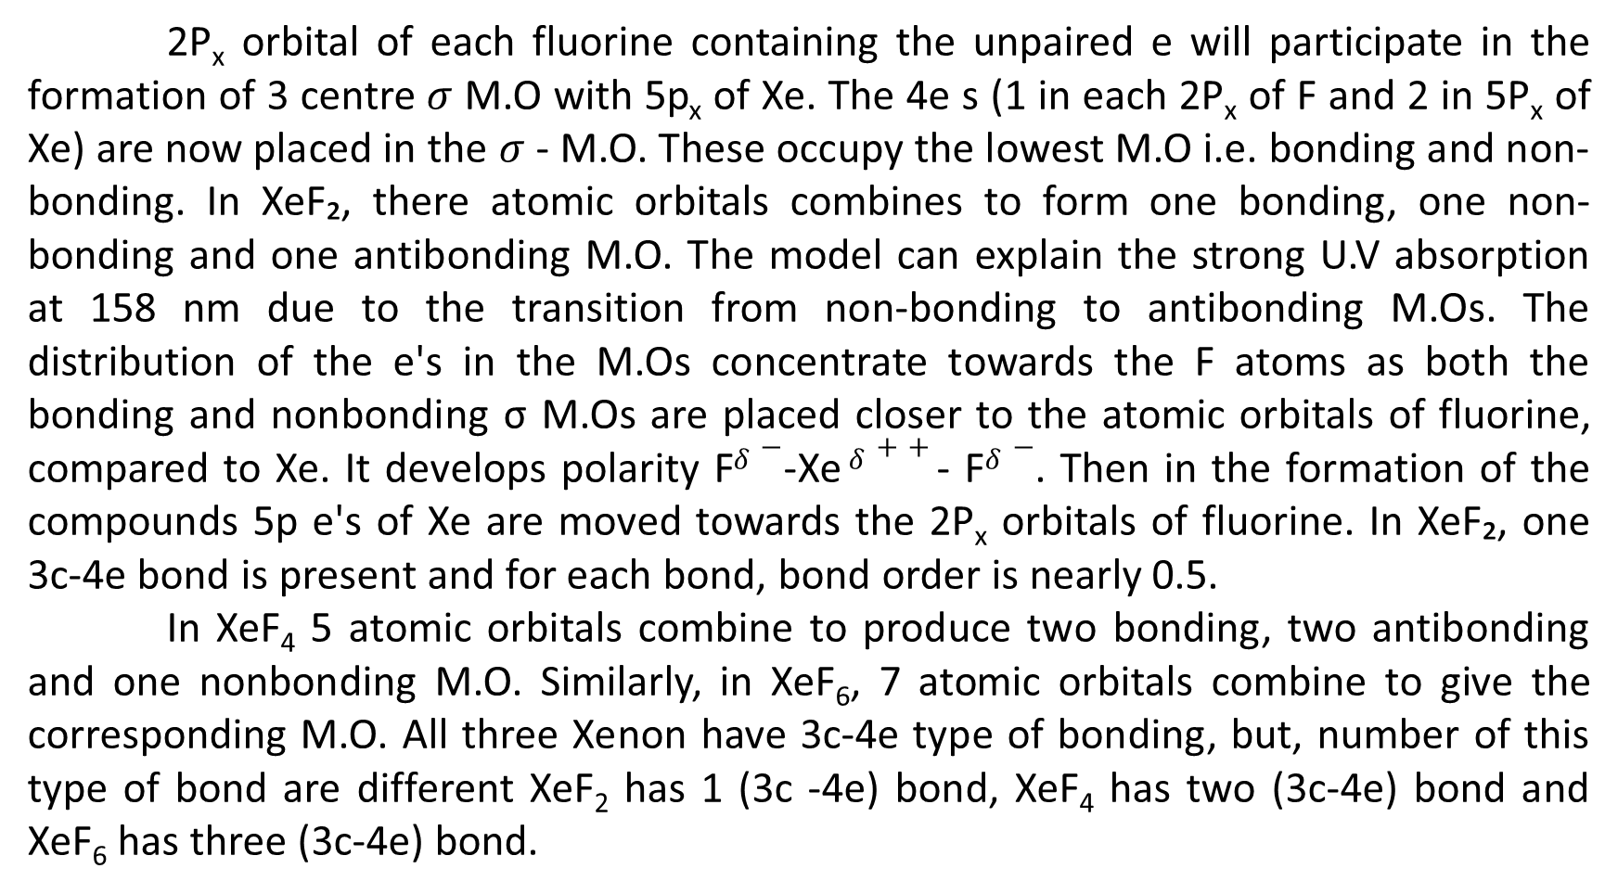
Nature of Bonding: MO treatment for XeF₂
2P_{x} orbital of each fluorine containing the unpaired e will participate in the formation of 3 centre $σ$ M.O with 5p_{x} of Xe. The 4e s (1 in each 2P_{x} of F and 2 in 5P_{x} of Xe) are now placed in the $σ$- M.O. These occupy the lowest M.O i.e. bonding and non-bonding. In XeF₂, there atomic orbitals combines to form one bonding, one non-bonding and one antibonding M.O. The model can explain the strong U.V absorption at 158 nm due to the transition from non-bonding to antibonding M.Os. The distribution of the e's in the M.Os concentrate towards the F atoms as both the bonding and nonbonding σ M.Os are placed closer to the atomic orbitals of fluorine, compared to Xe. It develops polarity F$δ−$-Xe $δ++$- F$δ−$. Then in the formation of the compounds 5p e's of Xe are moved towards the 2P_{x} orbitals of fluorine. In XeF₂, one 3c-4e bond is present and for each bond, bond order is nearly 0.5.
In XeF₄ 5 atomic orbitals combine to produce two bonding, two antibonding and one nonbonding M.O. Similarly, in XeF₆, 7 atomic orbitals combine to give the corresponding M.O. All three Xenon have 3c-4e type of bonding, but, number of this type of bond are different XeF₂ has 1 (3c -4e) bond, XeF₄ has two (3c-4e) bond and XeF₆ has three (3c-4e) bond.

Slide 22
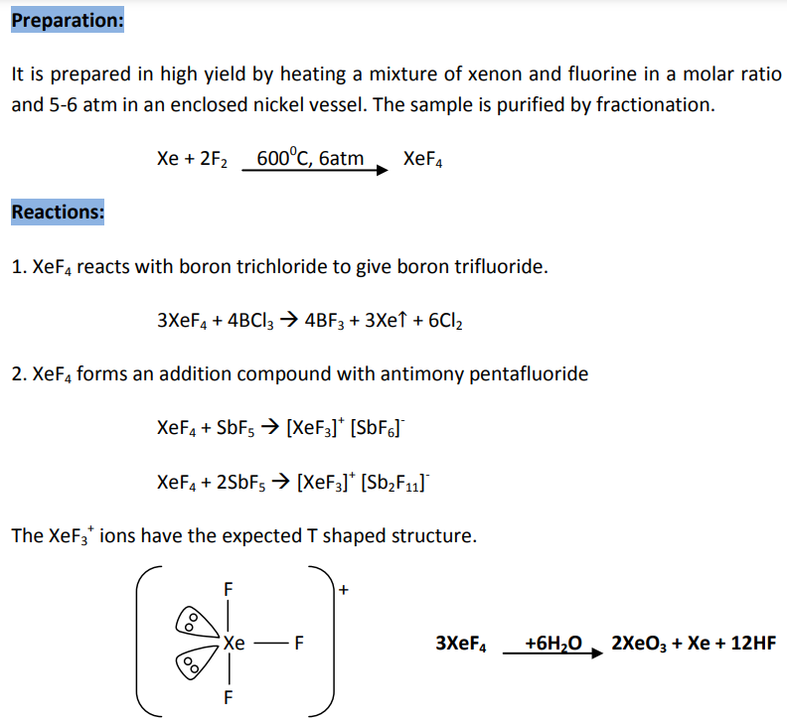
XeF₄

Slide 23
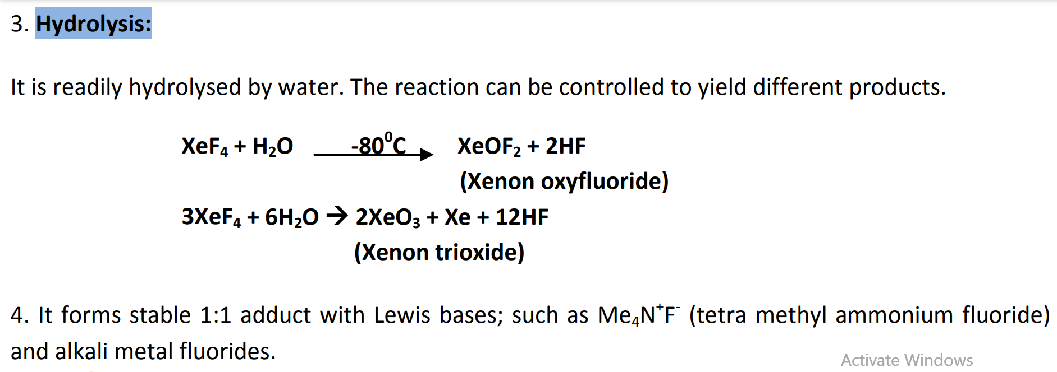
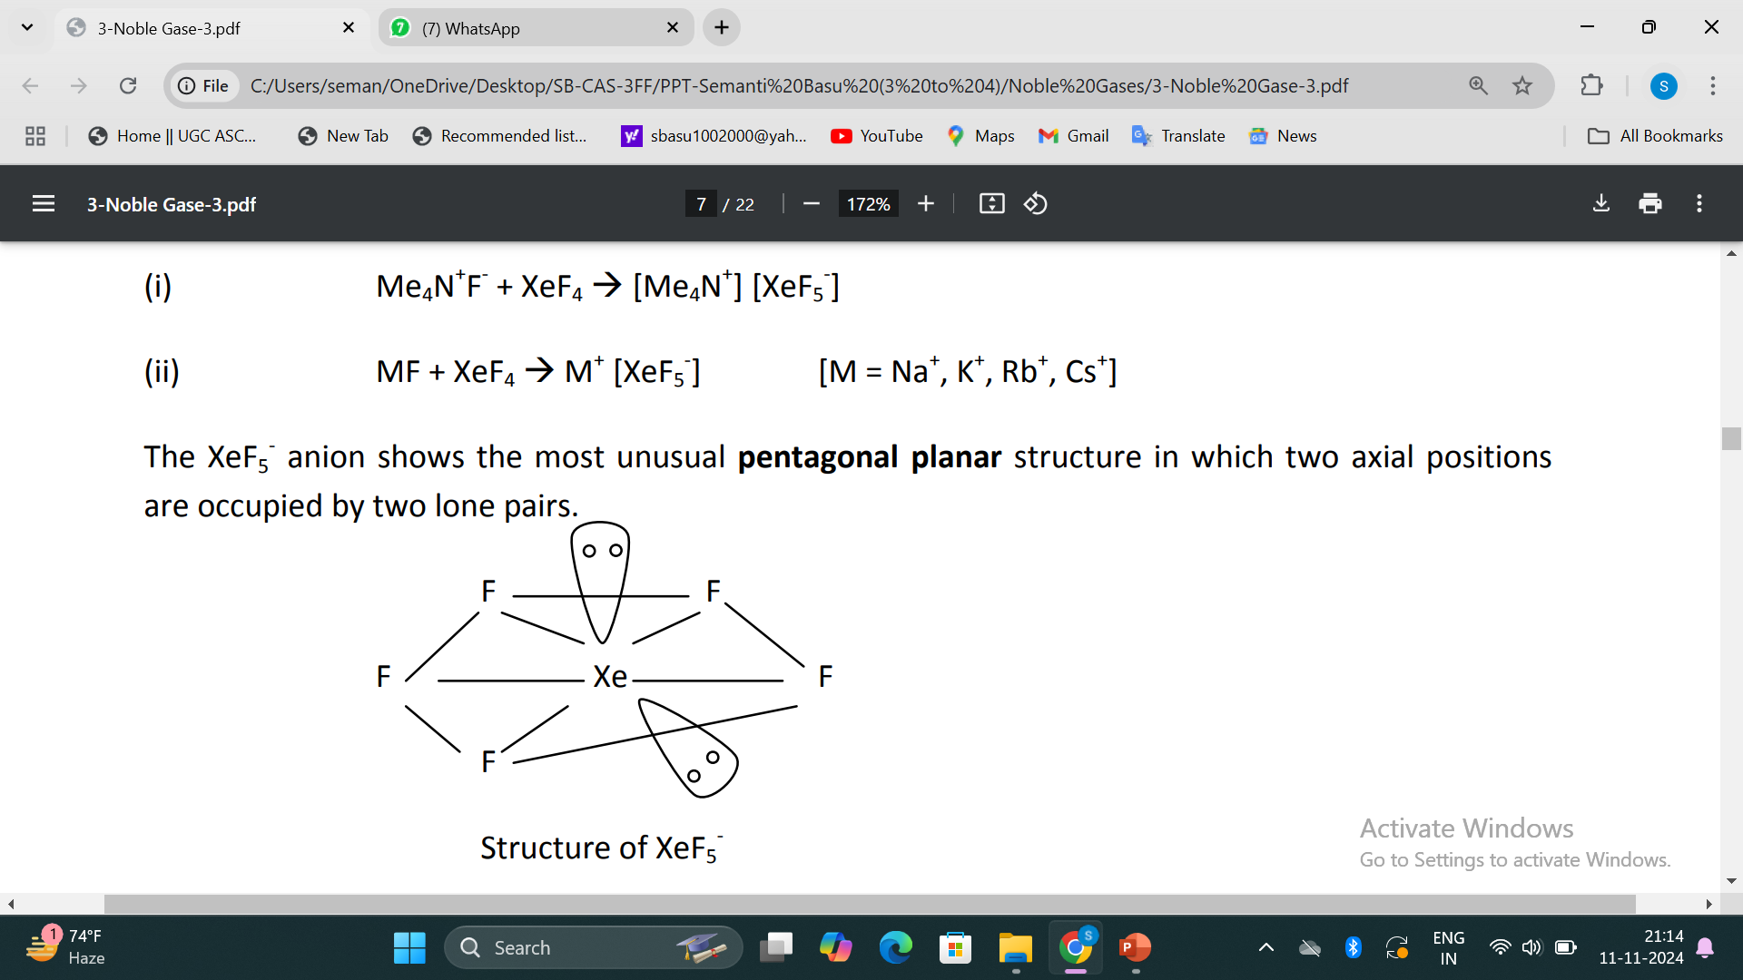
Reaction of XeF₄

Slide 24
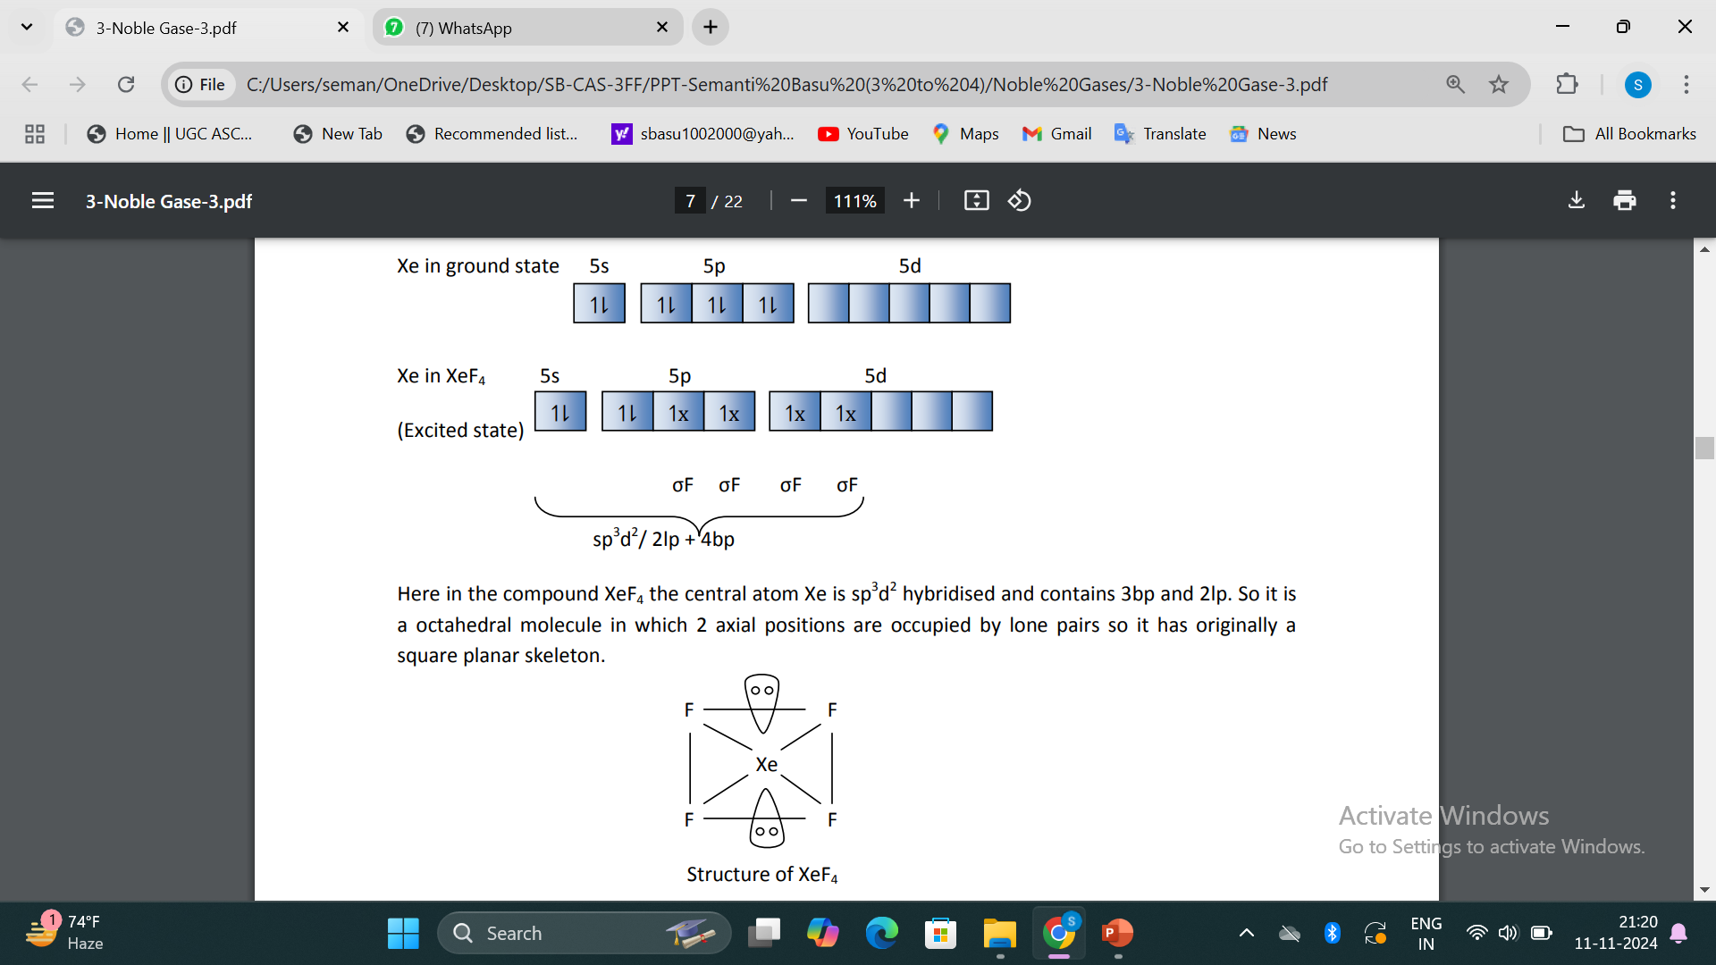
Structure & Bonding (VSEPR theory) of XeF₄

Slide 25
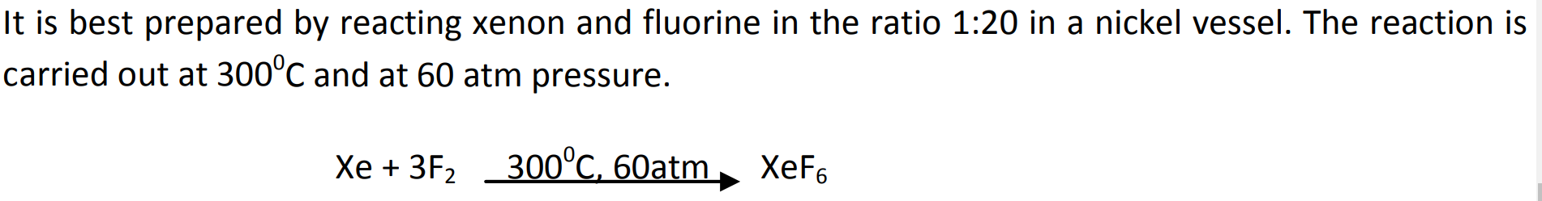
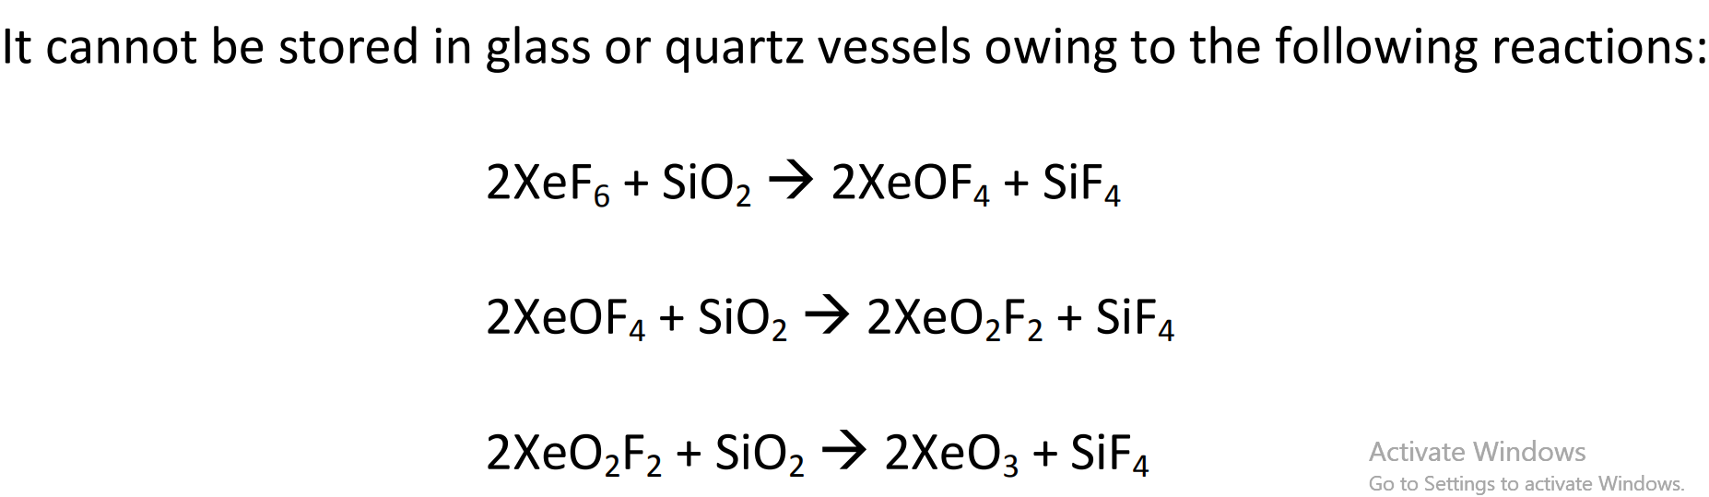
XeF₆
Preparation:
Reactions:
1. Reaction with glass or quartz vessels

Slide 26
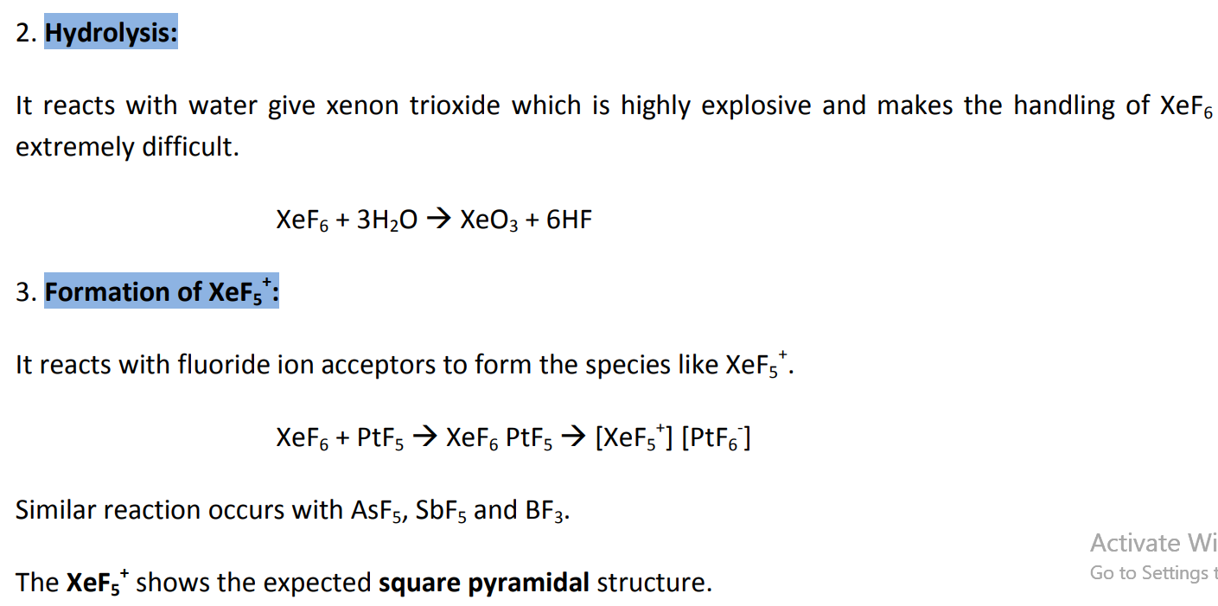
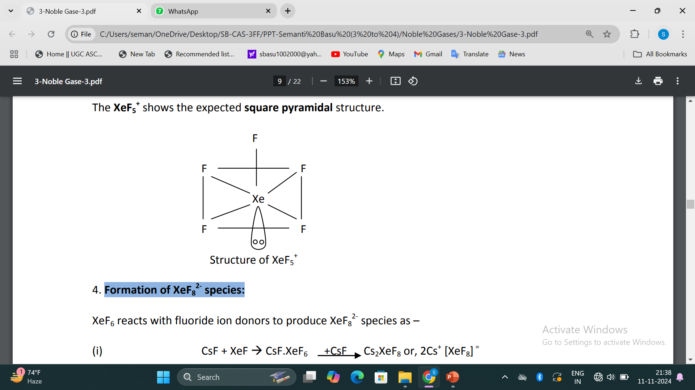
Reaction of XeF₆

Slide 27
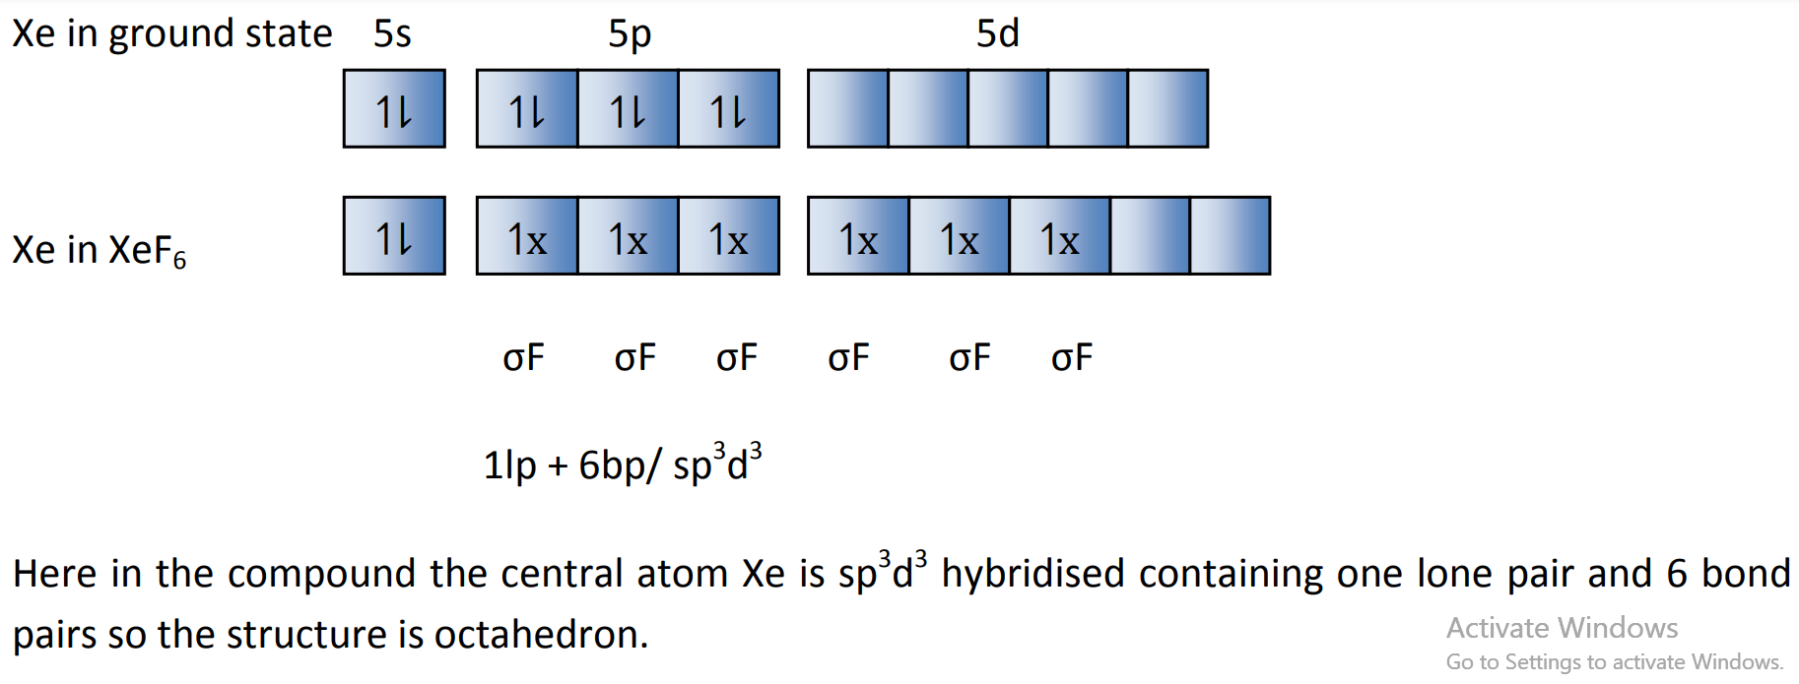
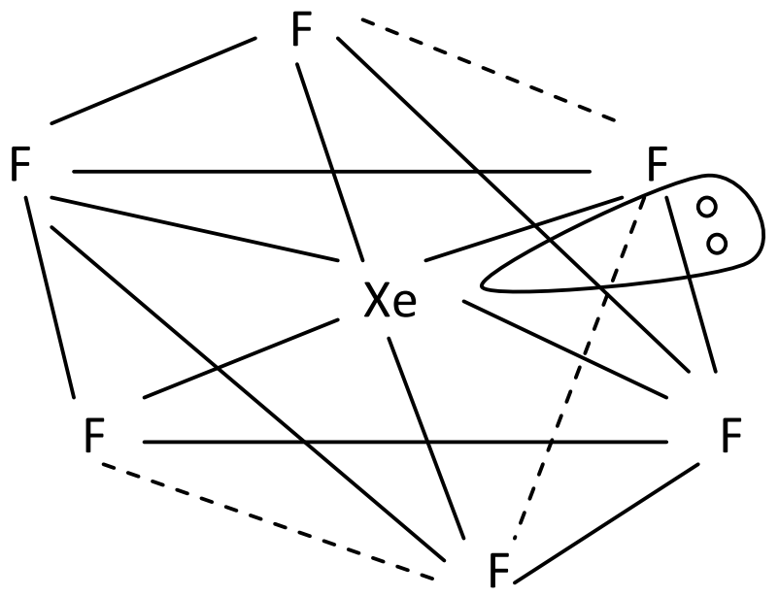
Structure & Bonding (VSEPR theory) of XeF₆

Slide 28
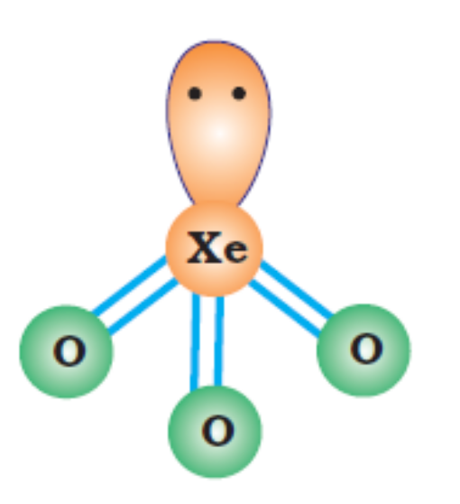
Xenon oxygen Compounds and their Molecular Structure
XeO_{3,} XeO_{4,} XeOF_{2,} XeOF_{4,} XeO₂F_{2,} XeO₃F_{2,} XeO₂F₄
Hydrolysis of XeF₄ and XeF₆ with water gives XeO₃
6XeF₄ + 12 H₂O → 4Xe + 2XeO₃ + 24 HF + 3O₂
XeF₆ + 3 H₂O → XeO₃ + 6 HF
XeO₃ is a colourless explosive solid
And has a pyramidal molecular structure
.
sp³
Hybridization
Notes:
XeOF₄ and XeO₂F₂

Slide 29
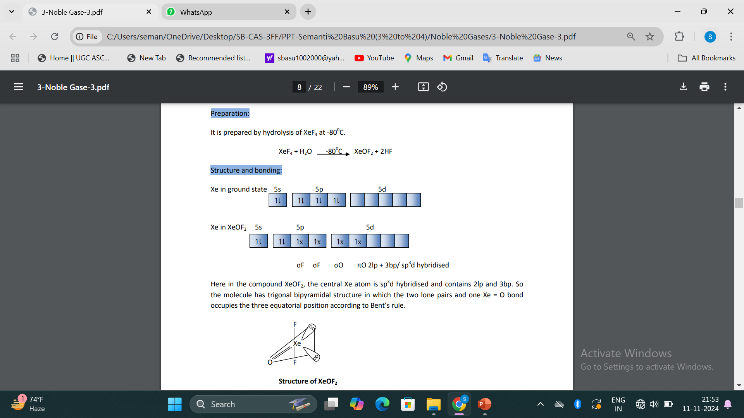
XeOF₂

Slide 30
Xenon oxygen Compounds and their Molecular Structure
XeOF₄ and XeO₂F₂
Partial hydrolysis of XeF₆ gives oxyfluorides, XeOF₄ and XeO₂F₂.
XeF₆ + H₂O → XeOF₄ + 2 HF
Xenon oxytetrafluoride
XeF₆ + 2 H₂O → XeO₂F₂ + 4HF
Xenon dioxydifluoride
XeOF₄ is a colourless volatile liquid and has a square pyramidal molecular
structure

Slide 31
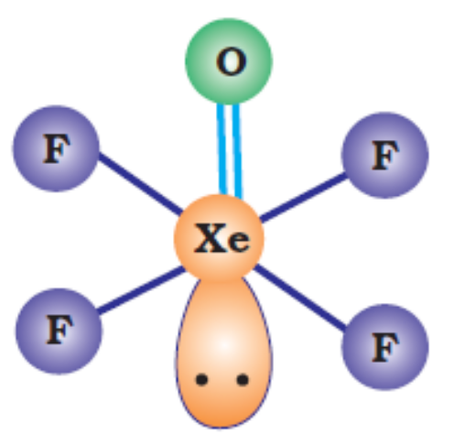

Structures of several known xenon compounds
↑↓
Xe
F
F
O
O
XeO₂F₂
sp³d Hybridization
Distorted tetrahedral
XeOF₄
sp³d² Hybridization
Square pyramidal

Slide 32
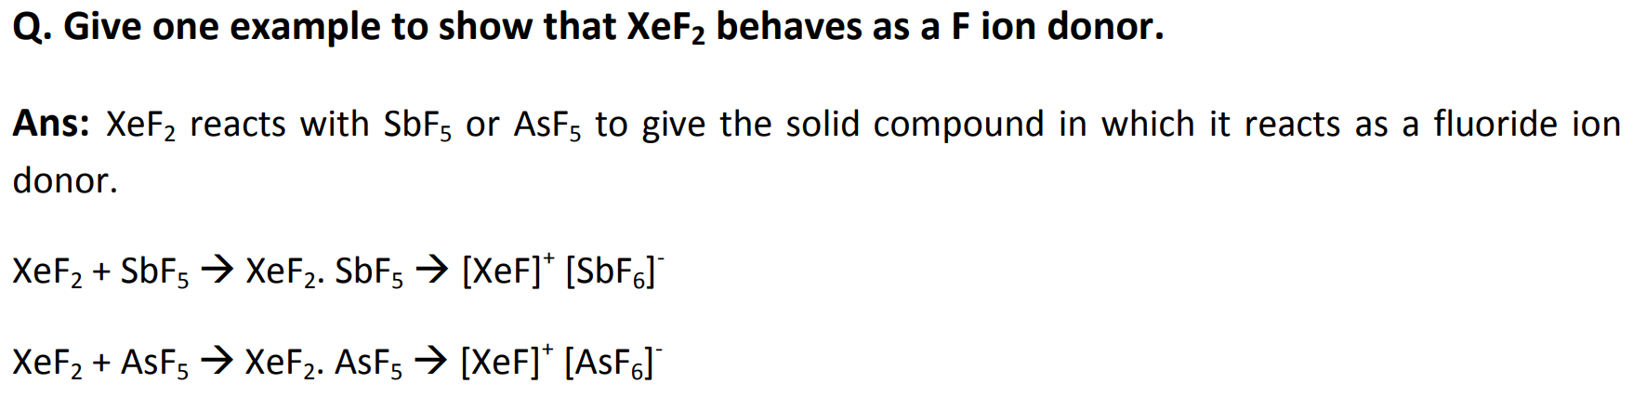
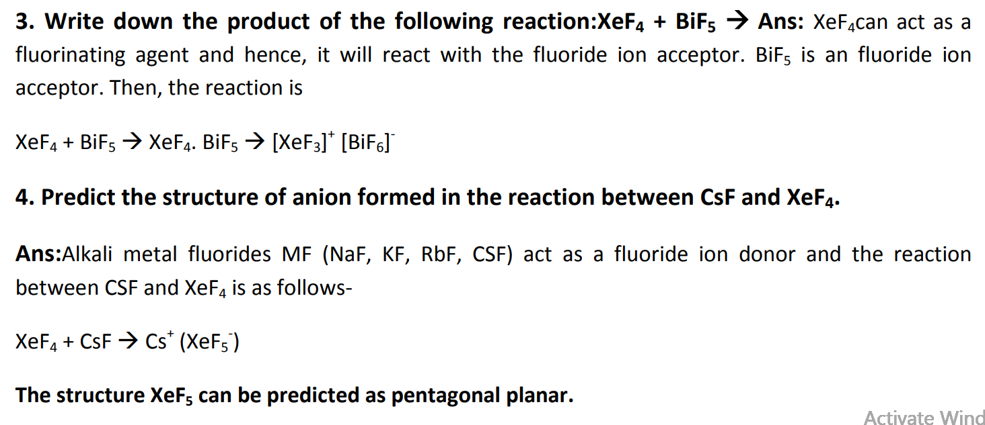

Slide 33
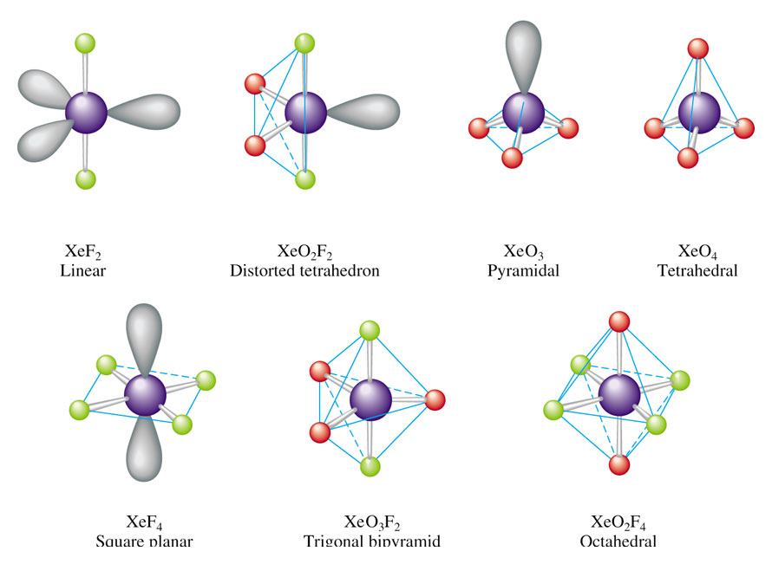
Structures of several known xenon compounds

Slide 34
Thank you

