Slide 1
Organometallic Chemistry- III
Dr. Semanti Basu
Assistant Professor
Department of Chemistry
Bejoy Narayan Mahavidyalaya
Itachuna, Hooghly, W. B., India

Slide 2
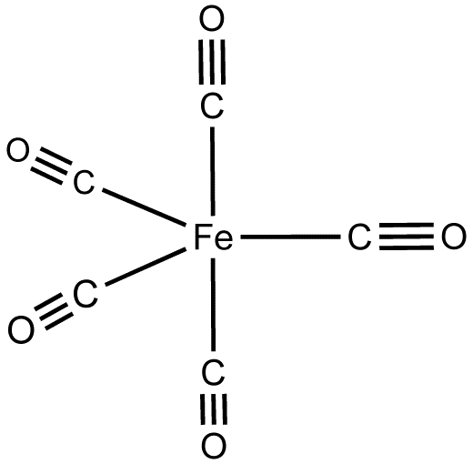
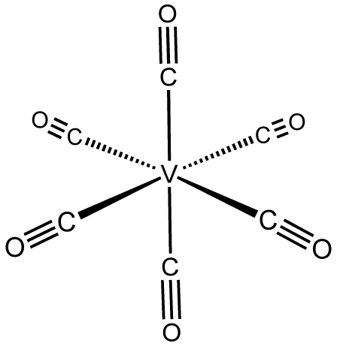
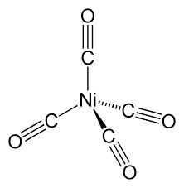
Structures of mononuclear carbonyls
[M(CO)₄]
M is sp³
Tetrahedral
[M(CO)₆], M=Fe, Ru
M is dsp³
TBP
[M(CO)₆], M= V, Cr, W,
Mo, M is d²sp³
Octahedral

Slide 3
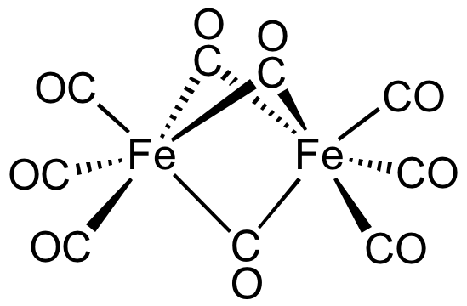

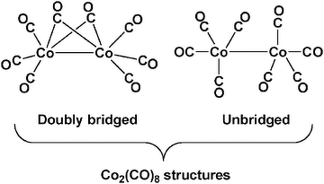
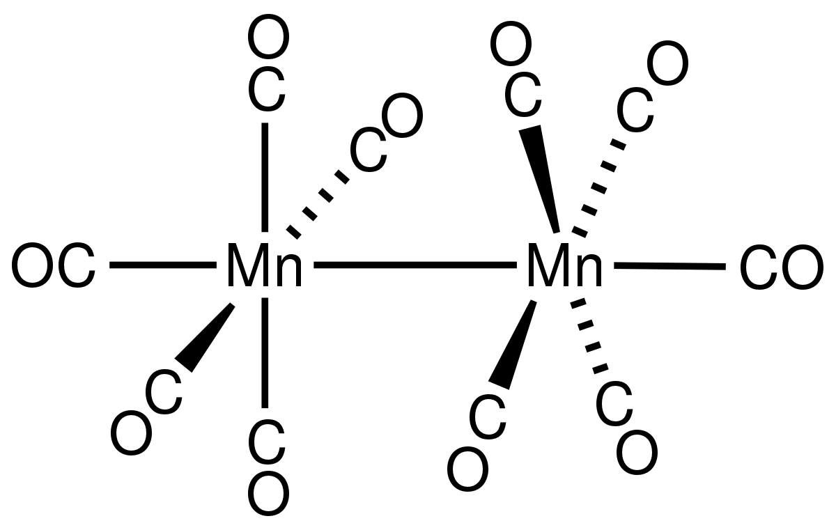
Structures of binuclear carbonyls

Slide 4
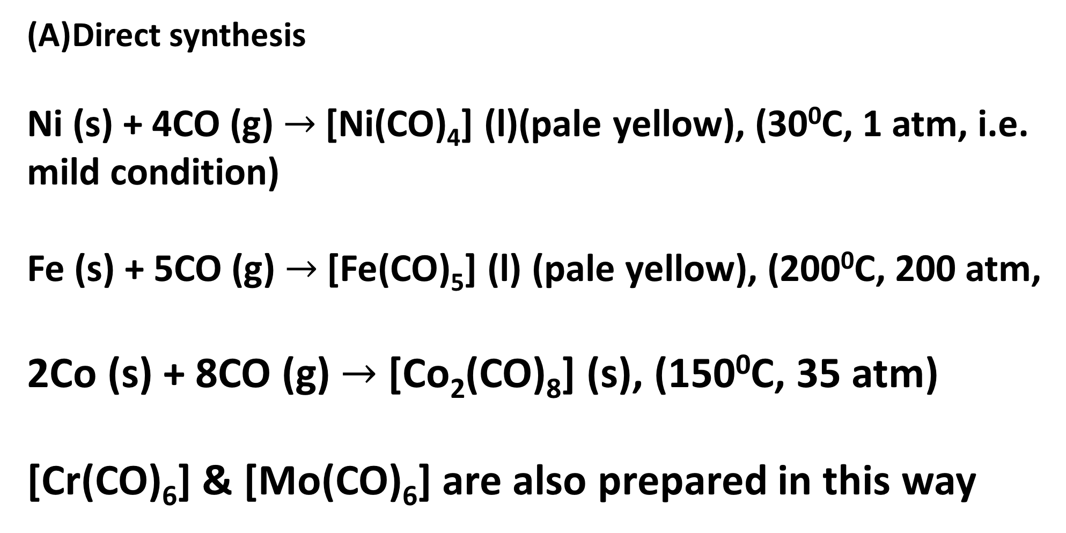
General methods of preparation of mono and binuclear carbonyls of 3d series
Direct synthesis
Ni (s) + 4CO (g)$→$[Ni(CO)₄] (l)(pale yellow), (30⁰C, 1atm, i.e. mild condition)
Fe (s) + 5CO (g)$→$[Fe(CO)₅] (l) (pale yellow),(200⁰C, 200 atm,
2Co (s) + 8CO (g)$→$ [Co₂(CO)₈] (s), (150⁰C, 35 atm)
[Cr(CO)₆] & [Mo(CO)₆] are also prepared in this way

Slide 5
Synthesis of Metal Carbonyls
(B) Reductive carbonylation:
Reduction of metal compounds (generally halides) in presence of CO (generally under at high pressur, 200-300 atm) produces the metal carbonyls.
In some cases, CO may itself act as a reducing agent. This advantage (i.e. no requirement of external reducing agent) is available generally for the metal oxides used as the starting material.
Generally, the temp. & pressure required for the synthesis of carbonyls through the reductive carbonylation are less than those required for the direct combination of CO.

Slide 6
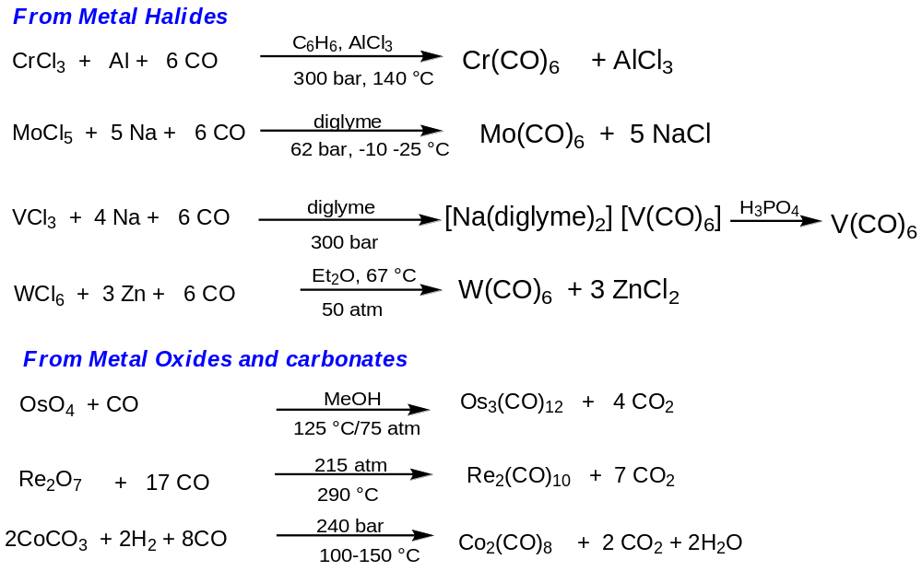
Synthesis of Metal Carbonyls
(B) Reductive carbonylation

Slide 7
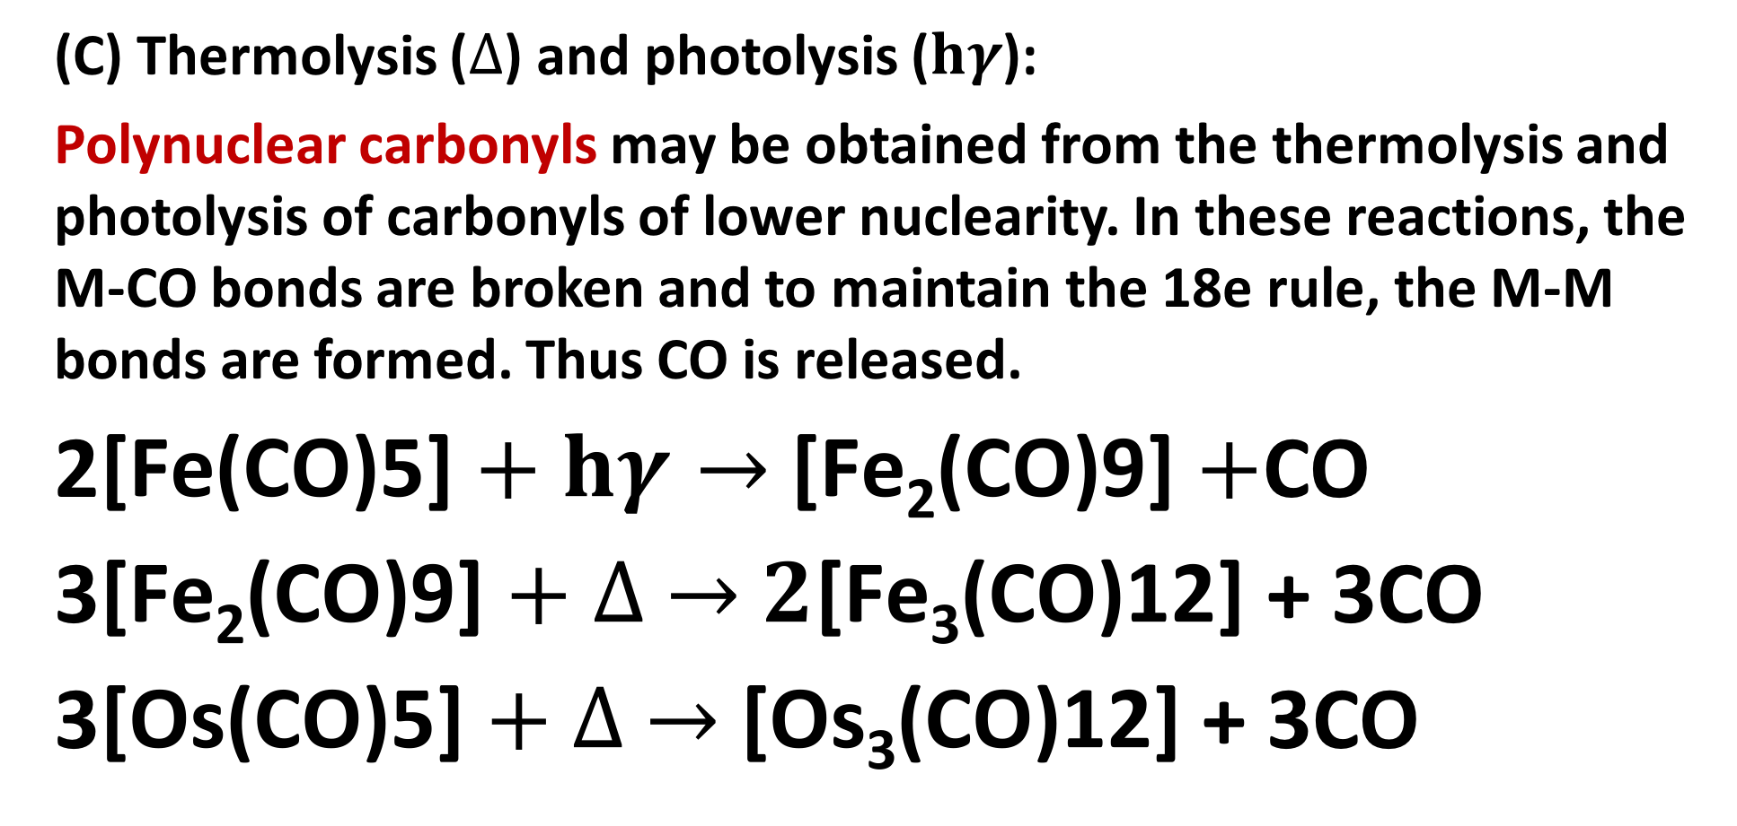
General methods of preparation of mono and binuclear carbonyls of 3d series
(C) Thermolysis ($∆$) and photolysis ($hγ$):
Polynuclear carbonyls may be obtained from the thermolysis and photolysis of carbonyls of lower nuclearity. In these reactions, the M-CO bonds are broken and to maintain the 18e rule, the M-M bonds are formed. Thus CO is released.
2$\text{[}\text{Fe}\text{(}\text{CO}\text{)5]}+hγ→\text{[}\text{Fe}\text{2}\text{(}\text{CO}\text{)9]}+$CO
3$\text{[}\text{Fe}\text{2}\text{(}\text{CO}\text{)9]}+∆ →2\text{[}\text{Fe}\text{3}\text{(}\text{CO}\text{)12]}$ + 3CO
3$\text{[}\text{Os}\text{(}\text{CO}\text{)5]}+∆ →\text{[}\text{Os}\text{3}\text{(}\text{CO}\text{)12]}$ + 3CO

Slide 8
Structures of mononuclear carbonyls
[M(CO)₄]
M is sp³
Tetrahedral
[M(CO)₆], M=Fe, Ru
M is dsp³
TBP
[M(CO)₆], M= V, Cr, W,
Mo, M is d²sp³
Octahedral
In all cases, the inner orbital complexes (since CO is strong field ligand) (i.e. low spin complexes in terms of CFT) are formed by using the (n-1) d orbitals in hybridization. To provide the necessary (n-1) d orbitals (i.e. dx²-y² and dz2 for Oh & dz2 for TBP), the electrons are properly arranged within the inner d-orbitals. It is illustrated in next page

Slide 9
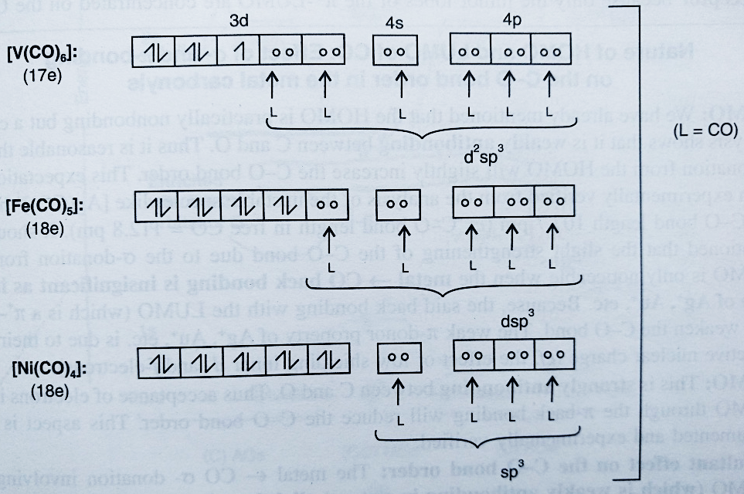
Bonding of mononuclear carbonyls-VBT treatment

Slide 10
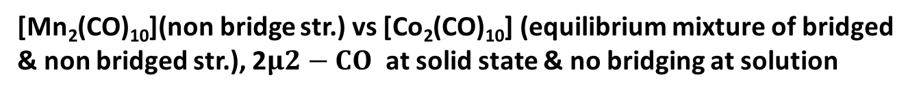
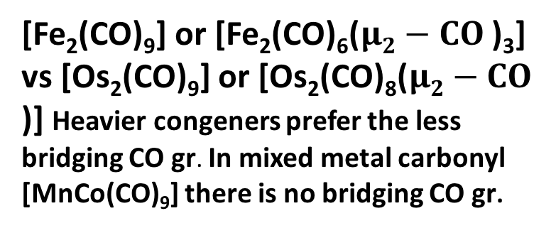
Structures of binuclear carbonyls
[Fe₂(CO)₉] or [Fe₂(CO)₆($μ2−CO$)₃] vs [Os₂(CO)₉] or [Os₂(CO)₈($μ2−CO$)] Heavier congeners prefer the less bridging CO gr. In mixed metal carbonyl [MnCo(CO)₉] there is no bridging CO gr.
[Mn₂(CO)₁₀](non bridge str.) vs [Co₂(CO)₁₀] (equilibrium mixture of bridged
& non bridged str.), 2$μ2−CO$ at solid state & no bridging at solution

Slide 11
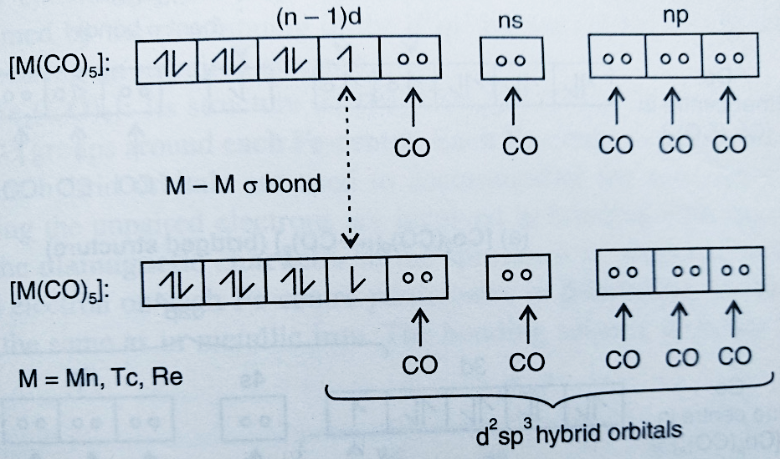
Bonding of mononuclear carbonyls-VBT treatment

Slide 12
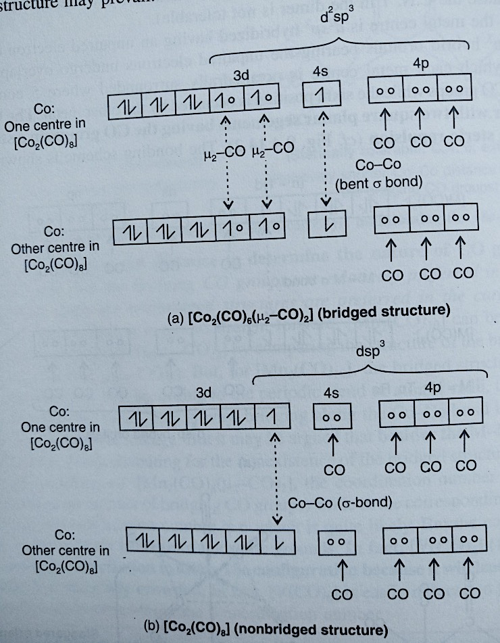
Bonding of mononuclear carbonyls-VBT treatment

Slide 13
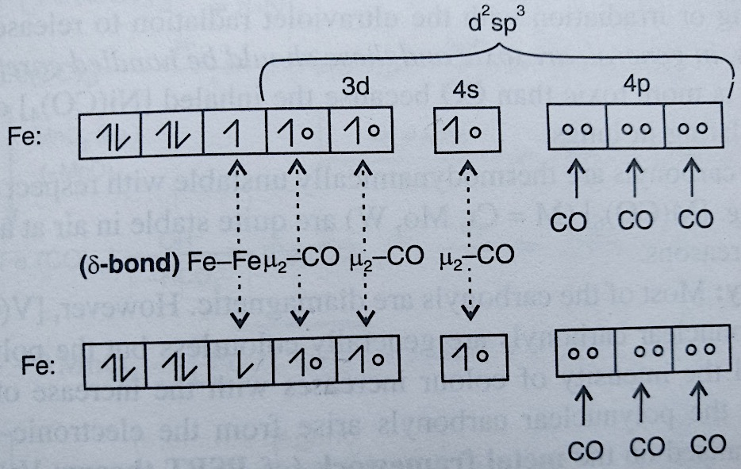
Bonding of mononuclear carbonyls-VBT treatment

Slide 14
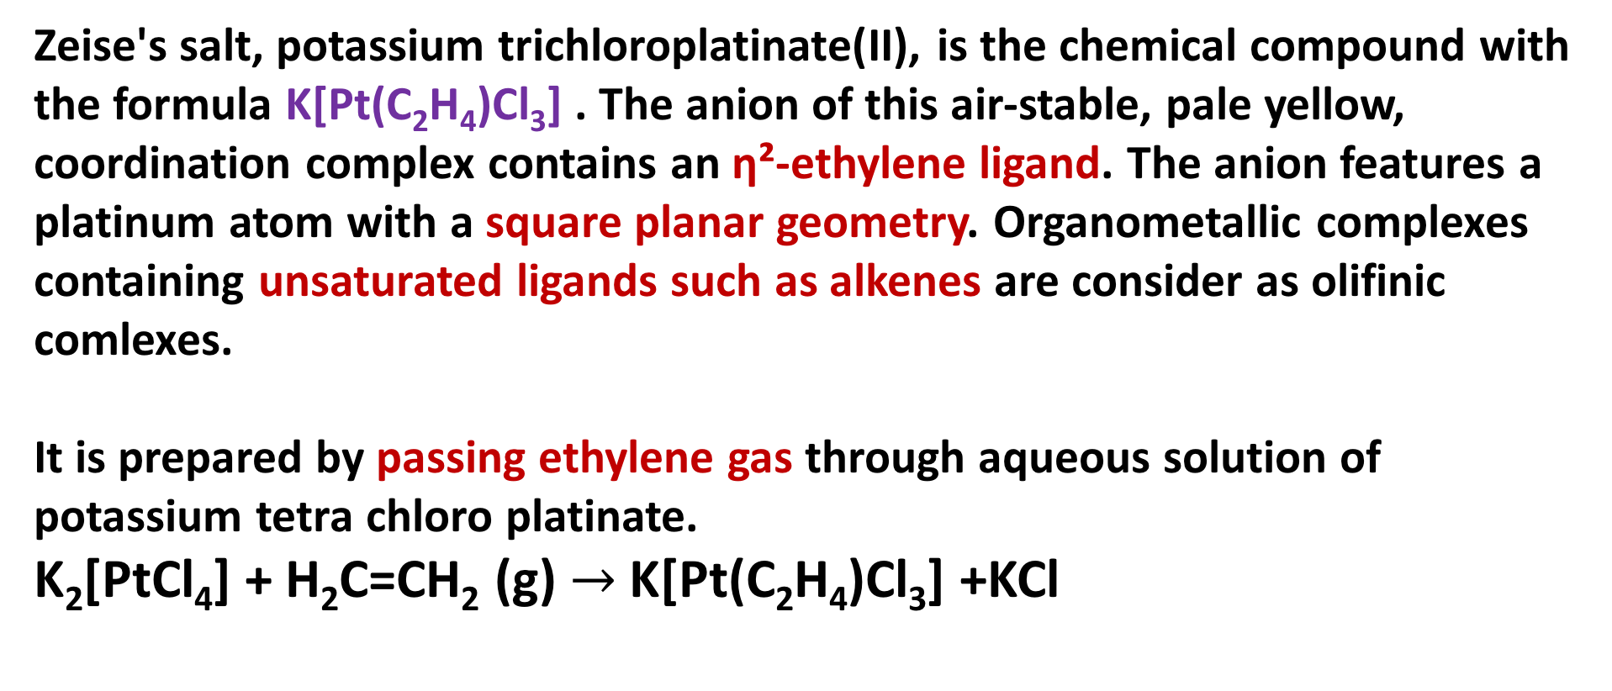
Zeise’s salt (K[Pt(C₂H₄)Cl₃] ): Preparation
Zeise's salt, potassium trichloroplatinate(II), is the chemical compound with the formula K[Pt(C₂H₄)Cl₃] . The anion of this air-stable, pale yellow, coordination complex contains an η²-ethylene ligand. The anion features a platinum atom with a square planar geometry. Organometallic complexes containing unsaturated ligands such as alkenes are consider as olifiniccomlexes.
It is prepared by passing ethylene gas through aqueous solution of potassium tetra chloroplatinate.
K₂[PtCl₄] + H₂C=CH₂ (g) $→$ K[Pt(C₂H₄)Cl₃] +KCl

Slide 15
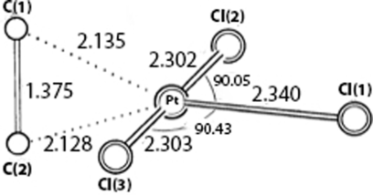
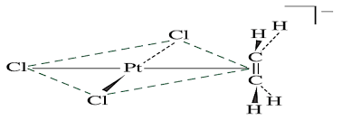
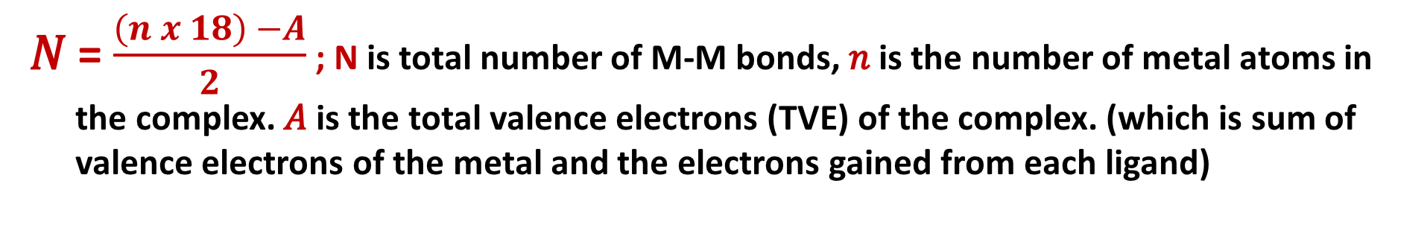
Zeise’s salt: Structure, evidences of synergic effect
[Pt(C₂H₄)Cl₃]⁻ C-C segment perpendicular to the PtCl3 plane
$γ_{C=C }$= 1623 Cm⁻¹ in free C₂H₄ (C=C is 1.33.5 pm)
$γ_{C=C }$= 1526 Cm⁻¹ in Zeise’s salt C₂H₄ (C=C is 1.37 pm)
The longer C-C bond length (1.37 pm) in the complex compared to that in free C₂H₄ (C=C is 1.33.5 pm) indicates the fact that the vacant $π∗$ of C₂H₄ receives the e cloud in the bonding interaction.

Slide 16
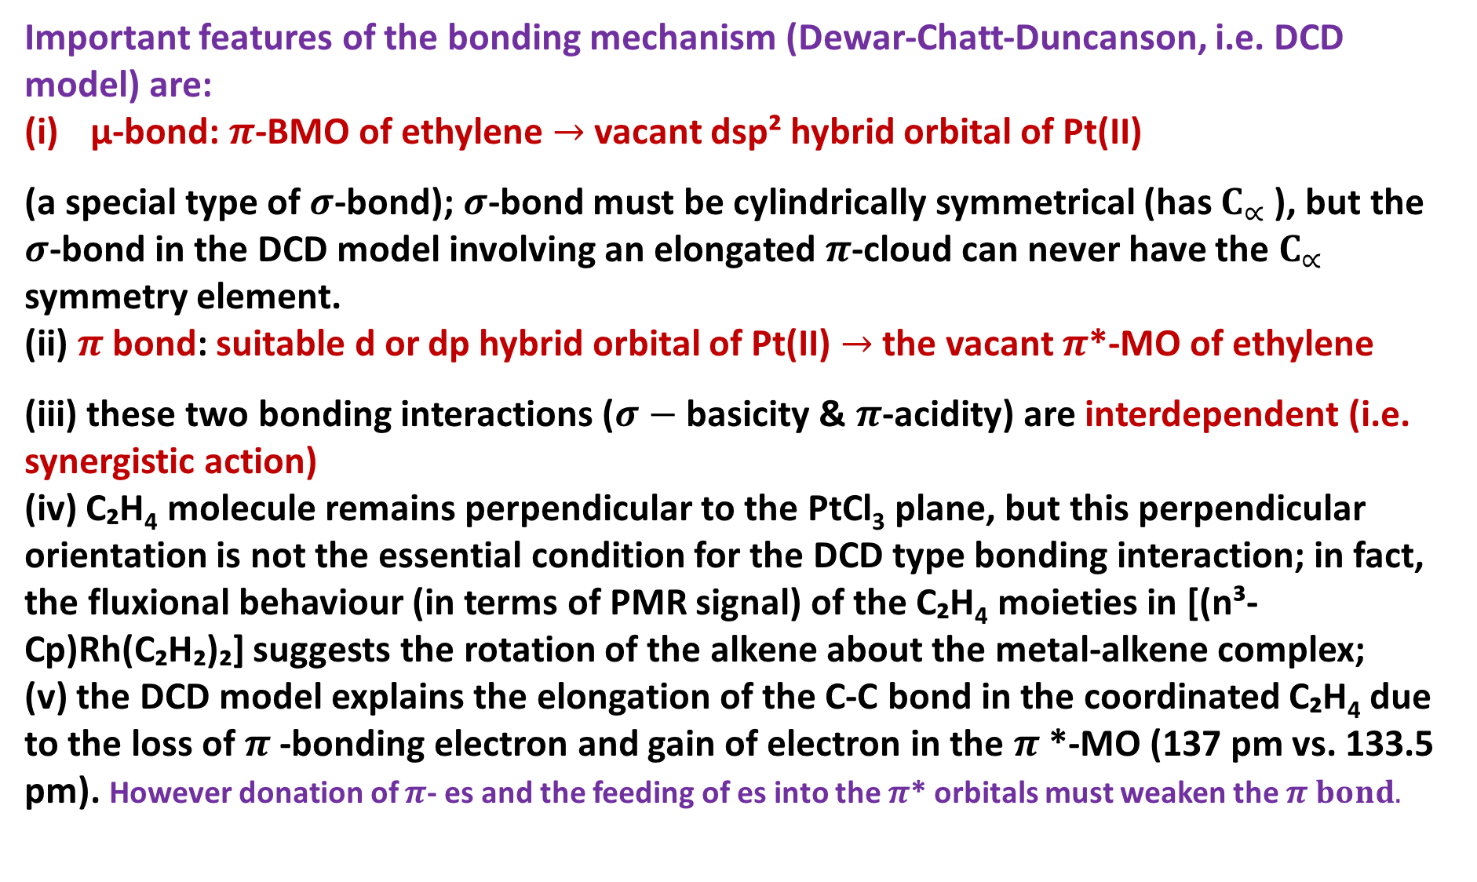
Zeise’s salt: Structure
Important features of the bonding mechanism (Dewar-Chatt-Duncanson, i.e. DCD model) are:
μ-bond:$π$-BMO of ethylene $→$vacant dsp² hybrid orbital of Pt(II)
(a special type of $σ$-bond); $σ$-bond must be cylindrically symmetrical (has $C_{∝ }$), but the $σ$-bond in the DCD model involving an elongated $π$-cloud can never have the $C_{∝ }$ symmetry element.
(ii) $π$bond: suitable d or dp hybrid orbital of Pt(II) $→$ the vacant $π$*-MO of ethylene
(iii) these two bonding interactions ($σ−$ basicity &$π$-acidity) are interdependent (i.e. synergistic action)
(iv) C₂H₄ molecule remains perpendicular to the PtCl₃plane, but this perpendicular orientation is not the essential condition for the DCD type bonding interaction; in fact, the fluxional behaviour (in terms of PMR signal) of the C₂H₄moieties in [(n³-Cp)Rh(C₂H₂)₂] suggests the rotation of the alkene about the metal-alkene complex;
(v) the DCD model explains the elongation of the C-C bond in the coordinated C₂H₄ due to the loss of $π$-bonding electron and gain of electron in the $π$*-MO (137 pm vs. 133.5 pm). However donation of $π$- es and the feeding of es into the $π$* orbitals must weaken the $π bond.$

Slide 17
Zeise’s salt: Evidences of synergic effect
Both Zeise's salt and carbonyl compounds show a synergic effect
The synergic effect is arising due to metal-ligand bonding.
In Zeise's salt, ethylene acts as the donor.
It is a poor donor but due to the back bonding, it becomes better.
In metal carbonyl, the carbonyl group acts as the donor.
It is a poor donor but due to the back bonding, it becomes better.
In Zeise's salt, metal has filled d orbital and ethylene has vacant Π* orbitals, necessary for back bonding.
In Metal carbonyl, metal has filled d orbital and carbonyl has vacant Π* orbitals, necessary for back bonding.
In Zeise's salt C=C bond length increases due to back bonding
In metal carbonyl C=O bond length increases due to back bonding
In Zeise's salt strength of the C=C bond determines the strength of back bonding.
But it weakens the C-C bond
In metal carbonyl strength of the C=O bond determines the strength of back bonding.
But it weakens the C-O bond in carbonyls

Slide 18
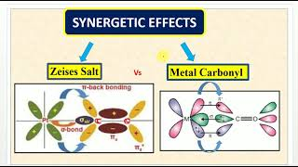
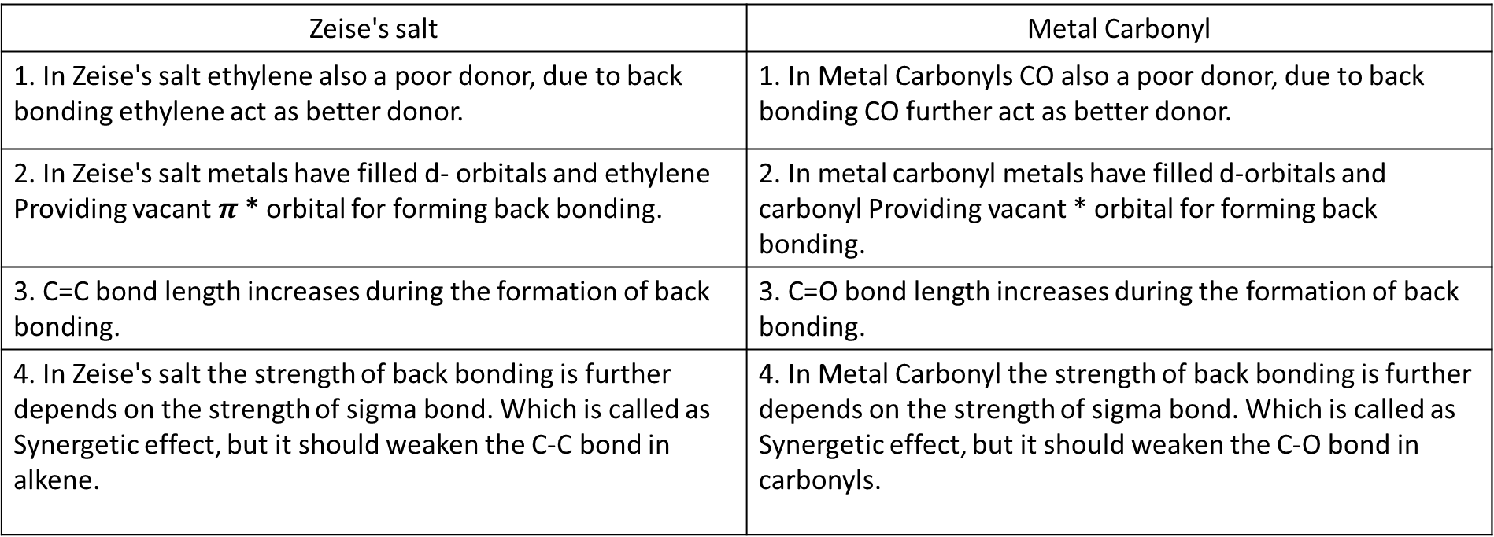
Zeise's salt | Metal Carbonyl
1. In Zeise's salt ethylene also a poor donor, due to back bonding ethylene act as better donor. | 1. In Metal Carbonyls CO also a poor donor, due to back bonding CO further act as better donor.
2. In Zeise's salt metals have filled d- orbitals and ethylene Providing vacant $π$* orbital for forming back bonding. | 2. In metal carbonyl metals have filled d-orbitals and carbonyl Providing vacant * orbital for forming back bonding.
3. C=C bond length increases during the formation of back bonding. | 3. C=O bond length increases during the formation of back bonding.
4. In Zeise's salt the strength of back bonding is further depends on the strength of sigma bond. Which is called as Synergetic effect, but it should weaken the C-C bond in alkene. | 4. In Metal Carbonyl the strength of back bonding is further depends on the strength of sigma bond. Which is called as Synergetic effect, but it should weaken the C-O bond in carbonyls.

Slide 19

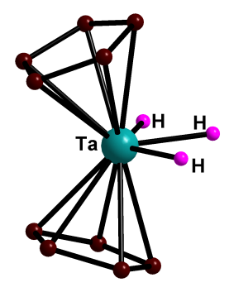
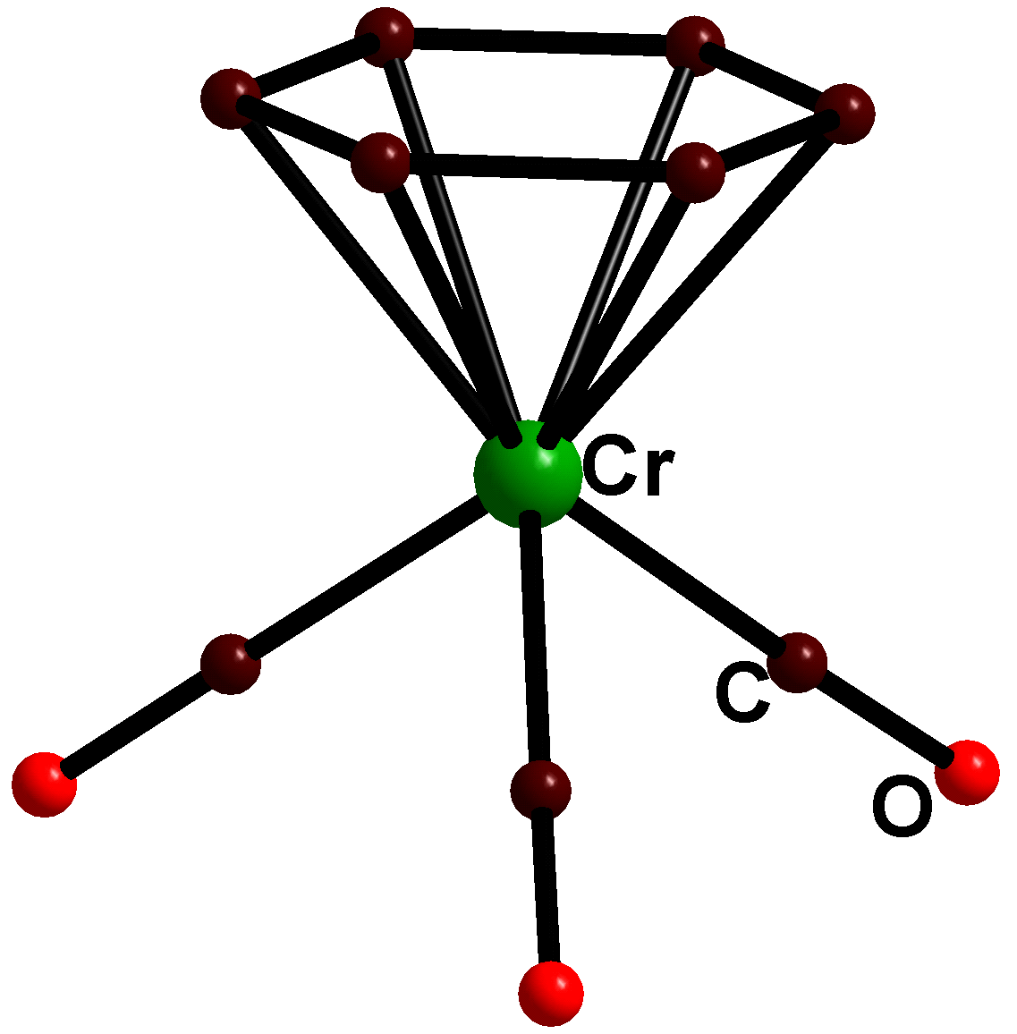
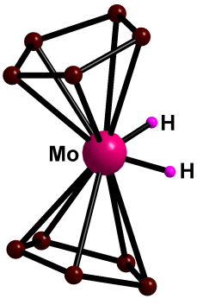
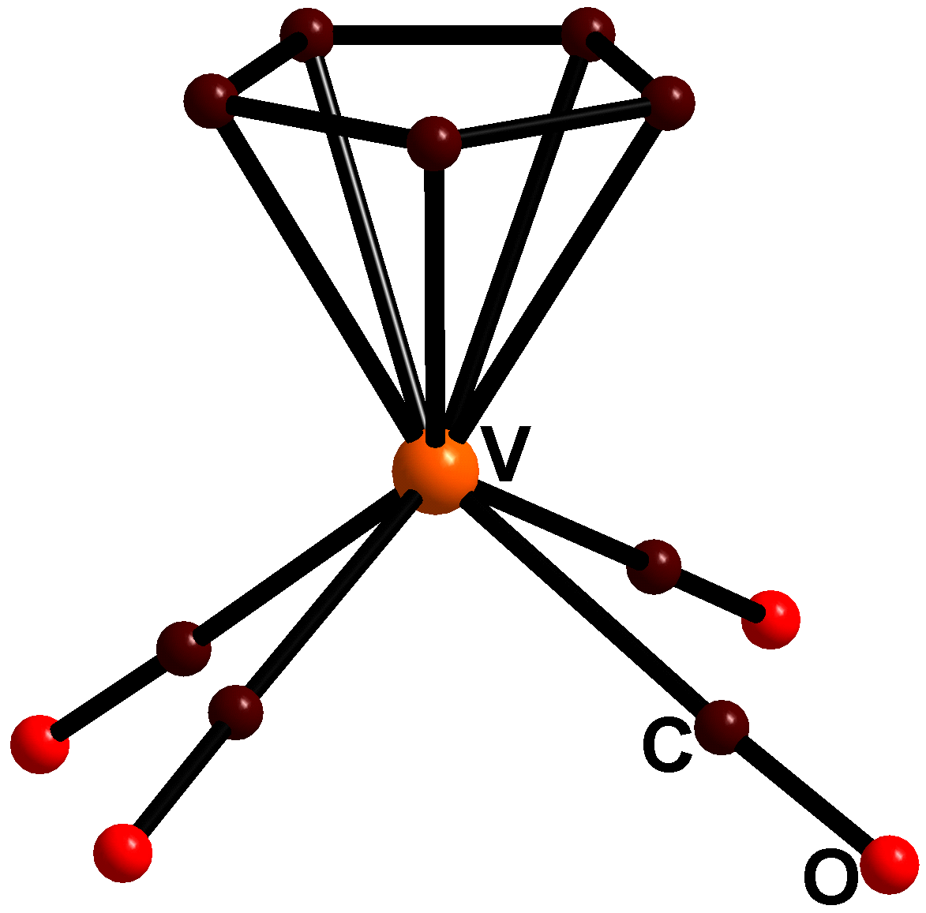
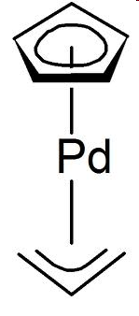
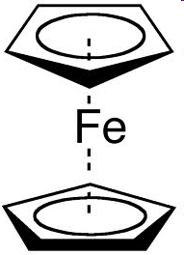

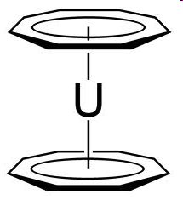
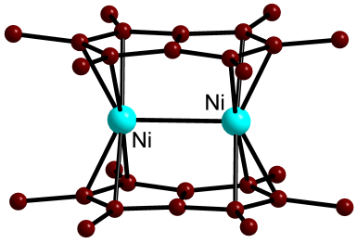
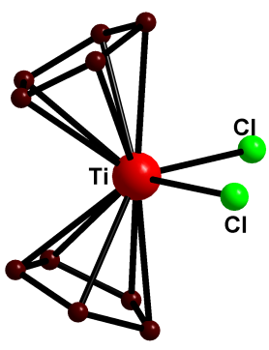
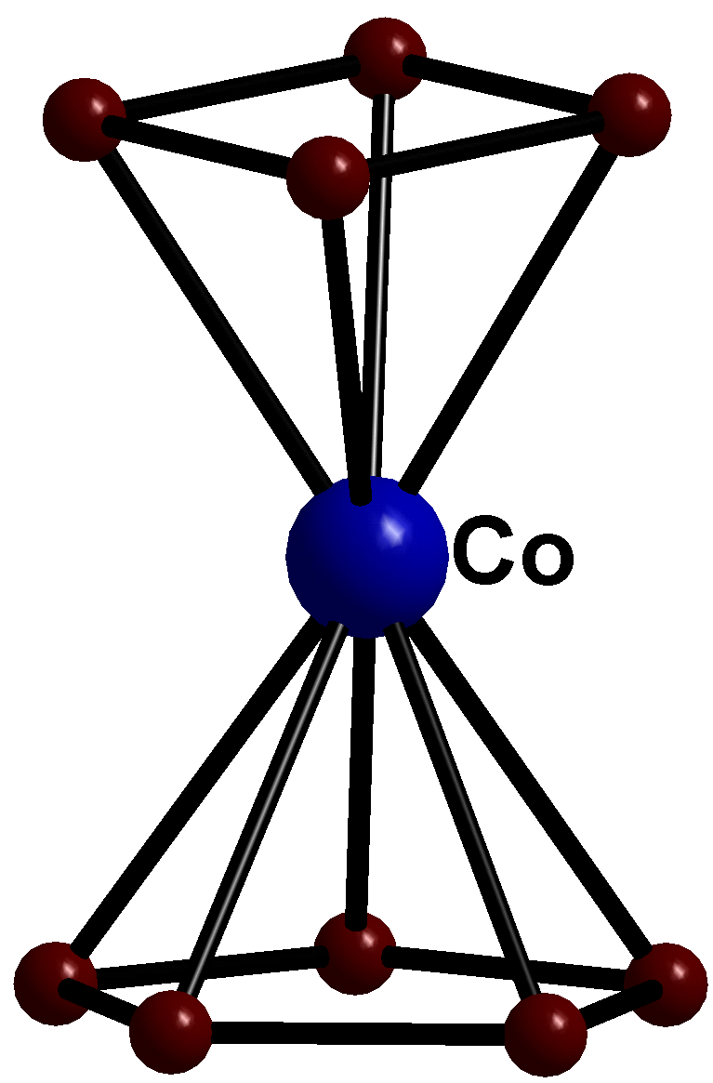
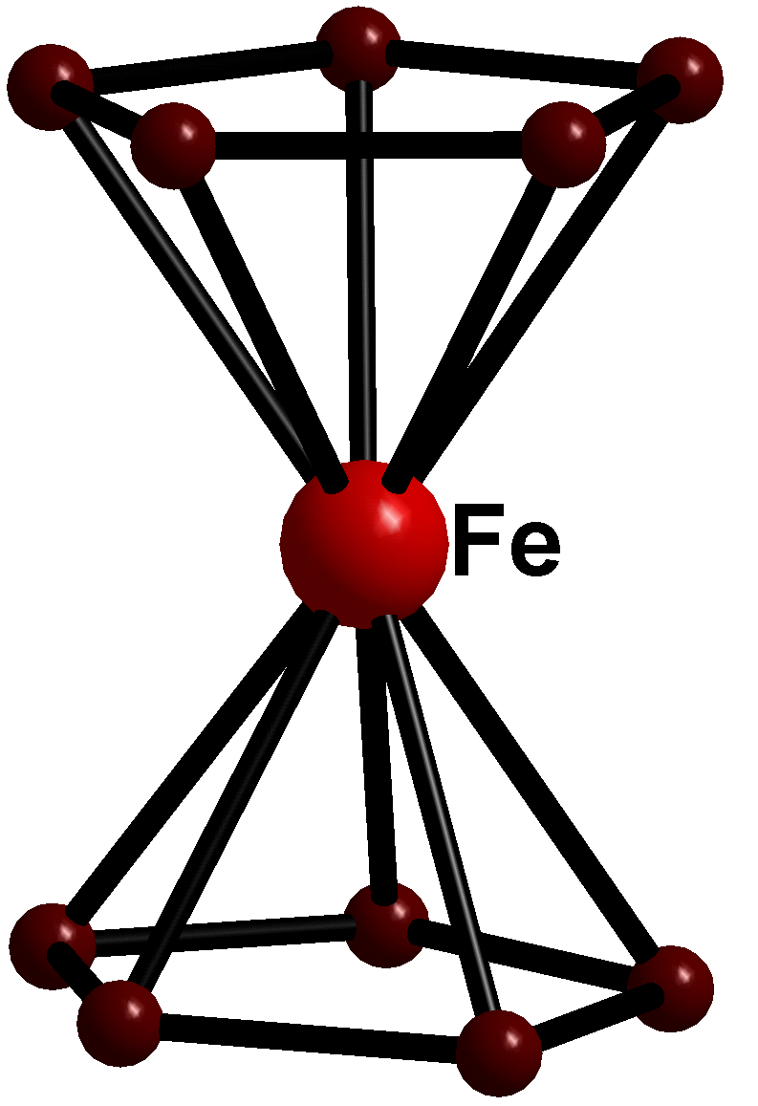
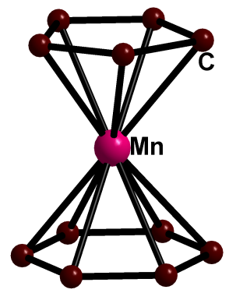
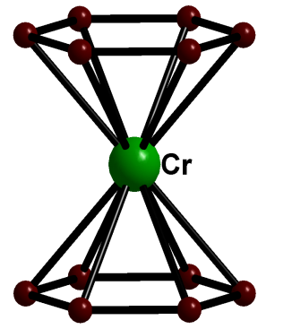
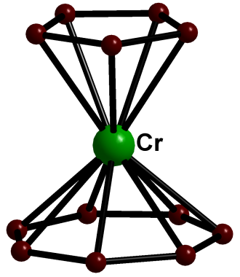

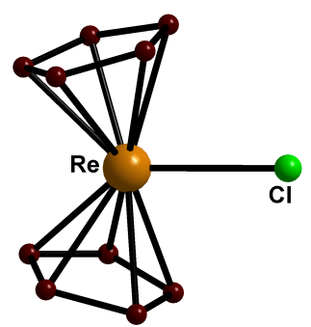
Metal- Sandwich compounds
Bent Sandwich
Hapticity of sandwich compounds varies from 1-8
Half Sandwich

Slide 20
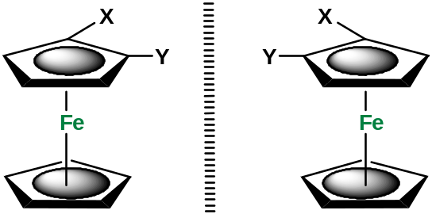
Why metal – sandwich compounds are important?
1. Transition metal/ metal ion embedded inside an organic matrix: Makes a metal ion soluble even in hydrocarbon solvents. E.g. Ferrocene is soluble in hexane while Fe2+ as such is not. Outcome: a hydrocarbon soluble additive/catalyst
2. Coordination to an electropositive metal often changes the reactivity and electronic properties of the π system bound to it (benzene vs ferrocene)
3. A stericially protected metal site where a wide range of catalytic applications are possible on the. e.g alkene polymerization
4. Metal sandwich compounds are excellent substrates to make planar chiral compounds. Applications as chiral catalysts in asymmetric catalysis
Planr chirality:
Non- super-imposable mirror images

Slide 21
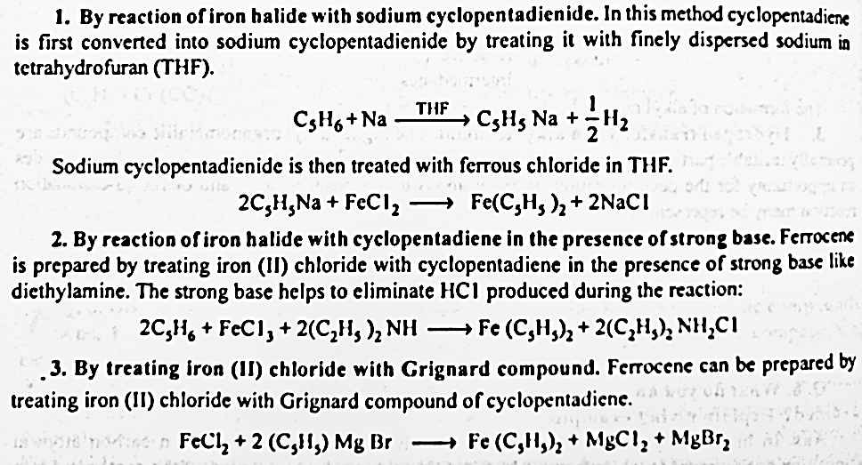
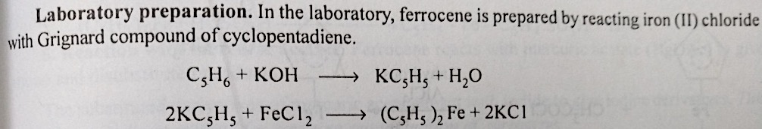
Ferrocene: Preparation

Slide 22
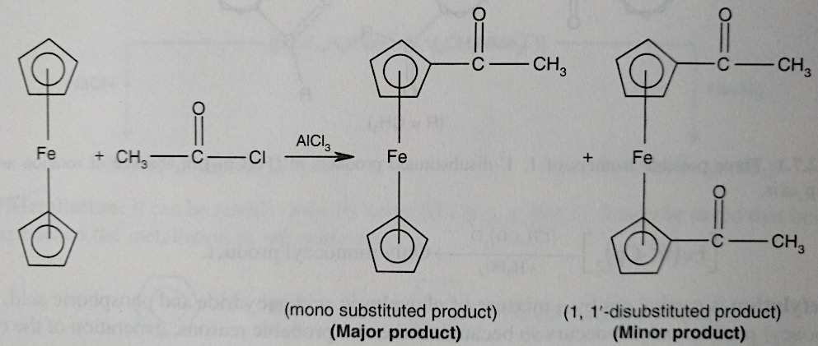
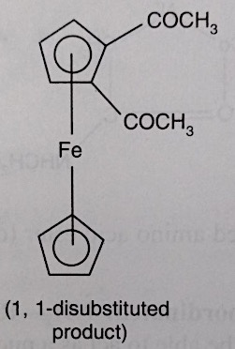
Ferrocene: reactions (Friedel Craft’s Acetylation
Cyclopentyl rings of ferrocene are aromatic in character. So ferrocene undergoes electrophilic substitution reactions. Many of its reactions are faster than similar reactions of benzene. Necessary requirement: The electrophile should not be oxidizing in nature
+
Trace
1,1’ pdt : 1,1 pdt = 60 : 1

Slide 23
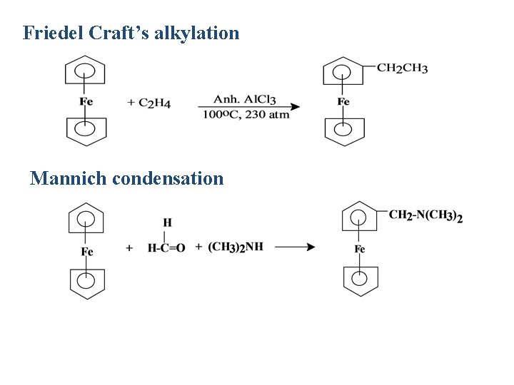
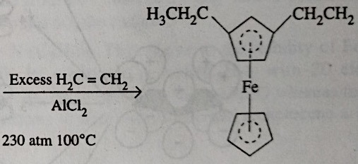
Ferrocene: reactions (Alkylation, Mannich Condensation)

Slide 24
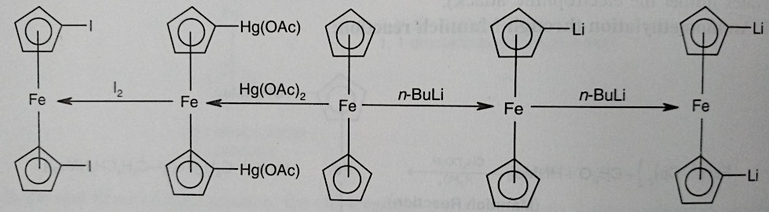
Ferrocene: reactions (Mannich Condensation)
This easy metallation process suports the typical aromatic systems in the Cp-rings of ferrocene. Thus the lithio- derivatives obtained may be used in many reactions to prepare the ferrocenyl derivatives

Slide 25
Reactions of organometallic complexes
Substitution
Oxidative Addition
Reductive Elimination
Insertion

Slide 26
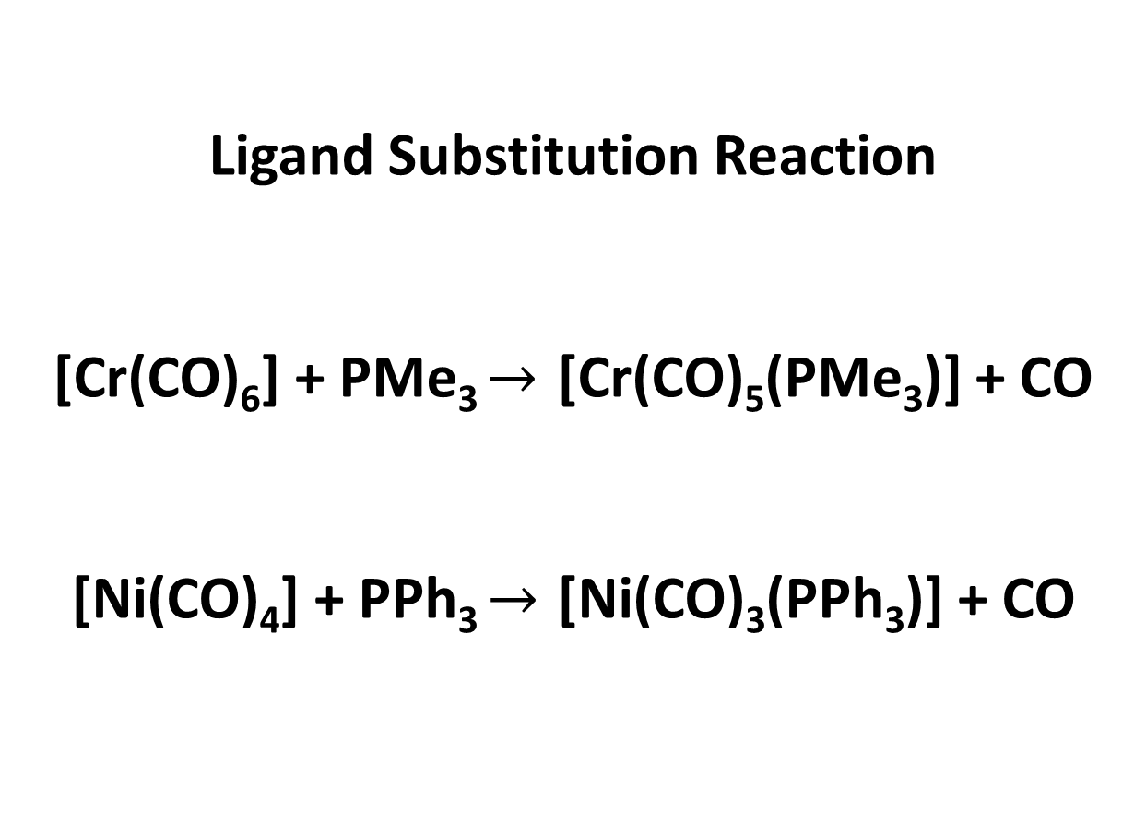
1. Substitution
Ligand Substitution Reaction
[Cr(CO)₆] + PMe₃ $→$ [Cr(CO)₅(PMe₃)] + CO
[Ni(CO)₄] + PPh₃ $→$ [Ni(CO)₃(PPh₃)] + CO

Slide 27
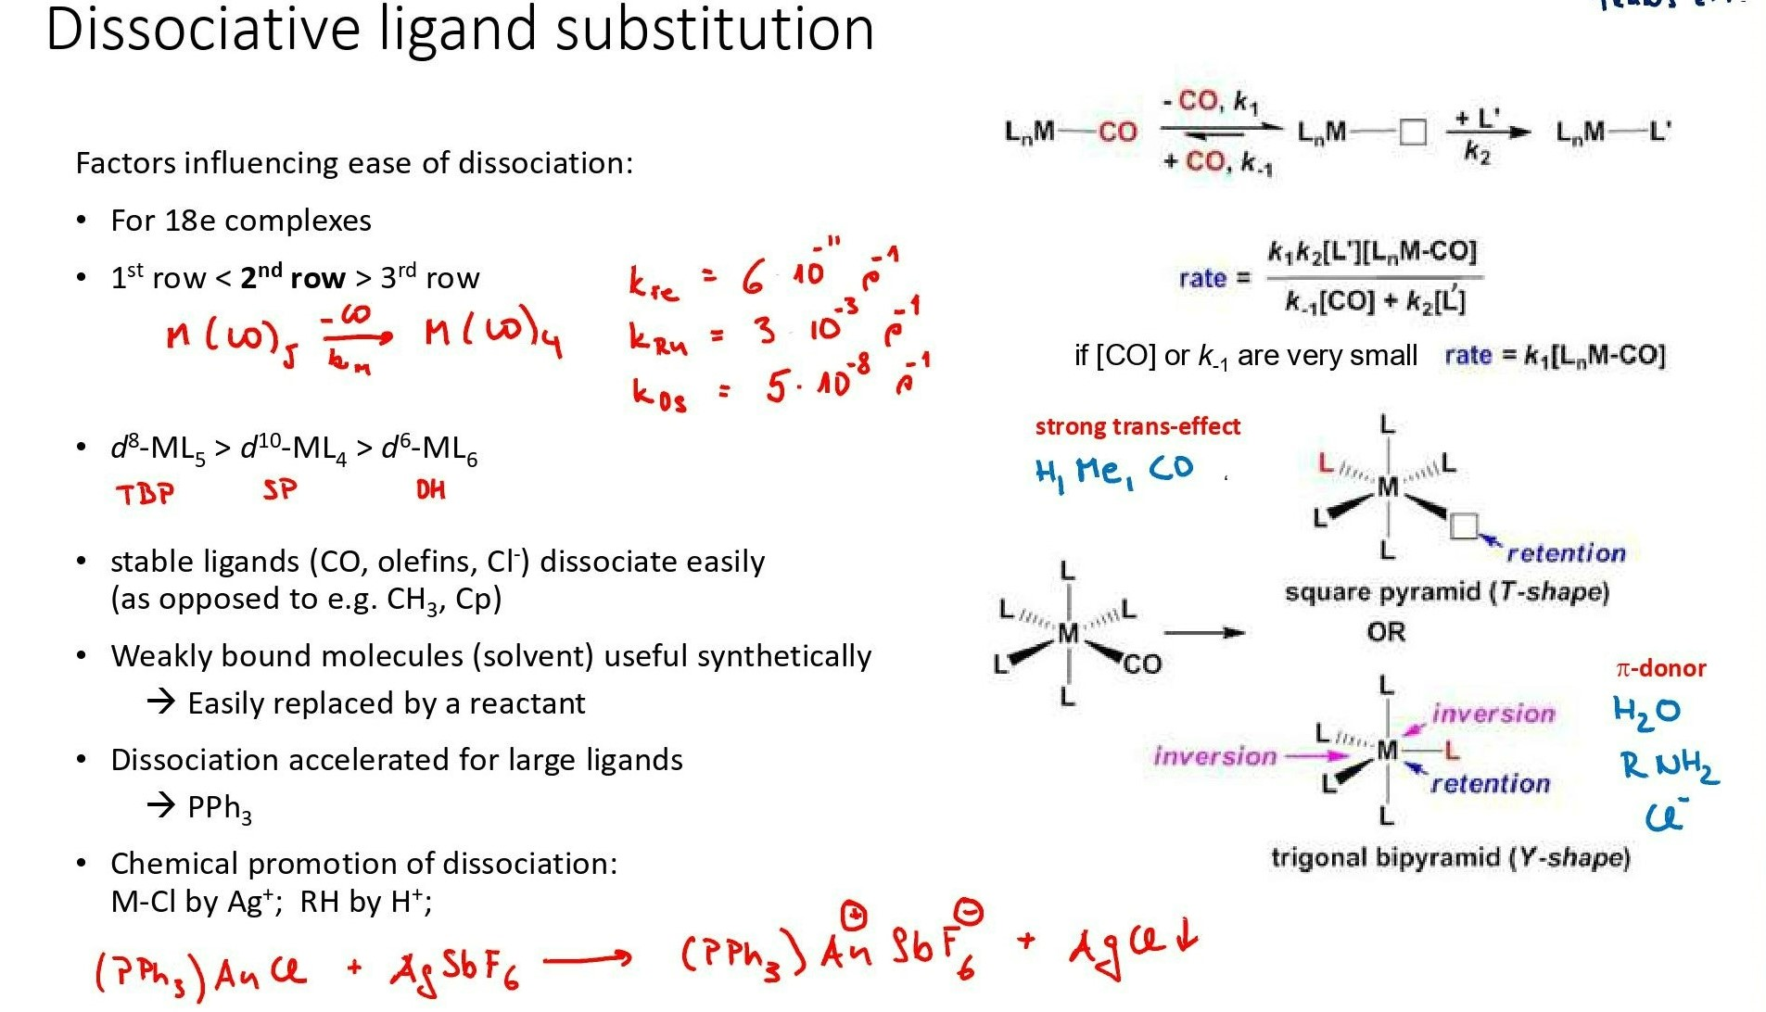
1. Substitution

Slide 28
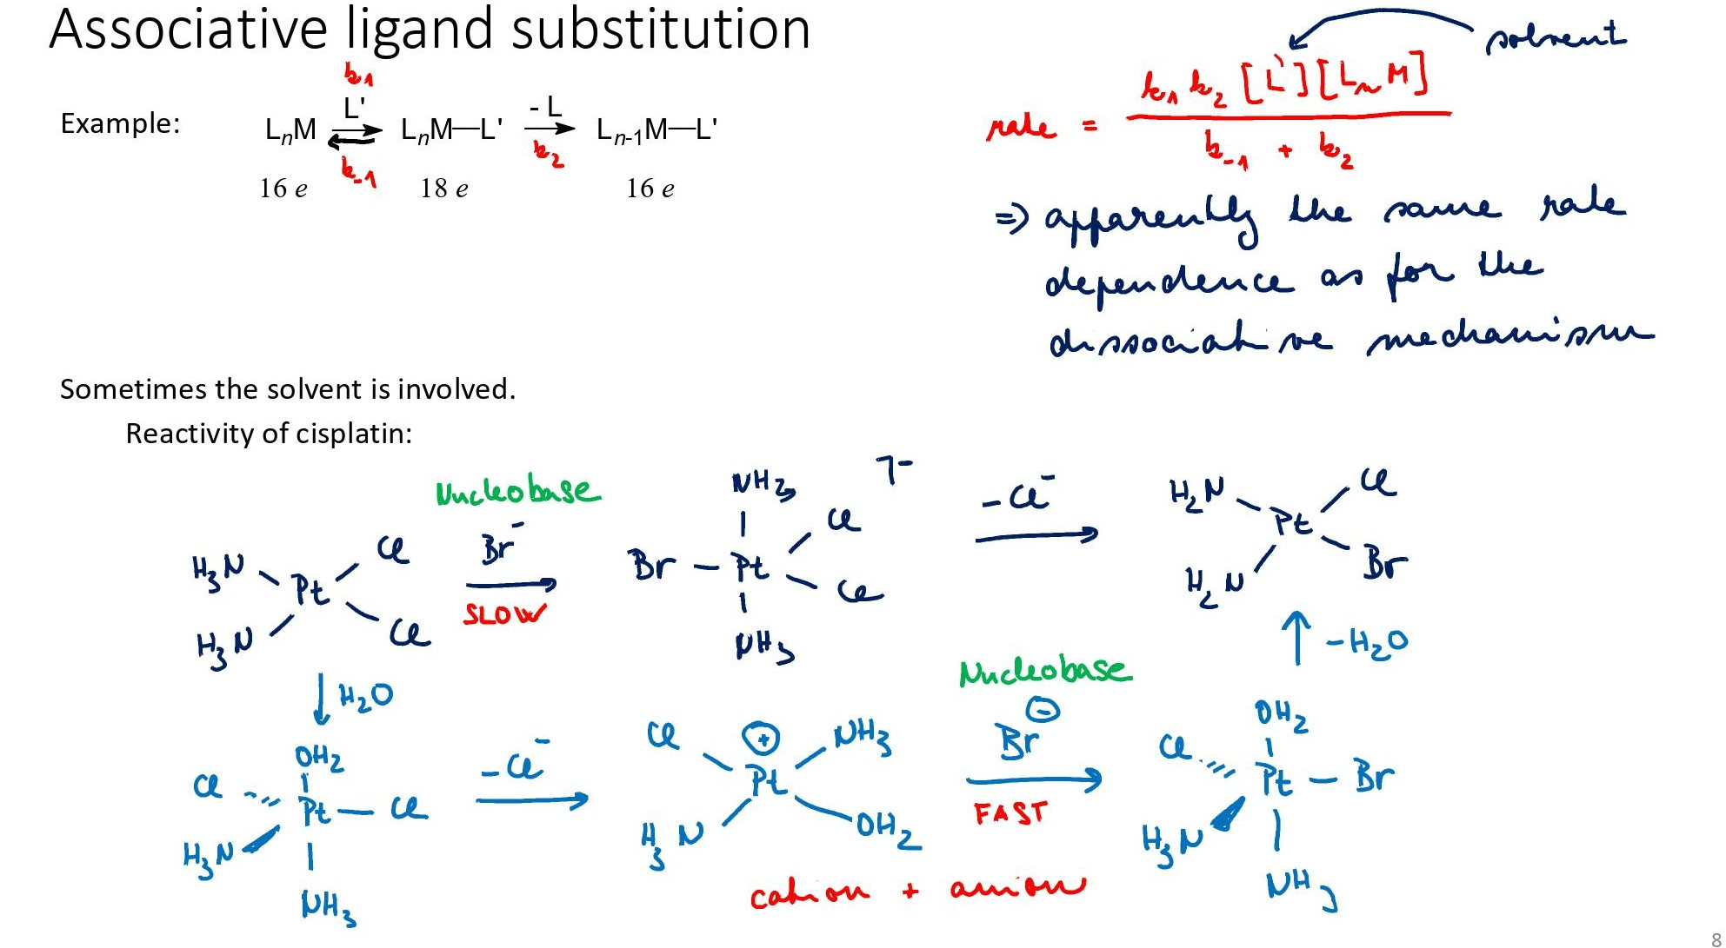
1. Substitution

Slide 29
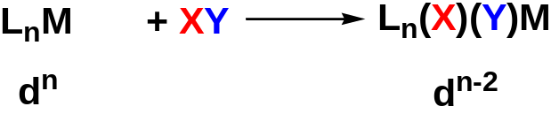
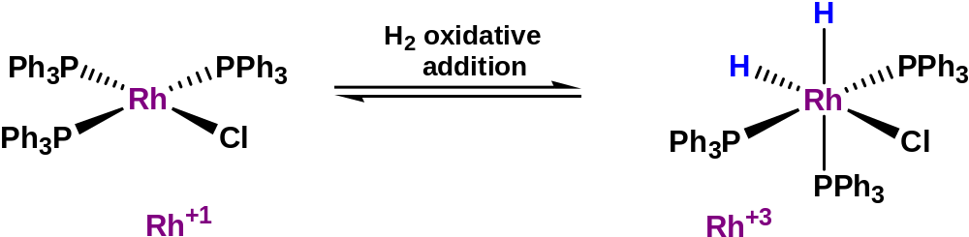
2. Oxidative addition
When addition of ligands is accompanied by oxidation of the metal, it is called an oxidative addition reaction
OX state of metal increases by 2 units
Coordination number increases by 2 units
2 new anionic ligands are added to the metal
Requirements for oxidative addition
two vacant coordination sites on the reacting complex (L_{n}M), that is, the complex must be coordinatively unsaturated,
a metal with stable oxidation states separated by two units; the higher oxidation state must be energetically accessible and stable.
An important step in many homogeneous catalytic cycles
The more electron rich the metal, more easy is the oxidative addition

Slide 30

Examples of Oxidative addition : Cis or trans ?
Homonuclear systems (H₂, Cl₂, O₂, C₂H₂) Cis
Heteronuclear systems (MeI) Cis or trans

Slide 31

3. Reductive elimination
Almost the exact reverse of Oxidative Addition
Pt⁴⁺
Pt²⁺
Oxidation state of metal decreases by 2 units
Coordination number decreases by 2 units
2 cis oriented anionic ligands form a stable σ bond and leave the metal
Factors which facilitate reductive elimination
a high formal positive charge on the metal,
the presence of bulky groups on the metal, and
an electronically stable organic product.
Cis orientation of the groups taking part in reductive elimination is a MUST
Final step in many catalytic cycles

Slide 32


4. Insertion
No change in the formal oxidation state of the metal
A vacant coordination site is generated during a migratory insertion (which gets occupied by the incoming ligand)
The groups undergoing migratory insertion must be cis to one another
These reactions are enthalpy driven and although the reaction is entropy prohibited the large enthalpy term dominates

Slide 33



Types of Migratory Insertion

Slide 34
Reference
Ashim K Das & Mahua Das, Fundamental Concept of Inorganic Chemistry, CBC Publishers & Distributors, Volume 6, First Edition: 2014
Ashim K Das & Mahua Das, Fundamental Concept of Inorganic Chemistry, CBC Publishers & Distributors, Volume 3, First Edition: 2014
Wahid U. Malik, G. D. Tuli & R. D. Madan, Selected topics in inorganic chemistry, S. Chand & Company Ltd, first edition
Christoph Elschenbroich, Organometallics, 3rd Completely Revised and Extended Edition, Wiley-VCH Verlag GmbH & Co. KGaA, Weinheim, Germany, 2006
Robert H Crabtree, The Organometallic Chemistry of the Transition Metals, 4th Edition, John Wiley & Sons, Inc., Hoboken, New Jersey, 2005
B D Gupta and A J Elias, Basic Organometallic Chemistry, University Press (India) Pvt Ltd., 2010

Slide 35
Thank you

