Slide 1
Organometallic Chemistry
for B.Sc. CBCS Chemistry Semester-6 (Honours)
Dr Semanti Basu
Assistant Professor
Department of Chemistry
Bejoy Narayan Mahavidyalaya
Itachuna, Hooghly, W. B., India

Slide 2
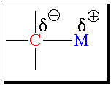
What are organometallic compounds?
A branch of coordination chemistry where the complex has one or more direct metal-carbon bonds
C is carbon atoms of an organic group or molecule
M is metal atom or ion of main group, transition, lanthanide, or actinide
The M-C bond is ionic or covalent, localized or delocalized
C always more electronegative compared to M
Defination: The leading journals of the field define an "organometallic" compound as one in which there is a direct bonding interaction (ionic or covalent, localized or delocalized) between one or more carbon atoms of an organic group or molecule and a main group, transition, lanthanide, or actinide metal atom (or atoms).
According to this definition, metal carbides (M=C), metal carbonyls (M-CO), cyanide complex (M-CN) should not be orgsanometallic compound, since here C are from inorganic moity, CO and CN⁻.
But in broad sence M-CO & M-CN complexes are consider as a part of organometallic compound.
In a broad sense, organic derivatives of the metalloids & non metals such as boron, silicon, arsenic, tellurium also are included in this definition. Thus organoborons, organosilicons etc constitute an important fragment of organometallics
[Ti(OR)₄], or [Co(acac)₃] are not organometallic compound, since there is no direct M-C bond.

Slide 3
Application of Organometallic compounds
As synthetic reagents
Grignard reagents
Used widely in organic synthesis
As Catalysts
Many synthetic reactions like hydrogenetion, polymerisation, hydroformylation etc.
Ziegler Natta Catalyst [TiCl₄ + (CH₃CH₂)₃Al] used as polymerisation of olefin
Wilkinson catalyst[ (PPh₃)₃RhCl], for hydrogenation of alkene
Zeise’s salt is the first recorded ex. In the organometallic chemistry (1827-31) a case of serendipity, means accidentally discovered
Vit B₁₂ is an unique ex. Of organometallic comp. occuring in nature. For the determination (1948) of 3 D str. of Vit B₁₂ by X-ray crystallography, Dorothy Hodgkin was awarded the Nobel Prize in Chemistry in 1964. Though Vit B₁₂ was synthesized by Woodward in 1973.

Slide 4
Significance of the Field
Nobel prizes in Organometallic Chemistry
1908: Ehrlich [salvarsan, organoarsenic compound, syphilis]
1912: Grignard and Sabatier [Grignard reagent]
1963: Ziegler and Natta [Ziegler-Natta catalyst]
1973: Fischer and Wilkinson [sandwich compounds]
1979: Brown and Wittig [hydroboration]
1981: Hoffmann and Fukui [Woodward-Hoffman Rules]
2001: The Nobel Prize in Chemistry was divided, one half jointly to William S. Knowles and Ryoji Noyori "for their work on chirally catalysed hydrogenation reactions" and the other half to K. Barry Sharpless "for his work on chirally catalysed oxidation reactions
2005: Chauvin, Schrock and Grubbs [alkene metathesis]
2010: Heck, Negishi and Suzuki [Pd-catalyzed C-C coupling]

Slide 5

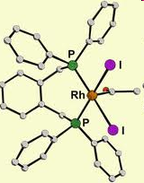
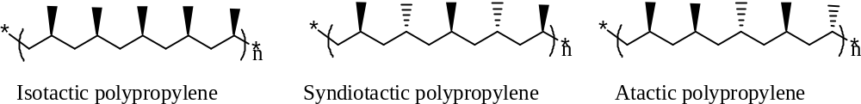
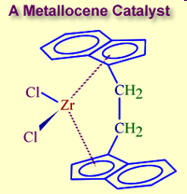
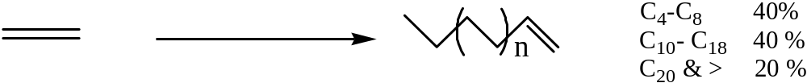
Organometallic catalysts in industrial synthesis : Three Nobel Prizes 2001, 2005 and 2010
Hydrogenation
Methanol to acetic acid process
Olefin polymerization and oligomerization

Slide 6
History of Organometallic compounds
In 1760, The first Organometallic compound
As₂O₃ + CH₃CO₂K → [(CH₃)₂As]₂O

Slide 7
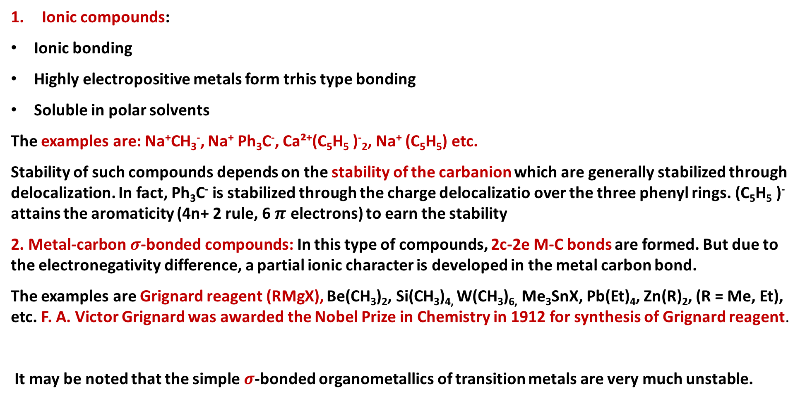
Classification of organometallic compounds on the basis of bond type (M-C)
Ionic compounds:
Ionic bonding
Highly electropositive metals form trhis type bonding
Soluble in polar solvents
The examples are: Na⁺CH₃⁻, Na⁺ Ph₃C⁻, Ca²⁺(C₅H₅)⁻₂, Na⁺(C₅H₅) etc.
Stability of such compounds depends on the stability of the carbanionwhich are generally stabilized through delocalization. In fact, Ph₃C⁻is stabilized through the charge delocalizatio over the three phenyl rings. (C₅H₅ )⁻attains the aromaticity (4n+ 2 rule, 6 $π$electrons) to earn the stability
2. Metal-carbon $σ$-bonded compounds: In this type of compounds, 2c-2e M-C bonds are formed. But due to the electronegativity difference, a partial ionic character is developed in the metal carbon bond.
The examples are Grignard reagent (RMgX), Be(CH₃)₂, Si(CH₃)_{4,} W(CH₃)_{6,}Me₃SnX, Pb(Et)₄, Zn(R)₂, (R = Me, Et), etc. F. A. Victor Grignard was awarded the Nobel Prize in Chemistry in 1912 for synthesis of Grignard reagent.
It may be noted that the simple $σ$-bonded organometallics of transition metals are very much unstable.

Slide 8
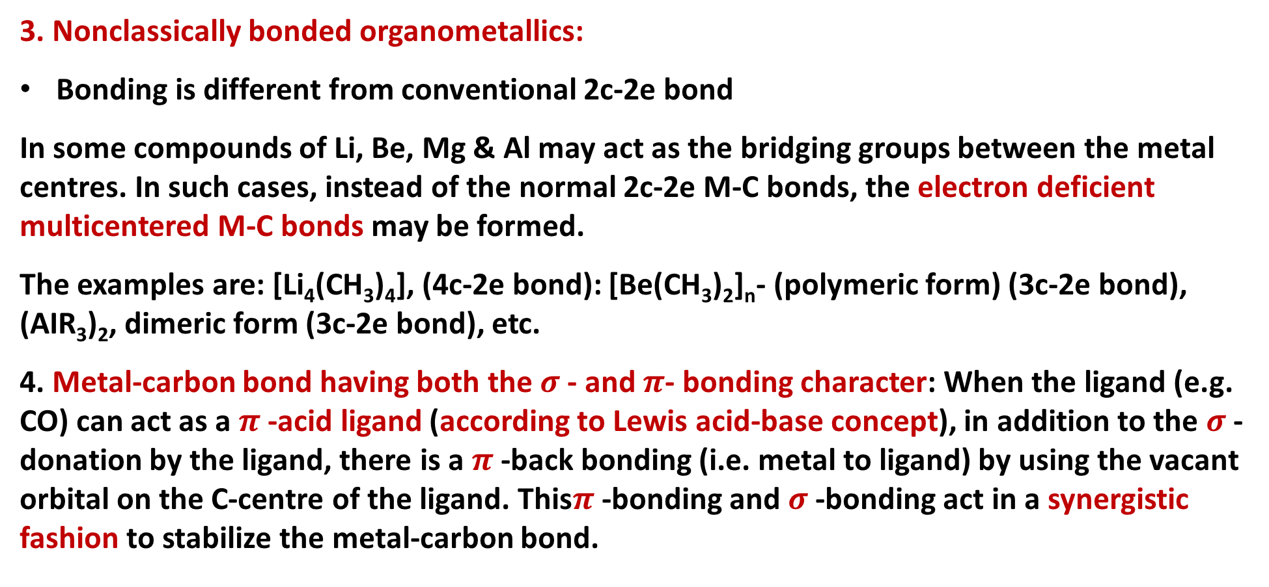
Classification of organometallic compounds on the basis of bond type
3. Nonclassically bonded organometallics:
Bonding is different from conventional 2c-2e bond
In some compounds of Li, Be, Mg & Al may act as the bridging groups between the metal centres. In such cases, instead of the normal 2c-2e M-C bonds, the electron deficient multicentered M-C bonds may be formed.
The examples are: [Li₄(CH₃)₄], (4c-2e bond): [Be(CH₃)₂]_{n}- (polymeric form) (3c-2e bond), (AIR₃)₂, dimeric form (3c-2e bond), etc.
4. Metal-carbon bond having both the $σ$- and $π$- bonding character: When the ligand (e.g. CO) can act as a$π$-acid ligand (according to Lewis acid-base concept), in addition to the $σ$-donation by the ligand, there is a $π$-back bonding (i.e. metal to ligand) by using the vacant orbital on the C-centre of the ligand. This$π$ -bonding and $σ$-bonding act in a synergistic fashion to stabilize the metal-carbon bond.

Slide 9
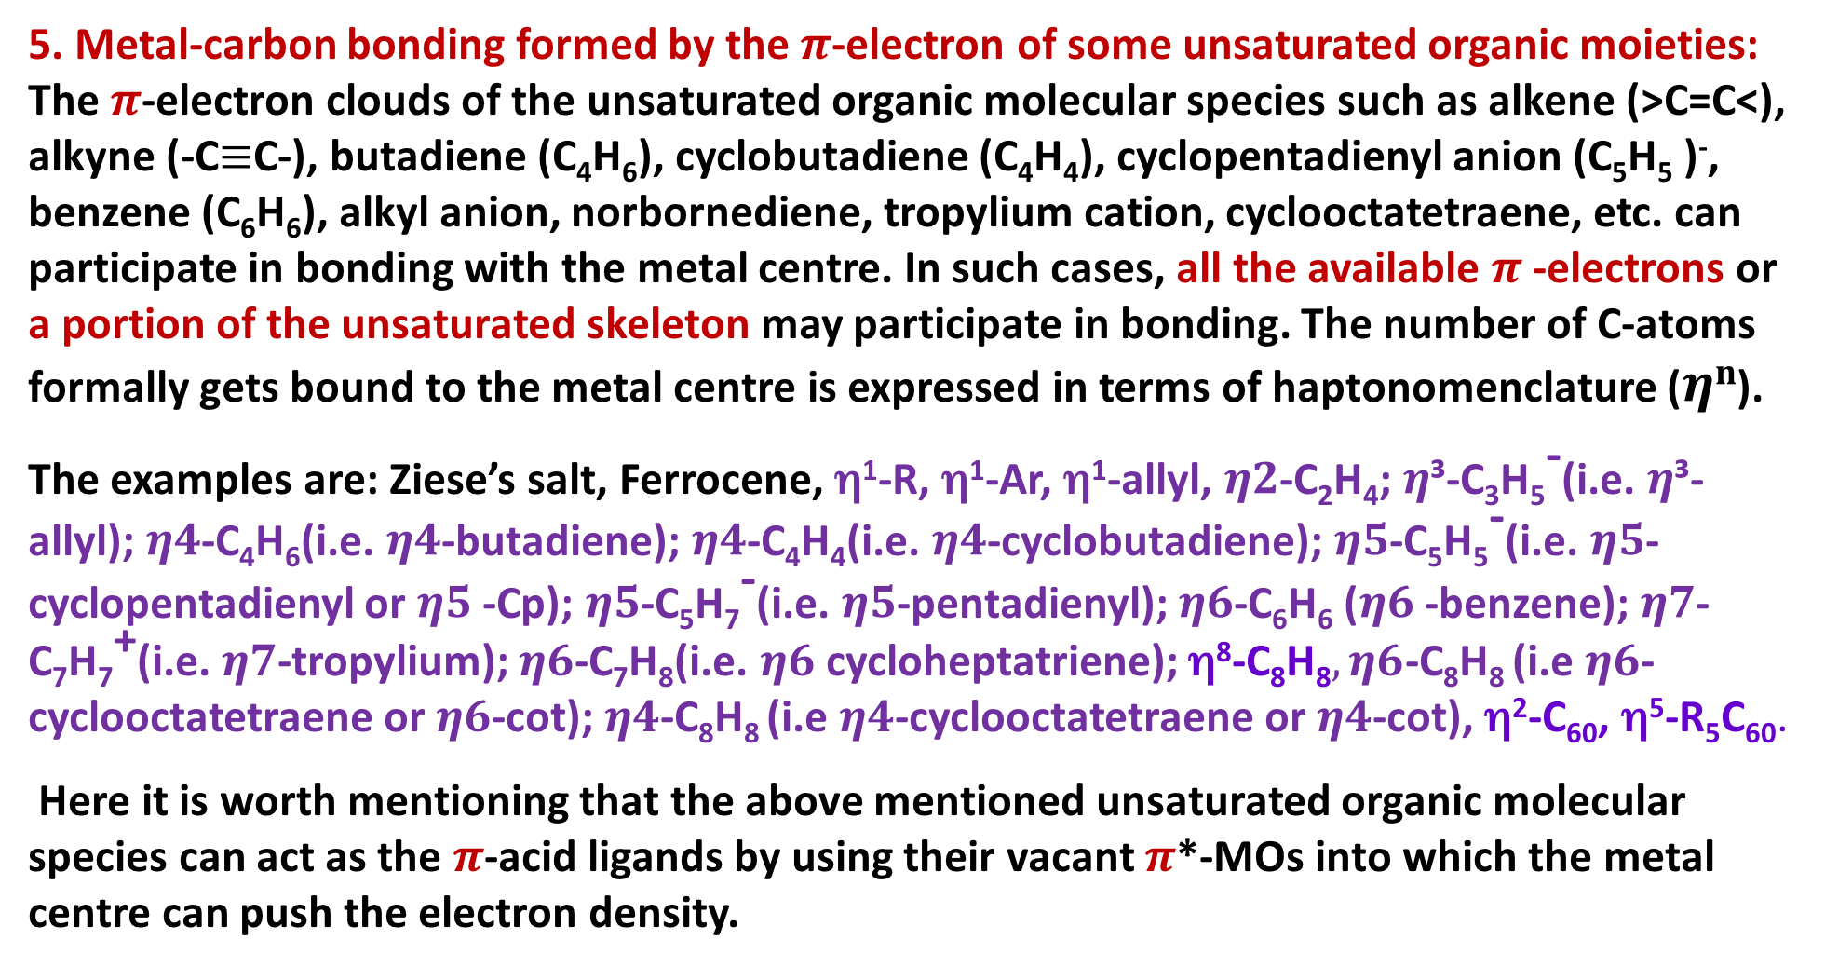
Classification of organometallic compounds on the basis of bond type
5. Metal-carbon bonding formed by the $π$-electron of some unsaturated organic moieties: The $π$-electron clouds of the unsaturated organic molecular species such as alkene (>C=C<), alkyne (-C$≡$C-), butadiene (C₄H₆), cyclobutadiene (C₄H₄), cyclopentadienyl anion (C₅H₅)⁻, benzene (C₆H₆), alkyl anion, norbornediene, tropyliumcation, cyclooctatetraene, etc. can participate in bonding with the metal centre. In such cases, all the available $π$-electrons or a portion of the unsaturated skeleton may participate in bonding. The number of C-atoms formally gets bound to the metal centre is expressed in terms of haptonomenclature ($ηn$).
The examples are: Ziese’s salt, Ferrocene,η¹-R, η¹-Ar, η¹-allyl, $η2$-C₂H₄; $η$³-C₃H₅⁻(i.e. $η$³-allyl); $η4$-C₄H₆(i.e. $η4$-butadiene); $η4$-C₄H₄(i.e. $η4$-cyclobutadiene); $η5$-C₅H₅⁻(i.e. $η5$-cyclopentadienyl or $η5$-Cp); $η5$-C₅H₇⁻(i.e. $η5$-pentadienyl); $η6$-C₆H₆($η6$-benzene); $η7$-C₇H₇⁺(i.e. $η7$-tropylium); $η6$-C₇H₈(i.e. $η6$cycloheptatriene); η⁸-C₈H₈$, η6$-C₈H₈ (i.e$η6$-cyclooctatetraene or $η6$-cot); $η4$-C₈H₈ (i.e$η4$-cyclooctatetraene or $η4$-cot), η²-C₆₀, η⁵-R₅C₆₀.
Here it is worth mentioning that the above mentioned unsaturated organic molecular species can act as the $π$-acid ligands by using their vacant $π$*-MOs into which the metal centre can push the electron density.

Slide 10

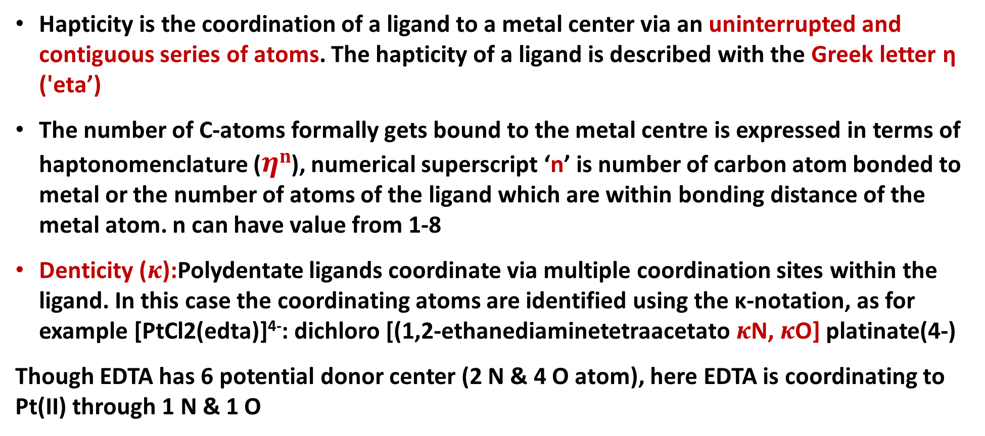
Concept of hapticity ($ηn$) of organic ligands
Hapticity is the coordination of a ligand to a metal center via an uninterrupted and contiguous series of atoms. The hapticity of a ligand is described with the Greek letter η('eta’)
The number of C-atoms formally gets bound to the metal centre is expressed in terms of haptonomenclature ($ηn$), numerical superscript ‘n’ is number of carbon atom bonded to metal or the number of atoms of the ligand which are within bonding distance of the metal atom.n can have value from 1-8
Denticity ($κ$):Polydentate ligands coordinate via multiple coordination sites within the ligand. In this case the coordinating atoms are identified using the κ-notation, as for example [PtCl2(edta)]⁴⁻: dichloro [(1,2-ethanediaminetetraacetato $κ$N,$κ$O] platinate(4-)
Though EDTA has 6 potential donor center (2 N & 4 O atom), here EDTA is coordinating to Pt(II) through 1 N & 1 O

Slide 11
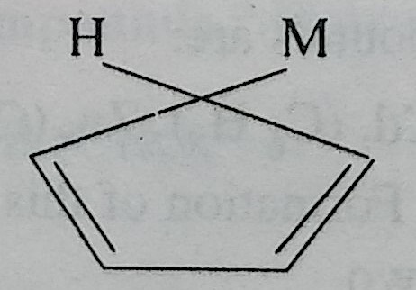
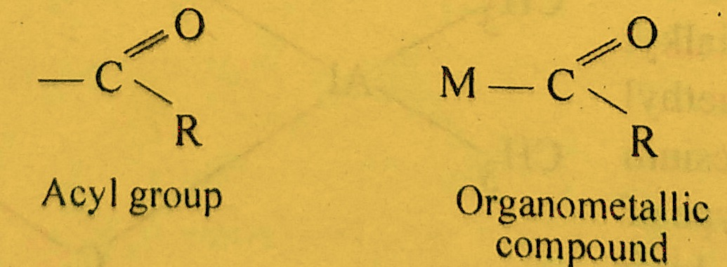
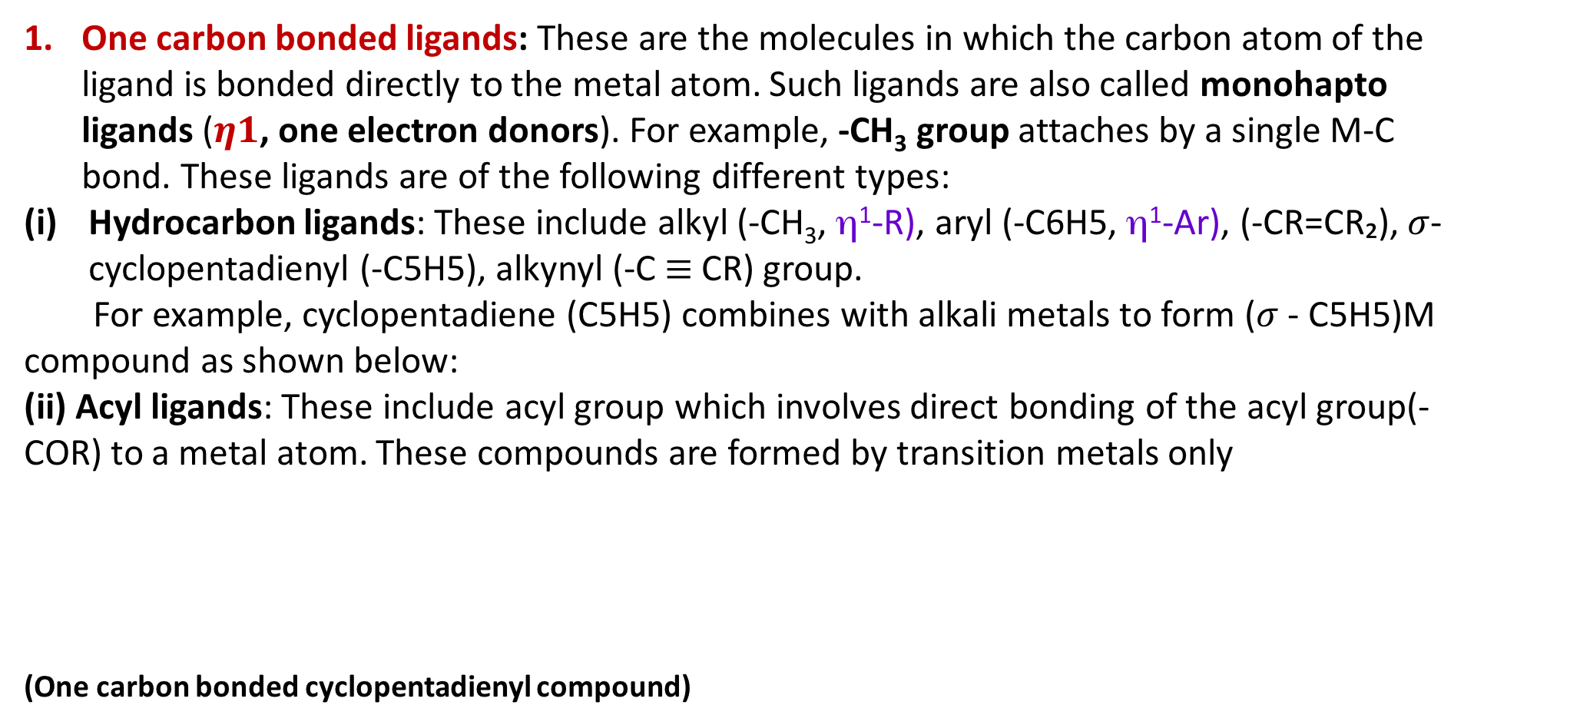
Classification of organic ligands on the basis of C atoms involved in bonding to the metal atom, i. e. hapticity
One carbon bonded ligands: These are the molecules in which the carbon atom of the ligand is bonded directly to the metal atom. Such ligands are also called monohapto ligands ($η1$, one electron donors). For example, -CH₃group attaches by a single M-C bond. These ligands are of the following different types:
Hydrocarbon ligands: These include alkyl (-CH₃, η¹-R), aryl (-C6H5,η¹-Ar), (-CR=CR₂), $σ$-cyclopentadienyl(-C5H5), alkynyl (-C$≡$CR) group.
For example, cyclopentadiene (C5H5) combines with alkali metals to form ($σ$- C5H5)M compound as shown below:
(ii) Acyl ligands: These include acyl group which involves direct bonding of the acyl group(-COR) to a metal atom. These compounds are formed by transition metals only
(One carbon bonded cyclopentadienyl compound)

Slide 12
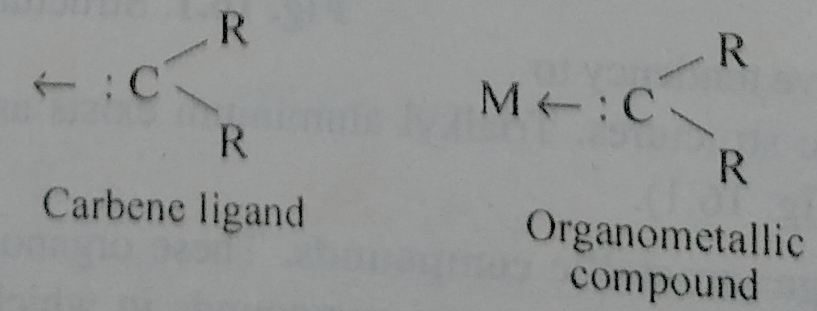
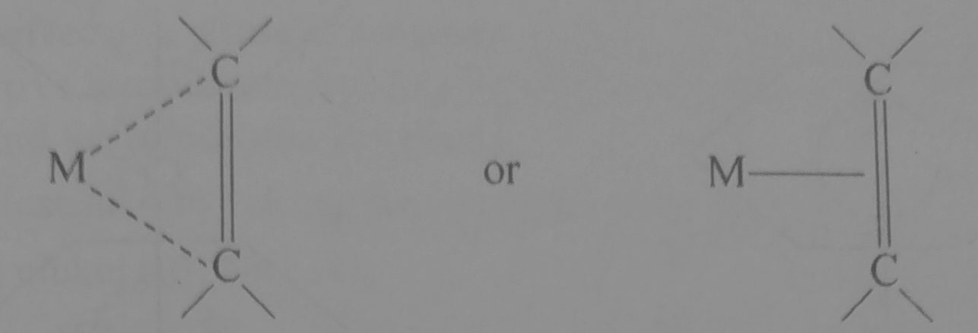
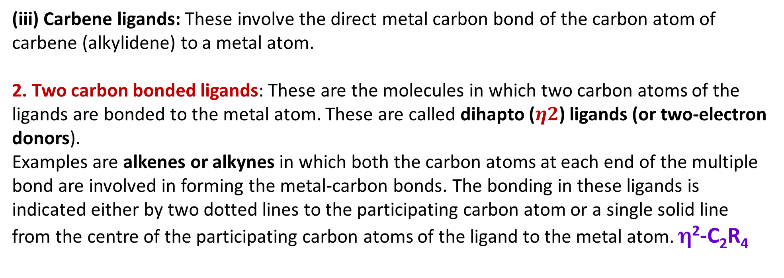
Classification of organic ligands on the basios of C atoms involved in bonding to the metal atom, i. e. hapticity
(iii) Carbene ligands: These involve the direct metal carbon bond of the carbon atom of carbene (alkylidene) to a metal atom.
2. Two carbon bonded ligands: These are the molecules in which two carbon atoms of the ligands are bonded to the metal atom. These are called dihapto ($η2$) ligands (or two-electron donors).
Examples are alkenes or alkynes in which both the carbon atoms at each end of the multiple bond are involved in forming the metal-carbon bonds. The bonding in these ligands is indicated either by two dotted lines to the participating carbon atom or a single solid line from the centre of the participating carbon atoms of the ligand to the metal atom.η²-C₂R₄

Slide 13
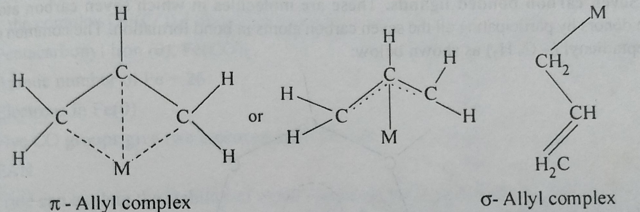
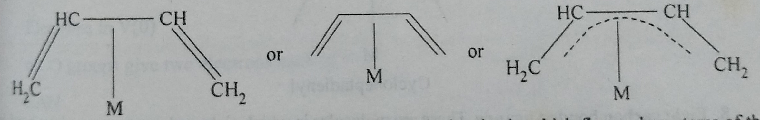
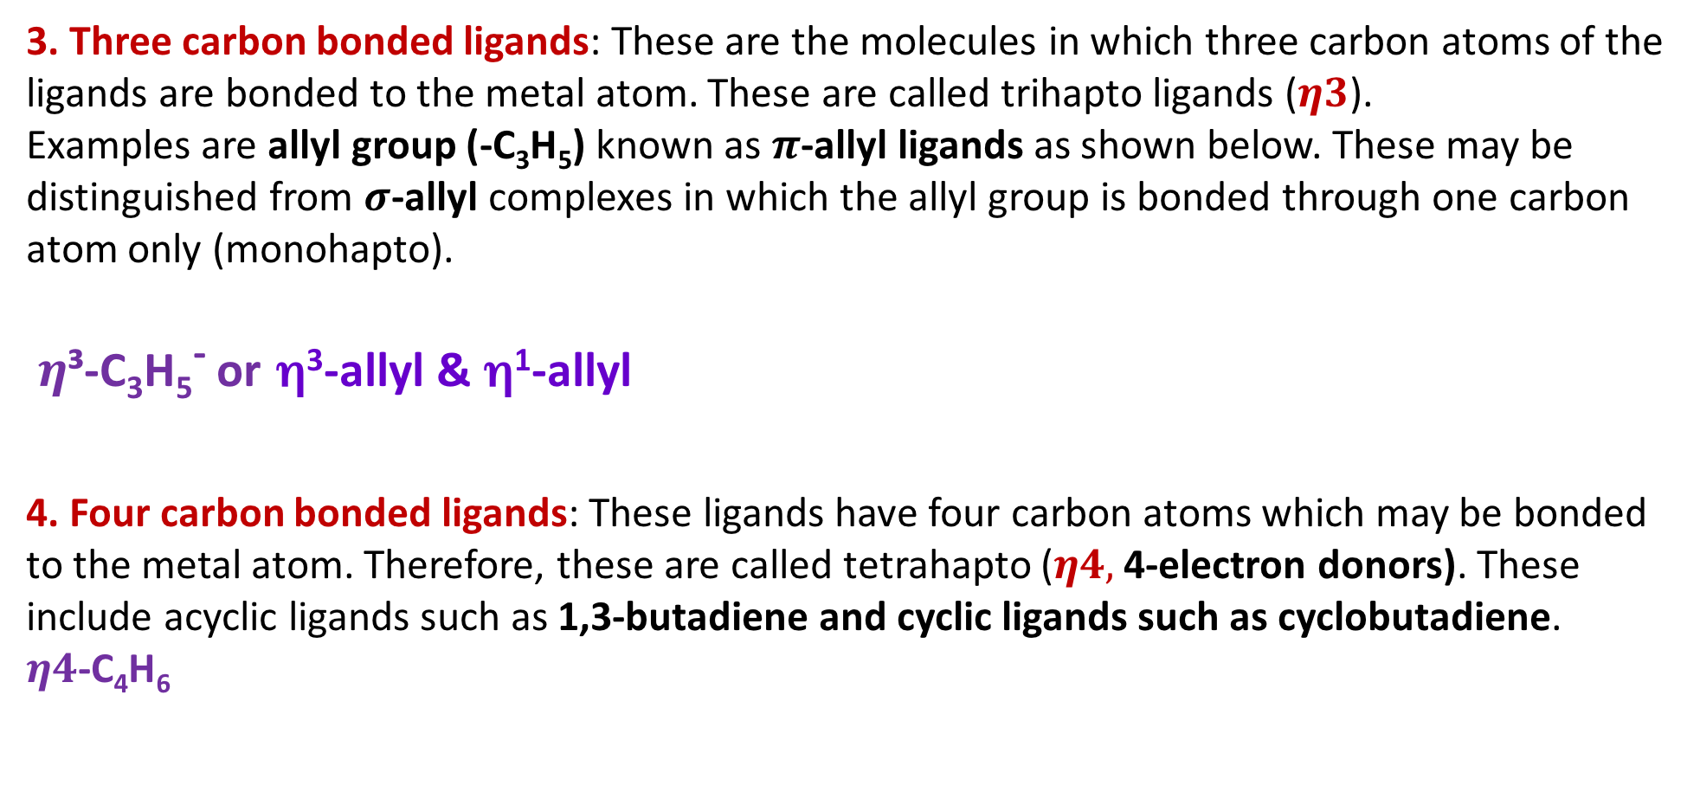
Classification of organic ligands on the basios of C atoms involved in bonding to the metal atom, i. e. hapticity
3. Three carbon bonded ligands: These are the molecules in which three carbon atoms of the ligands are bonded to the metal atom. These are called trihapto ligands ($η3$).
Examples are allyl group (-C₃H₅) known as $π$-allyl ligands as shown below. These may be distinguished from $σ$-allylcomplexes in which the allyl group is bonded through one carbon atom only (monohapto).
$η$³-C₃H₅⁻ orη³-allyl &η¹-allyl
4. Four carbon bonded ligands: These ligands have four carbon atoms which may be bonded to the metal atom. Therefore, these are called tetrahapto ($η4,$4-electron donors). These include acyclic ligands such as 1,3-butadiene and cyclic ligands such as cyclobutadiene.
$η4$-C₄H₆

Slide 14
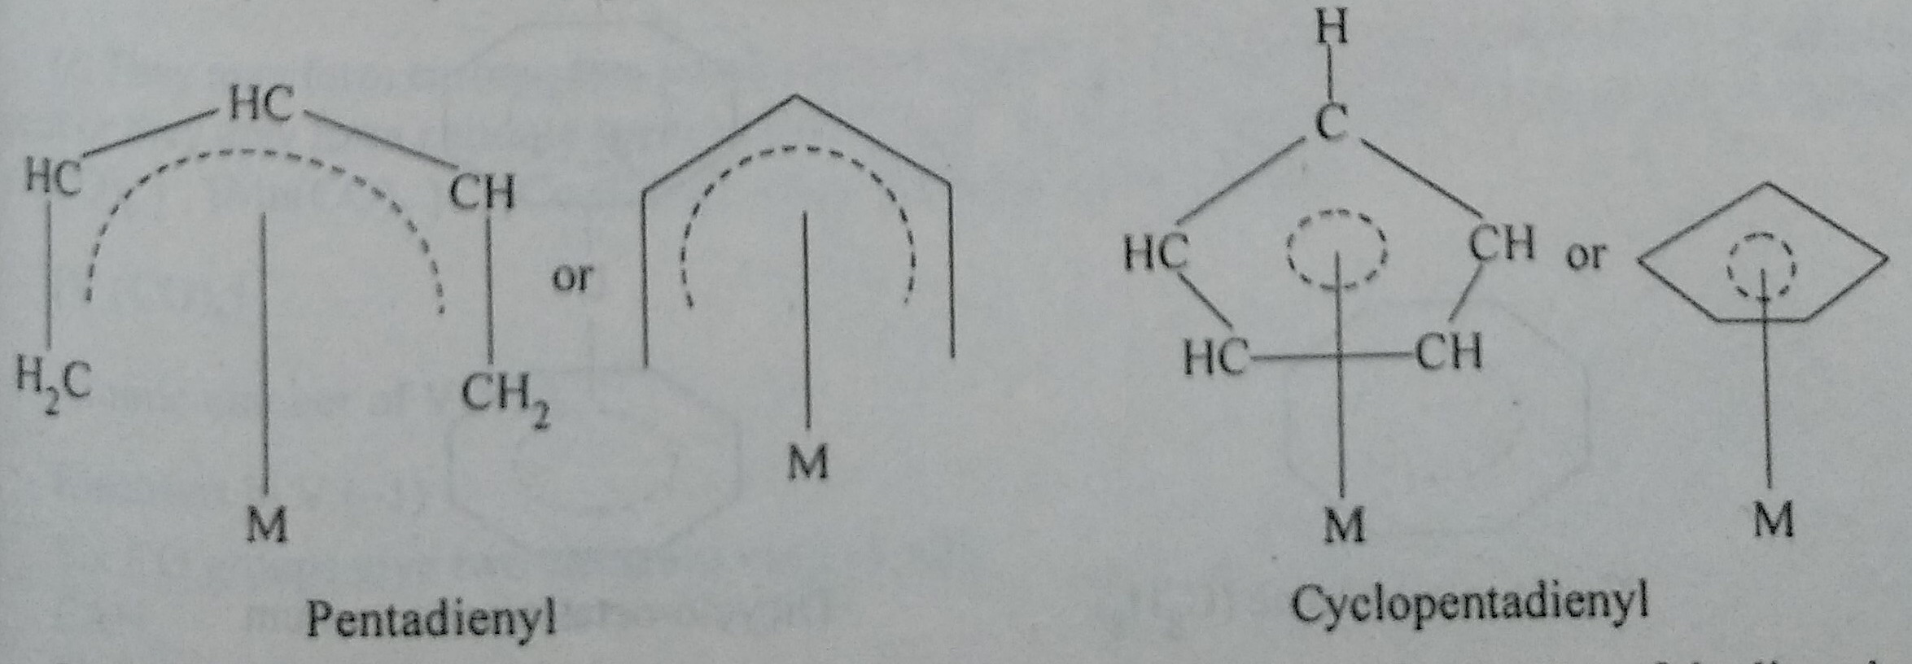
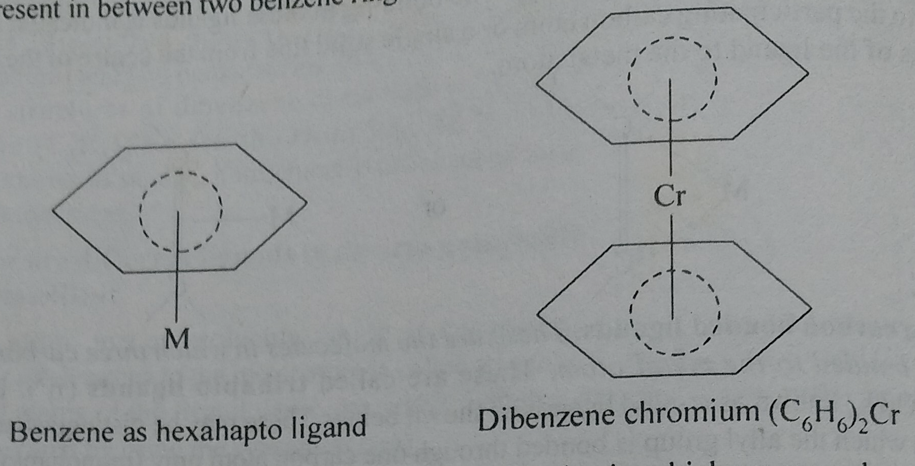
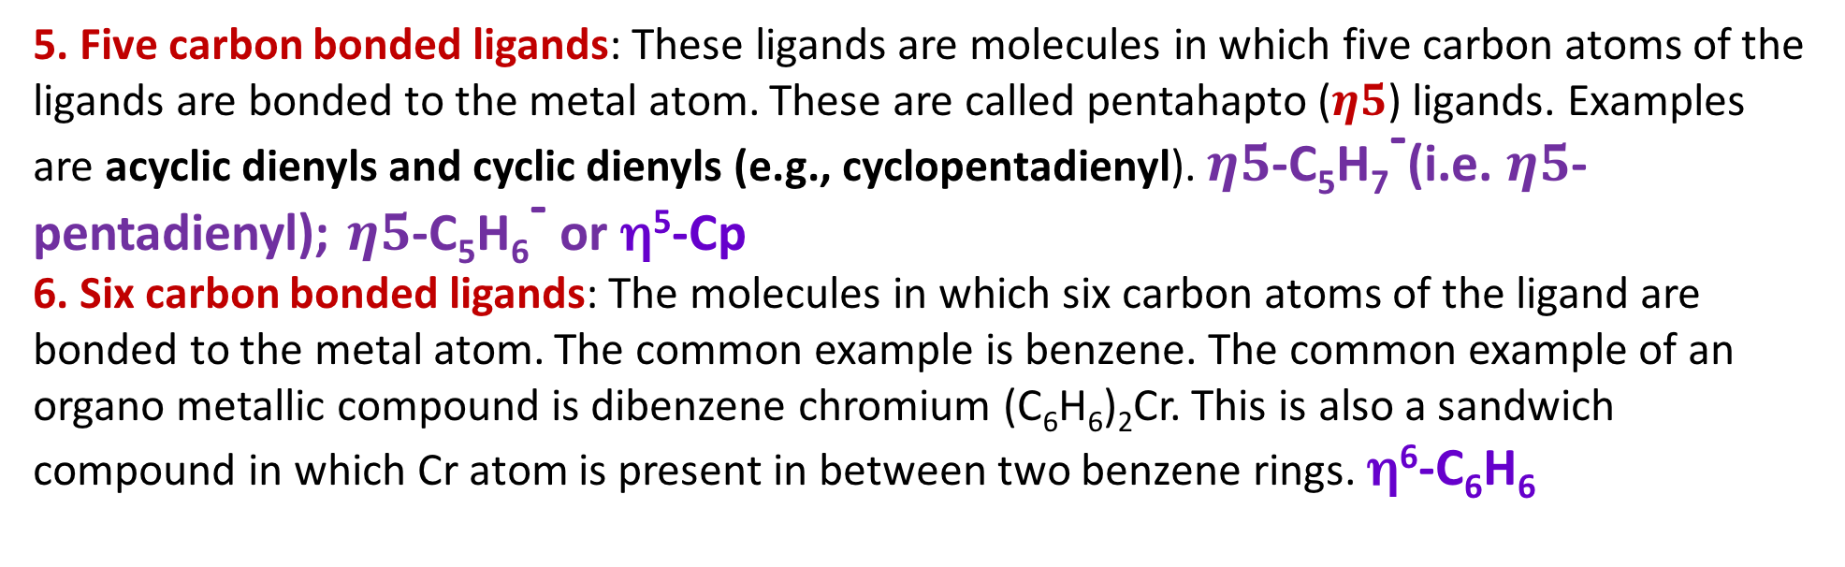
Classification of organic ligands on the basios of C atoms involved in bonding to the metal atom, i. e. hapticity
5. Five carbon bonded ligands: These ligands are molecules in which five carbon atoms of the ligands are bonded to the metal atom. These are called pentahapto($η5$) ligands. Examples are acyclic dienyls and cyclic dienyls (e.g., cyclopentadienyl).$η5$-C₅H₇⁻(i.e. $η5$-pentadienyl); $η5$-C₅H₆⁻ or η⁵-Cp
6. Six carbon bonded ligands: The molecules in which six carbon atoms of the ligand are bonded to the metal atom. The common example is benzene. The common example of an organometallic compound is dibenzene chromium (C₆H₆)₂Cr. This is also a sandwich compound in which Cr atom is present in between two benzene rings.η⁶-C₆H₆

Slide 15
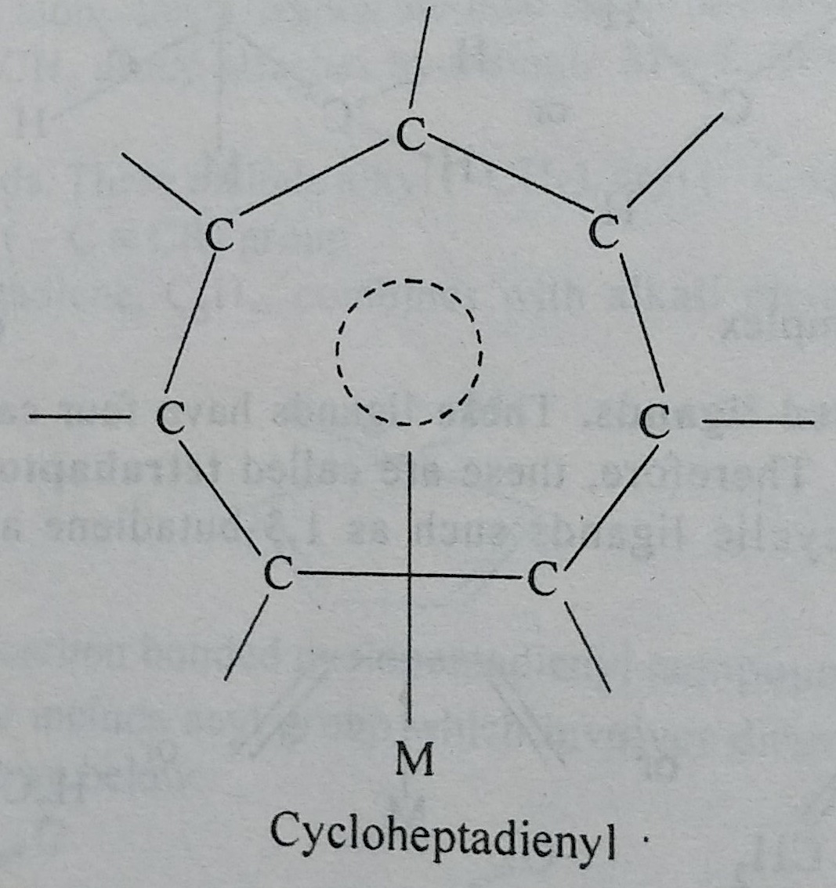
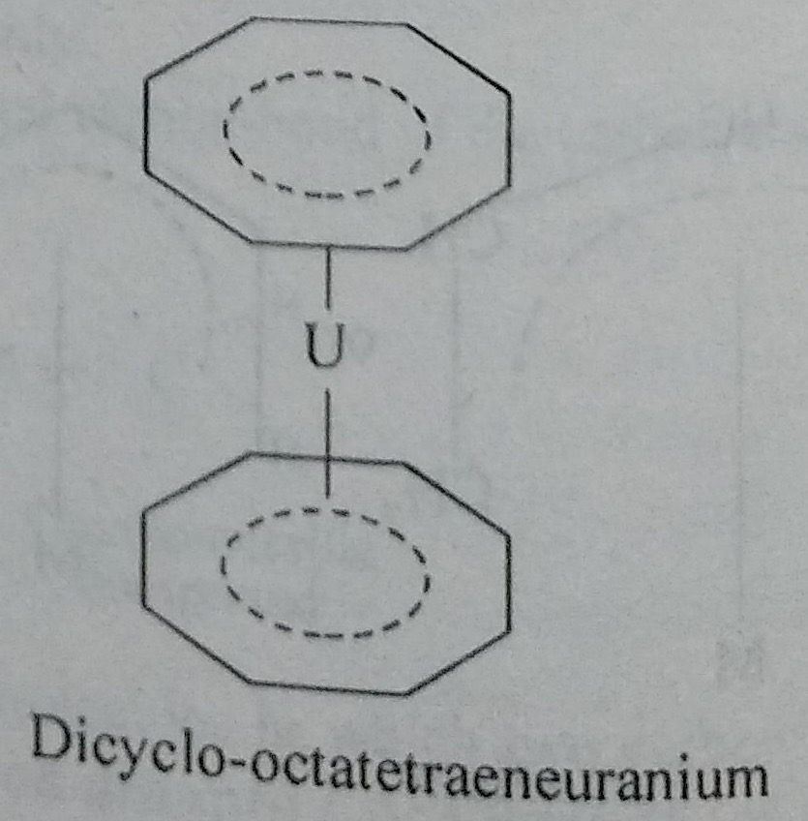
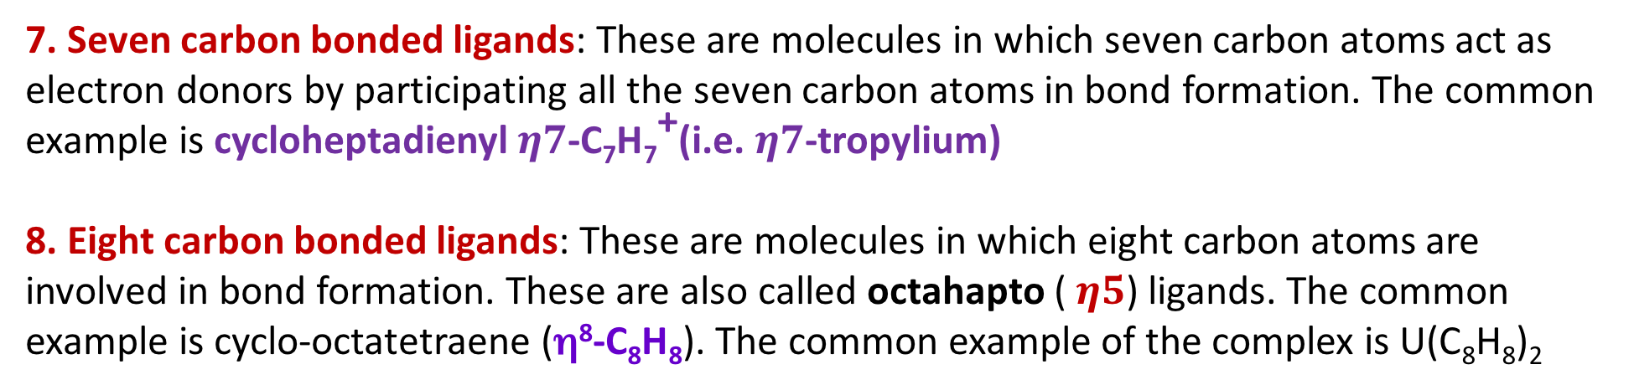
Classification of organic ligands on the basios of C atoms involved in bonding to the metal atom, i. e. hapticity
7. Seven carbon bonded ligands: These are molecules in which seven carbon atoms act as electron donors by participating all the seven carbon atoms in bond formation. The common example is cycloheptadienyl$η7$-C₇H₇⁺(i.e. $η7$-tropylium)
8. Eight carbon bonded ligands: These are molecules in which eight carbon atoms are involved in bond formation. These are also called octahapto ($η5$) ligands. The common example is cyclo-octatetraene(η⁸-C₈H₈). The common example of the complex is U(C₈H₈)₂

Slide 16
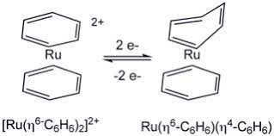
The hapticity of a ligand can change in the course of a reaction. e.g. in a redox reaction

Slide 17
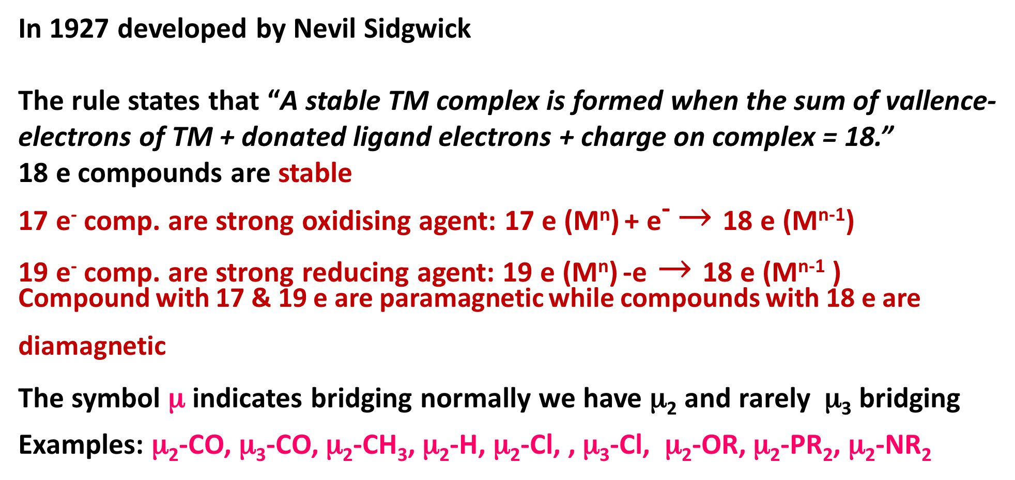
18-electron and 16-electron rules (pictorial MO approach)
In 1927 developed by NevilSidgwick
The rule states that “A stable TM complex is formed when the sum of vallence-electrons of TM + donated ligand electrons +charge on complex = 18.”
18 e compounds are stable
17 e⁻ comp. are strong oxidising agent: 17 e (M^{n})+ e⁻ $→$18 e (M^{n-1})
19 e⁻comp. are strong reducing agent: 19 e (M^{n})-e$→$18 e (M^{n-1} )
Compound with 17 & 19 e are paramagnetic while compounds with 18 e are diamagnetic
The symbol μ indicates bridging normally we have μ₂ and rarelyμ₃bridging
Examples: μ₂-CO, μ₃-CO, μ₂-CH₃, μ₂-H, μ₂-Cl, , μ₃-Cl, μ₂-OR, μ₂-PR₂, μ₂-NR₂

Slide 18
18-electron and 16-electron rules
Transition Metals
Total No. of vallence e:3 4 5 6 7 8 9 10 11 12
3d: Sc Ti V Cr Mn Fe Co Ni Cu Zn
4d: Y Zr Nb Mo Tc Ru Rh Pd Ag Cd
5d: Ta W Re Os Ir Pt Au Hg
18 e rule: 3d TM carbonyl compleses mostly obey 18 e rule
16 e rule: d⁸ square planner complexes of 4d & 5d transition series of group 9, i.e. Rh(I), Ir (I), and group 10 , i.e. Pd(II), Pt (II), & Cu(III) are 16 e compounds
Ni (28): 1S² 2S² 2p⁶ 3S² 3p⁶ 4S² 3d⁸: it is better to promote 4S e to 3d, Therefore Ni (0) is d¹⁰
Cu (I), Ag (I), Au (I) & Zn⁺², Cd⁺², Hg+² is d¹⁰

Slide 19
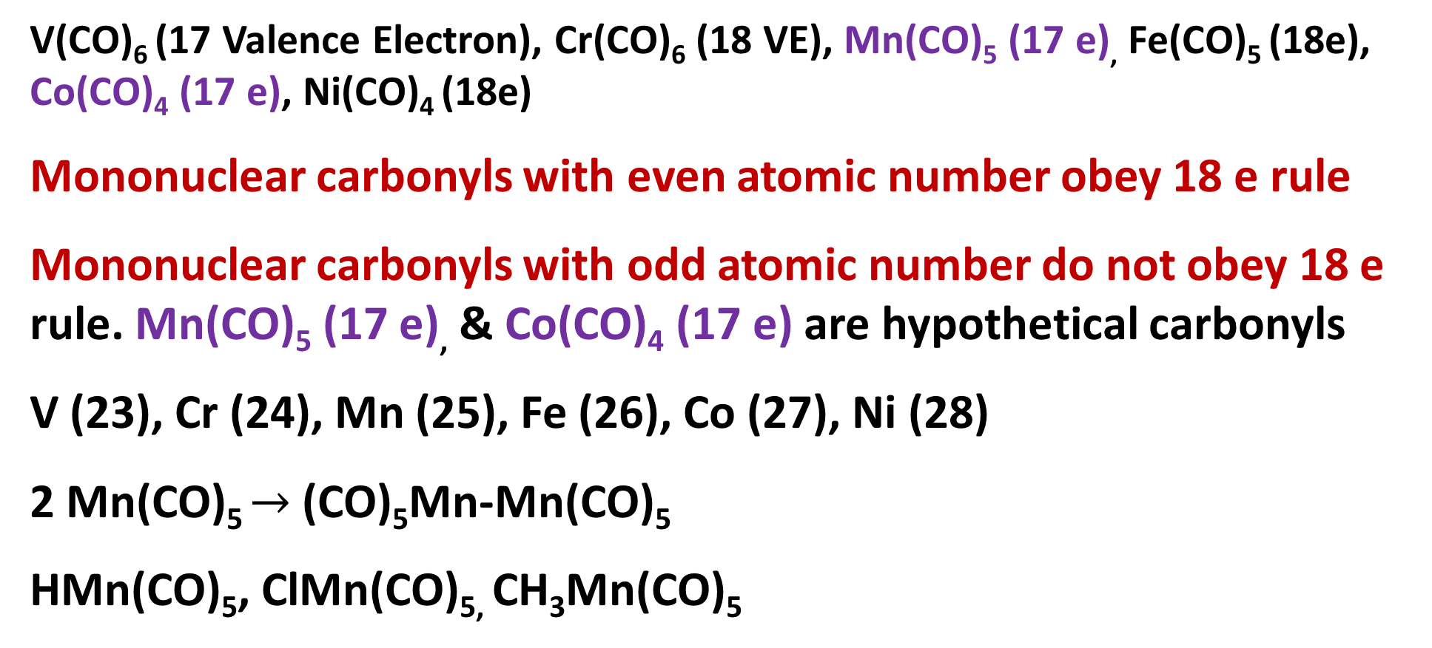
18-electron and 16-electron rules
V(CO)₆ (17 Valence Electron), Cr(CO)₆ (18 VE), Mn(CO)₅ (17 e), Fe(CO)₅ (18e), Co(CO)₄ (17 e), Ni(CO)₄ (18e)
Mononuclear carbonyls with even atomic number obey 18 e rule
Mononuclear carbonyls with odd atomic number do not obey 18 e rule. Mn(CO)₅ (17 e),&Co(CO)₄(17 e) are hypothetical carbonyls
V (23), Cr (24), Mn(25), Fe (26), Co (27), Ni (28)
2 Mn(CO)₅ $→$(CO)₅Mn-Mn(CO)₅
HMn(CO)₅, ClMn(CO)_{5,} CH₃Mn(CO)₅

Slide 20
Easy way to remember ligand electron contribution for neutral atom counting method
Electron contribution
Neutral terminal : CO, PR₃, NR₃ 2 electrons
Anionic terminal : X-, H-, R-, Ar-, R₂N-, R₂P-, RO- 1 electron
Hapto ligands : η²-C₂R₄ η²-C₂R₂, η⁴-C₂R₂ ,η¹-allyl,
η³-allyl, η⁴- Cb, η⁵-Cp, η⁶-C₆H₆
η⁷-C₇H₇ η⁸-C₈H₈ η²-C₆₀, η⁵-R₅C₆₀ same as hapticity
bridging neutral μ₂-CO, μ₃-CO 2 electrons
Bridging anionic μ₂-CH₃, μ₂-H ( no lone pairs) 1 electron
Bridging anionic μ₂-Cl, , μ₂⁻OR, μ₂-PR₂, μ₂-NR₂ 3 electrons
(with 1 lone pair)
μ₃-Cl( 2 l.p) 5 electrons
Bridging alkyne 4 electrons
NO linear 3 electrons
NO bent ( l. p on nitrogen) 1 electron
Carbene M=C 2 electron
Carbyne M≡C 3 electron

Slide 21
Methods of counting: Neutral atom method & Oxidation state method
Ligand | Neutral atom | Oxidation state |  | Ligand | Neutral atom | Oxidation state
 |  | Electron contribution | Formal charge |  |  | Electron contribution | Formal charge
Carbonyl (M–CO) | 2 | 2 | 0 | Halogen ( M–X) | 1 | 2 | –1
Phosphine (M–PR₃) | 2 | 2 | 0 | Alkyl (M–R) | 1 | 2 | –1
Amine (M–NR₃ ) | 2 | 2 | 0 | Aryl (M–Ar) | 1 | 2 | –1
Amide (M–NR₂ ) | 1 | 2 | –1 | acyl (M–C(O)–R | 1 | 2 | –1
Hydrogen (M–H) | 1 | 2 | –1 | η¹-cyclopentadienyl | 1 | 2 | –1
Alkene (sidewise) η²- | 2 | 2 | 0 | η¹-allyl | 1 | 2 | –1
Alkyne (sidewise) η²- | 2 | 2 | 0 | η³-allyl | 3 | 4 | –1
η²-C₆₀ | 2 | 2 | 0 | η⁵-cyclopentadienyl | 5 | 6 | –1
Nitrosyl bent | 1 | 2 | –1 | η⁶-benzene | 6 | 6 | 0
Nitrosyl linear | 3 | 2 | +1 | η⁷-cycloheptatrienyl | 7 | 6 | +1
Carbene (M=CR₂) | 2 | 4 | –2 | Carbyne (M≡CR) | 3 | 6 | –3
Alkoxide (M–OR) | 1 | 2 | –1 | Thiolate (M–SR) | 1 | 2 | –1
μ-CO (M–(CO)–M) | 2 | 2 | 0 | μ-H | 1 | 2 | –1
μ-alkyne | 4 | 4 | 0 | μ-X (M–X–M) X = halogen | 3 | 4 | –1
μ-alkyl | 1 | 2 | –1 | μ-amido (M–(NR₂)–M | 3 | 4 | –1
μ-phosphido (M–(PR₂)–M | 3 | 4 | –1 | μ-alkoxide (M–(OR)–M | 3 | 4 | –1

Slide 22
Applications of 18-electron rule to metal carbonyls
There are 2 methods of e counting
Neutral atom method: Metal is taken as in zero oxidation state for counting purpose
Oxidation state method: We first arrive at the oxidation state of the metal by considering the number of anionic ligands present and overall charge of the complex
For neutral ligand both method gives same result
Suggestion: Focus on one counting method till you are confident
Neutral atom method Oxidation state method
Mn₂(CO)₁₀
Mn⁰ (4S² 3d⁵): 7 VE
5 CO: 10 VE
1 M-M bond: 1 VE
Total 7+10+1 = 18 VE

Slide 23
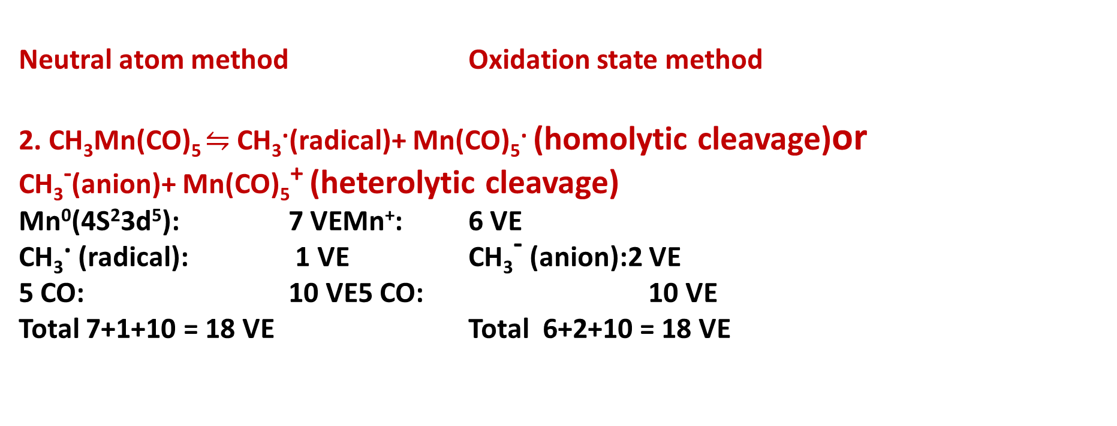
Applications of 18-electron rule to metal carbonyls
Neutral atom method Oxidation state method
2. CH₃Mn(CO)₅ $⇋$ CH₃.(radical)+ Mn(CO)₅. (homolytic cleavage)or
CH₃⁻(anion)+ Mn(CO)₅⁺ (heterolytic cleavage)
Mn⁰(4S²3d⁵): 7 VEMn⁺: 6 VE
CH₃. (radical): 1 VE CH₃⁻ (anion):2 VE
5 CO: 10 VE5 CO: 10 VE
Total 7+1+10 = 18 VE Total 6+2+10 = 18 VE

Slide 24
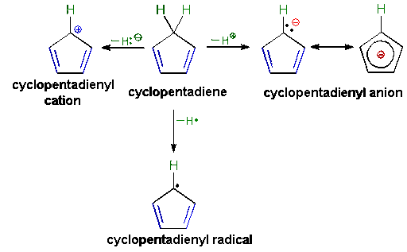
Applications of 18-electron rule to metal carbonyls
heterolytic cleavage
(C₅H₅⁻)
C₅H₆
homolytic cleavage
(C₅H₅.)

Slide 25
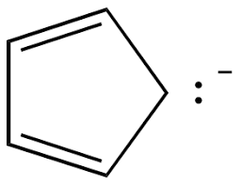
Applications of 18-electron rule to metal carbonyls
Neutral atom method Oxidation state method
2. Ferrocene:Fe(C₅H₅)₂
Fe⁰ (4S² 3d⁶): 8e Fe⁺²: 6e
2 (C₅H₅). (radical): 2x5= 10e 2 (C₅H₅)⁻ (anion): 2x6= 12e
Total 10+8 = 18 e Total 10+8 = 18 e
3. η⁵CpFe(CO)₂Cl:
8(Fe⁰) +5+ (2x2)+1= 18e 6(Fe⁺²) + 6 (Cp)+ (2x2)+2(Cl-)= 18e
4. [Cp₂Co)⁺:
9 (Co⁰) +(5x2) + -1 (for +1)= 18e 6(Co⁺³) + (6x2) = 18e
5. Na₂Fe(CO)n: 2Na⁺ +[Fe(CO)n]²⁻
8(Fe⁰) +(nx2)+2 (for 2-)= 18e, so n=46+Fe(+2)6+ (2x2)+2(Cl-)= 18e

Slide 26
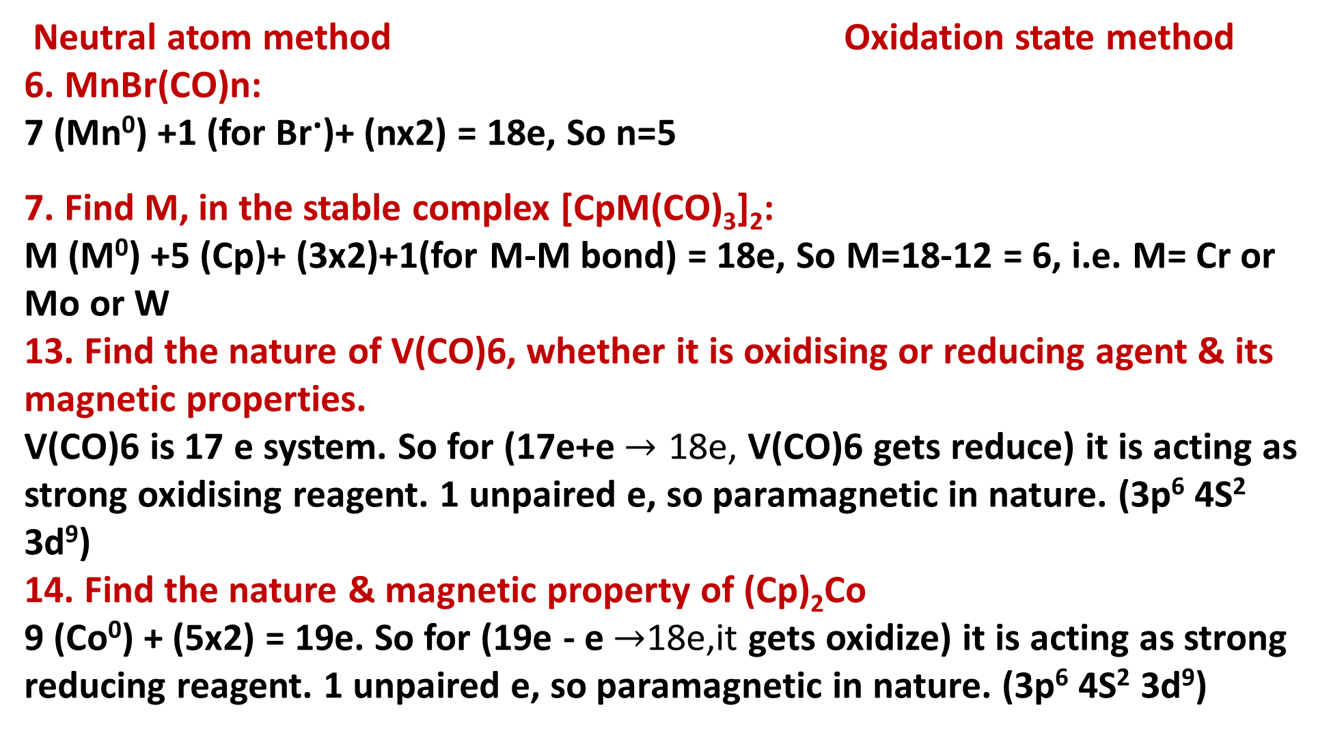
Applications of 18-electron rule to metal carbonyls
Neutral atom method Oxidation state method
6. MnBr(CO)n:
7 (Mn⁰) +1 (for Br.)+ (nx2) = 18e, So n=5
7. Find M, in the stable complex [CpM(CO)₃]₂:
M (M⁰) +5 (Cp)+ (3x2)+1(for M-M bond) = 18e, So M=18-12 = 6, i.e. M= Cr or Mo or W
13. Find the nature of V(CO)6, whether it is oxidising or reducing agent & its magnetic properties.
V(CO)6 is 17 e system. So for (17e+e$→$ 18e, V(CO)6 gets reduce) it is acting as strong oxidising reagent. 1 unpaired e, so paramagnetic in nature. (3p⁶ 4S² 3d⁹)
14. Find the nature & magnetic property of (Cp)₂Co
9 (Co⁰) + (5x2) = 19e. So for (19e - e$→$18e,it gets oxidize) it is acting as strong reducing reagent. 1 unpaired e, so paramagnetic in nature. (3p⁶ 4S² 3d⁹)

Slide 27
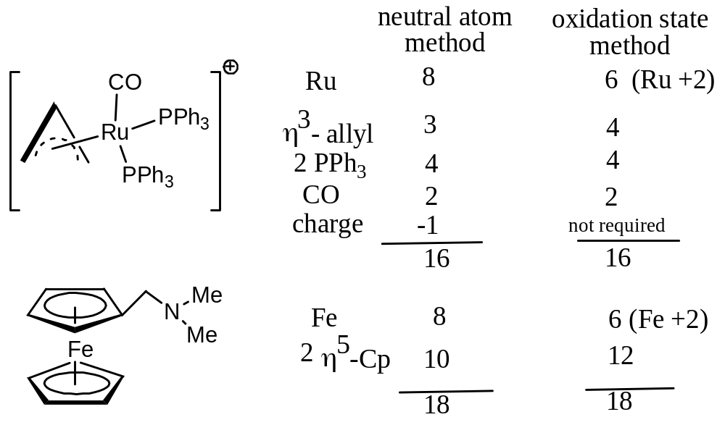
Applications of 18-electron rule to metal carbonyls
15
16

Slide 28
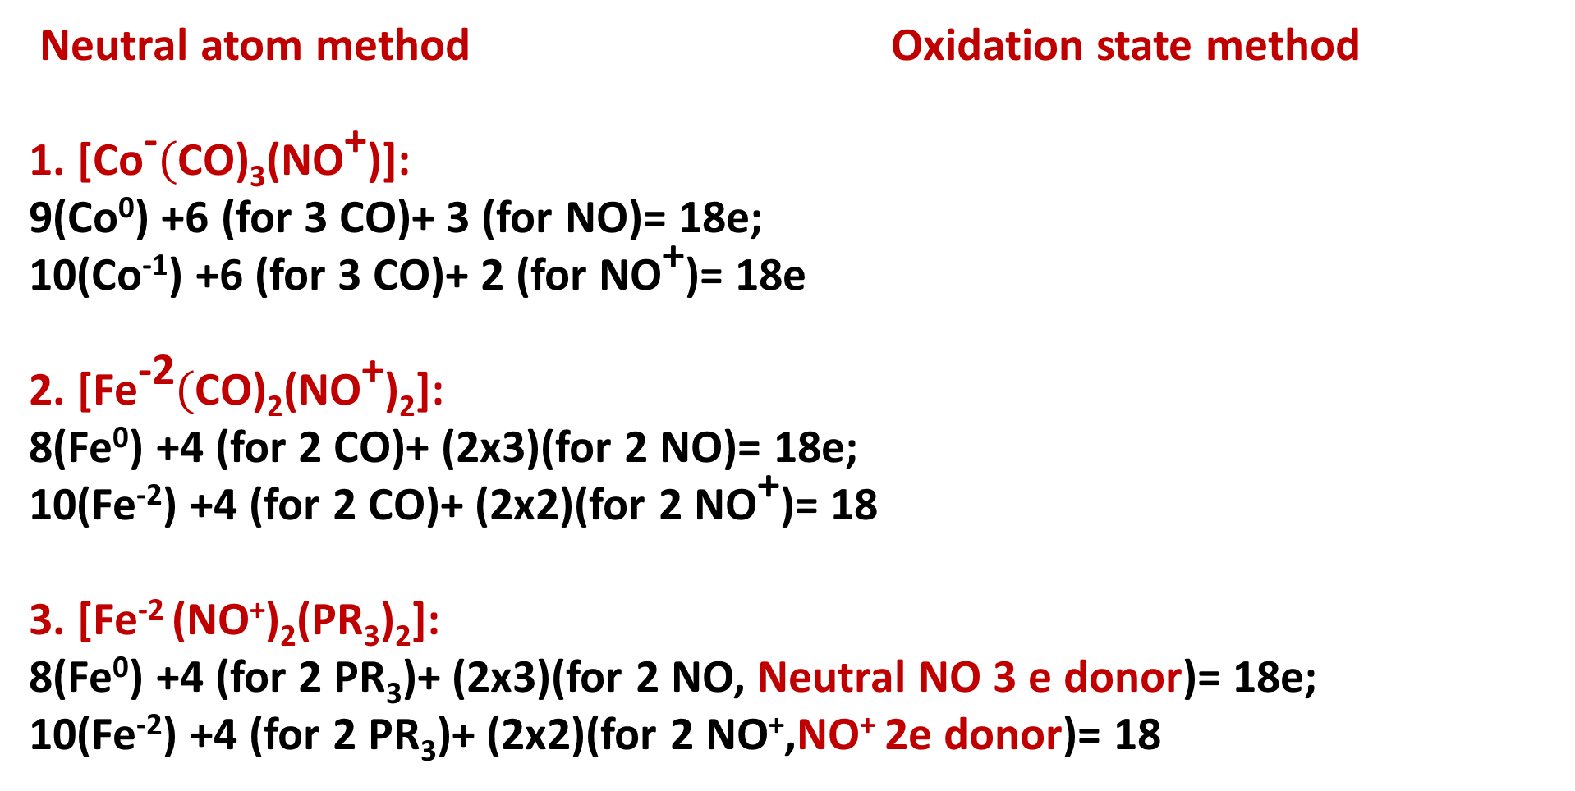
Applications of 18-electron rule to metal nitrosyls, cyanides
Neutral atom method Oxidation state method
1. [Co⁻$($CO)₃(NO⁺)]:
9(Co⁰) +6 (for 3 CO)+ 3 (for NO)= 18e;
10(Co⁻¹) +6 (for 3 CO)+ 2 (for NO⁺)= 18e
2. [Fe⁻²$($CO)₂(NO⁺)₂]:
8(Fe⁰) +4 (for 2 CO)+ (2x3)(for 2 NO)= 18e;
10(Fe⁻²) +4 (for 2 CO)+ (2x2)(for 2 NO⁺)= 18
3. [Fe⁻² (NO⁺)₂(PR₃)₂]:
8(Fe⁰) +4 (for 2 PR₃)+ (2x3)(for 2 NO, Neutral NO 3 e donor)= 18e;
10(Fe⁻²) +4 (for 2 PR₃)+ (2x2)(for 2 NO⁺,NO⁺ 2e donor)= 18

Slide 29
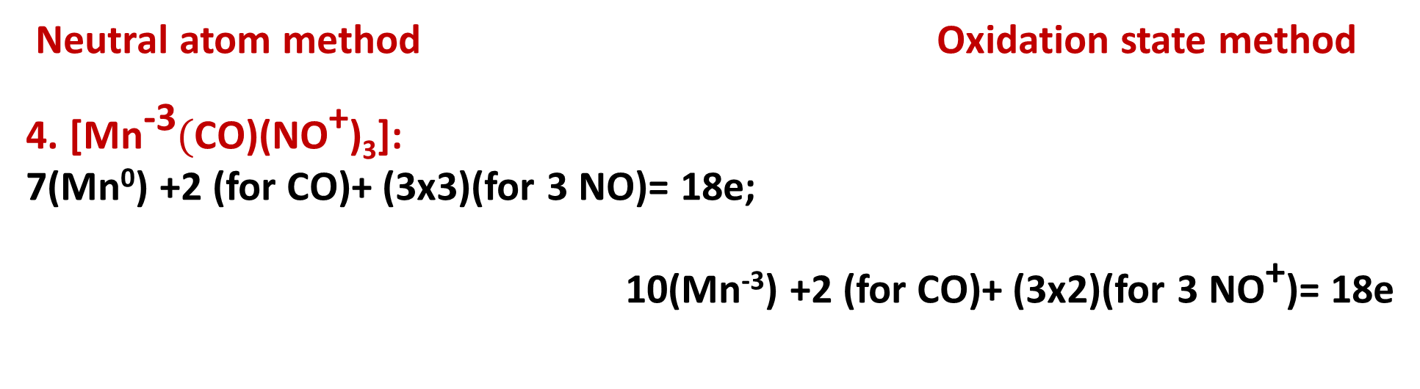
Applications of 18-electron rule to metal carbonyls, nitrosyls, cyanides
Neutral atom method Oxidation state method
4. [Mn⁻³$($CO)(NO⁺)₃]:
7(Mn⁰) +2 (for CO)+ (3x3)(for 3 NO)= 18e;
10(Mn⁻³) +2 (for CO)+ (3x2)(for 3 NO⁺)= 18e

Slide 30
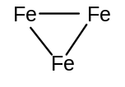
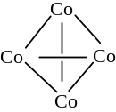
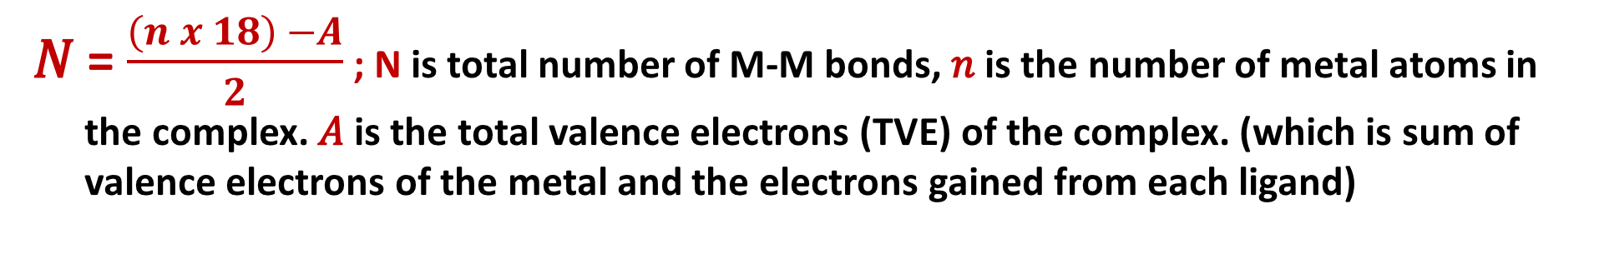
How to determine the total number of metal - metal bonds
𝑁 = $\frac{\left(n x 18\right) −A}{2}$; N is total number of M-M bonds, 𝑛 is the number of metal atoms in the complex. 𝐴 is the total valence electrons (TVE) of the complex. (which is sum of valence electrons of the metal and the electrons gained from each ligand)
Molecule | TVE (A) | (18 × n) – A | Total M–M bonds | Bonds per metal (18-A/n) | Basic geometry of metal atoms
Fe₃(CO)₁₂ | (3x8)+(12x2)=48 | (18x3)=54 54 – 48 = 6 | 6/2 = 3 | 48/3 = 16; 2
Co₄(CO)₁₂ | (4x9)+(12x2)=60 | 72 – 60 = 12 | 12/2 = 6 | 60/4 = 15; 3
[η⁵-CpMo(CO)₂]₂ | 30 | 36 – 30 = 6 | 6/2 = 3 | 30/2 = 15; 3 | Mo≡Mo
(η⁴-C₄H₄)₂Fe₂(CO)₃ | 30 | 36 – 30 = 6 | 6/2 = 3 | 30/2 = 15; 3 | Fe≡Fe
Fe₂(CO)₉ | (2x8)+(9x2)= 34 | (2x18)=36, 36 – 34 = 2 | 2/2 = 1 | 34/2 = 17; 1 | Fe–Fe

Slide 31
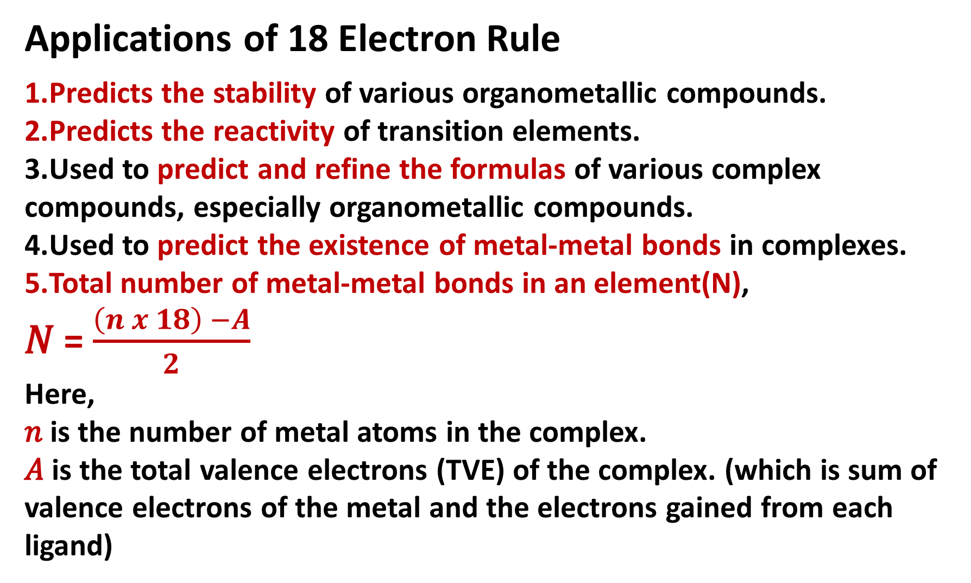
Applications of 18 Electron Rule
Predicts the stability of various organometallic compounds.
Predicts the reactivity of transition elements.
Used to predict and refine the formulas of various complex compounds, especially organometallic compounds.
Used to predict the existence of metal-metal bonds in complexes.
Total number of metal-metal bonds in an element(N),
𝑁 = $\frac{\left(n x 18\right) −A}{2}$
Here,
𝑛 is the number of metal atoms in the complex.
𝐴 is the total valence electrons (TVE) of the complex. (which is sum of valence electrons of the metal and the electrons gained from each ligand)

Slide 32
Exceptions to the 18 electron rule
1. The rule is not applicable to organometallic compounds of main group metals as well as to those of lanthanide and actinide metals.
2. Some organometallic complexes of the early transition metals (e.g. Cp₂TiCl₂, WMe₆, Me₂NbCl₃, CpWOCl₃)
3. Can not predict no. of terminal & bridging Lig (CO)
4. Electronic effects
Late TM with d8 electron configurations e.g. Rh(I), Ir(I), Pd(II), Pt(II) have a strong tendency to form square planar 16 VE complexes. Similarly, d10 complexes tend to form trigonal 16 VE complexes. As the atomic number Z increases, the d-shell is stabilised (lowers in energy). The occupied dz2 orbital (perpendicular to the plane) is no longer involved in ligand bonding.
5. Steric Effects
Early TM have fewer d-electrons to start with than the middle and late TM, so they must achieve their 18e count by coordination of a larger number of ligands. If the ligands involved are too bulky, then low-electron count complexes are formed.

Slide 33
Square planner d⁸ complexes of 4d & 5d transition series of group 9, i.e. Rh(I), Ir (I), and group 10 , i.e. Pd(II), Pt (II), & Cu(III) are 16 e compounds
Neutral atom method Oxidation state method
1. Wilkinson’s catalyst [Cl(PPh₃)₃Rh(I)]:
9(Rh⁰)+1 (for Cl.)+ (3x2)for 2 PPh3 = 16e; 8(Rh⁺¹)+2 (for Cl-)+ (3x2)for 2 PPh3 = 16e
2. Vaska’ complex [Cl(PPh₃)₂(CO)Ir(I)]:
9(Ir⁰) +1(for Cl.) + (2x2)for 2 PPh3 +2 (for CO)= 16e; 8(Ir⁺¹) +2(for Cl-) +(2x2)for 2 PPh3 +2 (for CO)= 16e
3. Zeise’s salt K[Pt(C₂H₄)Cl₃]H₂O: K⁺ + [Pt(C₂H₄)Cl₃]⁻
10(Pt⁰) +3(for 3 Cl.) + 2 for C₂H₄ +1 (for -1)= 16e;
8(Pt⁺²) +6(for 3 Cl⁻) + 2 for C₂H₄ = 16e
16-electron rules

Slide 34
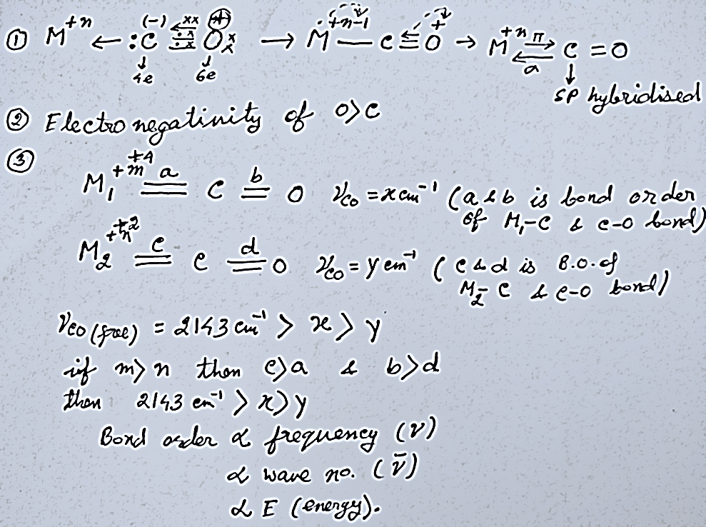
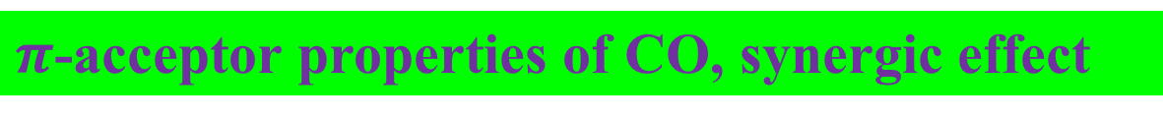
$π$-acceptor properties of CO, synergic effect
More back bonding = More increase of the M-C bond order = More lowering of the C=O bond order = More lower ν _{CO} stretching frequency. ΔE = E₂ – E₁ = hΔν = $\frac{hc}{Δλ}$ = hcΔ$\overline{ν}$, So E$∝\overline{ν}$ (in cm⁻¹)

Slide 35
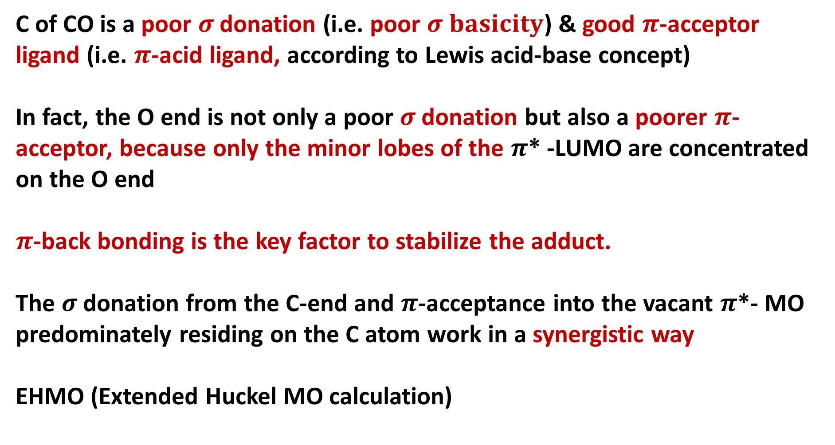
$π$-acceptor properties of CO, synergic effect
C of CO is a poor $σ$donation (i.e. poor $σ basicity$) &good $π$-acceptor ligand (i.e. $π$-acid ligand, according to Lewis acid-base concept)
In fact, the O end is not only a poor $σ$donation but also a poorer $π$-acceptor, because only the minor lobes of the $π$* -LUMO are concentrated on the O end
$π$-back bonding is the key factor to stabilize the adduct.
The $σ$donation from the C-end and $π$-acceptance into the vacant $π$*- MO predominately residing on the C atom work in a synergistic way
EHMO (Extended Huckel MO calculation)

Slide 36
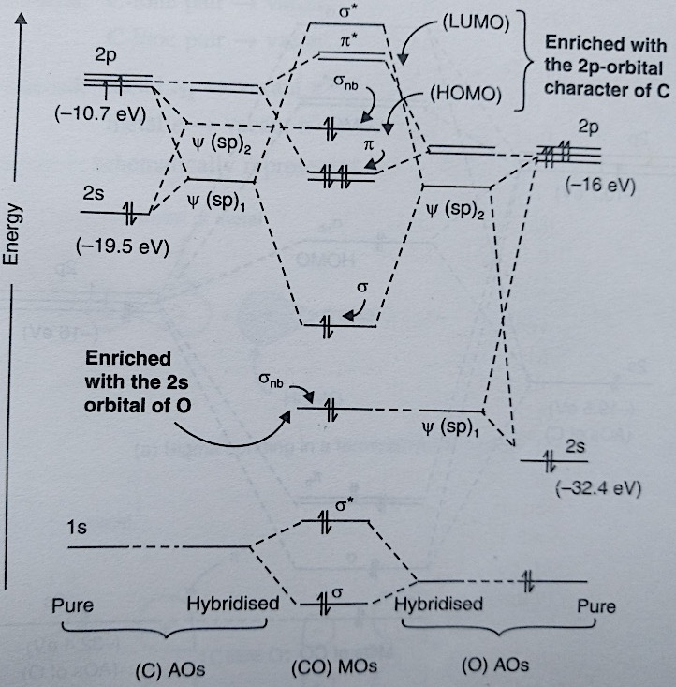
MO energy level diagram of CO
EHMO (Extended
Huckel MO calculation)

Slide 37
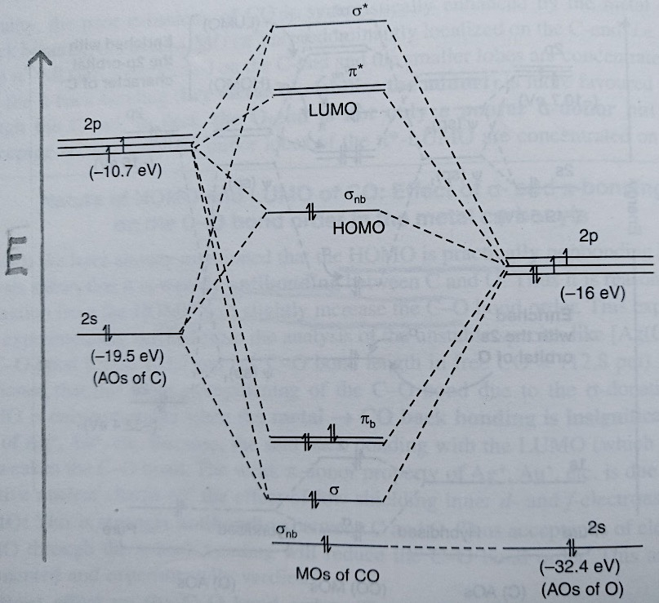
MO energy level diagram of CO

Slide 38
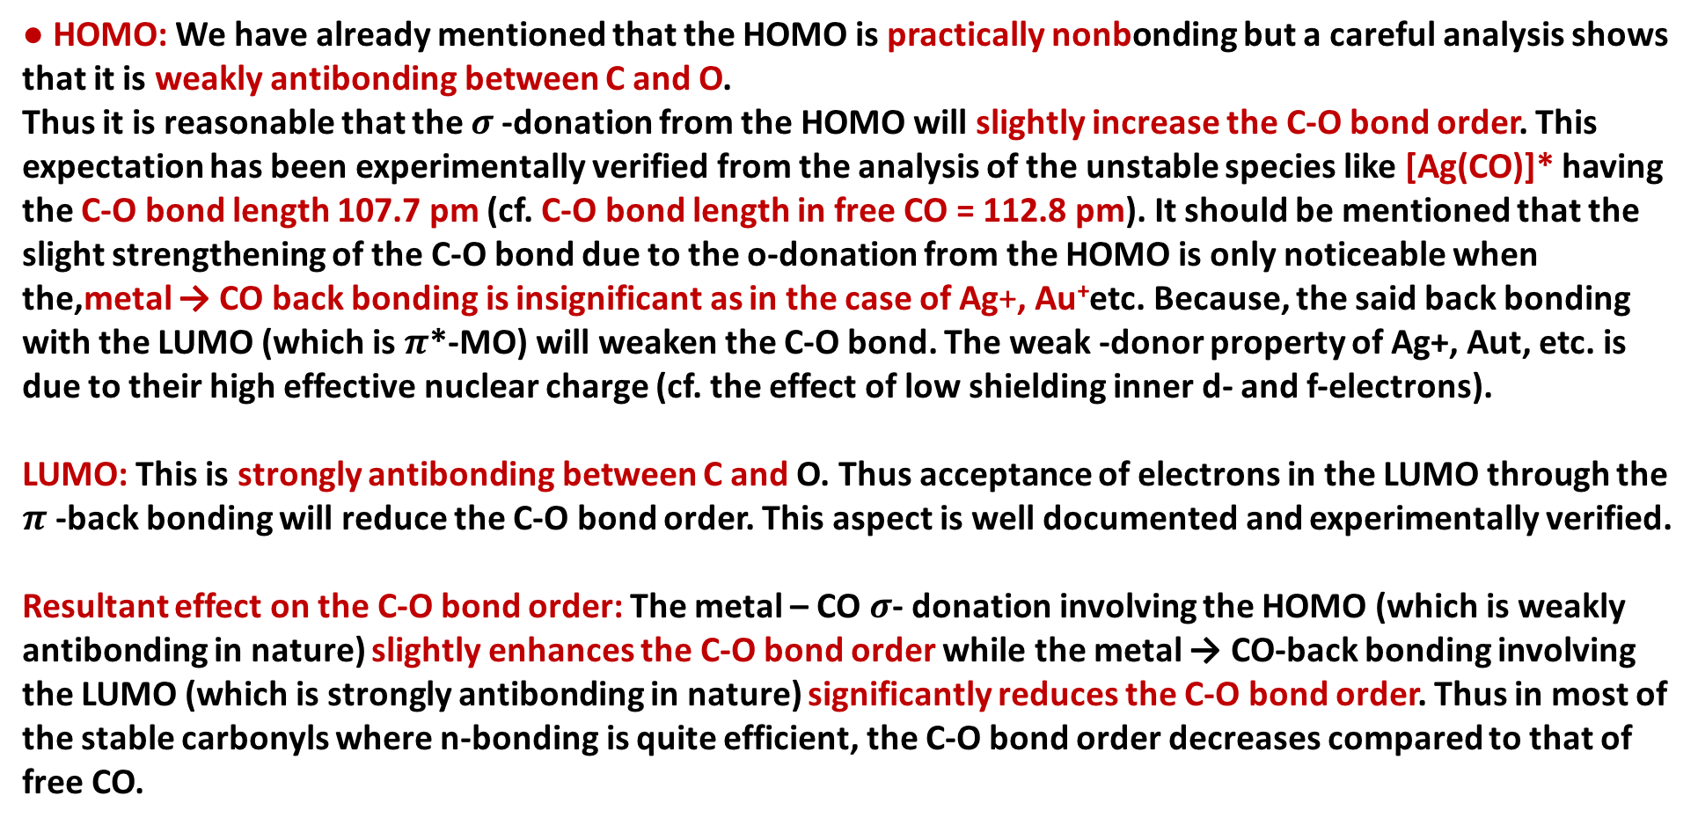
Nature of HOMO and LUMO of CO: Effect of $σ$- and $π$-bonding on the C-O bond order in the metal carbonyls
● HOMO: We have already mentioned that the HOMO is practically nonbonding but a careful analysis shows that it is weakly antibonding between C and O.
Thus it is reasonable that the $σ$-donation from the HOMO will slightly increase the C-O bond order. This expectation has been experimentally verified from the analysis of the unstable species like [Ag(CO)]* having the C-O bond length 107.7 pm (cf. C-O bond length in free CO = 112.8 pm). It should be mentioned that the slight strengthening of the C-O bond due to the o-donation from the HOMO is only noticeable when the,metal → CO back bonding is insignificant as in the case of Ag+, Au⁺etc. Because, the said back bonding with the LUMO (which is $π$*-MO) will weaken the C-O bond. The weak -donor property of Ag+, Aut, etc. is due to their high effective nuclear charge (cf. the effect of low shielding inner d- and f-electrons).
LUMO: This is strongly antibonding between C and O. Thus acceptance of electrons in the LUMO through the $π$-back bonding will reduce the C-O bond order. This aspect is well documented and experimentally verified.
Resultant effect on the C-O bond order: The metal – CO $σ$- donation involving the HOMO (which is weakly antibonding in nature) slightly enhances the C-O bond order while the metal → CO-back bonding involving the LUMO (which is strongly antibonding in nature) significantly reduces the C-O bond order. Thus in most of the stable carbonyls where n-bonding is quite efficient, the C-O bond order decreases compared to that of free CO.

Slide 39
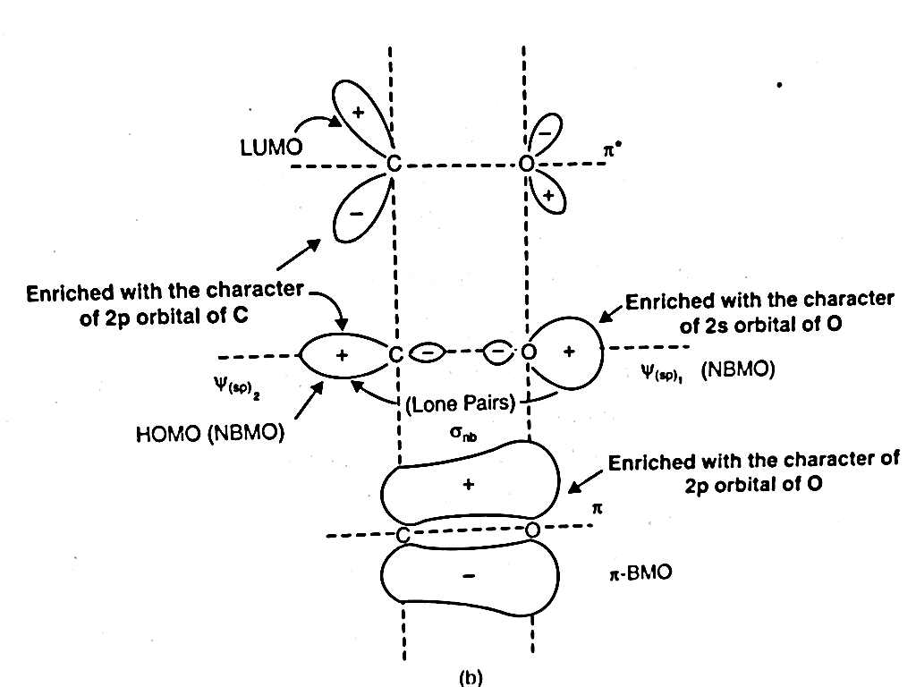
MO energy level diagram of CO

Slide 40
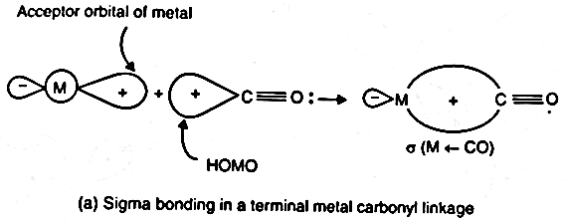
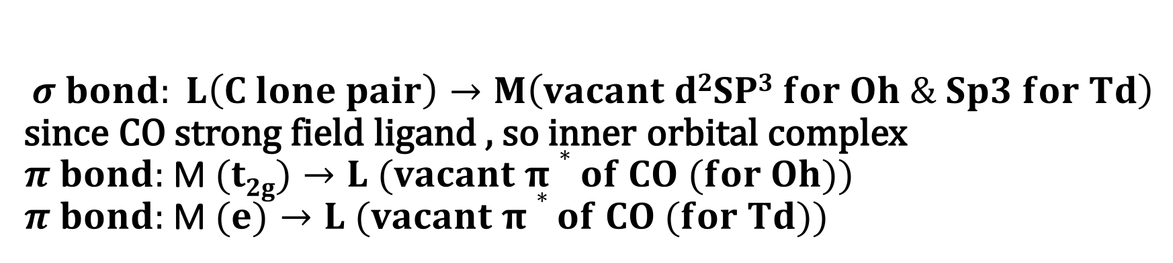
$$σ bond: L\left(C lone pair\right)→M\left(vacant d2SP3 for Oh \& Sp3 for Td\right)$$ since CO strong field ligand , so inner orbital complex
$π bond:$M$(t2g)→L (vacant π∗of CO (for Oh))$
$π bond:$M$(e)→L (vacant π∗of CO (for Td))$
Schematic representation of synergistic $σ$bonding in terminal M-CO bond

Slide 41
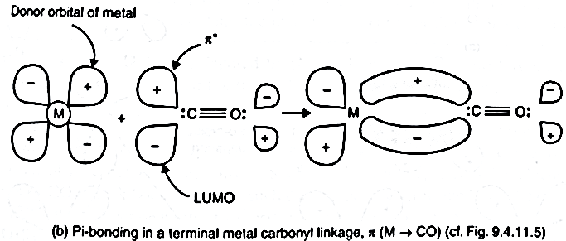
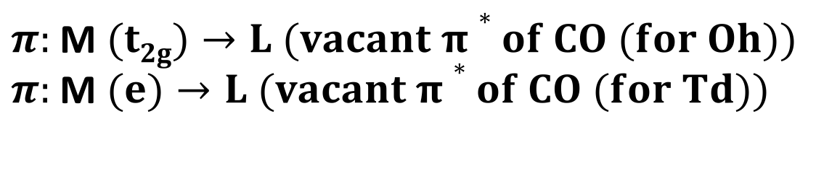
Schematic representation of synergistic $π$ bonding in terminal M-CO bond
$π:$M$(t2g)→L (vacant π∗of CO (for Oh))$
$π:$M$(e)→L (vacant π∗of CO (for Td))$

Slide 42
Use of IR data to explain extent of back bonding
Characterization of Organometallic compounds
X-ray crystallography
Infrared spectroscopy
NMR spectroscopy
Mass spectrometry
Elemental analysis
Others

Slide 43
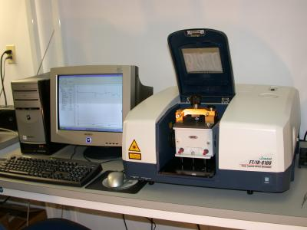
Infrared Spectroscopy- A spectro-analytical tool in chemistry
Infrared (IR) spectroscopy is one of the most common spectroscopic techniques used by organic and inorganic chemists. Simply, it is the absorption measurement of different IR frequencies by a compound positioned in the path of an IR beam. The main goal of IR spectroscopic analysis is to determine the chemical functional groups in the sample. Functional groups are identified based on vibrational modes of the groups such a stretching, bending etc. Different vibrational modes absorb characteristic frequencies of IR radiation. An infrared spectrophotometer is an instrument that passes infrared light through a molecule and produces a spectrum that contains a plot of the amount of light transmitted on the vertical axis against the wave number (in Cm⁻¹) of infrared radiation on the horizontal axis. Absorption of radiation lowers the percentage transmittance value.

Slide 44

Infrared Spectroscopy- A spectro-analytical tool in chemistry
The main goal of IR spectroscopic analysis is to determine the chemical functional groups in the sample. Functional groups are identified based on vibrational modes of the groups such a stretching, bending etc.
When 2 atoms of a diatomic molecule having different electronegativity (ex. CO), generate a dipole moment. Molecules with dipole moment absorbs the radiation from Infra-red region. This increase the vibrational energy within the molecule. Such molecules are IR active. Simple di-atomic linear polar molecules have only one mode of vibration, i.e. the stretching and contraction of bond. Therefore heteronuclear polar molecules like CO, NO, HCl are IR active.
IR study provide information regarding bond orders of M-C and C$−O$bonds. The decrease in C-O bond order or force constant is estimated by frequency of vibration.

Slide 45


Vibrational frequency in IR spectra is given by
$γ$ = 1/2$π\sqrt{\frac{K}{μ}}$ hz or $\overline{ν}$= 1/2$πc\sqrt{\frac{K}{μ}}$ cm⁻¹
[k= force const., $μ$= reduced mass of bonded atoms with mass m₁& m₂, $\frac{1}{μ}$ = $\frac{1}{m_{1}}+ \frac{1}{m_{2}}$]
Frequency $α$ $\sqrt{Force constant}$
Force constant $α$ bond strength
$α$ bond order
So higher $γ$ $→$ Higher bond order
So vibrational frequency of C-O ($γCO$) gives measure of extent of back bonding
More $π$ back bonding $→$ greater e density on antibonding orbital of CO $→$decrease C-O bond order $→$ lower $γCO$

Slide 46

Infrared Spectroscopy- A spectro-analytical tool in chemistry

Slide 47


Infrared Spectroscopy- A spectro-analytical tool in chemistry
ΔE = E₂ – E₁ = hΔν = $\frac{hc}{Δλ}$ = hcΔ$\overline{ν}$, So E$∝\overline{ν}$ (in cm⁻¹)
IR stretching frequency as diagonestic tool to identify ligational motifs, i.e. terminal or bridging CO, single or double or triple bridge CO
$γCO$(in free CO) >$γCO$(in terminal CO) >$γCO$(in $μ2−CO$) >$γCO$(in $μ3−CO$ )
2143 cm⁻¹(C$≡$O) M=C=O (2e-2c) (3c-2e) (4c-2e)

Slide 48




Terminal versus bridging carbonyls
2000 cm-1
2018, 1826 cm-1
1620 cm-1

Slide 49




Infrared Spectroscopy- Spectra of Metal Carbonyls
The range in which the band appears decides bridging or terminal .
The number of bands is only related to the symmetry of the molecule
^{terminal}
bridging
^{terminal}

Slide 50



Coordinating Behaviours of the CO group in Carbonyls
Terminal CO group: 2e donor ligand
Bridging CO group: 2 types, doubly bridge ($μ2−CO$) & triply bridge ($μ3−CO$) (4c-2e $σ−$bonding) ex. [Rh6(CO)12]. 2 types doubly & triply bridge: Symmetric ex: Mn₂(CO)₁₀($μ2−CO$) &Unsymmetric ex. Fe₃(CO)₁₀ ($μ2−CO$). Triply bridging CO gr are described as the apical bridging.
Side on bonding by the $π electrons of CO$:
Semi bridging: Unsymmetric doubly bridge ($μ2−CO$) ex. Os₄(CO)₁₄)
Bonding of CO through O: ex. Unstable isocarbonyl(carbonyl)gold, COAu⁰CO. Str. Has been suggested from spectroscopic data & X-ray difraction study. Condensation of Au with excess CO in a noble gas matrix (matrix isolation) at very low temp. produces it.

Slide 51

Factors which affect ν_{CO} stretching frequencies
1. e- density on metal: Greater the e density on metal $→$ greater the tendency of back bonding $→$ lower bond order of C-O bond $→$ lower $γCO$
2. Charge on the metal: Greater negative charge on metal $→$Greater the e density on metal $→$ greater the tendency of back bonding $→$ lower bond order of C-O bond $→$ lower $γCO$
Greater positive charge on metal $→lower$ the e density on metal $→$ less the tendency of back bonding $→$ greater bond order of C-O bond $→$ higher $γCO$
3. Presence of e- donating ligands: more e- donation power of ligand $→$ increase e- density on metal $→$ more $π$ back bonding $→$ lower bond order of C-O bond $→$ lower $γCO$
4. Effect of co-ligands on $γCO$
5. Effect of co-ligands trans to CO on $γCO$

Slide 52
Factors which affect ν_{CO} stretching frequencies
Charge on the metal
Variation in ν_{CO} (cm^{–1}) of the first row transition metal carbonyls
 | free CO: 2143
Ni(CO)₄: 2057
Co(CO)₄⁻ : 1890 |  | Co₂(CO)₈ :2044(av, ter)
[Fe(CO)₄]²⁻: 1815 |  | Fe(CO)₅: 2030
[Mn(CO)₄]³⁻1600,1790 | Mn(CO)₆ + 2098 | Mn₂(CO)₁₀ 2013 (av)
[Cr(CO)₄]⁴⁻ 1462,1657 | Cr(CO)₆ 2000
 | V(CO)₆¯: 1860 | V(CO)₆: 1976
 | Ti(CO)₆²⁻ : 1747
As the electron density on a metal centre increases, more π-back­bonding to the CO ligand(s) takes place. This weakens the C–O bond further as more electron density is pumped into the empty π* anti-bonding carbonyl orbital. This increases the M–C bond order and reduces the
C-O bond order. That is, the resonance structure M=C=O becomes more dominant.
More back bonding

Slide 53




Effect of co-ligands on $γCO$
2$. Bond$ length parameters in [Mo(CO)₆], [Mo(CO)₃(PPh₃)₃] &[Mo(CO)₃(NH₃)₃]
$$\text{The} π\text{−}\text{accepror} \text{strength} \text{of} \text{isoelectronic} \text{ligands} \text{with} \text{CO} \text{are}$$
$\text{(:}\text{N}≡\text{O}\text{)}\text{+}\text{> (:}\text{C}≡\text{O}\text{:)>(:}\text{N}≡N\text{)>>(:}\text{C}≡\text{N}\text{)}\text{−}$>PR₃> PPh₃
Dien (diethylenetriamine, tridentate neutral lig.), NH3 is only $σ donating ligand$
$γCO$in: (free CO) 2143 cm⁻¹> [Mo(CO)₆] > [Mo(CO)₃(PPh₃)₃] > [Mo(CO)₃(NH₃)₃] Mo-C Bond length order in: [Mo(CO)₆] > [Mo(CO)₃(PPh₃)₃] > [Mo(CO)₃(NH₃)₃]
C-O Bond length order in: [Mo(CO)₆] <[Mo(CO)₃(PPh₃)₃] <[Mo(CO)₃(NH₃)₃]
More favourable factors for M$→$ CO $π$ bonding in [Mo(CO)₃(NH₃)₃]
Less no. of competitive CO groups (3 vs 6)
Absence of competitive interactive interaction from the trans positions

Slide 54


Effect of co-ligands trans to CO on $γCO$
3. Bond length parameters in [Cr(CO)₅(PPh₃)] &[Cr(CO)₆] :
Cr-C distance in [Cr(CO)₆] is 191.5 pm
Cr-C distance trans to PPh₃ in [Cr(CO)₅(PPh₃)] is 184.4 pm
C-O distance in [Cr(CO)₆] is 114.0 pm
C-O distance trans to PPh₃ in [Cr(CO)₆] is 115.4 pm
PPh₃ is good $σ$ donor ligand & weaker $π$- acid ligand than CO.
Since 2 trans $π$- acid ligands will compete for the same two t_{2g} orbitals for $π$ bonding. On the other hand, two cis-$π$- bonding ligands compete through one metal d-orbital.
Thus, a $π$- acid ligand L can affect the $π$- bonding of its trans-CO group more than that of its cis-CO group
The better the σ donating capability of the other ligands on the metal, more electron density given to the metal, more back bonding (electrons in the antibonding orbital of CO) and lower the CO stretching frequency.

Slide 55


Effect of co-ligands trans to COon $γCO$
4. In [M(CO)₅L]
If L better $π$- acceptor ligand (e.g. NO+), then
$γCO$(trans) > $γCO$(cis) > $γCO$(unsubstituted)
If L weaker $π$- acceptor ligand (e.g. PPh₃ or CN⁻), then
$γCO$(trans) < $γCO$(cis) < $γCO$(unsubstituted)
The better the σ donating capability of the other ligands on the metal, more electron density given to the metal, more back bonding (electrons in the antibonding orbital of CO) and lower the CO stretching frequency.

Slide 56

Example
1: [W(CO)₅Cl]- [Re(CO)₅Cl] both are d⁶
$γCO$ < $γCO$
2: [Fe(CO)₅] [Fe(CO)₄Br]
d⁸ (higher e- density) d⁶
$γCO$ < $γCO$
3: [Mo(CO)₄(PMe₃)₂] [Mo(CO)₄(PPh₃)₂]
d⁶ d⁶
PMe₃ is good $σ$electron donor as compared to PPh₃
$γCO$ < $γCO$
4: [Mo(CO)₆] [Mo(CO)₄(PPh₃)₂]
d⁶ d⁶
CO is good $σ$electron donor as compared to PPh₃
$γCO$ > $γCO$

Slide 57

General methods of preparation of mono and binuclear carbonyls of 3d series
Direct synthesis
Ni (s) + 4CO (g)$→$[Ni(CO)₄] (l)(pale yellow), (30⁰C, 1atm, i.e. mild condition)
Fe (s) + 5CO (g)$→$[Fe(CO)₅] (l) (pale yellow),(200⁰C, 200 atm,
2Co (s) + 8CO (g)$→$ [Co₂(CO)₈] (s), (150⁰C, 35 atm)
[Cr(CO)₆] & [Mo(CO)₆] are also prepared in this way

Slide 58
Synthesis of Metal Carbonyls
(B) Reductive carbonylation:
Reduction of metal compounds (generally halides) in presence of CO (generally under at high pressur, 200-300 atm) produces the metal carbonyls.
In some cases, CO may itself act as a reducing agent. This advantage (i.e. no requirement of external reducing agent) is available generally for the metal oxides used as the starting material.
Generally, the temp. & pressure required for the synthesis of carbonyls through the reductive carbonylation are less than those required for the direct combination of CO.

Slide 59

Synthesis of Metal Carbonyls
(B) Reductive carbonylation

Slide 60

General methods of preparation of mono and binuclear carbonyls of 3d series
(C) Thermolysis ($∆$) and photolysis ($hγ$):
Polynuclear carbonyls may be obtained from the thermolysis and photolysis of carbonyls of lower nuclearity. In these reactions, the M-CO bonds are broken and to maintain the 18e rule, the M-M bonds are formed. Thus CO is released.
2$\text{[}\text{Fe}\text{(}\text{CO}\text{)5]}+hγ→\text{[}\text{Fe}\text{2}\text{(}\text{CO}\text{)9]}+$CO
3$\text{[}\text{Fe}\text{2}\text{(}\text{CO}\text{)9]}+∆ →2\text{[}\text{Fe}\text{3}\text{(}\text{CO}\text{)12]}$ + 3CO
3$\text{[}\text{Os}\text{(}\text{CO}\text{)5]}+∆ →\text{[}\text{Os}\text{3}\text{(}\text{CO}\text{)12]}$ + 3CO

Slide 61



Structures of mononuclear carbonyls
[M(CO)₄]
M is sp³
Tetrahedral
[M(CO)₆], M=Fe, Ru
M is dsp³
TBP
[M(CO)₆], M= V, Cr, W,
Mo, M is d²sp³
Octahedral
In all cases, the inner orbital complexes (since CO is strong field ligand) (i.e. low spin complexes in terms of CFT) are formed by using the (n-1) d orbitals in hybridization. To provide the necessary (n-1) d orbitals (i.e. dx²-y² and dz2 for Oh & dz2 for TBP), the electrons are properly arranged within the inner d-orbitals. It is illustrated in next page

Slide 62

Bonding of mononuclear carbonyls-VBT treatment

Slide 63






Structures of binuclear carbonyls
[Fe₂(CO)₉] or [Fe₂(CO)₆($μ2−CO$)₃] vs [Os₂(CO)₉] or [Os₂(CO)₈($μ2−CO$)] Heavier congeners prefer the less bridging CO gr. In mixed metal carbonyl [MnCo(CO)₉] there is no bridging CO gr.
[Mn₂(CO)₁₀](non bridge str.) vs [Co₂(CO)₁₀] (equilibrium mixture of bridged
& non bridged str.), 2$μ2−CO$ at solid state & no bridging at solution

Slide 64

Bonding of mononuclear carbonyls-VBT treatment

Slide 65

Bonding of mononuclear carbonyls-VBT treatment

Slide 66

Bonding of mononuclear carbonyls-VBT treatment

Slide 67

Zeise’s salt (K[Pt(C₂H₄)Cl₃] ): Preparation
Zeise's salt, potassium trichloroplatinate(II), is the chemical compound with the formula K[Pt(C₂H₄)Cl₃] . The anion of this air-stable, pale yellow, coordination complex contains an η²-ethylene ligand. The anion features a platinum atom with a square planar geometry. Organometallic complexes containing unsaturated ligands such as alkenes are consider as olifiniccomlexes.
It is prepared by passing ethylene gas through aqueous solution of potassium tetra chloroplatinate.
K₂[PtCl₄] + H₂C=CH₂ (g) $→$ K[Pt(C₂H₄)Cl₃] +KCl

Slide 68


Zeise’s salt: Structure, evidences of synergic effect
[Pt(C₂H₄)Cl₃]⁻ C-C segment perpendicular to the PtCl3 plane
$γ_{C=C }$= 1623 Cm⁻¹ in free C₂H₄ (C=C is 1.33.5 pm)
$γ_{C=C }$= 1526 Cm⁻¹ in Zeise’s salt C₂H₄ (C=C is 1.37 pm)
The longer C-C bond length (1.37 pm) in the complex compared to that in free C₂H₄ (C=C is 1.33.5 pm) indicates the fact that the vacant $π∗$ of C₂H₄ receives the e cloud in the bonding interaction.

Slide 69

Zeise’s salt: Structure
Important features of the bonding mechanism (Dewar-Chatt-Duncanson, i.e. DCD model) are:
μ-bond:$π$-BMO of ethylene $→$vacant dsp² hybrid orbital of Pt(II)
(a special type of $σ$-bond); $σ$-bond must be cylindrically symmetrical (has $C_{∝ }$), but the $σ$-bond in the DCD model involving an elongated $π$-cloud can never have the $C_{∝ }$ symmetry element.
(ii) $π$bond: suitable d or dp hybrid orbital of Pt(II) $→$ the vacant $π$*-MO of ethylene
(iii) these two bonding interactions ($σ−$ basicity &$π$-acidity) are interdependent (i.e. synergistic action)
(iv) C₂H₄ molecule remains perpendicular to the PtCl₃plane, but this perpendicular orientation is not the essential condition for the DCD type bonding interaction; in fact, the fluxional behaviour (in terms of PMR signal) of the C₂H₄moieties in [(n³-Cp)Rh(C₂H₂)₂] suggests the rotation of the alkene about the metal-alkene complex;
(v) the DCD model explains the elongation of the C-C bond in the coordinated C₂H₄ due to the loss of $π$-bonding electron and gain of electron in the $π$*-MO (137 pm vs. 133.5 pm). However donation of $π$- es and the feeding of es into the $π$* orbitals must weaken the $π bond.$

Slide 70
Zeise’s salt: Evidences of synergic effect
Both Zeise's salt and carbonyl compounds show a synergic effect
The synergic effect is arising due to metal-ligand bonding.
In Zeise's salt, ethylene acts as the donor.
It is a poor donor but due to the back bonding, it becomes better.
In metal carbonyl, the carbonyl group acts as the donor.
It is a poor donor but due to the back bonding, it becomes better.
In Zeise's salt, metal has filled d orbital and ethylene has vacant Π* orbitals, necessary for back bonding.
In Metal carbonyl, metal has filled d orbital and carbonyl has vacant Π* orbitals, necessary for back bonding.
In Zeise's salt C=C bond length increases due to back bonding
In metal carbonyl C=O bond length increases due to back bonding
In Zeise's salt strength of the C=C bond determines the strength of back bonding.
But it weakens the C-C bond
In metal carbonyl strength of the C=O bond determines the strength of back bonding.
But it weakens the C-O bond in carbonyls

Slide 71


Zeise's salt | Metal Carbonyl
1. In Zeise's salt ethylene also a poor donor, due to back bonding ethylene act as better donor. | 1. In Metal Carbonyls CO also a poor donor, due to back bonding CO further act as better donor.
2. In Zeise's salt metals have filled d- orbitals and ethylene Providing vacant $π$* orbital for forming back bonding. | 2. In metal carbonyl metals have filled d-orbitals and carbonyl Providing vacant * orbital for forming back bonding.
3. C=C bond length increases during the formation of back bonding. | 3. C=O bond length increases during the formation of back bonding.
4. In Zeise's salt the strength of back bonding is further depends on the strength of sigma bond. Which is called as Synergetic effect, but it should weaken the C-C bond in alkene. | 4. In Metal Carbonyl the strength of back bonding is further depends on the strength of sigma bond. Which is called as Synergetic effect, but it should weaken the C-O bond in carbonyls.

Slide 72


















Metal- Sandwich compounds
Bent Sandwich
Hapticity of sandwich compounds varies from 1-8
Half Sandwich

Slide 73

Why metal – sandwich compounds are important?
1. Transition metal/ metal ion embedded inside an organic matrix: Makes a metal ion soluble even in hydrocarbon solvents. E.g. Ferrocene is soluble in hexane while Fe2+ as such is not. Outcome: a hydrocarbon soluble additive/catalyst
2. Coordination to an electropositive metal often changes the reactivity and electronic properties of the π system bound to it (benzene vs ferrocene)
3. A stericially protected metal site where a wide range of catalytic applications are possible on the. e.g alkene polymerization
4. Metal sandwich compounds are excellent substrates to make planar chiral compounds. Applications as chiral catalysts in asymmetric catalysis
Planr chirality:
Non- super-imposable mirror images

Slide 74


Ferrocene: Preparation

Slide 75


Ferrocene: reactions (Friedel Craft’s Acetylation
Cyclopentyl rings of ferrocene are aromatic in character. So ferrocene undergoes electrophilic substitution reactions. Many of its reactions are faster than similar reactions of benzene. Necessary requirement: The electrophile should not be oxidizing in nature
+
Trace
1,1’ pdt : 1,1 pdt = 60 : 1

Slide 76


Ferrocene: reactions (Alkylation, Mannich Condensation)

Slide 77

Ferrocene: reactions (Mannich Condensation)
This easy metallation process suports the typical aromatic systems in the Cp-rings of ferrocene. Thus the lithio- derivatives obtained may be used in many reactions to prepare the ferrocenyl derivatives

Slide 78
Reactions of organometallic complexes
Substitution
Oxidative Addition
Reductive Elimination
Insertion

Slide 79

1. Substitution
Ligand Substitution Reaction
[Cr(CO)₆] + PMe₃ $→$ [Cr(CO)₅(PMe₃)] + CO
[Ni(CO)₄] + PPh₃ $→$ [Ni(CO)₃(PPh₃)] + CO

Slide 80

1. Substitution

Slide 81

1. Substitution

Slide 82


2. Oxidative addition
When addition of ligands is accompanied by oxidation of the metal, it is called an oxidative addition reaction
OX state of metal increases by 2 units
Coordination number increases by 2 units
2 new anionic ligands are added to the metal
Requirements for oxidative addition
two vacant coordination sites on the reacting complex (L_{n}M), that is, the complex must be coordinatively unsaturated,
a metal with stable oxidation states separated by two units; the higher oxidation state must be energetically accessible and stable.
An important step in many homogeneous catalytic cycles
The more electron rich the metal, more easy is the oxidative addition

Slide 83

Examples of Oxidative addition : Cis or trans ?
Homonuclear systems (H₂, Cl₂, O₂, C₂H₂) Cis
Heteronuclear systems (MeI) Cis or trans

Slide 84

3. Reductive elimination
Almost the exact reverse of Oxidative Addition
Pt⁴⁺
Pt²⁺
Oxidation state of metal decreases by 2 units
Coordination number decreases by 2 units
2 cis oriented anionic ligands form a stable σ bond and leave the metal
Factors which facilitate reductive elimination
a high formal positive charge on the metal,
the presence of bulky groups on the metal, and
an electronically stable organic product.
Cis orientation of the groups taking part in reductive elimination is a MUST
Final step in many catalytic cycles

Slide 85


4. Insertion
No change in the formal oxidation state of the metal
A vacant coordination site is generated during a migratory insertion (which gets occupied by the incoming ligand)
The groups undergoing migratory insertion must be cis to one another
These reactions are enthalpy driven and although the reaction is entropy prohibited the large enthalpy term dominates

Slide 86



Types of Migratory Insertion

Slide 87
Reference
Ashim K Das & Mahua Das, Fundamental Concept of Inorganic Chemistry, CBC Publishers & Distributors, Volume 6, First Edition: 2014
Ashim K Das & Mahua Das, Fundamental Concept of Inorganic Chemistry, CBC Publishers & Distributors, Volume 3, First Edition: 2014
Wahid U. Malik, G. D. Tuli & R. D. Madan, Selected topics in inorganic chemistry, S. Chand & Company Ltd, first edition
Christoph Elschenbroich, Organometallics, 3rd Completely Revised and Extended Edition, Wiley-VCH Verlag GmbH & Co. KGaA, Weinheim, Germany, 2006
Robert H Crabtree, The Organometallic Chemistry of the Transition Metals, 4th Edition, John Wiley & Sons, Inc., Hoboken, New Jersey, 2005
B D Gupta and A J Elias, Basic Organometallic Chemistry, University Press (India) Pvt Ltd., 2010

Slide 88
Thank you

