Slide 1
Coordination Chemistry-I (part-1)
Dr. Semanti Basu
Assistant Professor
Department of Chemistry
Bejoy Narayan Mahavidyalaya,
Itachuna, Hooghly, W. B., India

Slide 2
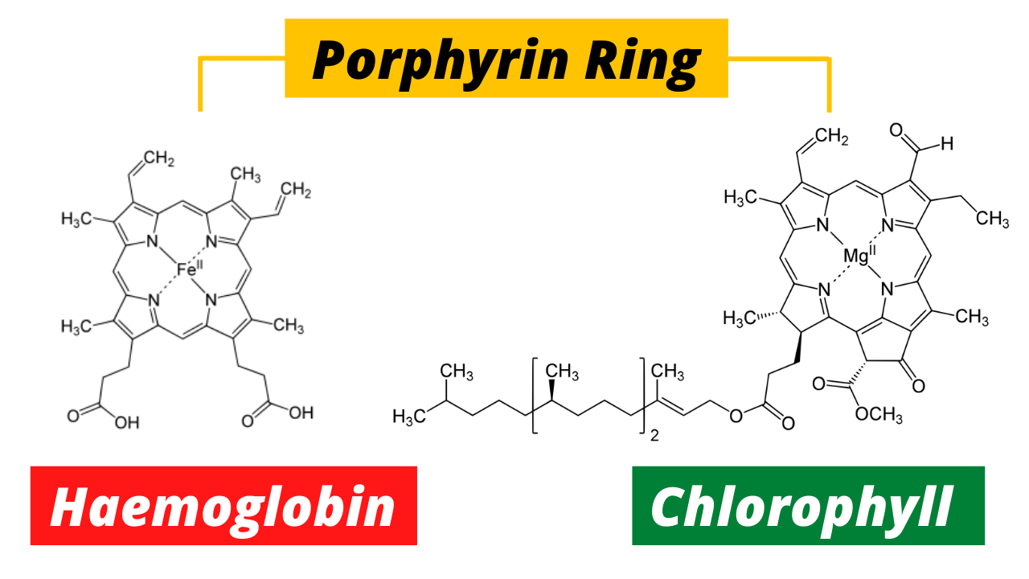
Natural Coordination Complexes

Slide 3
Importance of Coordination Chemistry
• In the natural world, complexes of iron, haemoglobin, myoglobinand, cytochrome are known as oxygen transport, oxygen storage and electron transport molecules respectively.
• Some complexes of iron, zinc, copper and molybdenum are involved in enzymatic processes in biological systems.
• Medicines like cis-platinand carboplatin are anticancer drugs.
• Some 3-d metal Schiff base complexes are known for their antitumor activity.
• Many industrial catalysts are metal complexes like Wilkinson catalyst
• In analytical chemistry, separation of metal ions, Ag⁺, Hg₂²⁺, Cu²⁺, Cd²⁺, Ni²⁺,Co²⁺ etc. is achieved by complex formation reactions.
• Quantitative estimation of Ca²⁺ and Mg²⁺ ions is performed titrimetrically using ethylenediamine tetra acetic acid.
• The concentration of metal ions, Cu²⁺, Co²⁺, Zn²⁺ and Ni²⁺ etc. is determined gravimetrically as their stable complexes.

Slide 4
Double salts and complex salts or compounds
Double salts | complex salts
1. These exist only in solid state and dissociate constituent species in their solution. | 1. They retain their identity in solid as well as in solution state.
2. Ex. Mohr's salt: FeSO₄. (NH₄)2SO₄.6H₂O | 2. Ex. [Co(NH₃)₄Cl₂]Cl .
3. Hydrolysis: FeSO4. (NH₄)2SO₄.6H₂O → Fe⁺², NH4⁺, SO₄⁻² | 3. Hydrolysis: [Co(NH₃)₄Cl₂]Cl → [Co(NH₃)₄Cl₂]⁺ + Cl⁻
4. They lose their identity in dissolved state. Their properties are essentially the same as those of constituent species. | 4. They do not lose their identity in dissolved state. Their properties are different from those of their constituents. For example [Co(NH₃)₄Cl₂]⁺ does not show the test of Co⁺³ , , NH4⁺ and Cl⁻ ions.
5. In double salts the metal atom/ion exhibit normal valency. | 5. In co-ordination compounds, the number negative ions or molecules surrounding the central metal atom is beyond its normal valency.

Slide 5
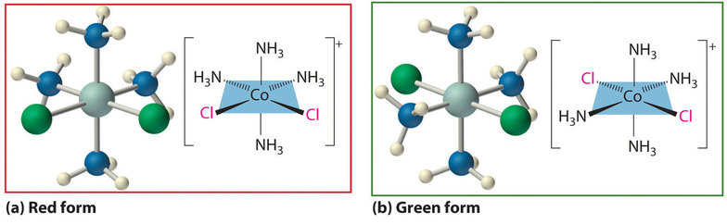
Coordination Compounds
A compound containing coordinate bonds, typically between a central metal atom and a number of oppositely charged ions or neutral atoms more than its normal valency

Slide 6
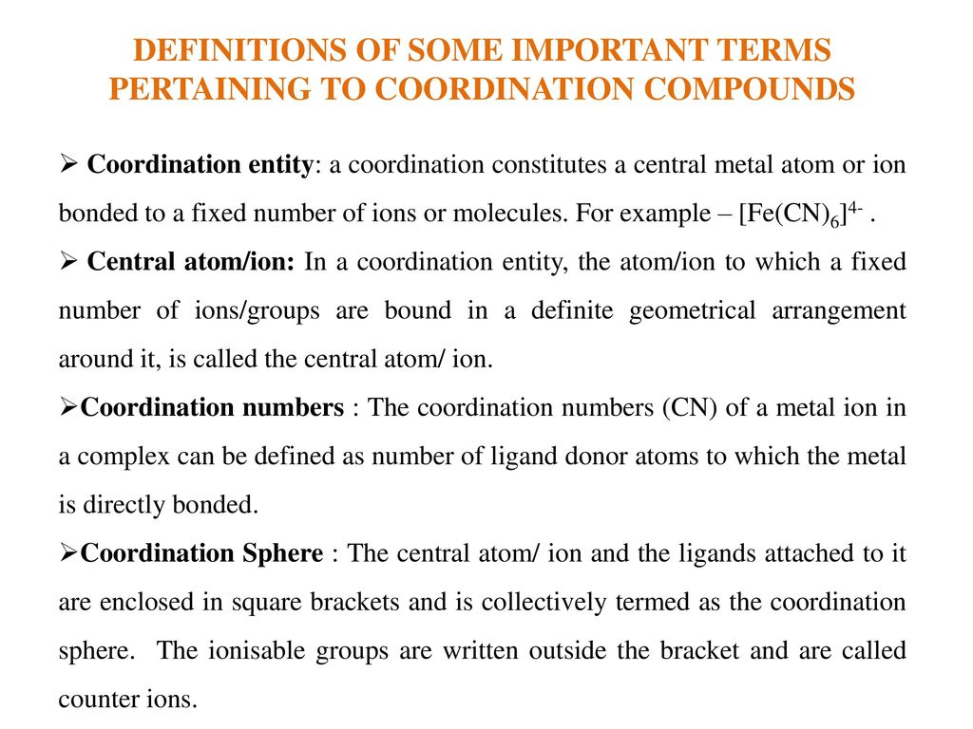

Slide 7
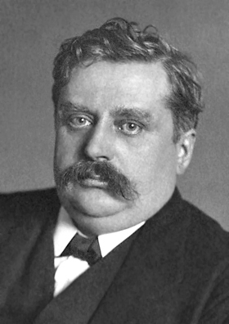
Werner’s Theory of Coordination Complex
Father of Coordination Chemistry
It was the 1st example of Nobel Prize in Inorganic Chemistry
Alfred Werner
Swiss Chemist
Nobel prize on 1913

Slide 8
Werner’s Theory of Coordination Complex
Postulate (1893)
In coordination compounds central metal ion possess two types of valency (means linkage), primary valency and secondary valency.
2. The primary valances are ionizable and are satisfied by negative ions and is equal to oxidation number of the metal (Ionization sphere).
3. Secondary valances are non-ionizable. These are satisfied by neutral molecules or negative ions. Secondary valency is equal to coordination number and is fixed for a metal (Coordination sphere).

Slide 9
Werner’s Theory of Coordination Complex
Postulate (1893)
4. Secondary valances are directional and so a complex has a particular shape The number and arrangement of ligands in space determines the stereochemistry of a complex
Primary valency = Oxidation number
Secondary valency = Coordination number

Slide 10
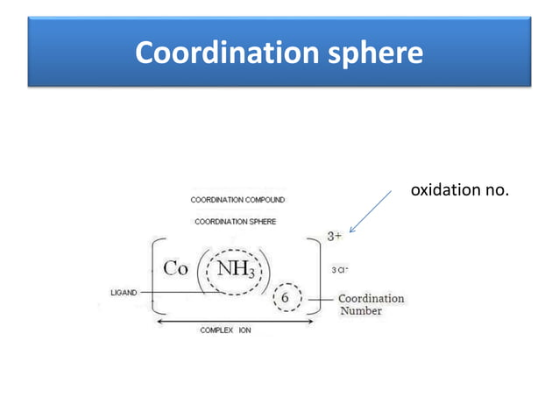

Slide 11
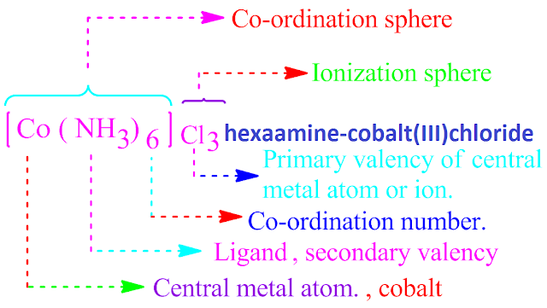
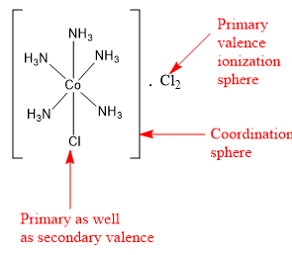
Werner’s Theory

Slide 12
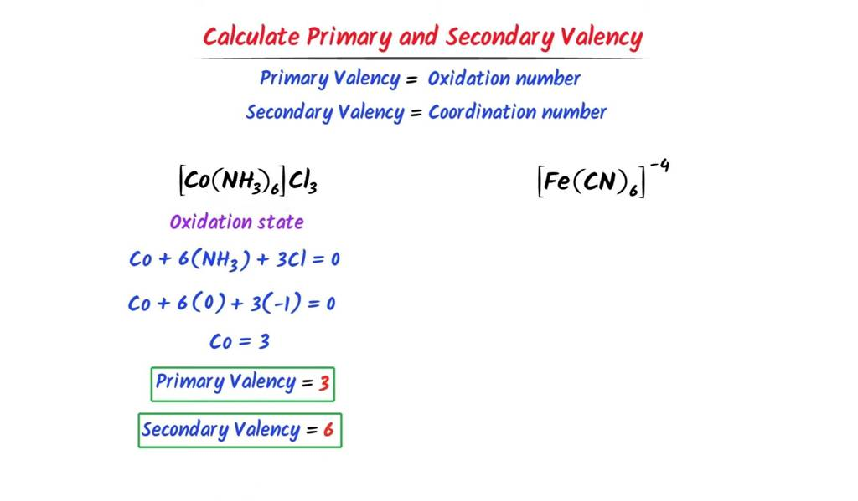
Werner’s Theory

Slide 13
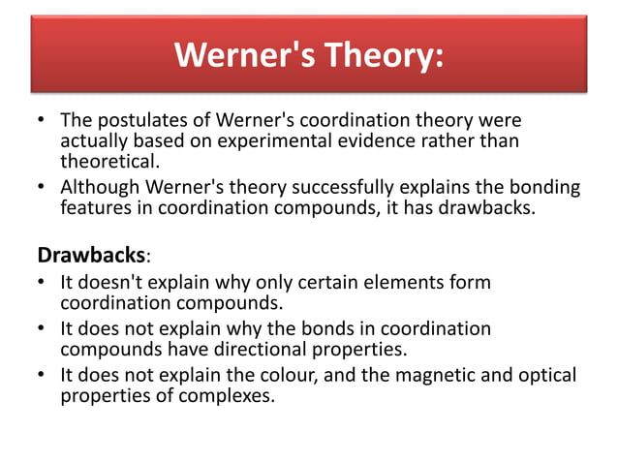

Slide 14
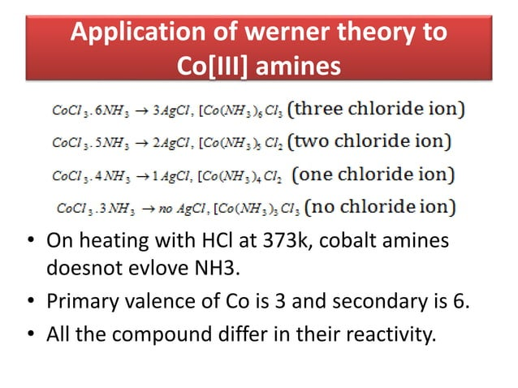

Slide 15
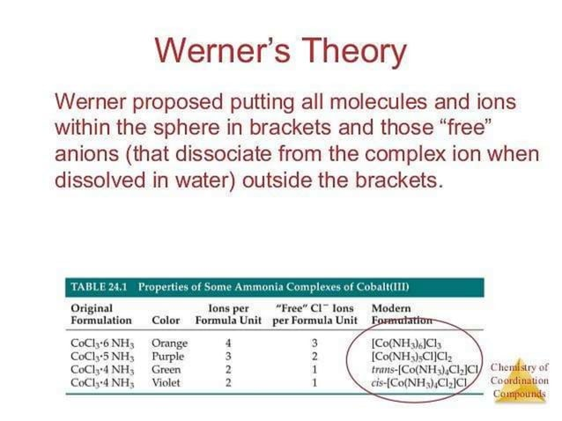

Slide 16
Coordination Complex
• A coordination complex consists of a central atom or ion which is usually metallic and is called coordination center and a surrounding array of bound molecules or ions that are in turn, known as ligands or complexing agents.
• Ligands are Lewis bases containing at least one pair of electrons to donate to a metal atom or ion.
Nature of complex
Depending on the charge, a complex may be cationic, anionic or neutral.
[Fe(H₂O)₆]²⁺ : Cationic complex
[Fe(CN)₆]⁴⁻: Anionic complex
[Ni(CO)₂]: Neutral complex
•Metal Is usually a transition metal. Transition metals are-
(i)Small, highly charged ions with variable oxidation states
(ii) Possess vacant / filled orbitals of right energy to accept electrons.

Slide 17
Coordination Number
• Number of atoms, ions or molecules that a central atom or ion holds as its nearest neighbors in a complex or coordination compound or in a crystal is known as coordination number.
• Ligands: The molecule or ion which are coordinated to a central metal atom or ion. They are classified in various ways-On the basis of charge, ligand may be neutral, anionic and cationic.
(a)Anionic-halide ions, CN⁻
(b)Cationic-NO⁺, [N₂H₅]⁺
(c)Neutral: NH₃, H₂O
•On the basis of ligand field strength
(a)Weak field ligands: I⁻, Br⁻, Cl⁻, F⁻, H₂O
(b)Strong field ligands: CN⁻, CO, o-dipyridyl, 1,10 phenanthroline, ethylenediamine, ammonia, pyridine

Slide 18
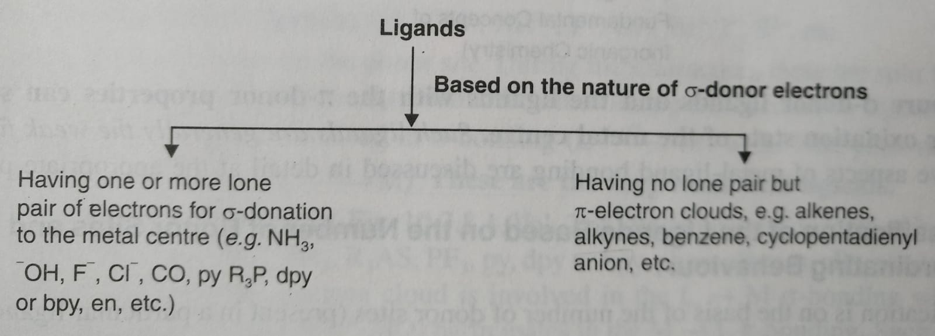
Ligand
On the basis of nature of bonding i.e. donor & acceptor properties of ligand

Slide 19
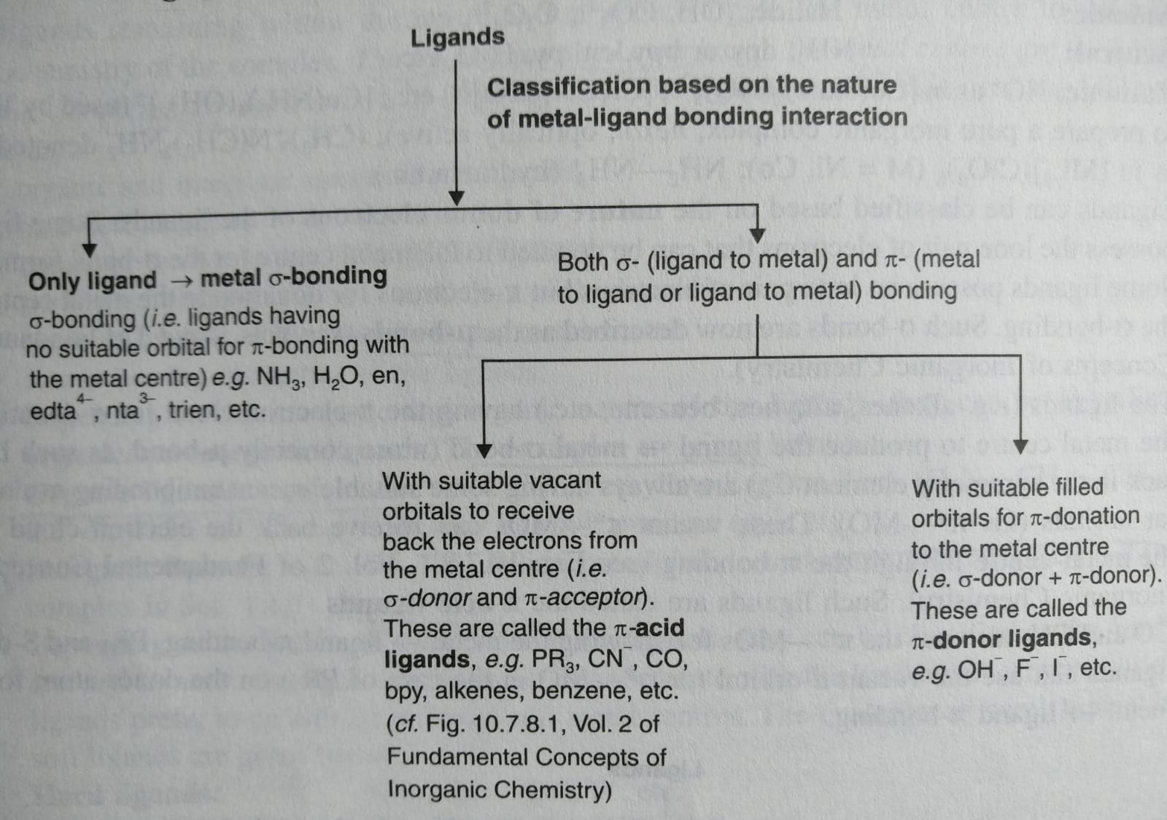
Ligand

Slide 20
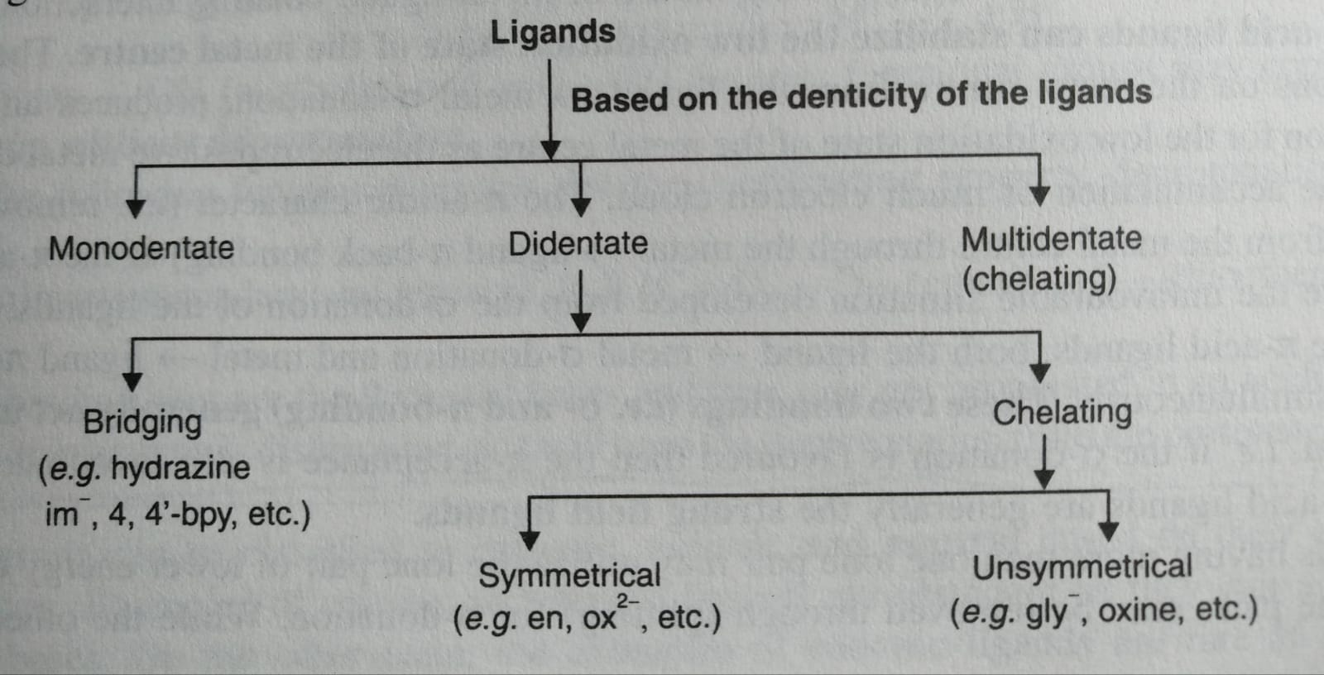
Ligand

Slide 21
Ligand
On the basis of number of coordinating sites
Monodentate = 1 (NH₃, H₂O)
Bidentate = 2 (bpy, phen)
Tridentate = 3 (di ethylene tri-amine)
Tetradentate = 4 (tri-ethylene tetra-amine)
Penta dentate =5 (ethylenediamine triacetic acid anion),
Hexadentate = 6 (EDTA)
polydentate = 2 or more donor atoms
polydentate = Chelating ligand

Slide 22
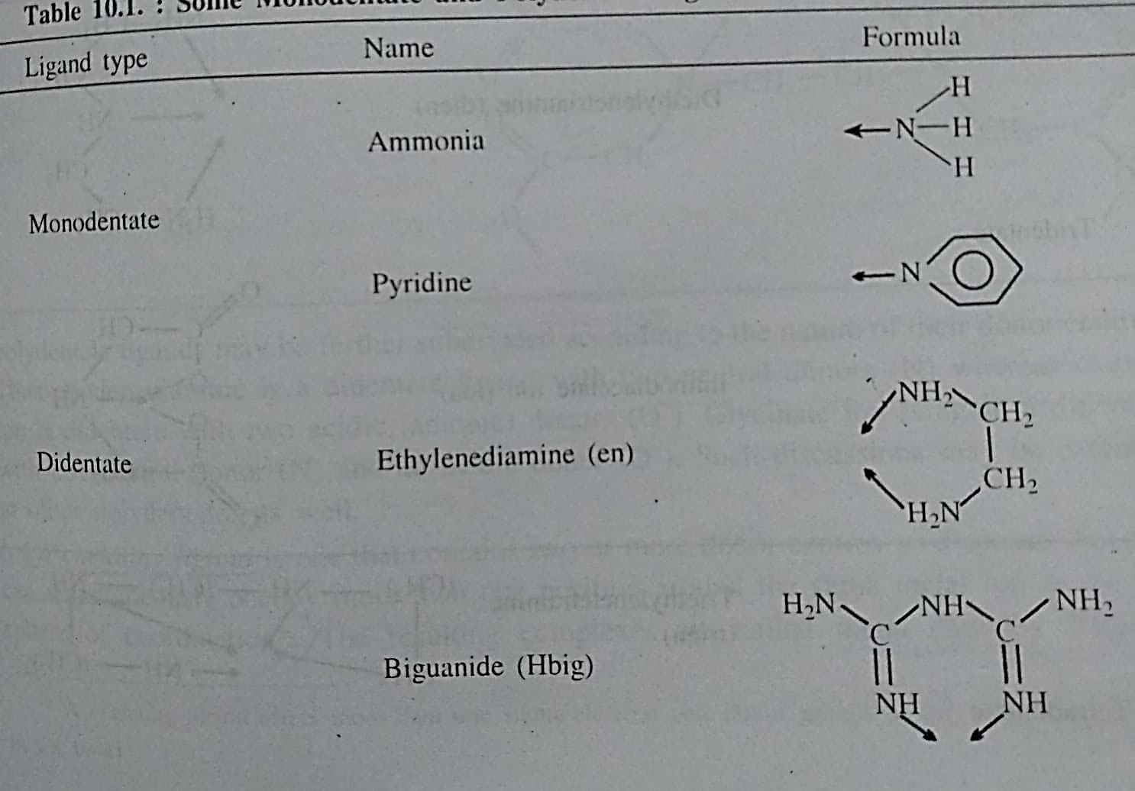
Ligand

Slide 23
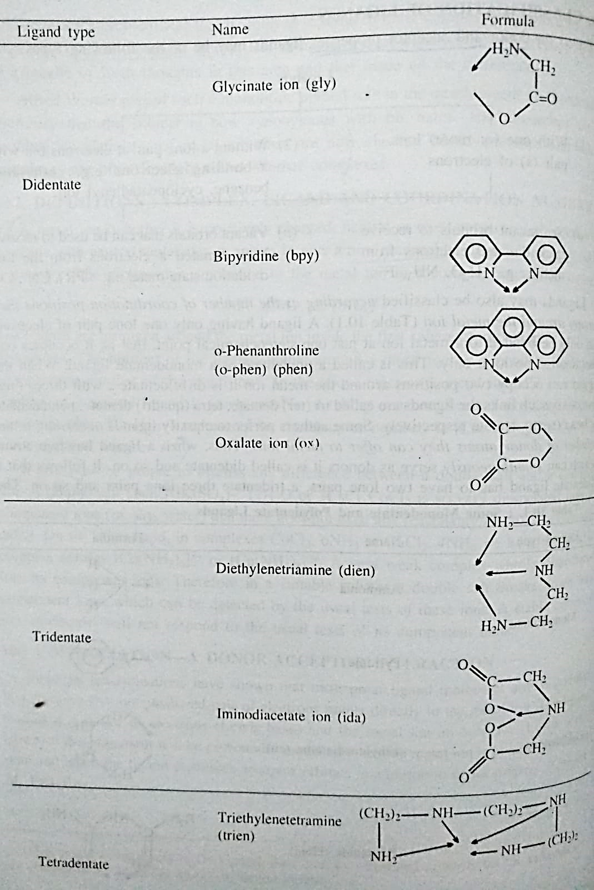
Ligand

Slide 24
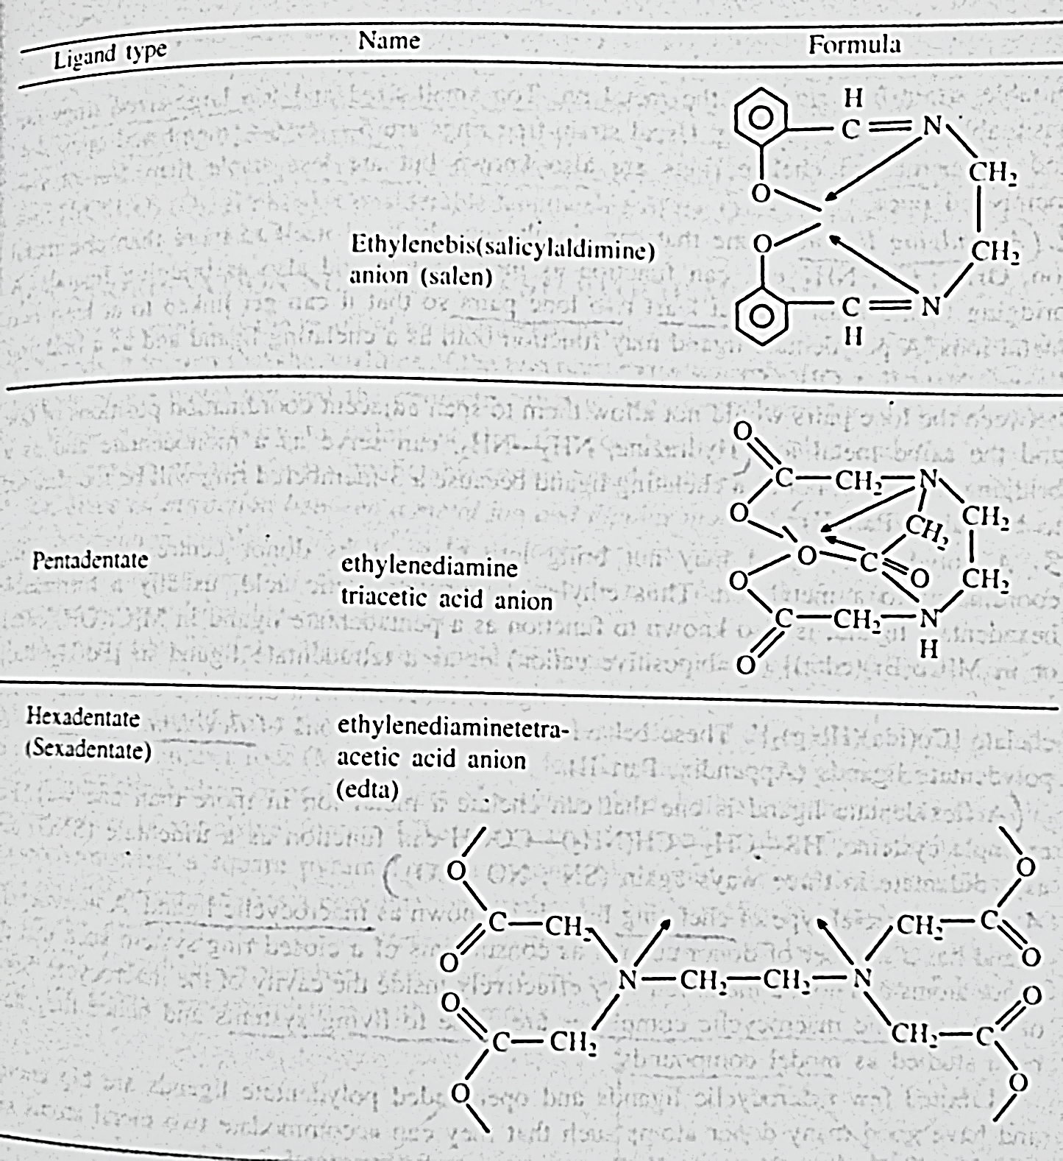
Ligand

Slide 25
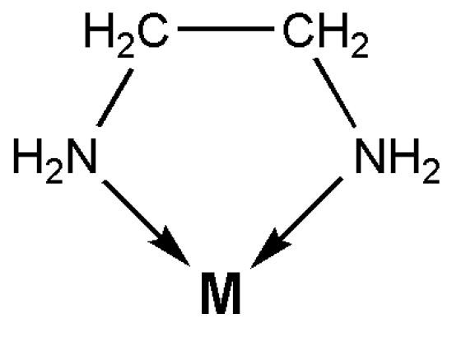
Ligand
Chelating: A chelating ligand is one that contains two or more donor centers convergent towards the same metal ions. The resulting complexes are called metal chelate.
Stable 5 & 6 membered chelate ring
4 & 7 membered rings are known but less stable
3 membered chelate ring is rare

Slide 26
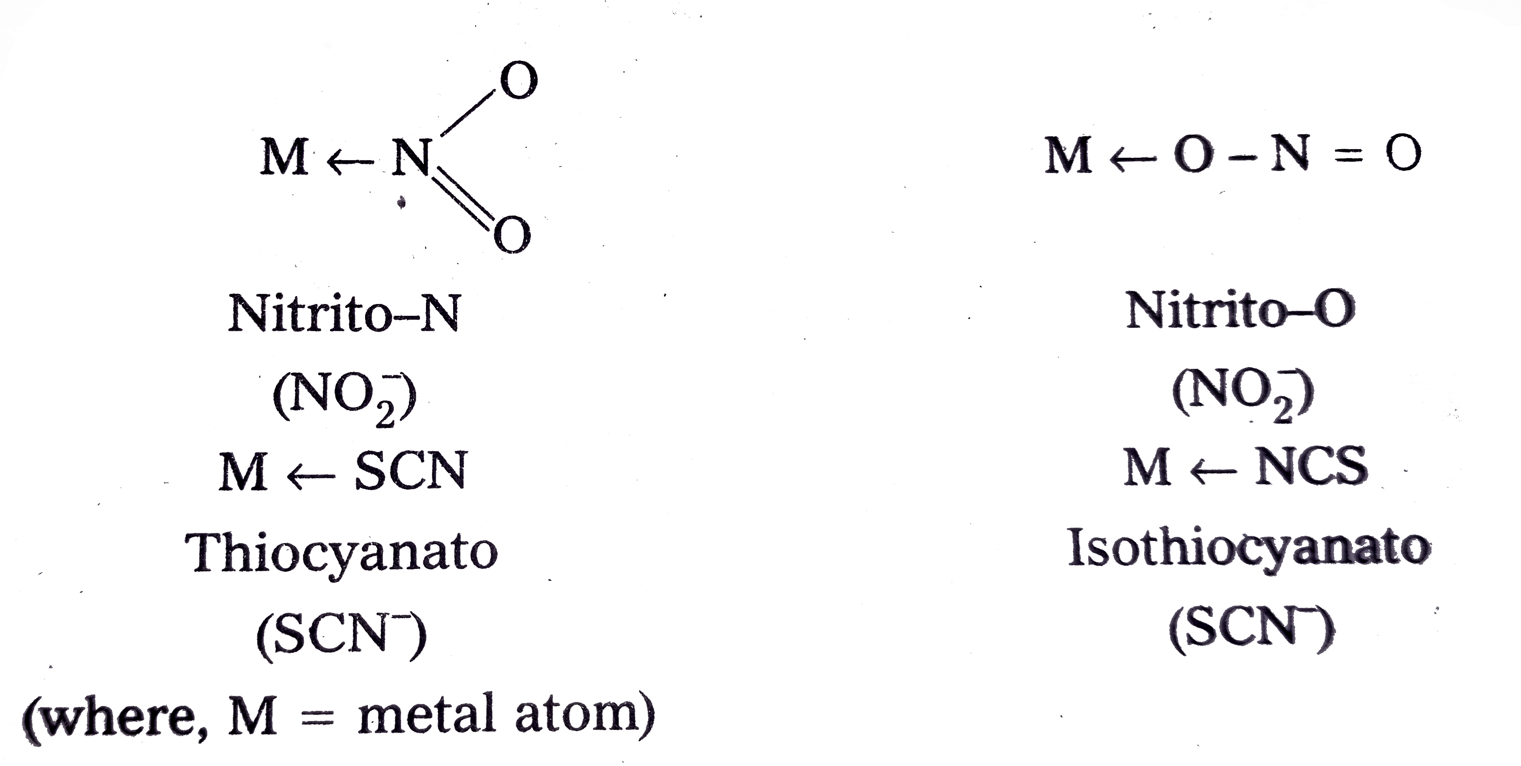
Ligand
(b) Ambidentate: If a ligand has 2 or more donor atoms, but it forms complex by Mono dentate ligands with different sites of bonding: SCN⁻, NCS, NO₂

Slide 27
Ligand
(c) Flexidentate: A flexidentate ligand is one that can chelate a metal ion in more than one way. For ex. Cysteine (HS-CH₂-CH(NH₂)-COOH) can function as a tridentate (SNO) and as a didentate in three ways (SN; NO; SO)

Slide 28
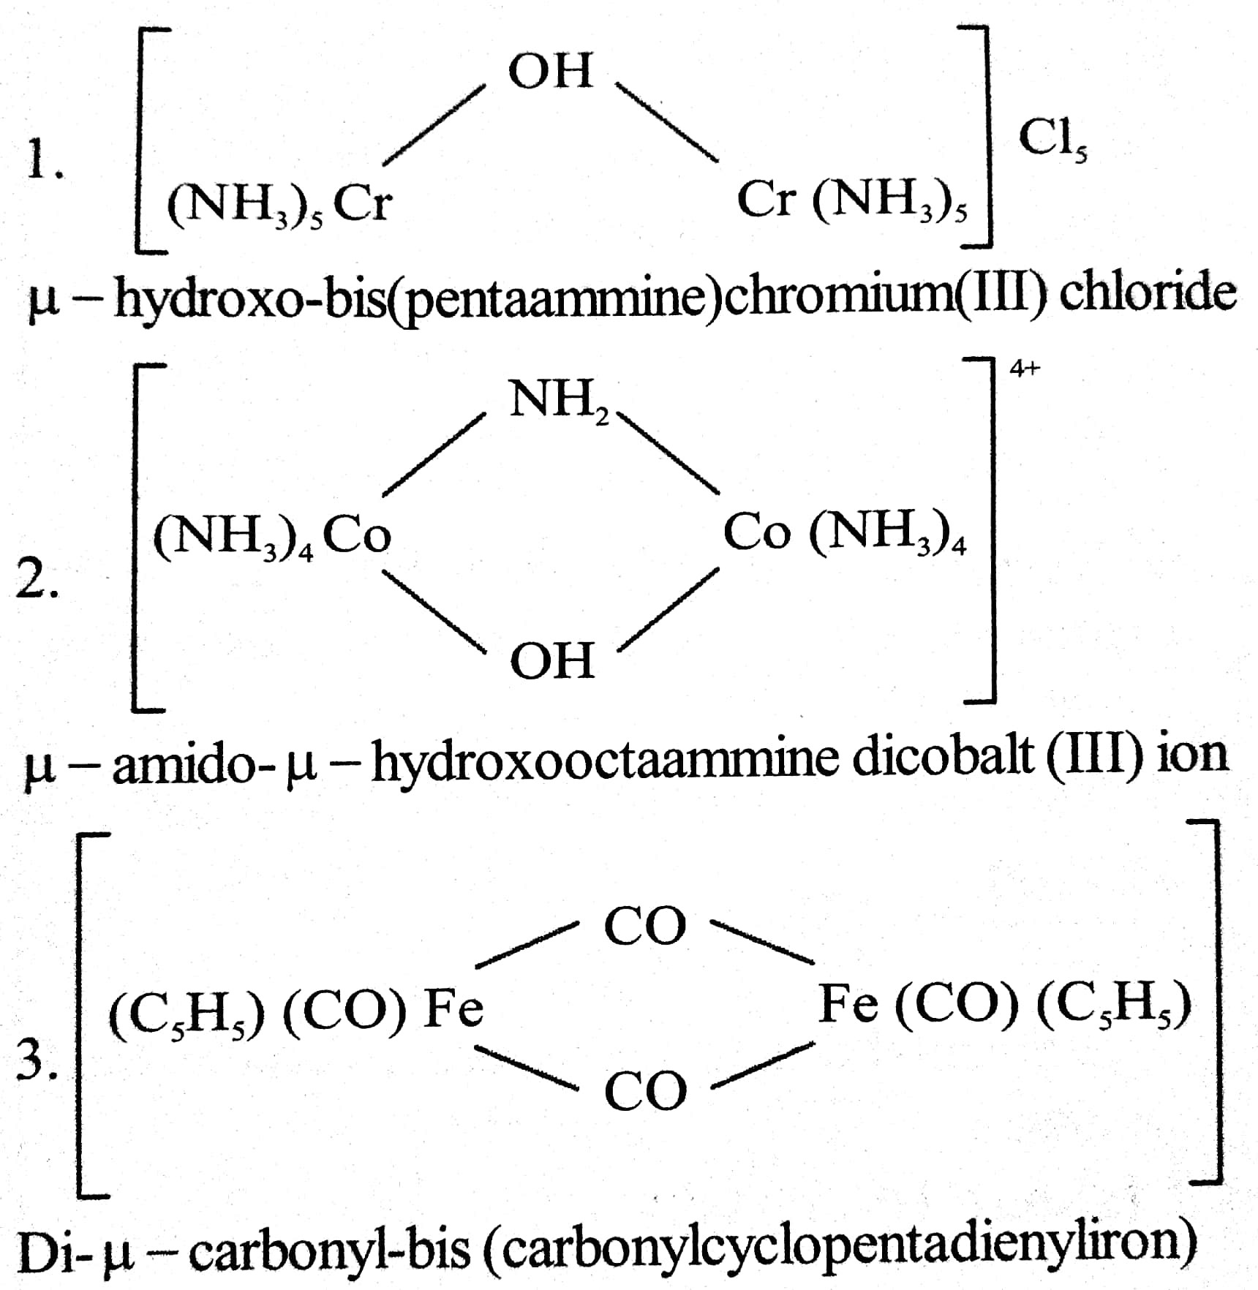
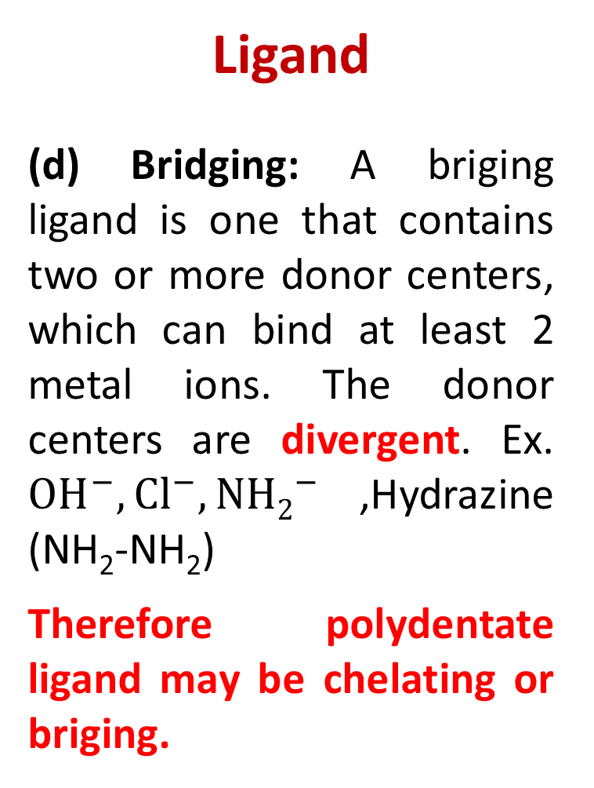
Ligand
(d) Bridging: A briging ligand is one that contains two or more donor centers, which can bind at least 2 metal ions. The donor centers are divergent. Ex. ${OH}^{−},{Cl}^{−},{NH2}^{−}$,Hydrazine (NH₂-NH₂)
Therefore polydentate ligand may be chelating or briging.

Slide 29
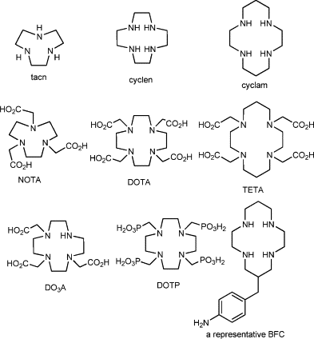
Ligand
(e) Macrocyclic: a macrocyclic ligand has a number of donor centres as constituents of a closed ring system such as the donor atoms can hold a metal ion very effectively inside the cavity of the macrocycle. Ex. Hemoglobin, Chlorophil II etc.

Slide 30
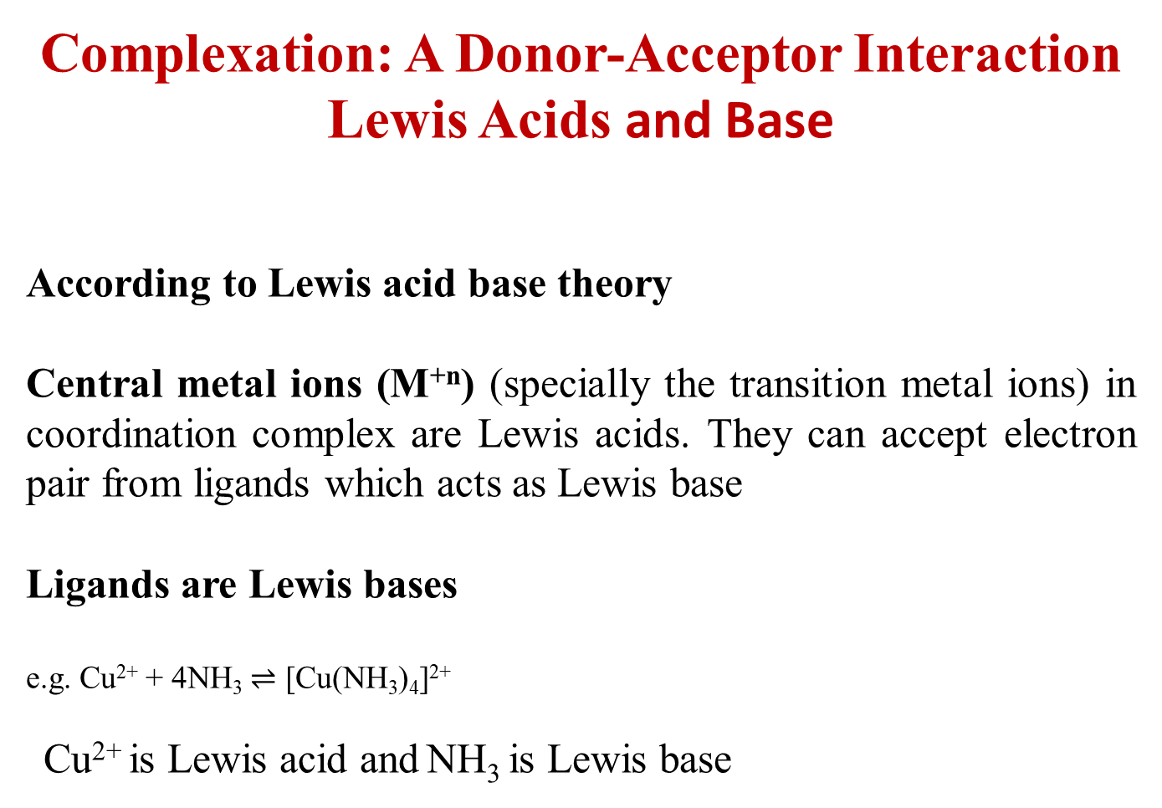
Complexation: A Donor-Acceptor Interaction
Lewis Acids and Base
According to Lewis acid base theory
Central metal ions (M^{+n}) (specially the transition metal ions) in coordination complex are Lewis acids. They can accept electron pair from ligands which acts as Lewis base
Ligands are Lewis bases
e.g. Cu²⁺ + 4NH₃ $⇌$ [Cu(NH₃)₄]²⁺
Cu²⁺ is Lewis acid and NH₃ is Lewis base

Slide 31
Homolyptic & Heterolyptic Complex
Homolyptic: When all the ligands around a metal ion are same in the complex, Ex. [Co(NH₃)₆]³⁺
Heterolyptic: When the ligands around a metal ion are different in the complex, Ex. [CoCl(NH₃)₅]²⁺

Slide 32
Reference
W.U. Malik, G.D. Tuli & R.D. Madan, Selected Topics in Inorganic Chemistry, S. Chand & Company Ltd.
Ashim K Das & Mahua Das, Fundamental Concept of Inorganic Chemistry, CBC Publishers & Distributors, Volume 4, First Edition, 2014
R.L. Dutta & G.S. De, Inorganic Chemistry, Part-1, The New Book Stall, 6th Edition 2009

Slide 33
Thank you

