Slide 1
Coordination Chemistry-I (part-2)
Dr. Semanti Basu
Assistant Professor
Department of Chemistry
Bejoy Narayan Mahavidyalaya,
Itachuna, Hooghly, W. B., India

Slide 2
Coordination Number & Stereo Chemistry
Since an attraction between a metal ion and dipolar molecules or anions is involved the coordination number will tend to be as large as possible.
2. The arrangement of the coordinated ligands must be such that it minimises the electrostatic repulsion between ligands.

Slide 3
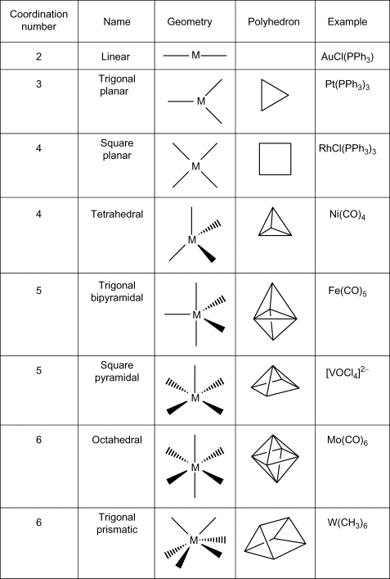
Coordination Number & Stereo Chemistry

Slide 4
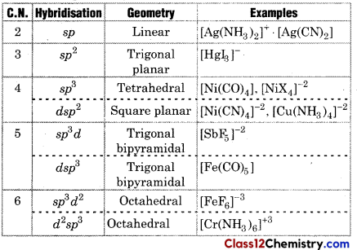
Coordination Number, Geometry & hybridisation

Slide 5
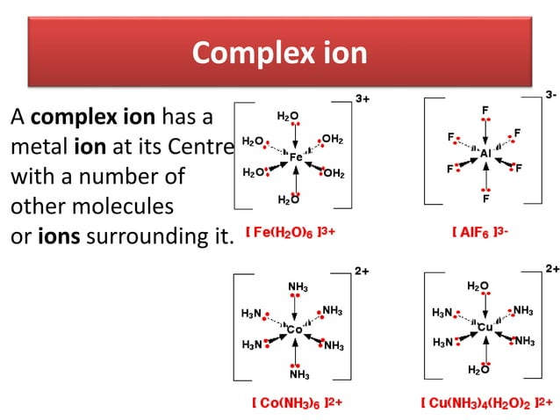

Slide 6
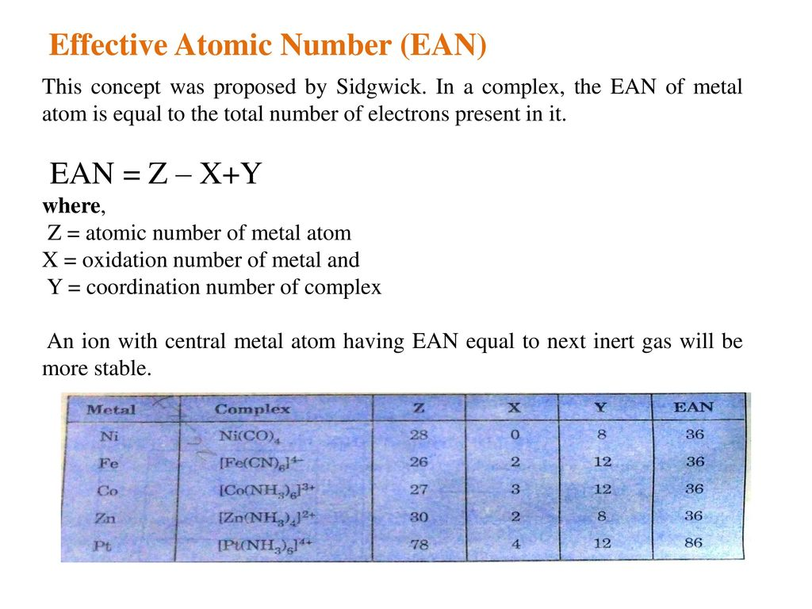

Slide 7
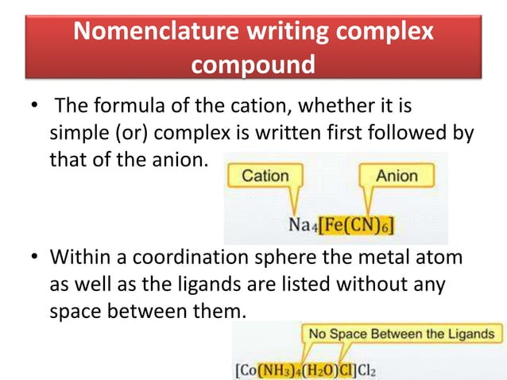

Slide 8
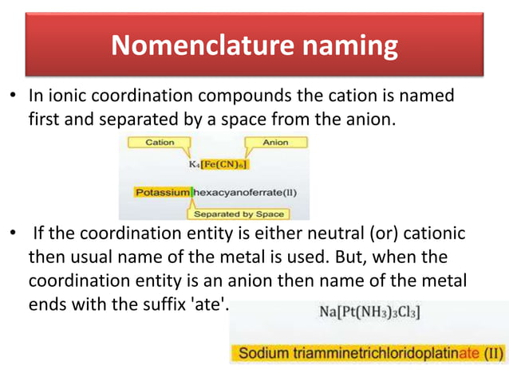

Slide 9
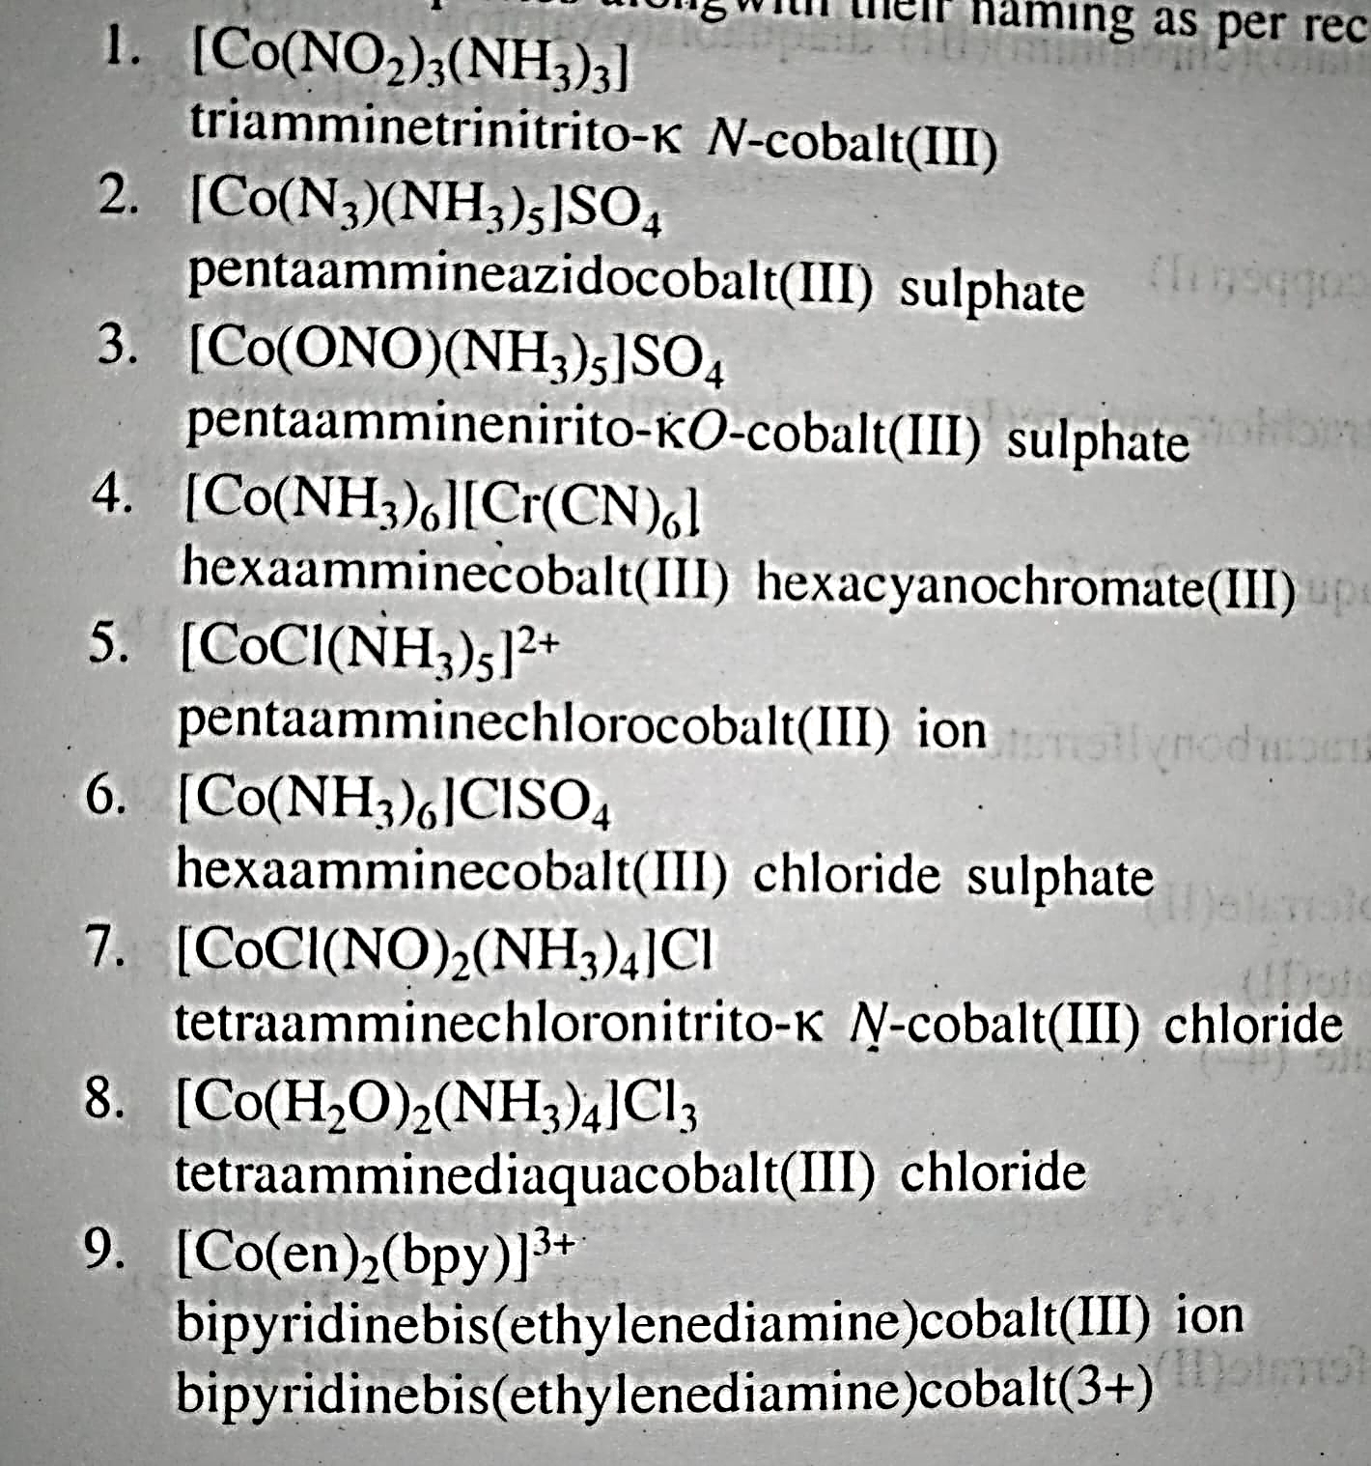

Slide 10
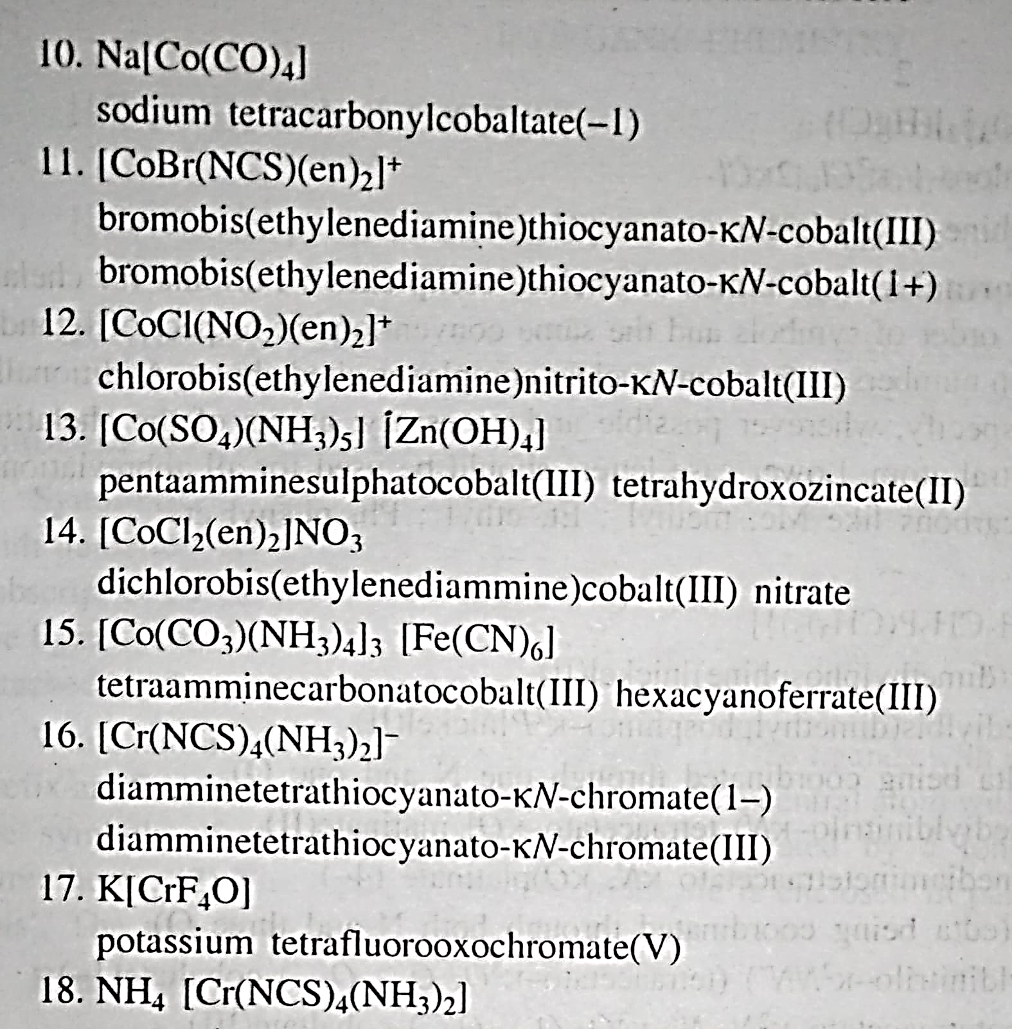

Slide 11
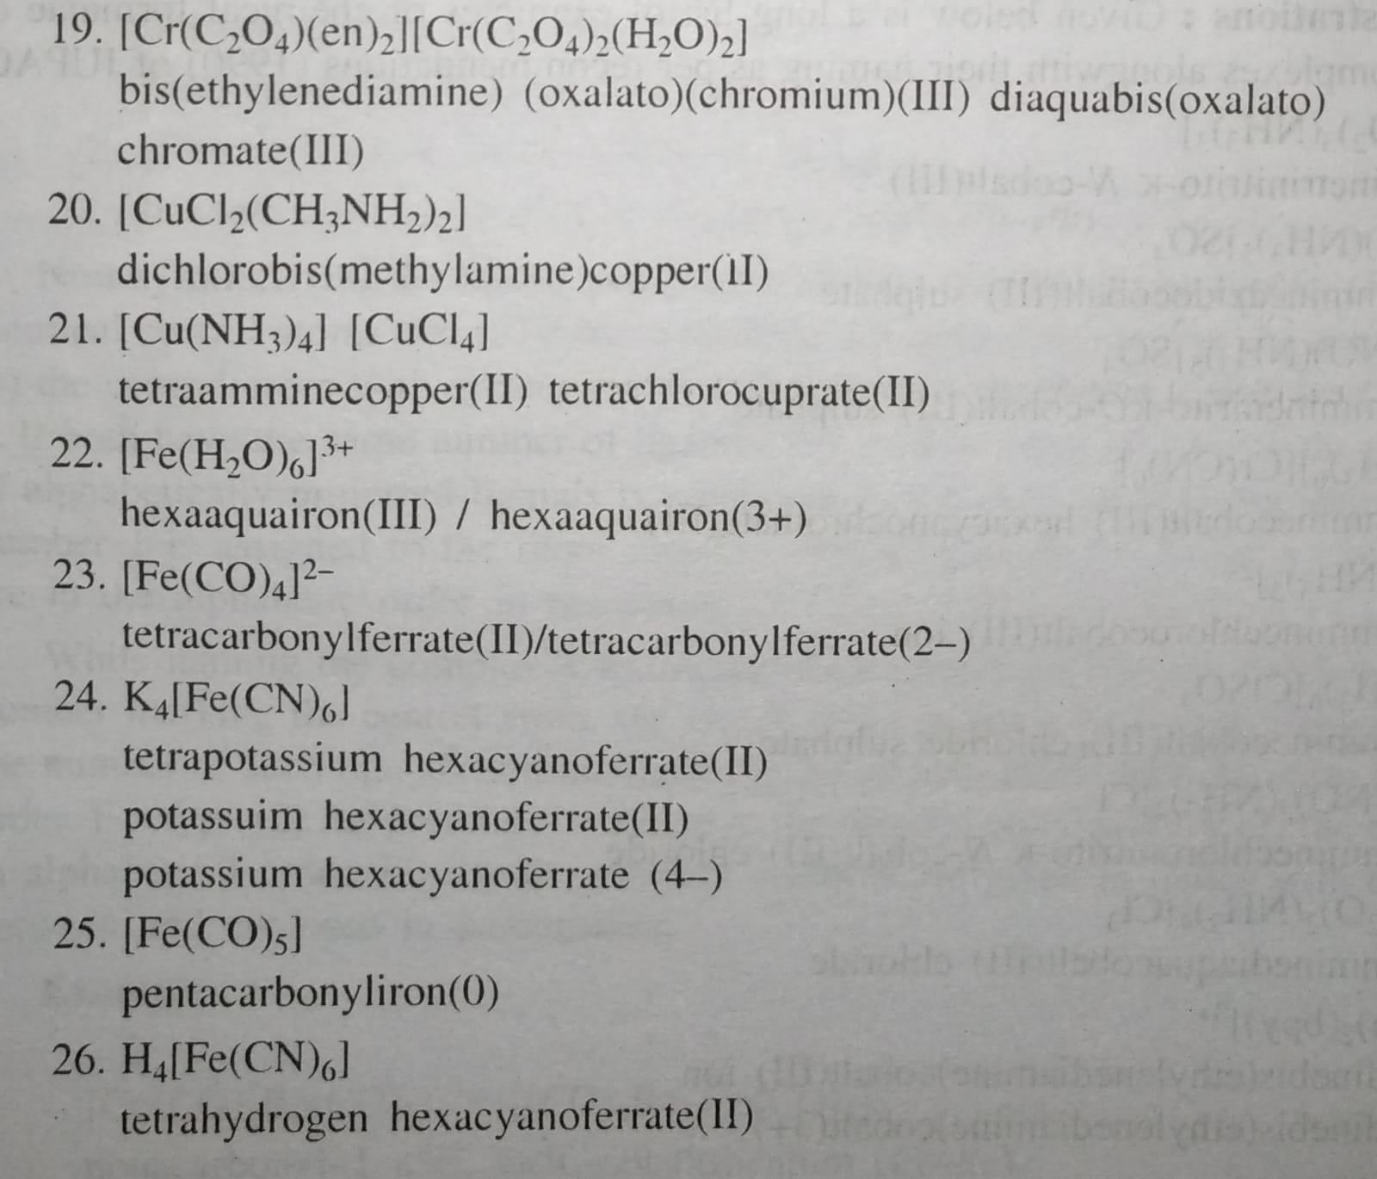

Slide 12
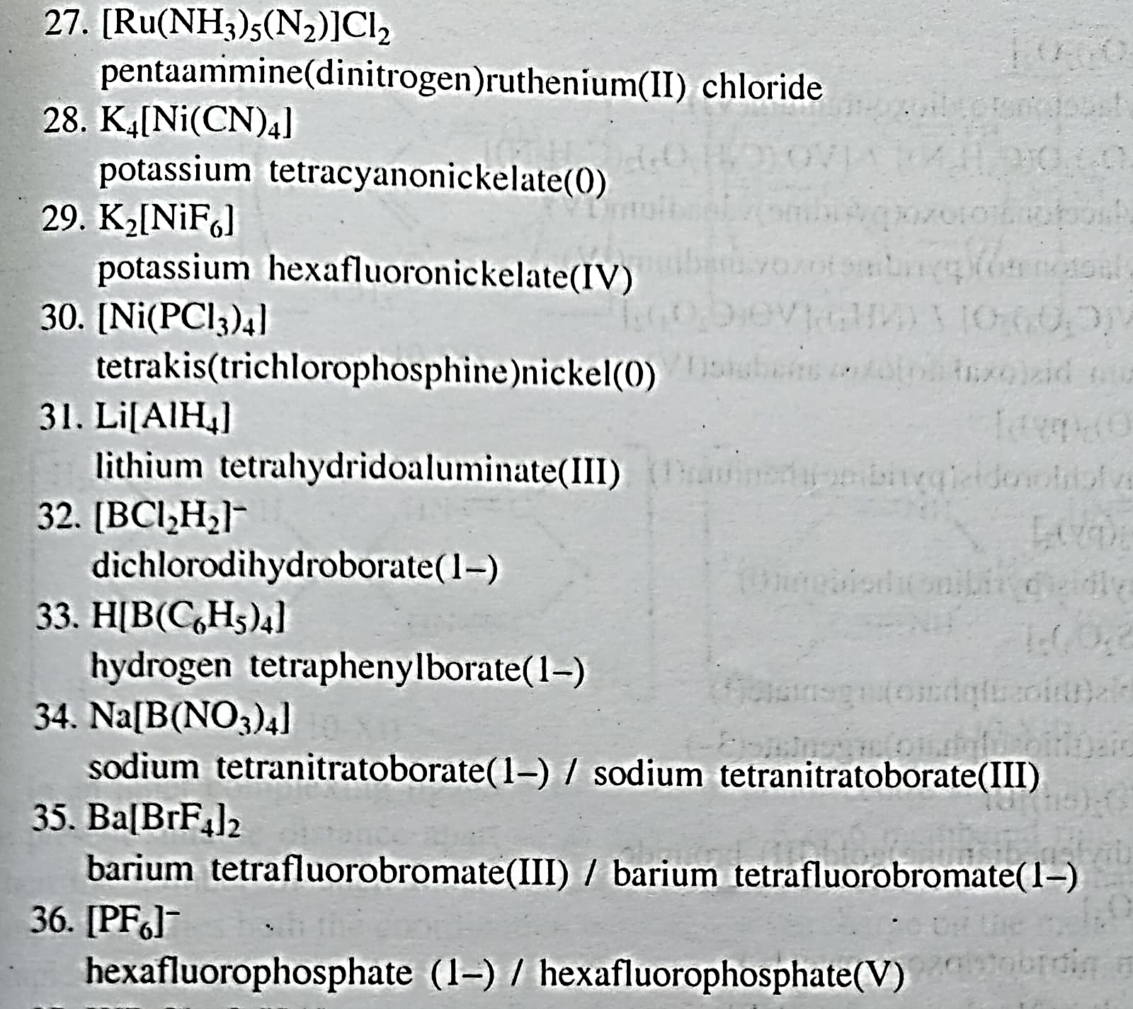

Slide 13
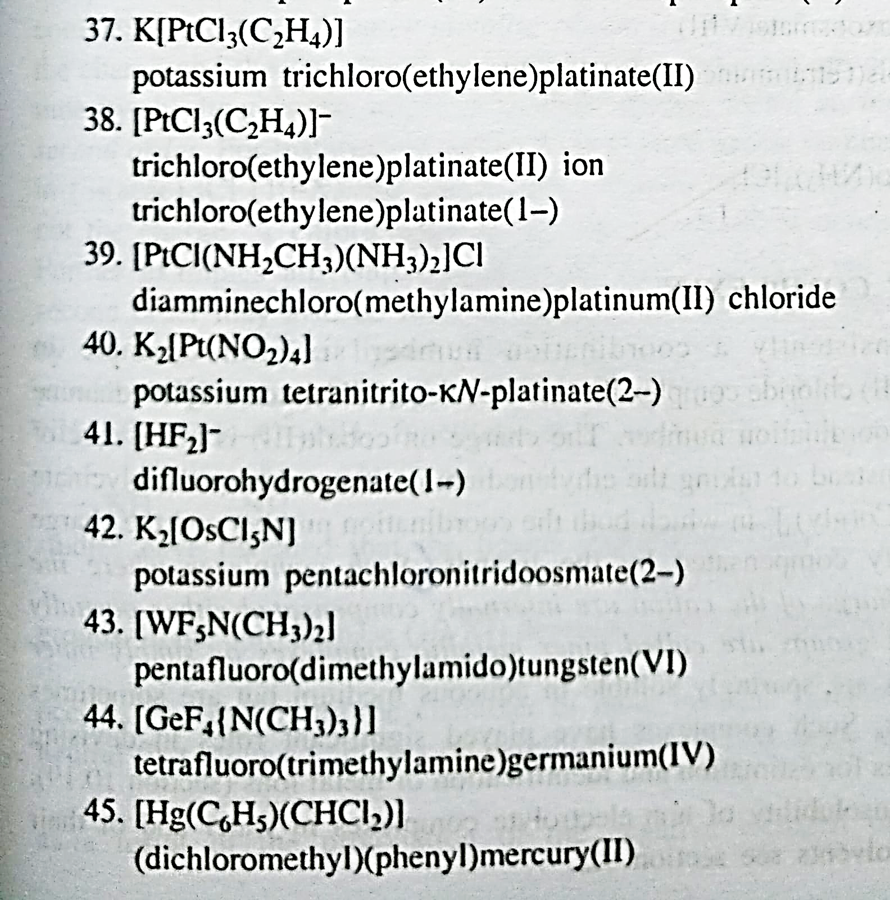

Slide 14
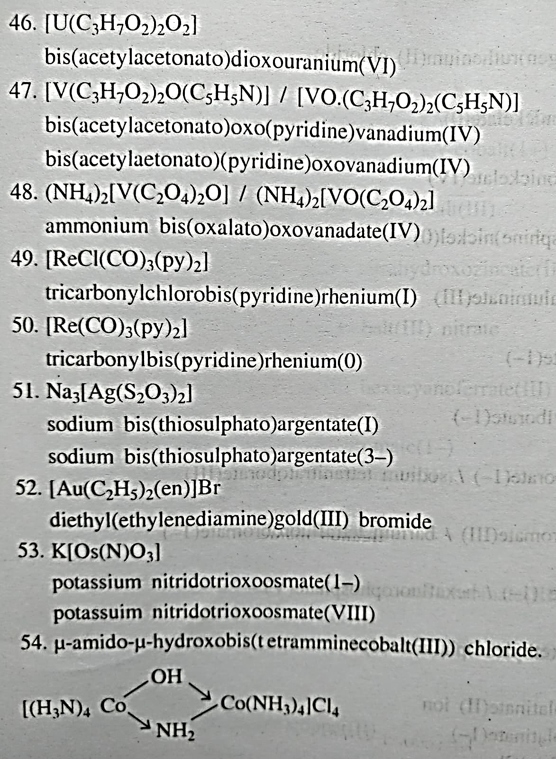

Slide 15
Isomerism in Coordination Compounds
Compounds which have the same chemical composition and different properties this phenomenon is called isomerism.
Same Chemical formula → Different Properties

Slide 16
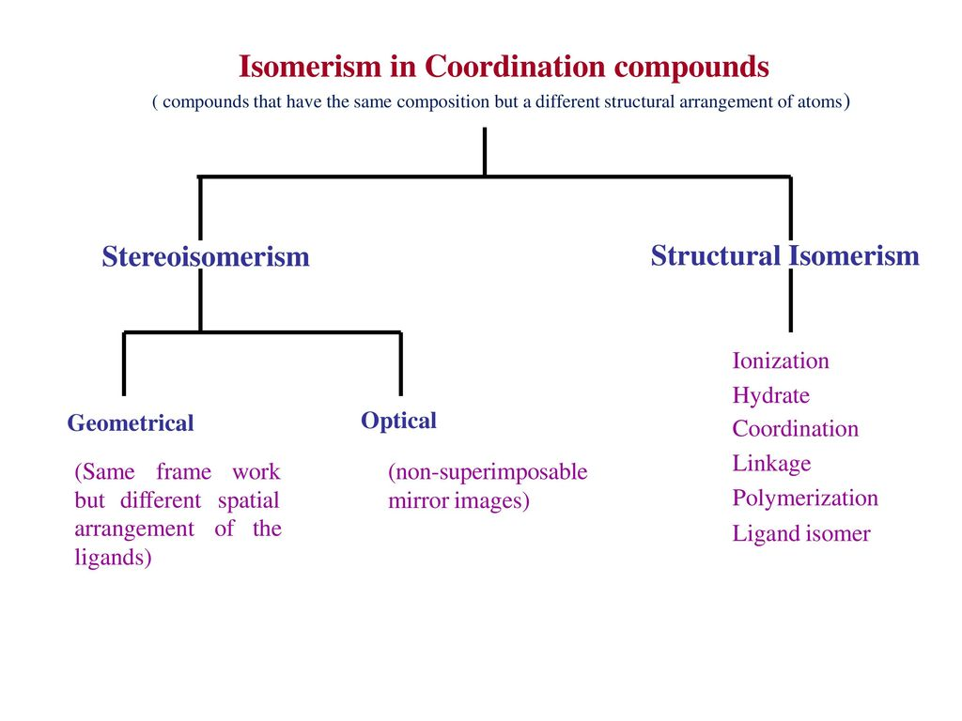

Slide 17
Structural Isomerism
Compounds which have the same chemical composition and different structural arrangements are called structural isomerism.
Ionisation Isomerism (Forming different ions)
Hydrate Isomerism (must have water of crystallisation)
Ligand Isomerism
Linkage Isomerism (Ambidentate ligands)
Coordination Isomerism (Both complex ions)
Coordination Position Isomerism (Polynuclear complexes)

Slide 18
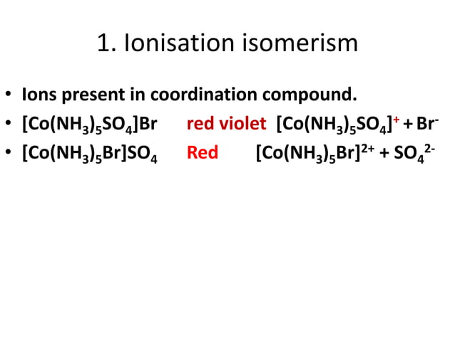

Slide 19
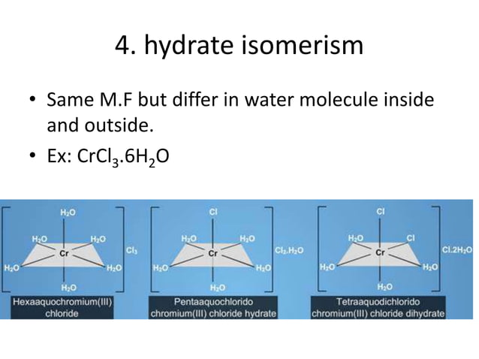

Slide 20
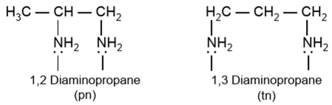
Ligand Isomerism
Some ligands themselves are capable of existing as isomers e.g. diamino propane can exist both as 1, 2-diamino propane (pn) and 1, 3-diamino propane (tn)

Slide 21
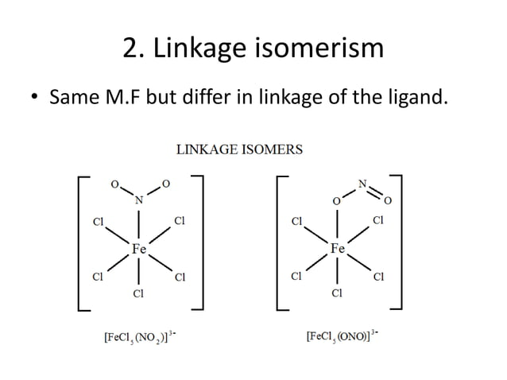

Slide 22
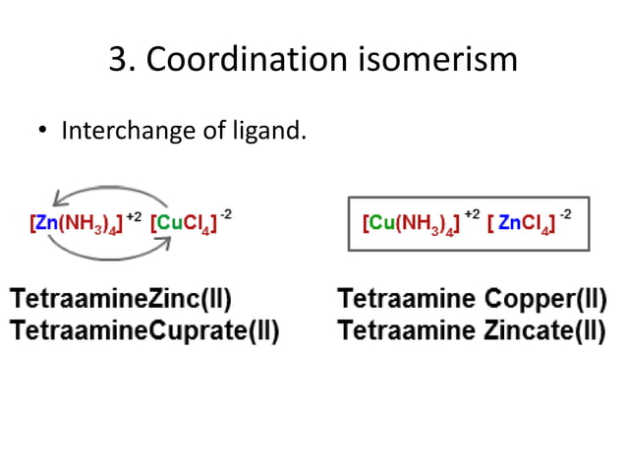

Slide 23
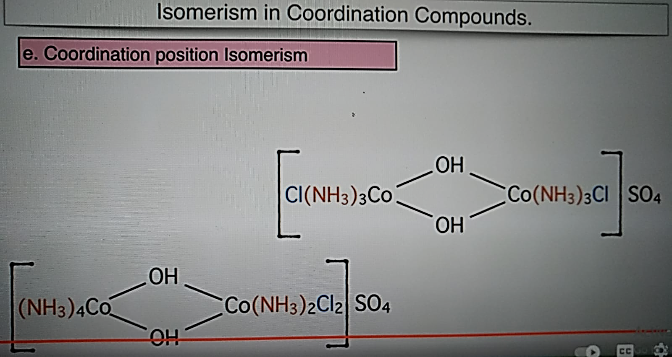

Slide 24
Stereoisomerism
When 2 compounds contain the same ligands coordinated to the same central ion, but the arrangement of ligands in space is different, the two compounds are said to be stereoisomers and the type of isomerism is called stereoisomerism.
Stereoisomerism is of 2 types:
Geometrical isomerism
Optical or mirror-image isomerism

Slide 25
Geometrical Isomerism
Geometrical isomers have identical empirical formula but differ in chemical and physical properties because of the different arrangement of ligands. They are not usually easily separated by chemical or physical means. Some (not all) of the isomers may develop optical activity due to distinct mirror-image forms. Thus, geometrical isomer which is capable of existing in non-superimposable mirror-image form is isomer of it.

Slide 26
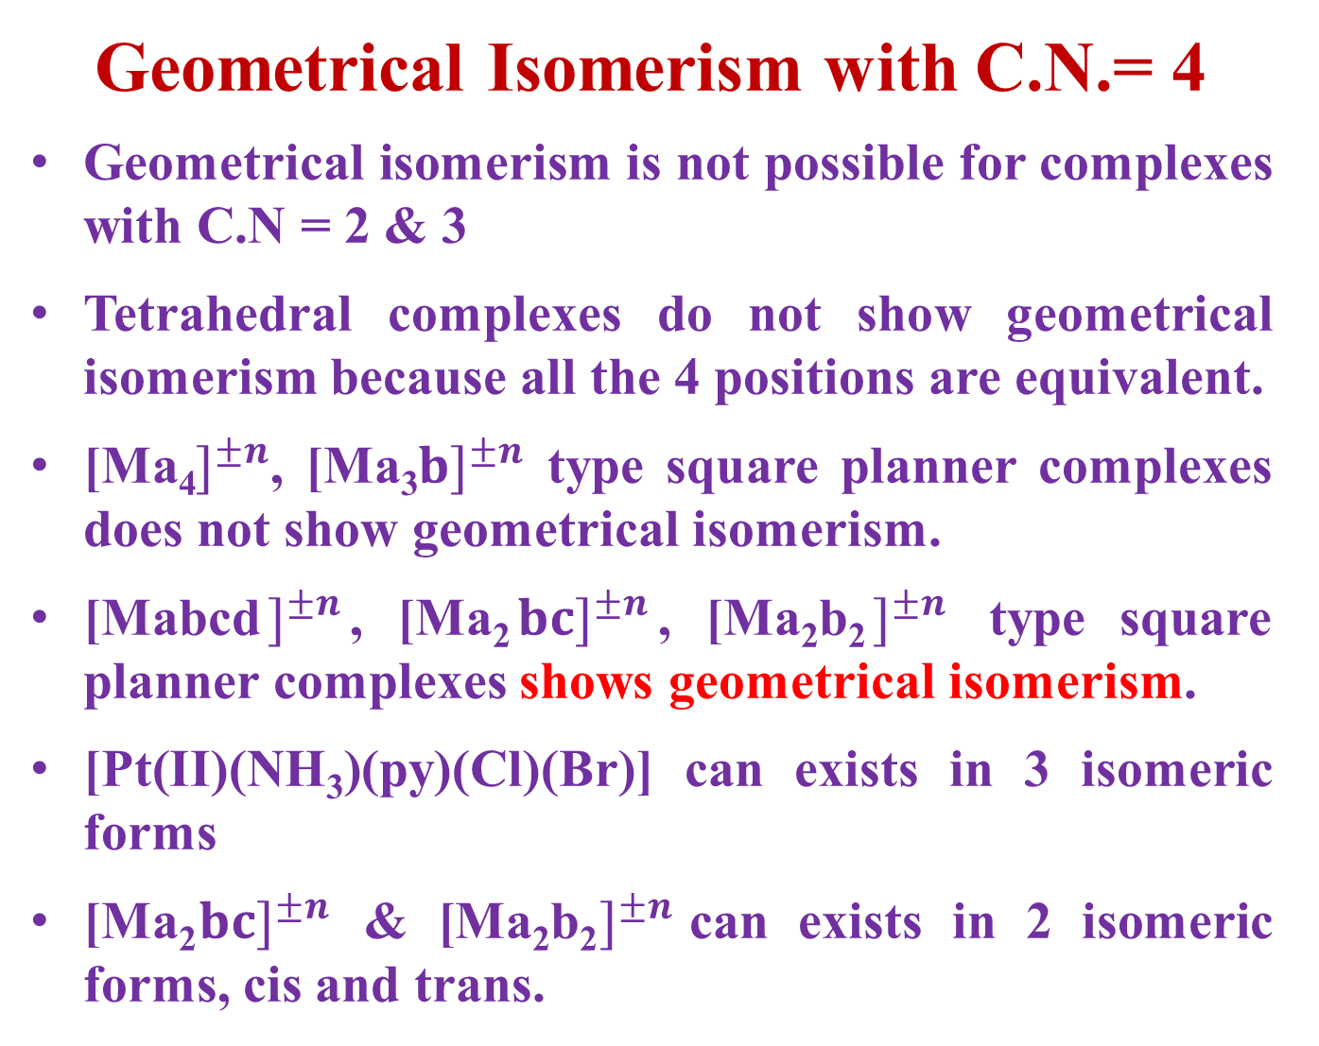
Geometrical Isomerism with C.N.= 4
Geometrical isomerism is not possible for complexes with C.N = 2 & 3
Tetrahedral complexes do not show geometrical isomerism because all the 4 positions are equivalent.
[Ma₄$]^{±n}$, [Ma₃$b]^{±n}$ type square planner complexes does not show geometrical isomerism.
[Mabcd$]^{±n}$, [Ma₂$b{c]}^{±n}$, [Ma₂b₂$]^{±n}$ type square planner complexes shows geometrical isomerism.
[Pt(II)(NH₃)(py)(Cl)(Br)] can exists in 3 isomeric forms
[Ma₂$b{c]}^{±n}$ & [Ma₂b₂$]^{±n}$can exists in 2 isomeric forms, cis and trans.

Slide 27
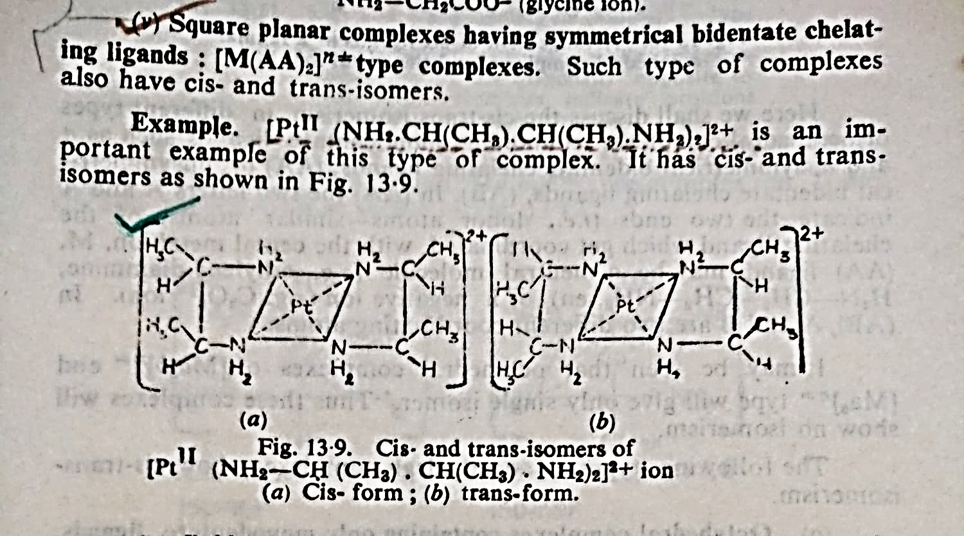
Geometrical Isomerism with C.N.= 4

Slide 28
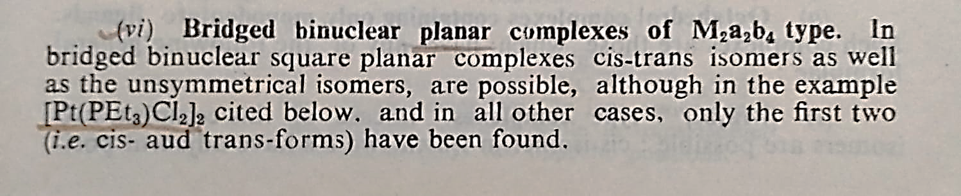
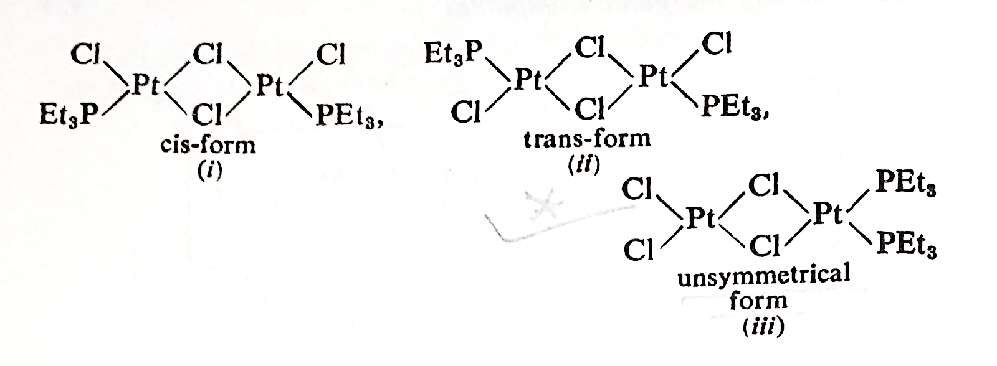
Geometrical Isomerism with C.N.= 4

Slide 29
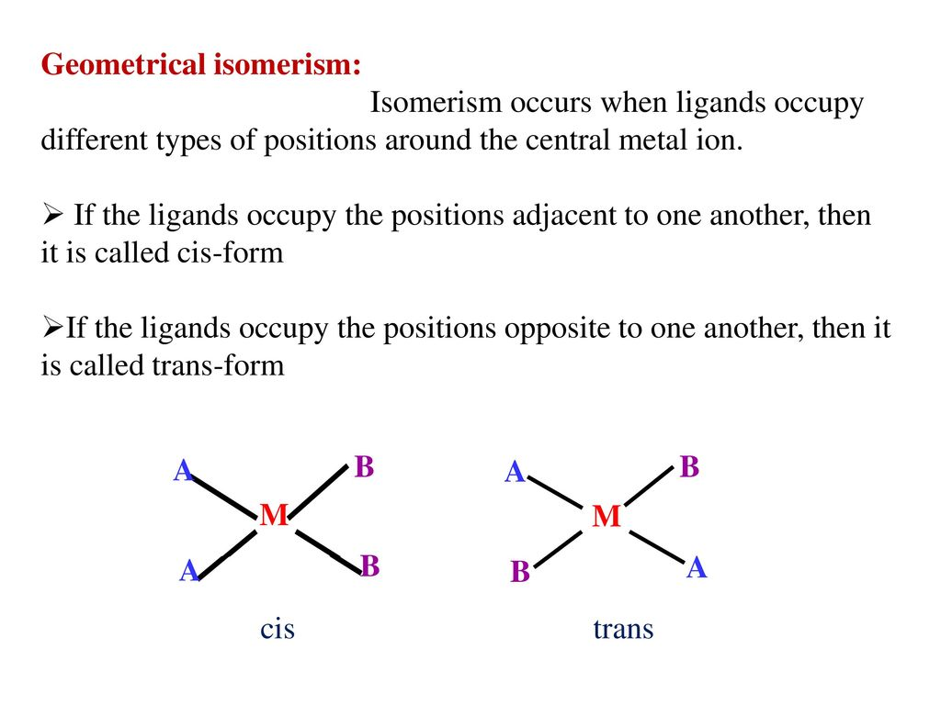

Slide 30
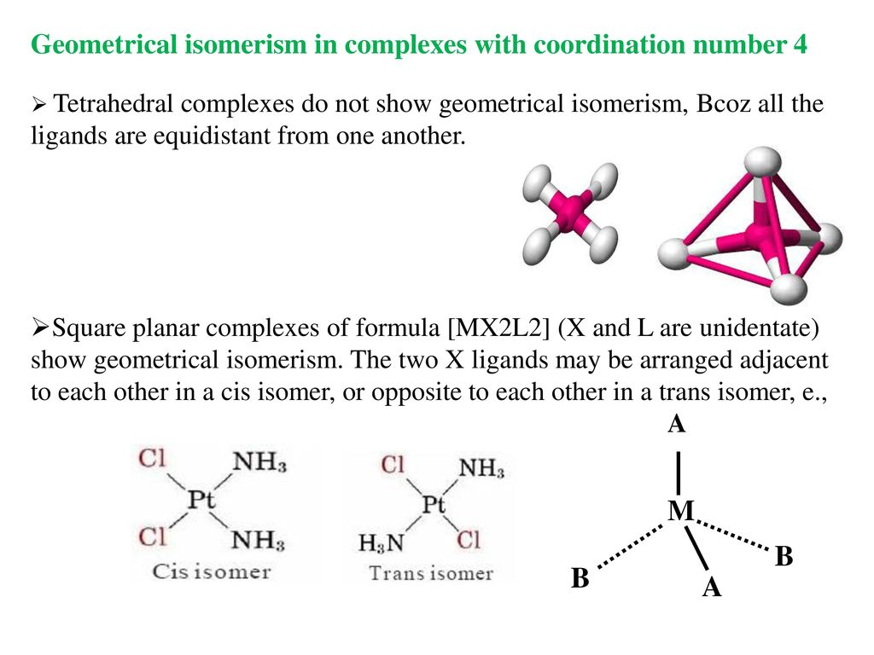

Slide 31
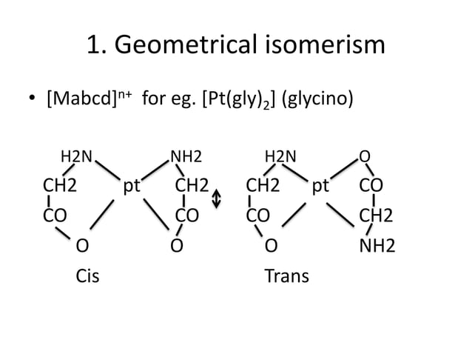

Slide 32
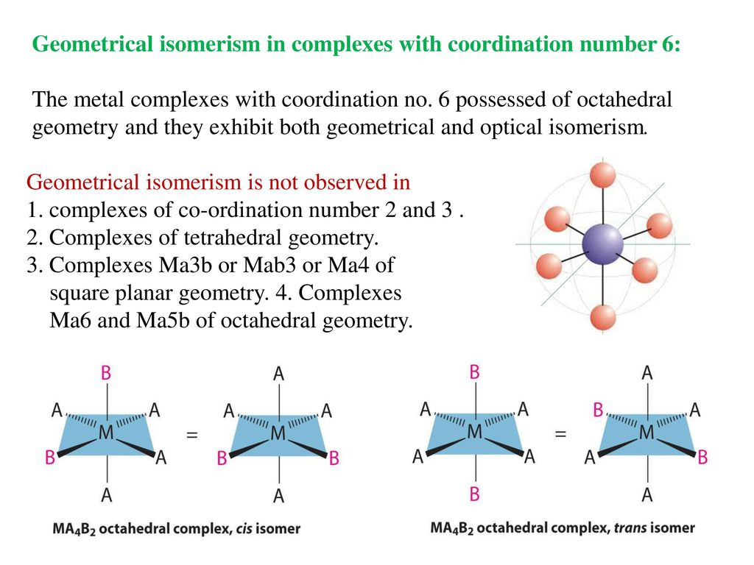

Slide 33
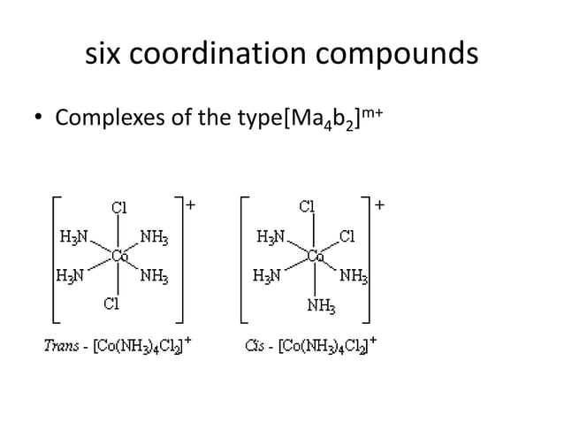

Slide 34
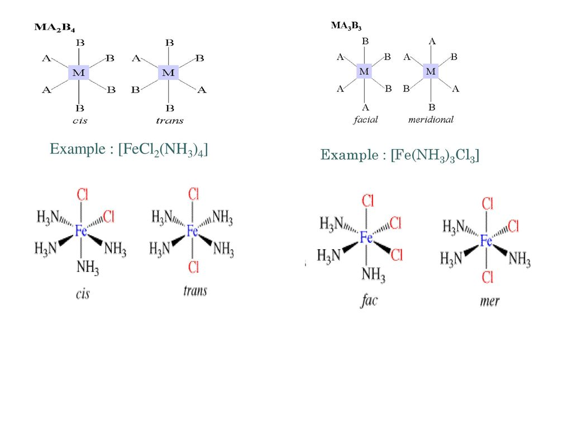

Slide 35
How can we understand the cis or trans isomer?
The following methods may be used to distinguish between cis-and trans-isomers.
Dipole Moments Measurements.
Jensen has shown that the Pt(ll) complexes of [Pt(II) A₂X₂] type where A = substituted phosphine, arsine or stilbine such as (C₂H₅)₃P, (C₃H₇)₃As or (C₂H₅)₃Sb and X=a halogen, have their dipole moments (μ) either equal to zero or between 8 and 12. Debye units. In the compounds with μ = 0, the individual moments have cancelled one another and so these are trans-isomers. The compound with μ = 8-12 Debye units are cis-isomers.
(2) X-ray Crystal Analysis
X-ray crystal analysis and dipole moment measurements of several Pt(II) complexes have confirmed the square-planarity of the bonds around the central metal atom. This square planar arrangement has also been established for 4-coordinated pt(II), Ag(II) Cu(II) and Au(lll) Tetrahedral configurations have been assigned to Cu(I), Ag(I), Au(I), B(III), Al(III), Zn(II), Cd(ll), Hg(ll) and Co(ll) in their coordination compounds. Some metals such as Ni(ll) appear to show either configuration for 4-coordination.
(3) IR Spectroscopic Technique

Slide 36
Reference
W.U. Malik, G.D. Tuli & R.D. Madan, Selected Topics in Inorganic Chemistry, S. Chand & Company Ltd.
Ashim K Das & Mahua Das, Fundamental Concept of Inorganic Chemistry, CBC Publishers & Distributors, Volume 4, First Edition, 2014
R.L. Dutta & G.S. De, Inorganic Chemistry, Part-1, The New Book Stall, 6th Edition 2009

Slide 37
Thank you

