Slide 1
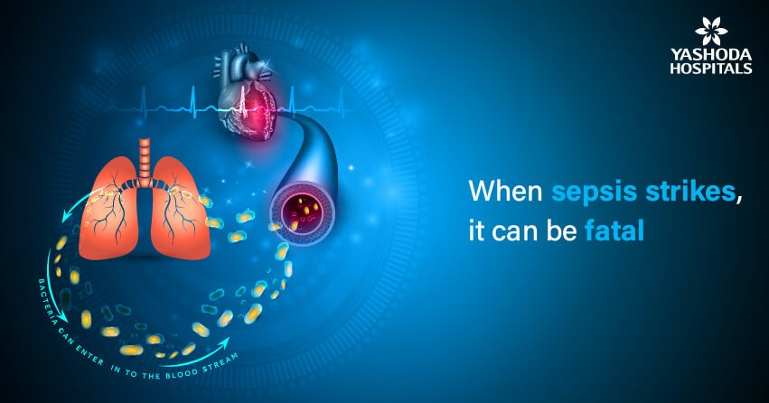
Sepsis :
Pathophysiology and Dietary Management

Slide 2
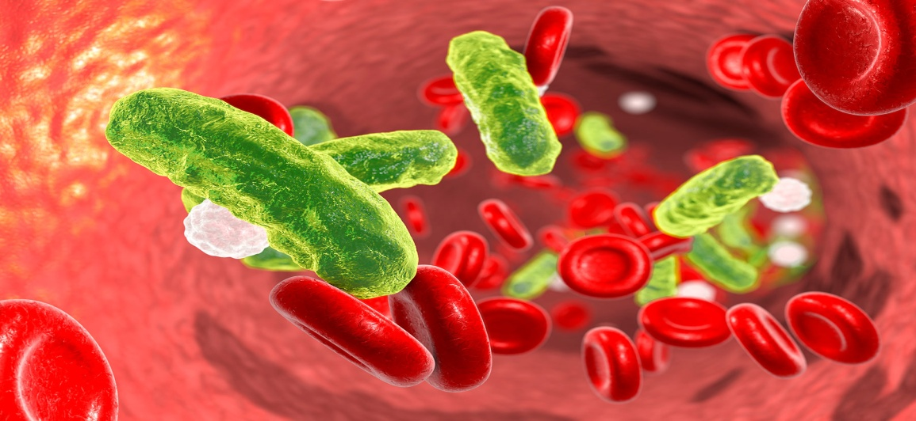
Definitions
'Sepsis is a life-threatening condition that arises when the body's response to an infection injures its own tissues and organs. Sepsis can lead to shock, multiple organ failure and death especially if not recognized early and treated promptly.’

Slide 3
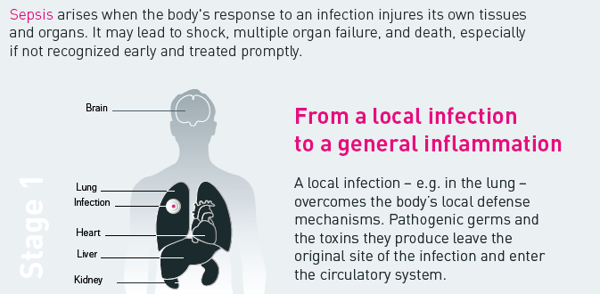
Stages of Sepsis:-

Slide 4
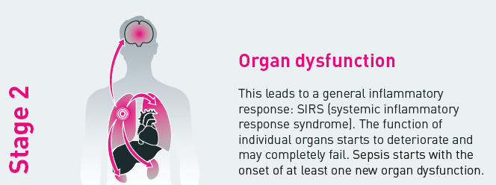
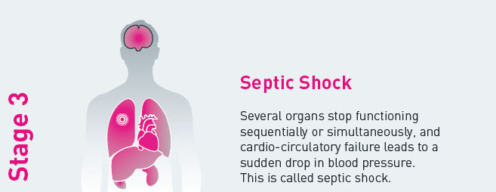
Stages of Sepsis:-

Slide 5
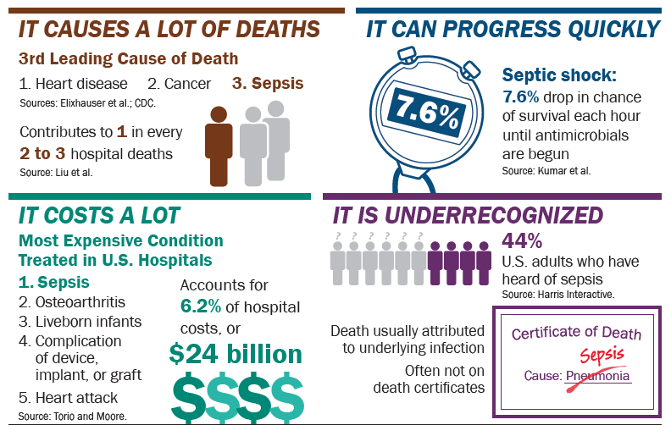
Sepsis at a Glance

Slide 6
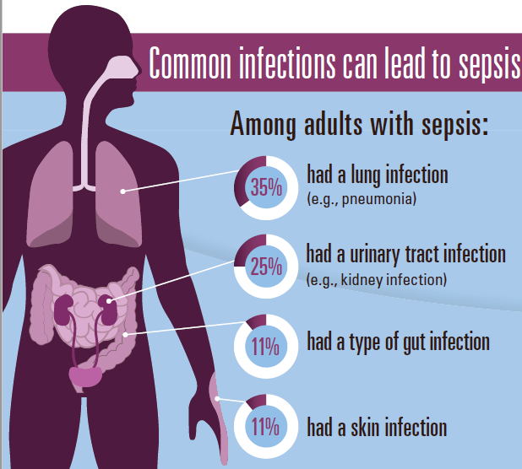
Causes of Sepsis:-

Slide 7
Pathogenesis of sepsis
An overview
Pathogen
Infection
Host response
Inflammation
Endothelial dysfunction
Other
factors
Coagulation/
fibrinolysis
Loss of homeostasis
Organ dysfunction
Death
Notes:
In the sepsis patient, endothelial dysfunction is central to the imbalance between inflammation, coagulation and fibrinolysis.
Other pathophysiological mechanisms, including nitric oxide and mitochondrial dysfunction, may also be involved in disease progression.⁴³
Loss of homeostasis in sepsis patients may result in organ dysfunction.^{41,44}

Slide 8
Pathogenesis of sepsis
An overview
Host
responses
Anti-inflammatory
mediators
e.g. IL-10, IL-1ra receptor antagonists
Pathogen
Infection
Pro-inflammatory
mediators
e.g. Tumour necrosis factor, IL-1, IL-6, IL-8,
nitric oxide
Leucocyte activation
Mitochondrial dysfunction
Inflammation
Microvascular flow redistribution
Endothelial dysfunction
Tissue factor expression
Organ dysfunction
Tissue injury
Microvascular coagulation/
thrombosis
Inhibition of fibrinolysis
Activation of coagulation
Death
Notes:
Stimulation of the host immune response by toxins causes an inflammatory response that can lead to endothelial damage.⁴¹
Pro-inflammatory cytokines, such as tumour necrosis factor (TNF), interleukin-1 (IL-1) and
IL-6, are released in response to infection with the aim of destroying damaged tissue and promoting wound repair. Normally, anti-inflammatory mediators (e.g. IL-10, IL-13) are subsequently released to regulate the inflammatory response and restore homeostasis.⁴⁸
Although inflammation is an essential host response, excessive levels of pro-inflammatory cytokines can lead to systemic endothelial damage, and high levels of anti-inflammatory mediators can result in immune suppression.⁴⁸
In sepsis, the imbalance between pro-inflammatory cytokines and anti-inflammatory mediators results in:
• stimulated coagulation response⁵²
• inhibited anticoagulant response^{44,47}
• inhibited fibrinolytic response.^{44,47,53,54}
These processes lead to endothelial damage and loss of equilibrium between the coagulation and fibrinolytic mechanisms.⁴⁴ As a procoagulant state develops, thromboses may form in the microvasculature, and in severe sepsis, the condition may progress to acute organ dysfunction and eventually death.^{44,47,55}
Sepsis involves a complex host response in an attempt to maintain homeostasis.^{41,46}
This illustration provides a simplification of some of the mechanisms involved in sepsis. In reality, a complex series of physiological events occur simultaneously.^{41,46}
Pro-inflammatory cytokines (including tumour necrosis factor, interleukin-1 and interferon-gamma) and thrombin are important in the up-regulation of adhesion molecules.^{41,57,58} Therefore, in sepsis where there is excessive inflammation and thrombin production, there can also be increased expression of adhesion molecules, which leads to further inflammation, vascular endothelial injury and selectin expression.⁵⁹

Slide 9
The disease continuum
Infection SIRS Sepsis Severe Sepsis MOF Death
In 1991 The American College of Chest Physicians and the Society of Critical Care Medicine (ACCP/SCCM) at a Consensus Conference developed clear clinical definitions for the disease continuum.
These groups developed three terms for the progression of clinical symptoms: SIRS, sepsis, severe sepsis and septic shock.
It is important to realise that these stages do not necessarily imply an increasing severity of infection, but rather an increasingly severe systemic response to infection.
Notes:
1991 The American College of Chest Physicians and the Society of Critical Care Medicine (ACCP/SCCM), at a Consensus Conference, developed clear clinical definitions for the disease continuum.
These groups developed three terms for the progression of clinical symptoms: sepsis, severe sepsis and septic shock.^{2,11}
The conference also defined an initial SIRS, which requires evaluation of abnormalities of temperature, heart rate, respiratory rate and white blood cell count.^{2,11}
SIRS (systemic inflammatory response syndrome) represents the clinical presentation of the widespread inflammation that results from a variety of insults including infection, pancreatitis, burns and trauma, including surgery.
SIRS is defined as the presence of two or more objective signs of systemic inflammation.¹¹

Slide 10
Systemic inflammatory response syndrome (SIRS)
Infection SIRS Sepsis Severe Sepsis MOF Death
SIRS (systemic inflammatory response syndrome) represents the clinical presentation of the widespread inflammation that results from a variety of insults and can also be caused by trauma, burns, pancreatitis and other insults…
The conference defined an initial SIRS, that requires evaluation of:
    temperature,
    heart rate,
    respiratory rate and
    white blood cell count.
Notes:
1991 The American College of Chest Physicians and the Society of Critical Care Medicine (ACCP/SCCM), at a Consensus Conference, developed clear clinical definitions for the disease continuum.
These groups developed three terms for the progression of clinical symptoms: sepsis, severe sepsis and septic shock.^{2,11}
The conference also defined an initial SIRS, which requires evaluation of abnormalities of temperature, heart rate, respiratory rate and white blood cell count.^{2,11}
SIRS (systemic inflammatory response syndrome) represents the clinical presentation of the widespread inflammation that results from a variety of insults including infection, pancreatitis, burns and trauma, including surgery.
SIRS is defined as the presence of two or more objective signs of systemic inflammation.¹¹

Slide 11
Systemic Inflammatory Response Syndrome
Diagnosis comprises 2 or more of the following:
Tachycardia >90 bpm
Core temperature <36°C or >38°C
Tachypnoea >20 bpm or P_{a}CO₂ <4.2 kPa
WBC >12,000 or <4,000 or
>10% immature neutrophils

Slide 12
Clinical Progression
Infection SIRS Sepsis Severe Sepsis MOF Death
Sepsis :
1) - two or more of SIRS, plus
2) - documented or suspected infection
(presence of commonly recognised signs of infection without an identifiable pathogen being isolated)

Slide 13
Clinical Progression
Infection SIRS Sepsis Severe Sepsis MOF Death
Severe sepsis: sepsis + one organ dysfunction
Circulatory failure
Respiratory failure
Renal failure
Haematological failure
Hepatic failure
“Brain failure”
Septic shock: Acute circulatory failure unexplained by other causes.
Circulatory failure is defined as:
Persistent arterial hypotension (SBP < 90 mmHg, Mean Arterial Pressure< 65, or a reduction in SBP 40 mmHg from baseline) despite adequate volume resuscitation

Slide 14
Severe sepsis – organ failures
Clinical Progression
Infection SIRS Sepsis Severe Sepsis MOF Death
Organ | Observation
Circulatory | SBP<90 or MAP <65 or reduction in SBP >40mmHg from baseline
Respiratory | S_{p}O₂ <90% or P_{a}O₂:F_{i}O₂ <40 kPa
Renal | Urine output <0.5 ml/kg/hr for >2 hr or Creatinine >176 µmol/l acutely
Haematological | Platelets <100x10⁹ or INR >1.5 or APTT >60s
Hepatic | Plasma lactate >4 mmol/l or Bilirubin >34 µmol/l
Mental | Acute alteration in mental status

Slide 15

Clinical Progression
Infection SIRS Sepsis Severe Sepsis MOF Death

Slide 16

Sepsis is a medical emergency . . .
minutes matter
Every hour a patient in septic shock doesn't receive antibiotics,
the risk of death increases by 7.6%.

Slide 17
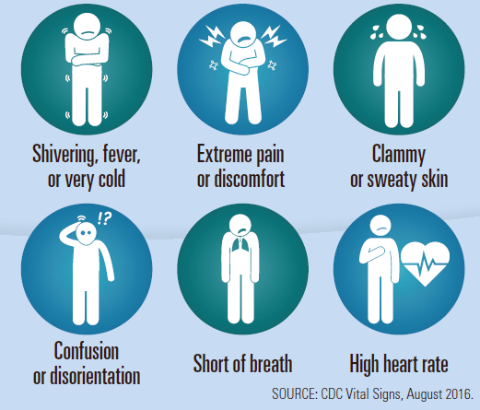
Know the Signs & Symptoms

Slide 18
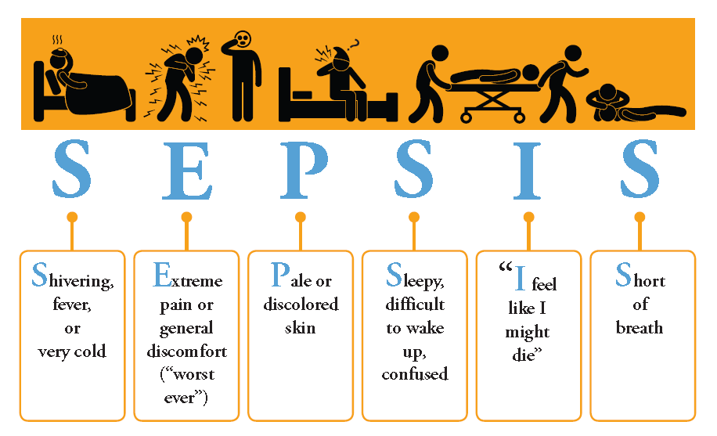
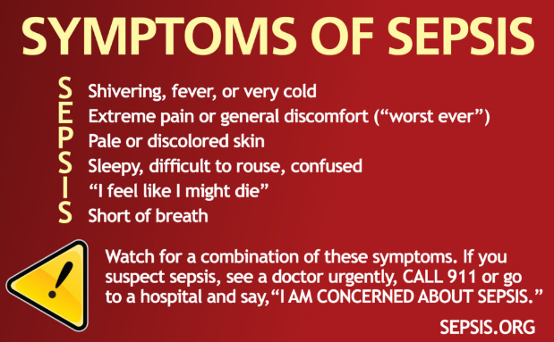

Slide 19
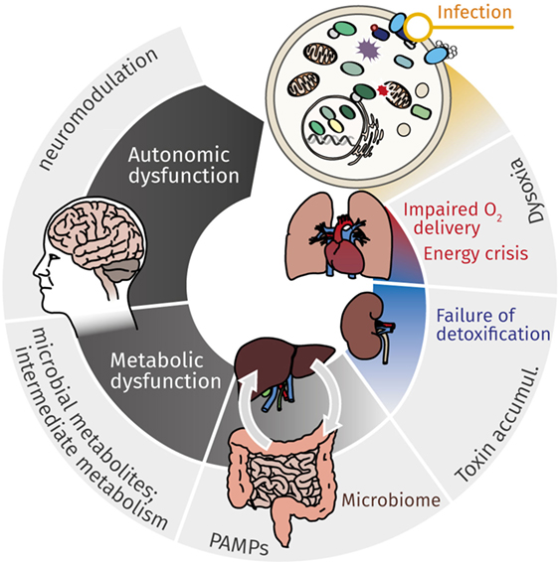
Complications of Sepsis
Circulatory collapse:
Organ dysfunction:
Septic shock:
Inflammation:
Acute Respiratory distress syndrome:
Blood clots:
Post-sepsis symptoms:
  Cognitive Decline,
  Fatigue
  Insomnia

Slide 20

Keys to Survival
Early Identification
  Subtle signs and symptoms
  Don’t wait until your patient is hypotensive!
  Appropriate antibiotics in a timely manner
  For every hour antibiotics are delayed during septic shock, the patient’s risk of death increases by 7.6%
  The single most important intervention in treating sepsis
  Source Control
  Antibiotics
  Surgery
  Intra Venous Fluids and vasopressors if necessary (hemodynamic stability)
  Emergency supportive care for acute organ dysfunction
  Ventilator
  Continuous Renal Replacement Therapy (CRRT)
  Prone positioning

Slide 21

Dietary Management of Sepsis
Providing adequate nutrition in patients with sepsis or septic shock is challenging.

Slide 22
The Recommendations For Nutrition Therapy In Sepsis Are Summarized In Table 1.
Nutrient | Recommended Dose
Caloric needs | Determined by indirect calorimetry
Protein | 0.8–1.3 g/kg/day
Lipids | 0.7–1.5 g/kg/day
Glucose | 1–1.5 g/kg/day
Glutamine | <0.35 g/kg/day IV or <0.5 g/kg/day enterally in TPN fed patients
Fluid | 1 mL/kg/h

Slide 23
Calories
Caloric targeting in critically ill patients most often depends on predictive equations.
A well-fed patient with normal immune function had the best chance to survive
Recommendations-
  Measurement of REE with IC.
  A slow but steady increase of caloric load to reach target values when shock is resolved.
Harris–Benedict equation
Men | BMR = (10 × weight in kg) + (6.25 × height in cm) - (5 × age in years) + 5
Women | BMR = (10 × weight in kg) + (6.25 × height in cm) - (5 × age in years) - 161

Slide 24
Protein
Enteral or parenteral protein substitution in critically ill patients mainly intends to ensure and enhance –
  Positive Nitrogen Balance.
  Muscle protein synthesis in order to avoid or attenuate muscle wasting.
  To boost the neuromuscular revalidation process.
Recommendations-
  Administration of 0.8 g/kg/day during sepsis and a gradual increase up to 1.3 g/kg/day when shock resolves.
Glucose
Optimal target blood glucose levels are not known.
Hyperglycemia is associated with an adverse outcome and must be avoided.
Tight glucose control is feasible in patients receiving parenteral nutrition if a strict protocol is followed.
Recommendations-
  Administration of 1–1.5 g/kg/day.

Slide 25
Lipids
Fatty acids are an important source of energy by their dense calorie content and contribute to the physical properties of the cell by their integration into cell membranes.
They also play a role as-
  precursors of bioactive lipid metabolites, such as prostaglandins,
  Are intertwined with cell response by gene expression.
Different sources of (intravenous) nutrition provide lipids and should be delivered daily to critically ill patients.
Recommendation-
    Administration of 0.7–1.5 g/kg/day
Pharmaco-Nutrition
Pharmaco-nutrition refers to the addition of nutrients with specific beneficial actions (e.g., antioxidant effcts) to standard feeding, and specifically aims to
  Invigorate gut mucosal and systemic immune defense mechanisms,
  To shackle an excessive pro-inflammatory response during the catabolic phase of illness.
The most relevant “pharmaco-nutrients” in septic patients are the-
  Amino-acids, Glutamine & Arginine, Omega-3 Fatty Acids, Selenium, And Vitamin C.

Slide 26
Glutamine
Glutamine is an essential nutrient for enterocytes and immune cells.
Glutamine maintains-
  preserves neutrophil bacterial killing,
  enhances lymphocyte and macrophage proliferation and secretion.
Intense immune activity and/or hyper catabolism, as occurring in burn injury, trauma, and sepsis, are associated with increased glutamine consumption and a dramatic fall in plasma glutamine concentrations.
Recommendation-
  <0.35 g/kg/day IV or <0.5 g/kg/day enterally in TPN fed patients.
Arginine
Arginine-deficient state impairs immune homeostasis and increases the risk of nosocomial infection.
supplementation of L-arginine is thought to contribute in-
  restoring physiologic processes in septic patients,
  including protein synthesis,
  Organ perfusion,
  wound healing.
Recommendation-
  <0.35 g/kg/day IV or <0.5 g/kg/day enterally in TPN fed patients.

Slide 27
Vitamin-C
Vitamin C has important vascular protective effects by-
  inhibiting oxidative stress,
  modulating intracellular signaling pathways,
  maintaining homeostatic levels of nitric oxide.
Vitamin C also is an essential cofactor for endogenous production of norepinephrine, epinephrine, and vasopressin.
Septic patients typically have very low or undetectable serum levels of vitamin C despite recommended enteral and parenteral intakes.
EN & PN
Both the enteral and parenteral route is useful to feed septic patients.
Apart from limitations and drawbacks specific to each particular route, early EN increases the risk of severe digestive complications in shock, whereas early non-individualized PN is associated with worse ICU outcomes. PN remains a valuable option if EN fails to reach calorie targets after 3 to 7 days.

Slide 28
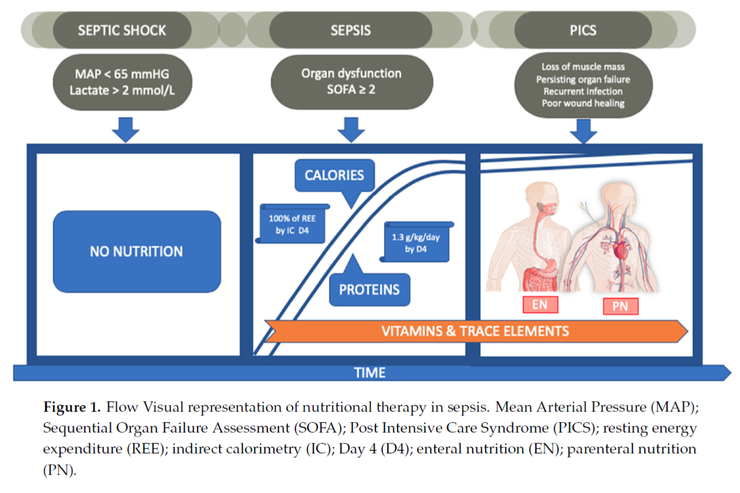

Slide 29


Slide 30


