Slide 1
Topic:- Calcium & vitamin :-k
Anukta Mukhopadhyay
Roll :-220340300007
Registration no:-202201042610 (2022-23)
Sub:- cc4
Sem Ii

Slide 2
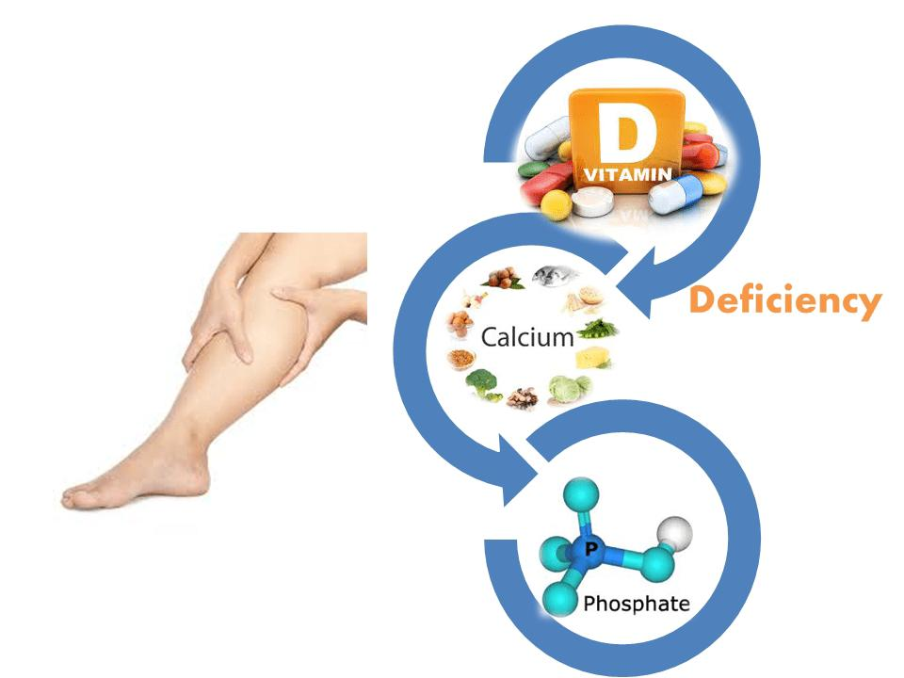
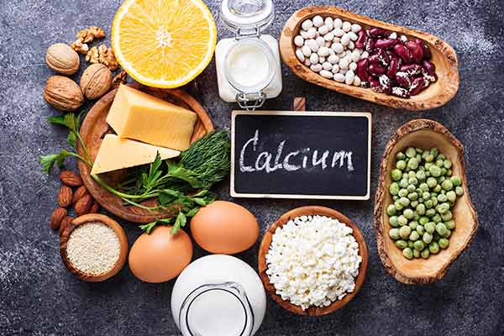
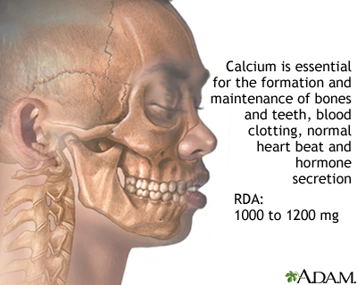
Calcium
A mineral most often associated with healthy bones and teeth also plays an important function in blood clotting,helps muscles to contract and regulating normal heart rhythms and nerve functions .
Functions:-
Bone formation
Tooth formation
Growth
Co-factor and regulator of biochemical reactions –
Blood clotting
Action on heart
Activation of enzyme
Release of hormones

Slide 3
Disease caused by deficiency and excess of calcium Deficiency:- osteoporosis Hypocalcaemia . Paresthesia of lips, tongue, fingers and feet . Excess :- HYPERCALCAEMA . Gastrointestinal symptoms like- anorexia, nausea, vomiting, constipation, abdominal pain.

Slide 4
Rda Of calcium
Calcium per day
Group
Man
Woman
Pregnant
Lacting
Post menopause woman
Infants
0-6m
0-12m
Children
1-3y
4-6y
7-9y
Boys
10-12y
13-15y
16-8y

Slide 5
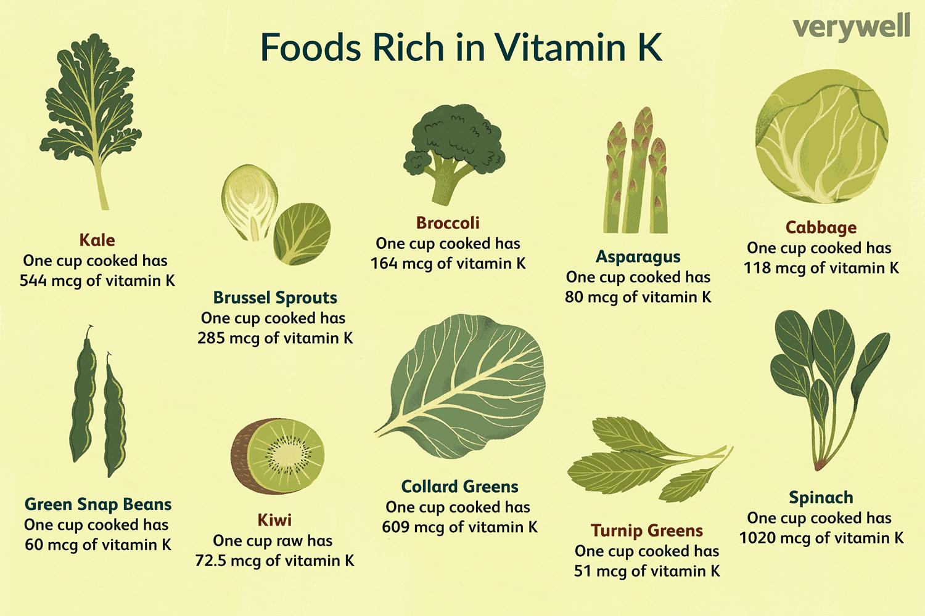
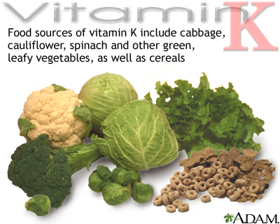
Vitamin:- k or phylloquinine
Vitamin k was first discovered in1934 by a Danish scientist named Dam . Vit :-K exits in nature in two forms vit :-K1 which is isolated from Lucerne and vit :-K 2 from putrid fish .
FUNCTION:- vit –K produces prothombin which helps in blood clotting, bone metabolism and heart health.
Source:- Vit –K is found in dark green leafy vegetables but also in fruits ,tubers,seeds and dairy and meat products. Alfalfa is specially a rich source of vitamin k.

Slide 6
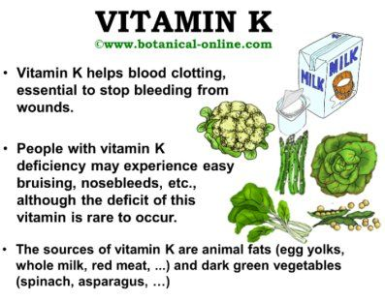
Disease caused by deficiency and excess of vit -k
Deficiency:- Results in osteoporosis, an increased risk of cardiovascular disease, significant bleeding and poor bone development.
Excess:- It manifest with the symptoms of jaundice, hemolytic anemia etc.

Slide 7
RDA for vitamin:- K

