Slide 1
Introducing India (Part-2)
Dr. Sanchali Banerjee
Assistant professor
Department of Philosophy
Bejoy Narayan Mahavidyalaya

Slide 2
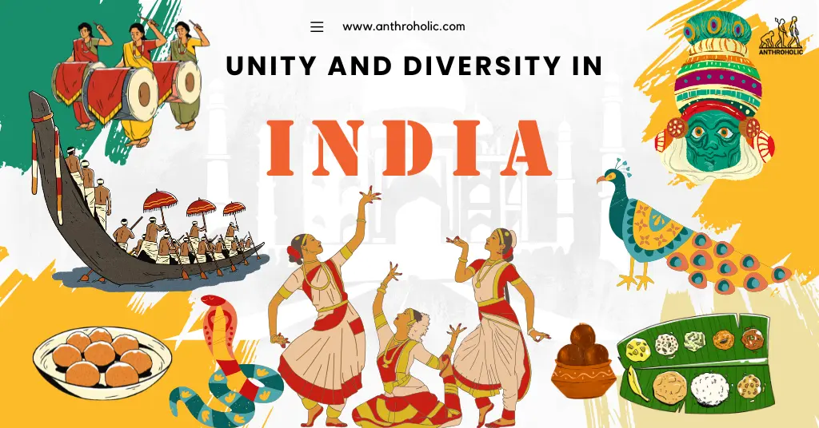
India as a Sub-continent
The diversity in this country, in terms of geography, climate, plants, soil, people and their language and way of life is so great that it is almost equivalent to a continent.
There is possibly no other country that is as diverse as India. We are blessed as a citizen of this country having a colourful history and an influx of people from all over the world. India is a glorious mix of religions, cultures and traditions. Visitors like Romans, Greek, Persians, French, Dutch, Portuguese, Chinese and British came here for as traders, looking for spices and jewels. Many of them also lived here and gave an impact of their culture.

Slide 3
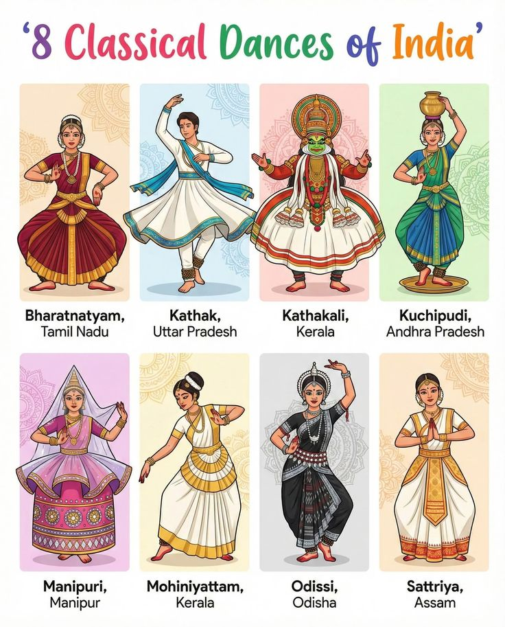
8 classical dance of India
There is no one single style of dance that you can call ‘Indian’. Just like Indian music, Indian dance forms can be divided into classical and folk.

Slide 4
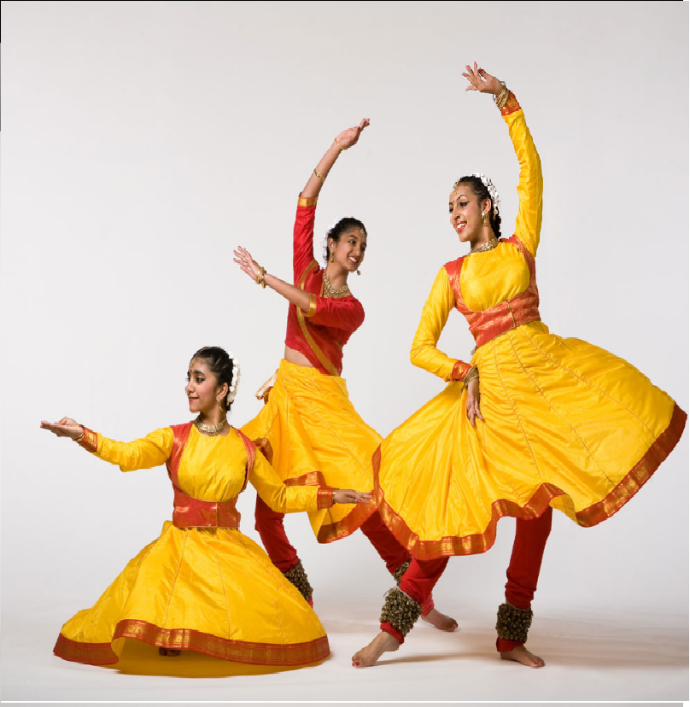
kathak
Once upon a time Kathak was a temple dance. Later according to the story tellers, the dances began to depict various stories, mainly those of Hindu God Krishna’s childhood.
Kathak dancers are nimble on their feet and are very expressive too.
Kathak was especially popular in the courts of the great Mughals and later appreciated by British.

Slide 5
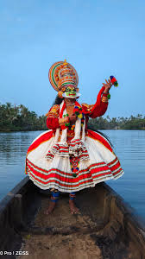
Kathakali
This dance is mainly performed in Kerala. Traditionally only male dancers perform this dance, but in later, women also have been participating in it. Dancers wear special costumes and make up.
The dancers play the role of characters from epics-Ramayana and Mahabharata and the whole stories are depicted entirely through dance.

Slide 6
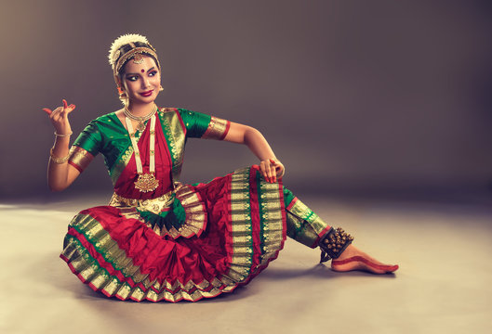
bharatnatyam
Bharatnatyam was one of India’s oldest dance forms and originated in Tamil Nadu. It used to be performed in temples and in the courts of kings. The women who danced for the gods in temple were called devdasies. They taught their daughters this dance, and so it went for centuries. Soon, the devdasies system fell apart. Great dancers worked hard to take this dance form from the temples to stage, where everyone could see it and enjoy it.

Slide 7
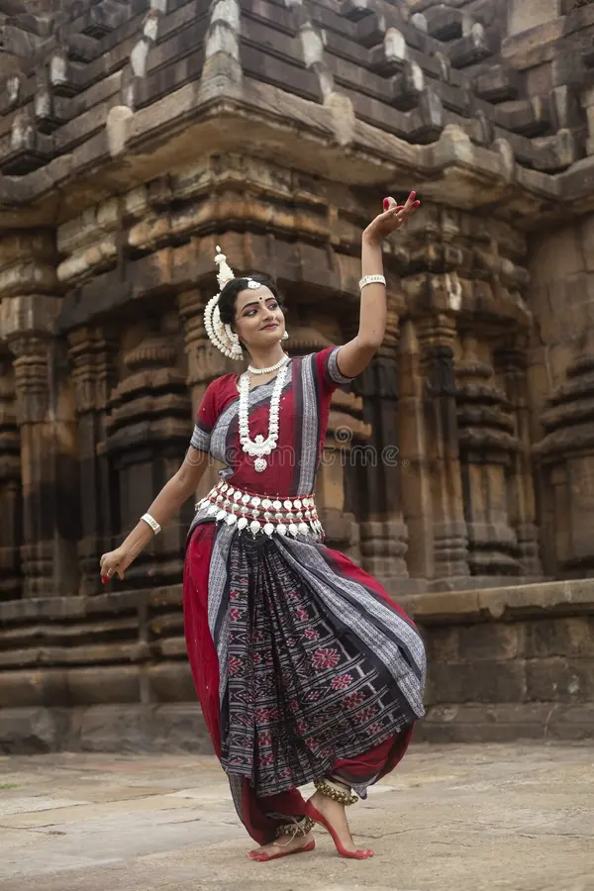
odissi
The name of the dance comes from the state Odisha.
Once upon a time, women would perform this dance for the entertainment of gods- so they believed. The women were called devdasies.
The performance of this dance forms involves the telling of a story, often about Hindu Gods.

Slide 8
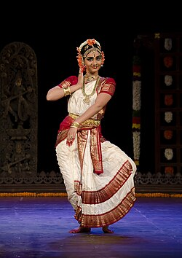
kuchipuri
This delightful dance is a beautiful mix of song, speech, dance, expression and gestures.
This dance is named after the village of Kuchipuri, in Andhra Pradesh, where it probably originated.

Slide 9
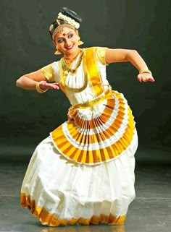
mohiniattam
This dance form is from Kerala and gets its name from the name of an avatar of the Hindu God, Vishnu, called Mohini. Through this dance, it is said, Mohini helped gods to win the battle between good and evil.
The bits of this dance is similar to the dance of Bharatnatyam. Facial expression is important part of this dance and its style, and the dancers use their eyes very expressively.

Slide 10
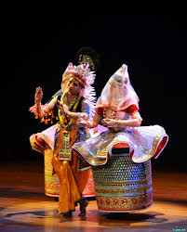
Manipuri
Manipuri dance is a major Indian classical dance form from the state Manipur, characterized by its graceful, fluid and lyrical movements. This dance symbolizes the eternal love between Radha and Krishna. It is performed in temple courtyards through the night, while devotees watch in rapt attention. The costume is dramatic. Women wear stiff, barre-shaped skirts, called poloi. Men wear bright colored dhotis called dhoras that cover their bodies from the waist down.

Slide 11
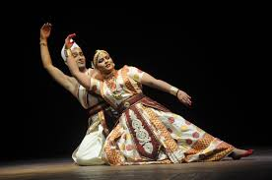
satriya
Satriya dance is 500-year-old major Indian classical dance form from the Vaishnavite monasteries of Assam. It is a devotional art form that tells mythological stories through graceful, codified movements and hand gestures, performed on stage by both men and women.

Slide 12
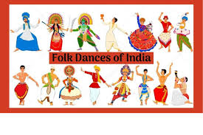
Folk dances in India
India’s folk dances are colorful & expressive. Many dances are performed to celebrate harvest or pray for a good crop.
The audience also can join in this dance.

Slide 13
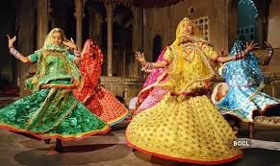
ghoomar
This dance has its origin in the desert side of Rajasthsan. Women wearing colorful ghagra cholis cover their faces with long veils and their wide skirts twirling to the rhythm. This dance dedicates its honor to the goddess Saraswati.

Slide 14
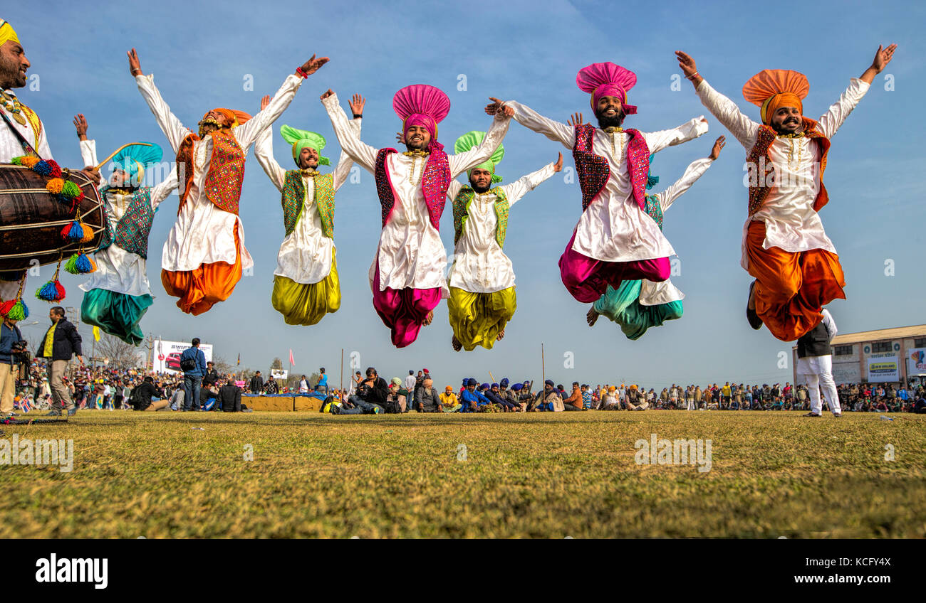
bhangra
From the state of Punjab, it is one of the best-known folk dances. It is performed mainly during Lohri- a harvest festival. Men (and sometimes women) dance to the loud beat of the dhol and there is much movements of the shoulders and feet.

Slide 15
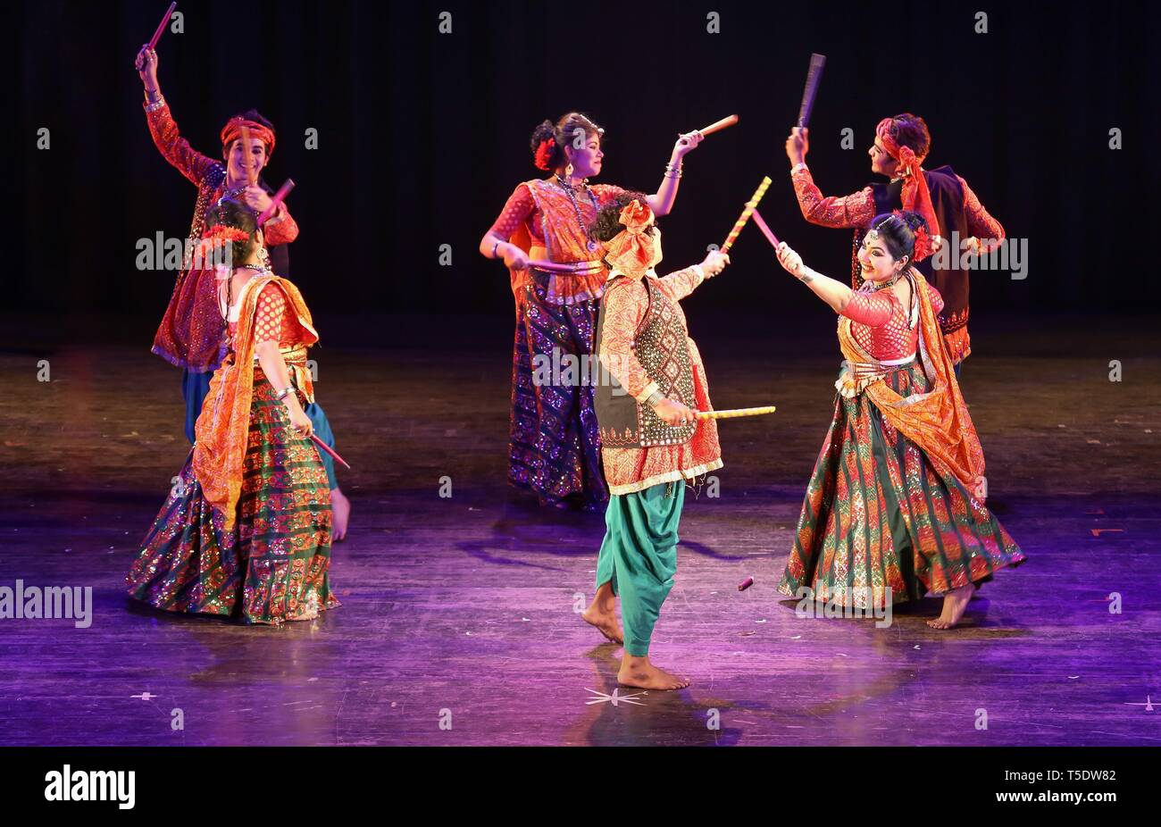
garba
The Garba is a high energy folk dance from Gujrat. In its original form, women would form a circle and dance with a mud lamp on their heads. They would clap their hands to a rhythm and twirl vigorously. Men and women both perform this dance at weddings, festivals and specially during the nine-day festival called Navratri.

Slide 16
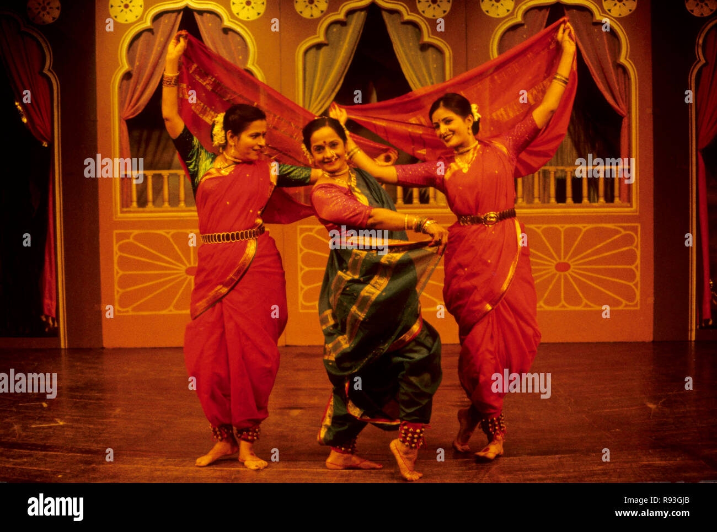
lavani
Lavani is a dance that is hundred of years old and is performed in Maharasthra, parts of Karnataka and Madhya Pradesh. It is traditionally performed by women wearing nine-yard sarees, and is a mixture of song and dance.

Slide 17
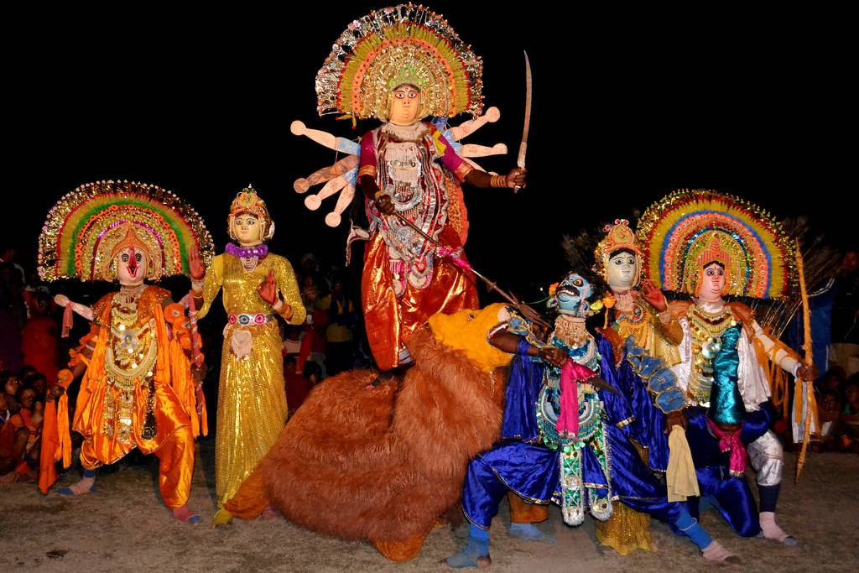
chhau
Chhau is a popular tribal dance, performed in different ways in several of the eastern states.

Slide 18
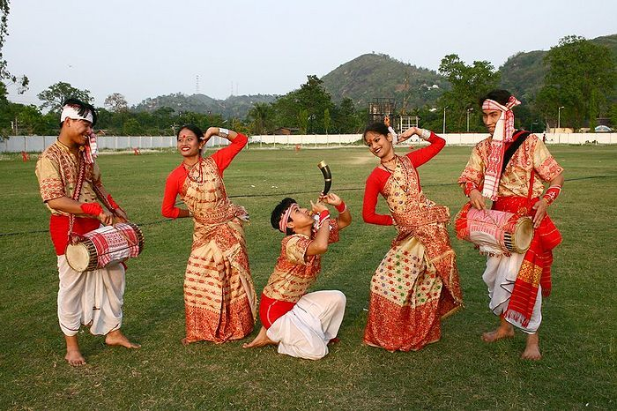
bihu
Bihu is one of Assam’s popular dances and is performed during the Bihu harvest festival.

Slide 19
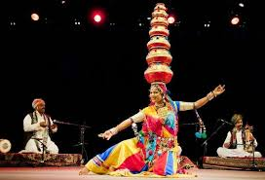
matki
Matki is a dance of balance and skill from Madhya Pradesh. A female dancer balances a series of earthen pots (called matkis) precariously on her head. This dance is performed during festivals and weddings.

Slide 20
musical moments
There are mainly two types of Indian music, namely classical and folk. By using local instruments, the folk music is played. It usually includes songs about local heroes, gods or goddesses.
Another one is classical music which need years of training to become master of it. Classical music also has two forms- Hindustani & Carnatic. All Indian classical music is based on Ragas. Ragas are set of rules that tell us how to build a particular melody. They define the order in which notes are to be played. There are numerous versions of ragas that have been around for centuries.
There are ragas for different times of the day. Where the morning ragas show us the rising of the sun, the evening ragas, on the other hand, make us feel the darkness of the evening. Even there are monsoon ragas having the sound like thunder and lightening.

Slide 21
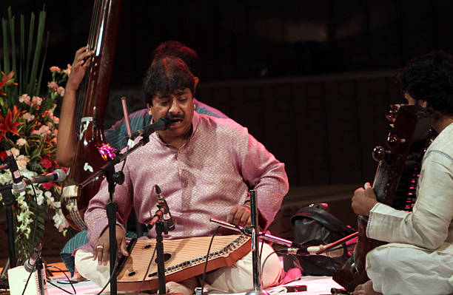
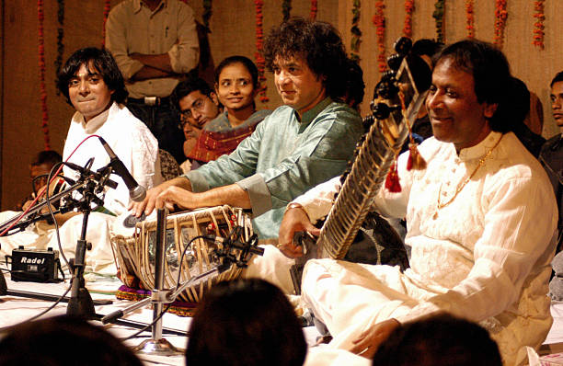
Hindustani classical music
In northern and central India, Hindustani music is most well-liked. Many individuals traveled from the Persia and the Middle East to trade with and live in India throughout the twelfth and thirteenth centuries. They carried their musical customs with them.
Amir Khusru was a poet and musician who lived at this time. He played a great role in developing Hindustani music. The courts of many kings adopted and supported this style of music which helped it gain popularity.

Slide 22
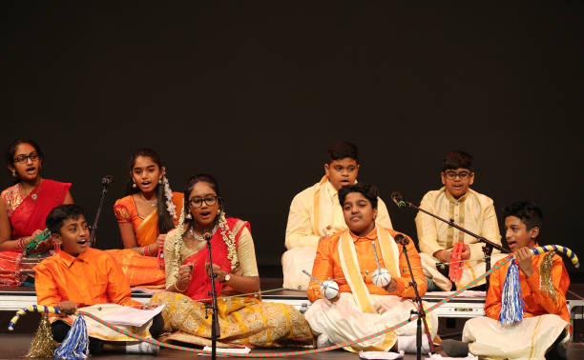
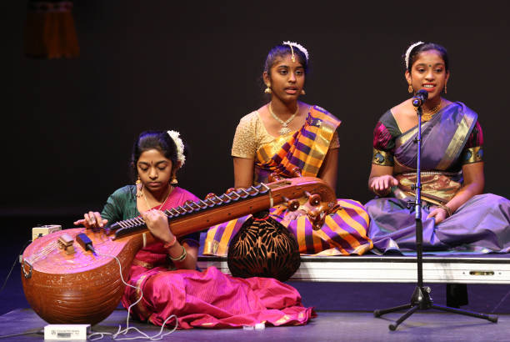
Carnatic music
Carnatic classical music is considered to be the world’s oldest genres. Since most compositions we hear are songs that demonstrate devotion to the gods, it was most likely born in temples.
There are very few pure instrumental works, and the emphasis is on the vocal rather than the instrument, ,may be because they were meant to be sung.
Carnatic music concerts, called kutcheris, are very popular even now.

Slide 23
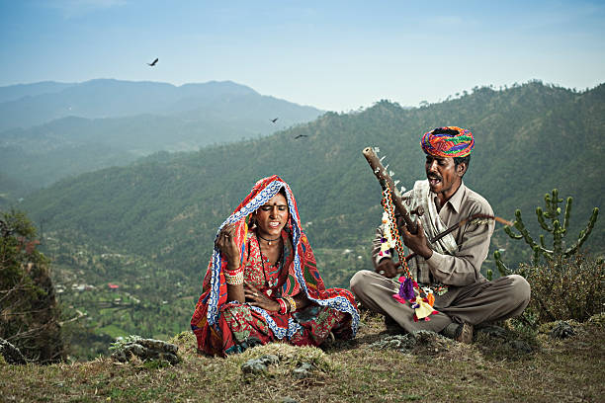
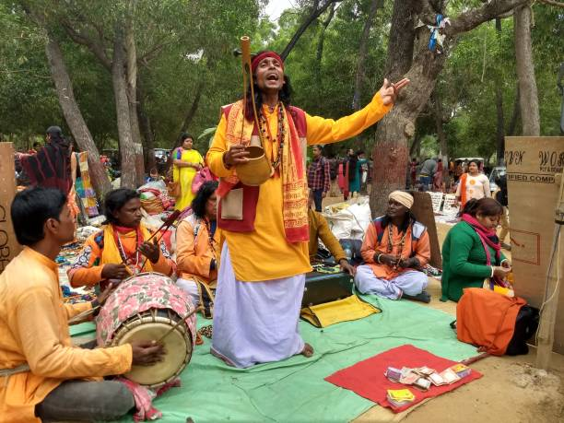
Folk music
There are many hundreds of styles of folk music in India. To express gratitude to the gods for a bountiful harvest, many folk songs are harvest songs. Other folk songs include the songs of bravery and heroism or are sung in praise of local gods or goddesses.
Folk music is played during festivals and occasions which people gather to commemorate.

Slide 24
Five fun facts about some popular forms of folk music in India
Rajasthani Maand is a nearly classical form that require years of practice to become proficient at.
Bihugeet from Assam were songs sung during the Bihu festival.
Baul singers wandering minstrels from West Bengal, Assam and Odisha who perform spiritual songs.
Dayro from Gujrat involves the singing of religious songs as well as songs with social messages.
Koli geet from Maharasthra are songs of the sea sung by the Koli, a fishing community that lives on the west coast.

Slide 25
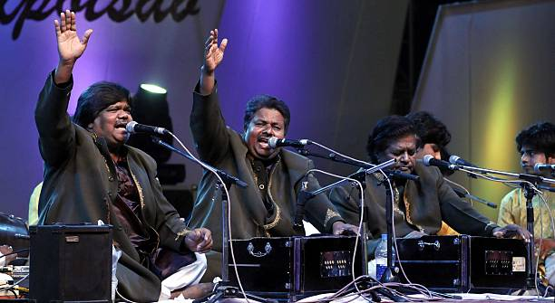
Qawwali songs
Amir Khusru is credited with inventing the qawwali by merging Persian, Turkish, Arabic and existing Indian musical traditions. Qawwalis tend to begin with a slow beat, and then steadily increase in intensity, with the goal being for both the singer and the listeners to feel like they are in a trance. Devotional qawwalis are sung in dargahs and mosques by Sufi musicians.

Slide 26
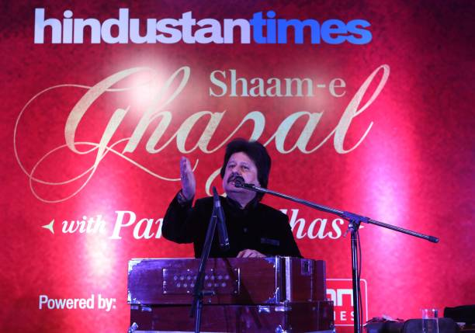
ghazal
The ghazal is an ancient musical style that is thought to have originated in Arabic holy poetry more than a millennium ago before making its way to Persia and Turkey. It is believed to have come to India in the twentieth century CE. Ghazals are mainly the songs of love and the pain of separation. The thirteenth century Persian poet Rumi wrote ghazals, as did Mirza Ghalib and Mir Taqi Mir in eighteenth and nineteenth century CE Mughal India.

Slide 27
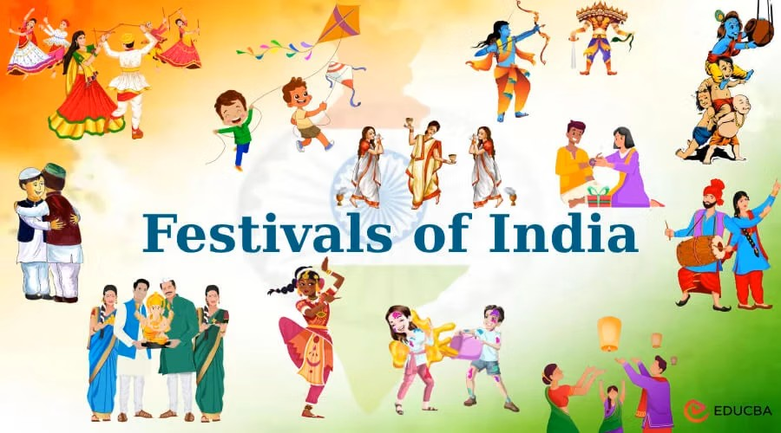
Festivals of India
India is a diverse nation where people follow their own set of religions, traditions, faith and culture. Indians are known all over the world for celebrating festivals unmatched devotion and incredible vibrancy. Each festival is dedicated to various gods, goddesses, events and harvest seasons, crop showing season or even change of season. Each festival is accompanied with detailed Vedic practices, folk dances and performances which add a lot of light, colour and positive vibes to the festivals in India.

Slide 28
Festivals
Festivals of mainly 3 types
Celebrating Harvest Celebrating victory Birthday Celebration
of good over evil

Slide 29
List of festivals for harvest celebration
Baisakhi Festival
Lohri Festival
Pongal Festival
Makar Sankranti
Bihu Festival
Dree Festival

Slide 30
List of festivals celebrated for victory of good over evil in India
Holi
Navratri
Dussehra
Durga Puja
Diwali
Losar

Slide 31
List of festivals (birthday celebration) in India
Ram Nabami
Mahavir Jayanti
Buddha Purnima
Hanuman Jayanti
Krishna Janmastami
Guru Nanak’s Birthday
Christmas
Eid-e-Milaad-un-Nabi
Gandhi Birthday
Radhakrishnan’s Birthday as Teacher’s Day
Ambedkar’s Jayant

Slide 32
Other festivals
Ganesh Chaturthi
Raksha Bandhan
Maha Shiv Ratri
Chatt Puja
Karva Chauth
Teej
Eid
Saraswati Puja
Easter
Horn Bill
Saga Dewa

Slide 33
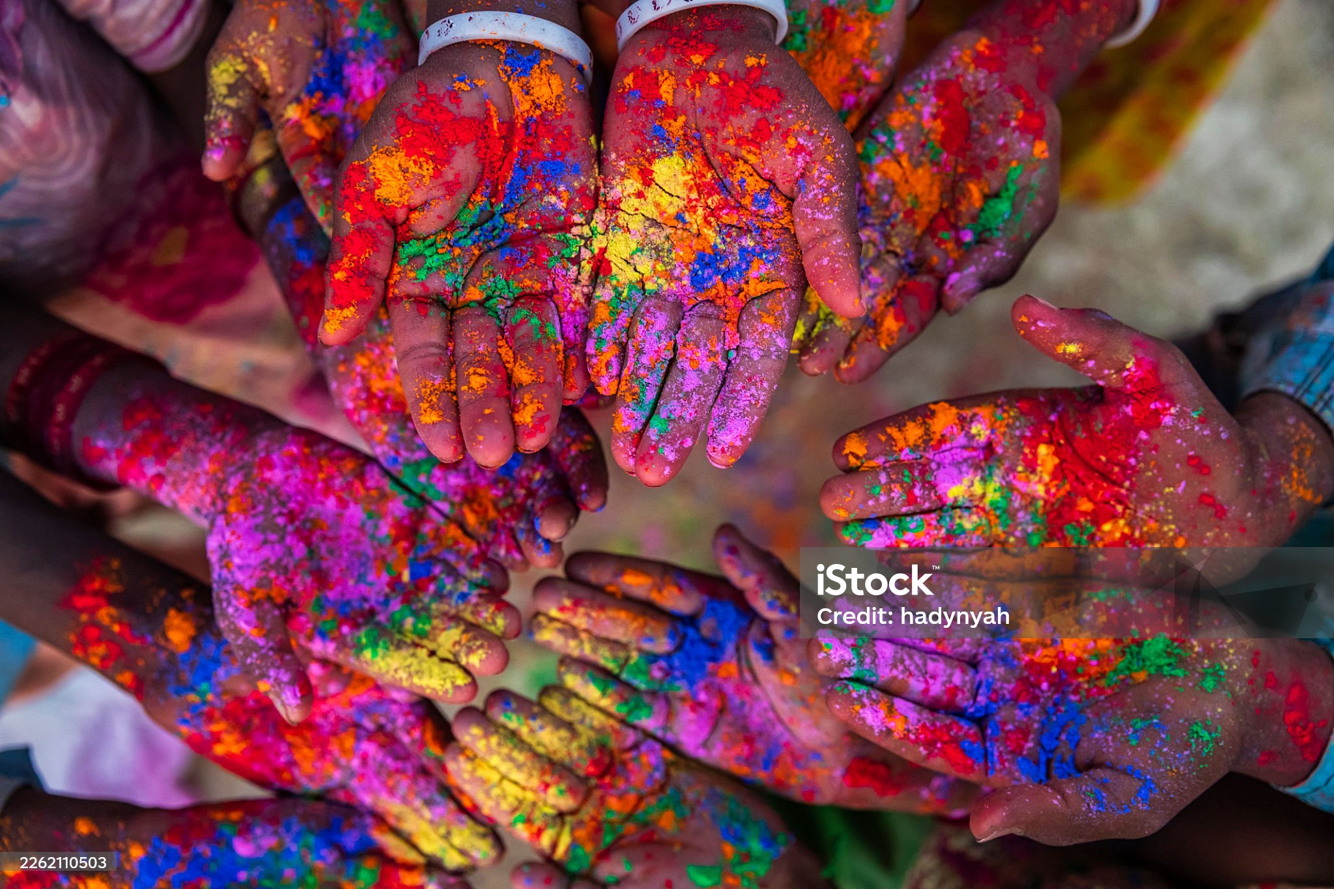
Holi festival
Holi is most awaited festivals in India. It is a festival of love and colours, and signifies the victory of good over evil, the eternally divine and pure love shared between Radha & Krishna and blossoming of the spring season. The Holika Dahan ritual takes place the night before the main day, making the official start of the holiday. A bonfire is lit as a sign of the murder of Holika, the demon king Hiranyakashyap’s sister. The other day, people cooked delicious food, exchange gifts and showered each other with bright colours.

Slide 34
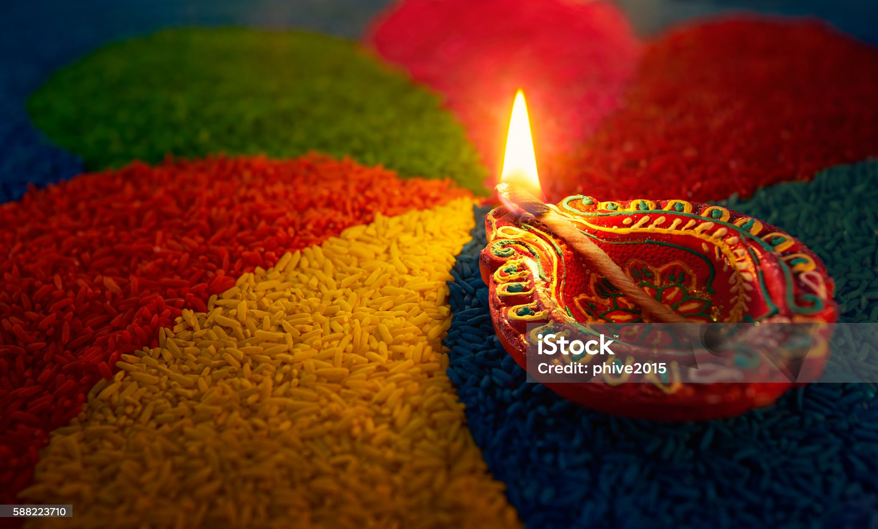
Diwali/ festival of lights
Diwali is celebrated according to the Hindu Lunisolar months of Ashwin and Kartik.
The festival is symbolic victory of light over darkness, good over evil and knowledge over ignorance.
The festival is associated with goddess Lakshmi and Lord Ganesha and the welcoming back of Lord Rama to his kingdom in Ayoddha after having defeated Ravana and completing an exile of 14 years.

Slide 35
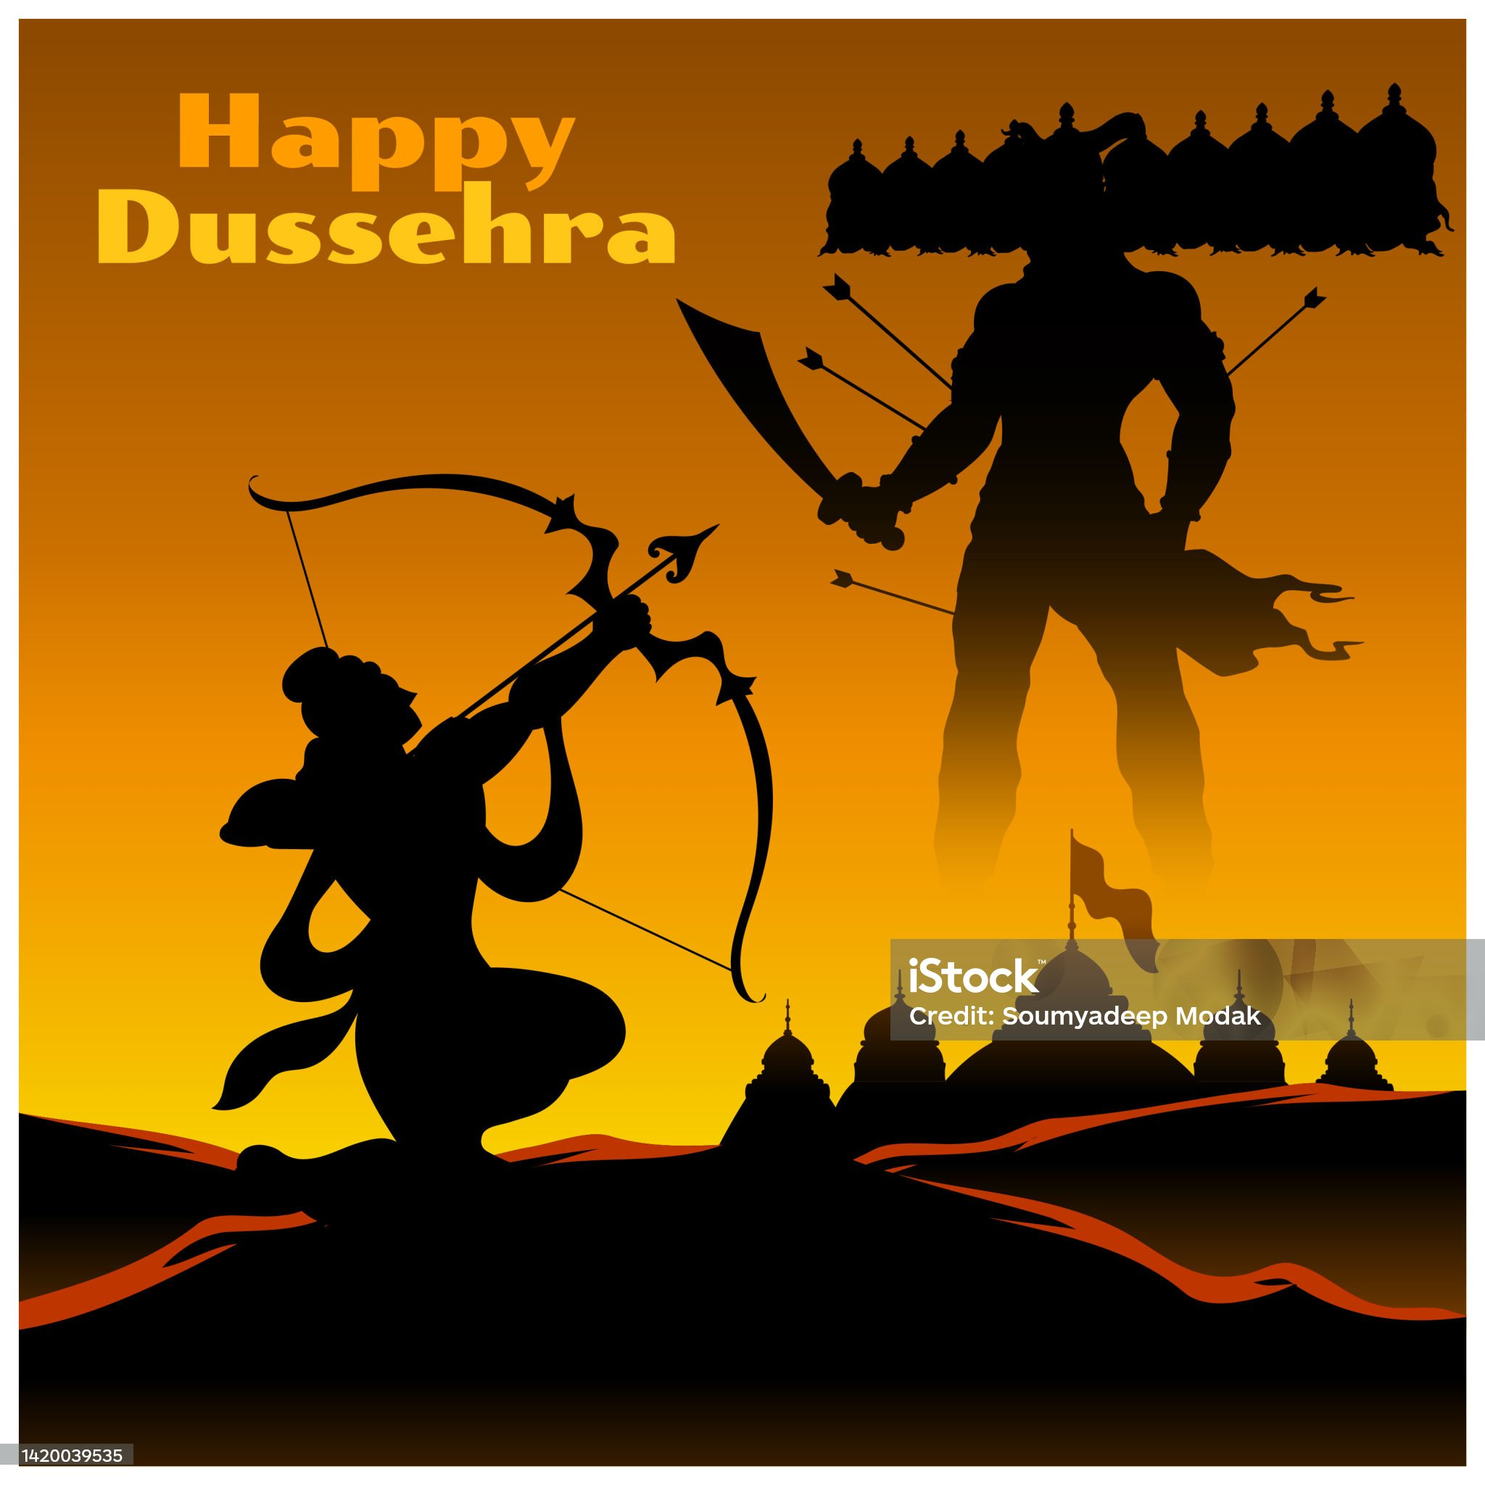
dusserha
This festival is celebrated at the end of Navratri every year, and also known as Vijayadashami.
This Hindu festival is observed on the 10th day of the Ashwin month.
Vijaydashami is celebrated for different reasons throughout the Indian subcontinent where people give different names to their faith. E.g., in northern India, this festival marks the end of Durga Puja , in other parts of the country, it is referred to as Dusserha that is commemorated by Ramlila performances etc.

Slide 36
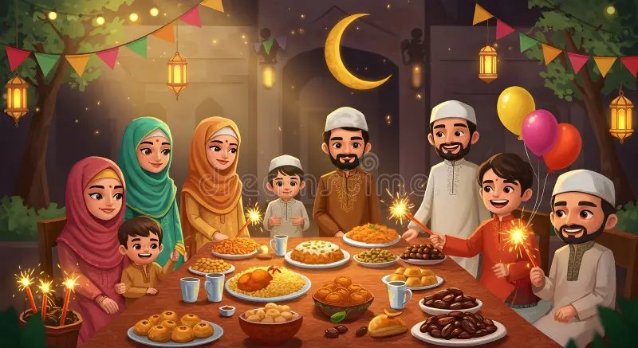
Eid day
By its meaning is the festival of breaking fast.
It is one of the two major Islamic festivals celebrated by the Muslim Community at a very large scale in India and across the globe as well.
The festival marks the end of the holy muslim month of fasting or Ramadan.
This is the time when people visit with each other, wear new cloths, exchanges gifts and break the fast by making elaborate, wholesome and nutritious meals.

Slide 37
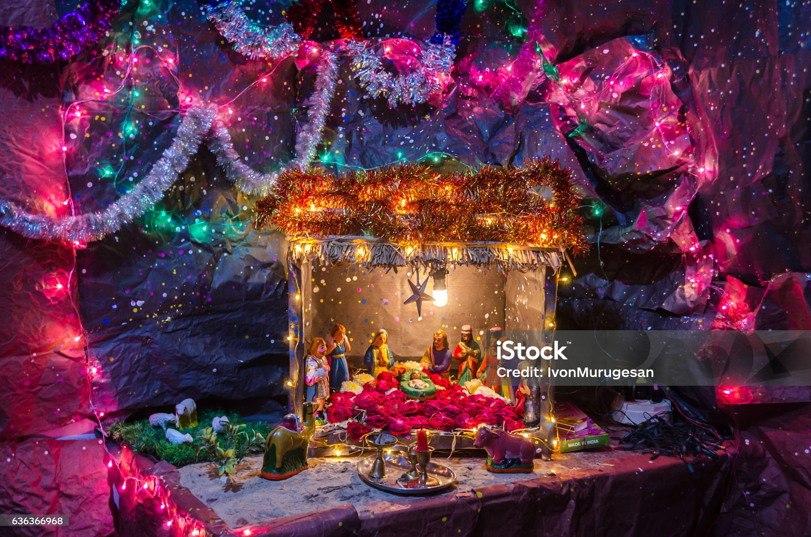
Christmas day
The bells of Christmas begin to ring in everyone’s ears as the end of the year approaches. Every year on 25th December, people celebrate Christmas, which honours the birth of Jesus.
People celebrate the day by decorating their houses in colourful lights, wreaths and flowers.
People visit Churches and give gifts to each other.

Slide 38
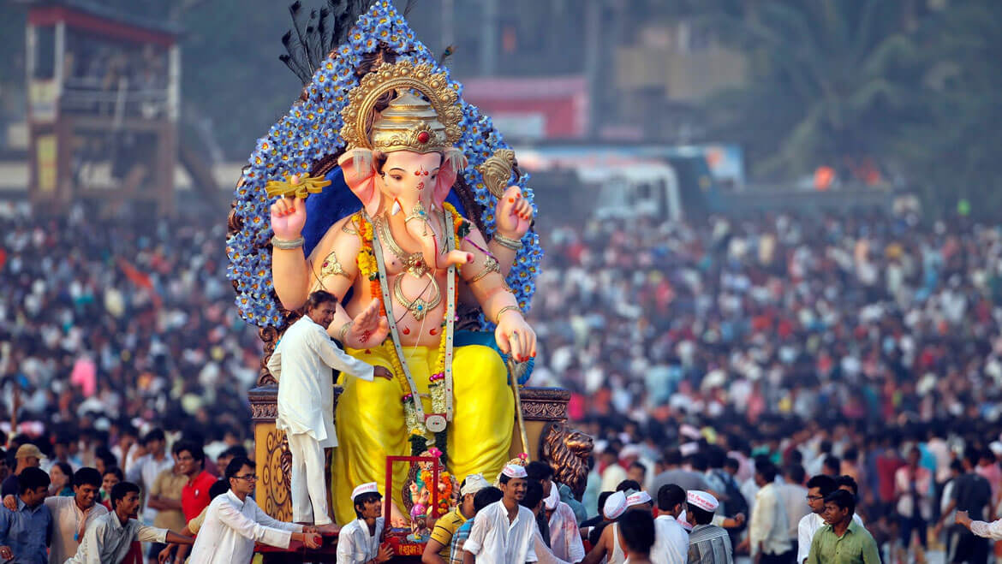
Ganesh chaturthi
Ganesh Chaturthi is one of the most beloved festivals in north and central India.
On this occasion, people celebrate the birth of the elephant-headed Hindu deity, Lord Ganesh.
Lord Ganesh is the god of prosperity, wisdom and someone who removes obstacles from life.
The festival kicks off on the 4th day of the month of Bhadrapada and ends when the idols of the lord are immersed in water bodies, symbolizing hos home journey back to his abode in Mount Kailash.

Slide 39
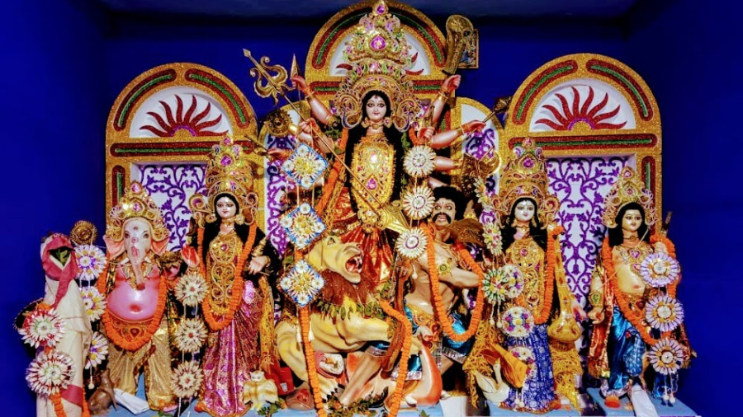
Durga puja
Durga Puja is a Hindu festival whose roots can be traced back to the prehistoric times.
As the name implies, the festival pays homage to goddess Durga and also celebrates her victory over the demon Mahisasura.
It is traditionally celebrated by the Bengali communities of West Bengal, Bihar, Jharkhand, Assam, Tripura etc.
The festival takes place in the Ashwin months of the Hindu calendar.
During the 10 days of this festival, various rituals and offerings to the goddess take place.

Slide 40
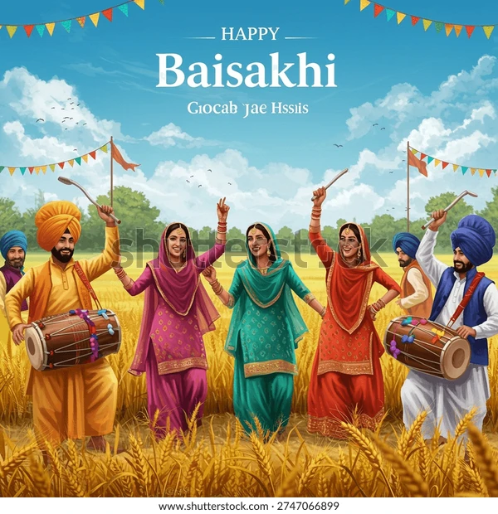
Baisakhi festival
Every year in April, the Vaisakhi celebration is held to commemorate the first day of the month of Vaisakh.
This spring harvest festival is primarily rooted to the northern regions and mainly celebrated by the Sikh community.
During this festival, they hold kirtans, visit local Gurudwaras, socialize and share festive foods.
Other Indian cultures and diaspora also celebrate this festival in their own way.

Slide 41
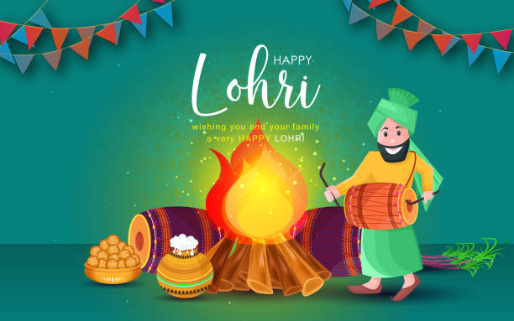
Lohri festival
Lohri, a well-known winter folk festival in
Punjab, is one of the many festivals in India that have its roots in honouring agriculture.
The Lohri festival greets the sun’s arrival in the northern hemisphere and signals the end of the bitterly cold winter season.
It happens just one night before Makar Sankranti where people light up bonfire and throw handfuls of grains in it to bless the coming of the new agricultural season and harvest.

Slide 42
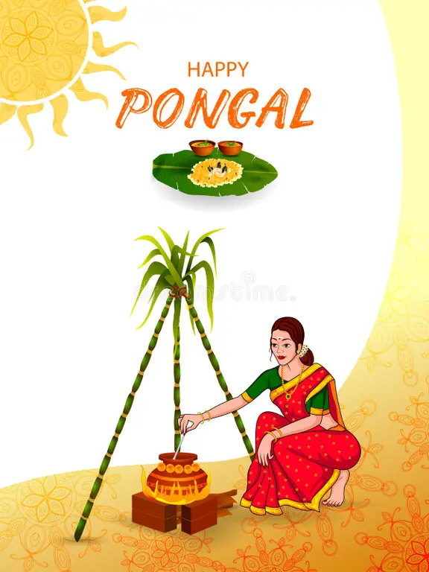
Pongal
In Tamil Nadu, Pongal is one of the most popular and eagerly anticipated harvest festivals.
It is also celebrated in Sri Lanka.
According to the Tamil solar calendar, Pongal begins by the end of the Tai month, which usually occurs in the winter month of January.
The festival is dedicated to the sun god or Surya dev, and the festival corresponds with the north Indian festival of Makar Sankrati.

Slide 43
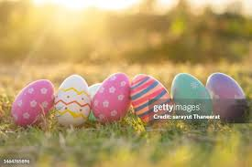
Easter festival
Easter is anther significant Christian celebration or feast, after Christmas.
Easter comes from the term eostre, a goddess who is celebrated at the beginning of the spring season.
Easter also comes with many traditions which can be traced back to the custom folks.
Easter is typically celebrated with entertaining egg hunts and delectable feasts.

Slide 44
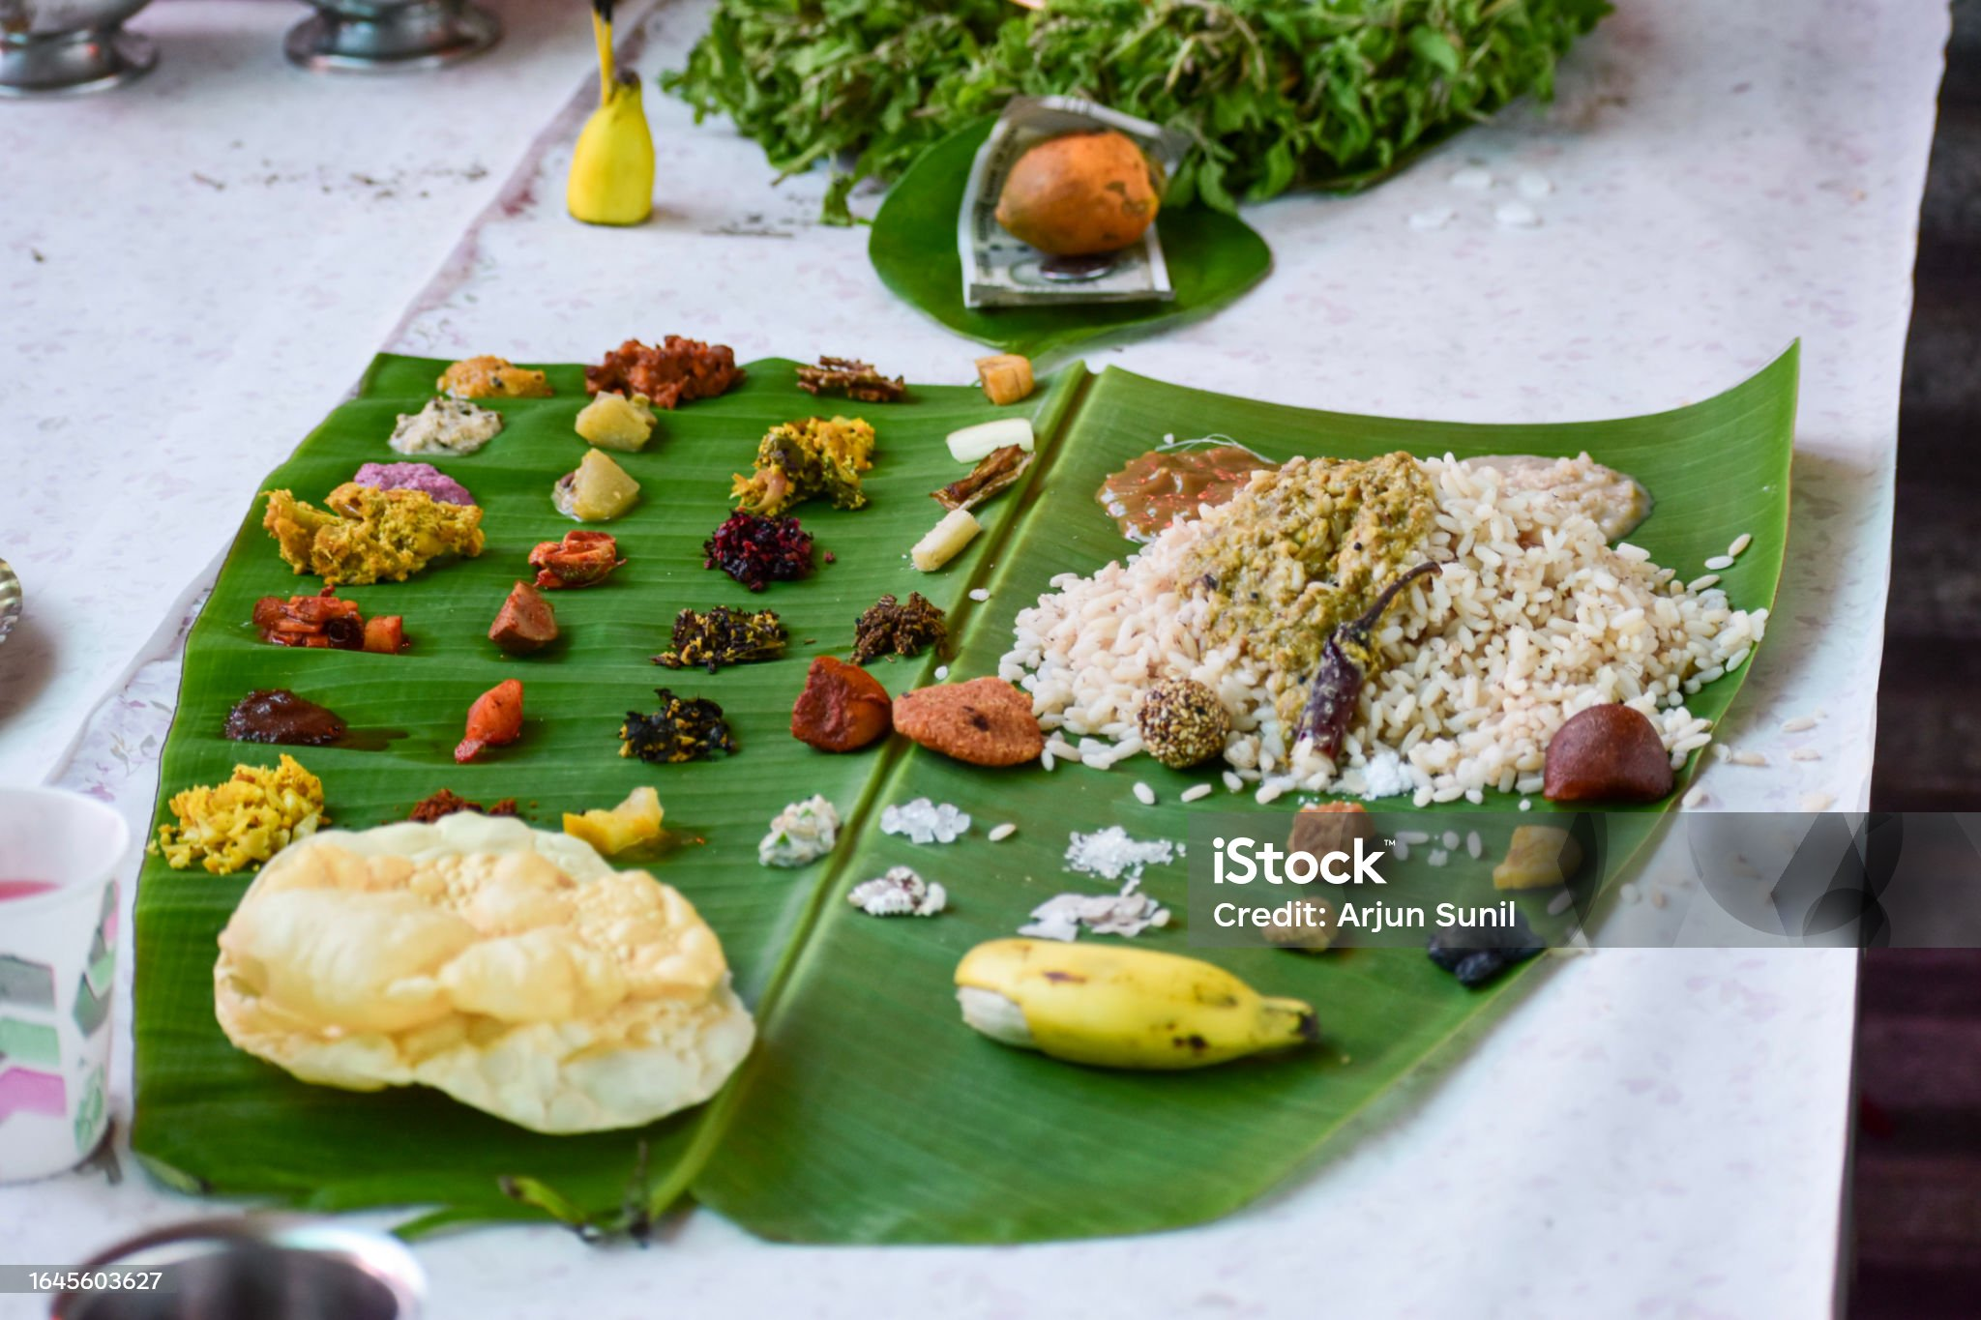
Onam festival
In South India, Onam festival is celebrated majorly by the Malyali community of the people of Kerala.
It is celebrated widely to mark the welcoming of their great king Mahabali
This 10 days long festival is celebrated with incredible splendor and is also said to mark the beginning of the harvest season.
The celebrations include cultural parade, making of flower rangolis, traditional folk musical and dance performances boat race, tiger dance and more.

Slide 45
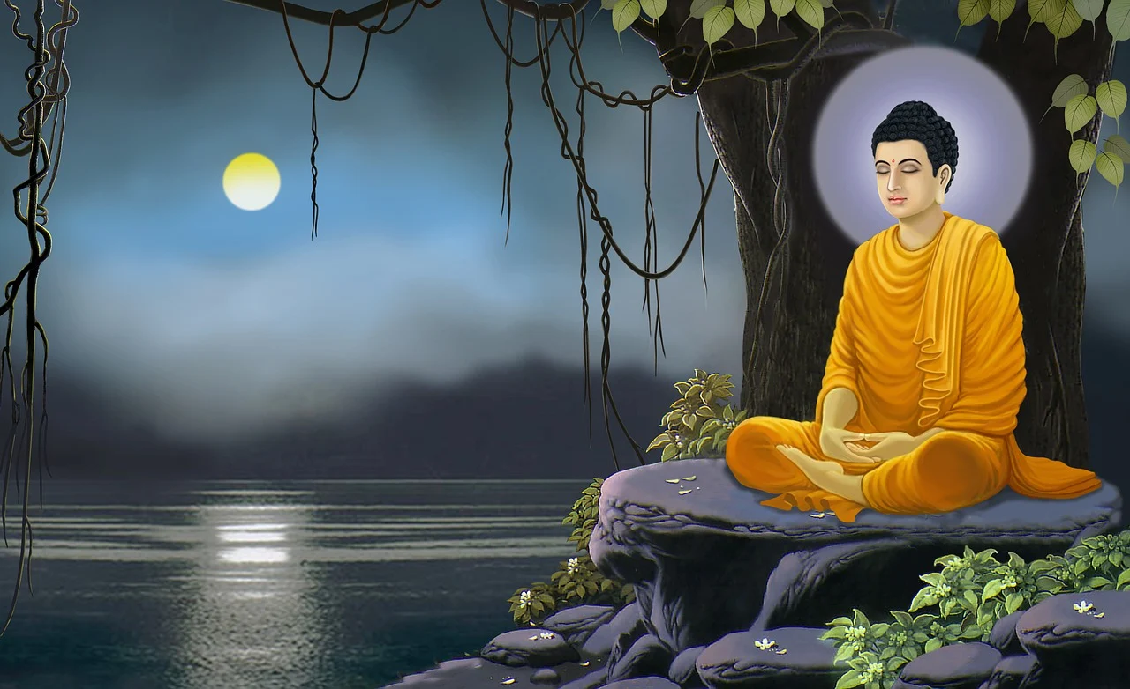
Buddha purnima
Buddha Purnima is also referred as Buddha Jsaysanti, it marks the day of enlinghtenment of Gautama Buddha which had a strong impact on the spirituality of the world as a whole.
This Buddhist festival is widely observed in the East and South Asian community, as Siddhartha Gautama’s birthday in Lumbini, Nepal.
The exact date for the Buddha’s birth is dependent on the Asian Lunisolar calendars.

Slide 46
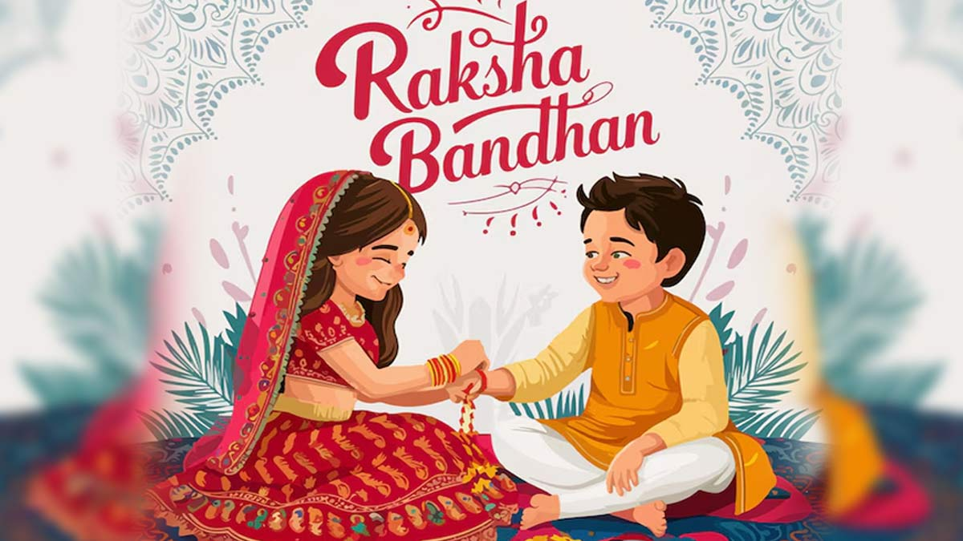
Raksha bandhan
Raksha Bandhan or Rakhi is a major traditional Hindu festival that takes place between brother and sister.
On this day, sisters of all ages tie up an amulet called Rakhi on their brother’s wrist. This symbolizes the brother’s promise to protect the sister.
In return to tying Rakhi, the sisters receive gifts and blessings with a promise of sharing the responsibility in the future.
It is observed on the last day of Shravan.

Slide 47
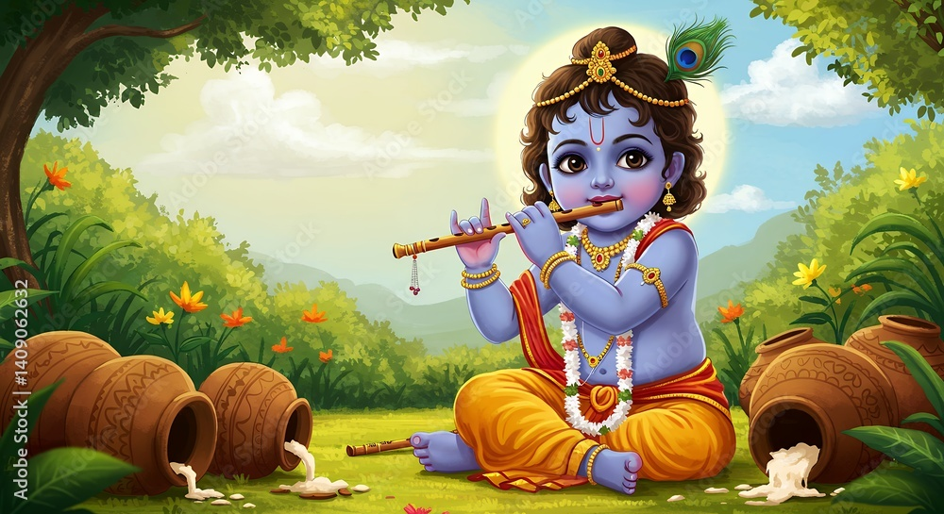
Krishna janmastami
This festival is dedicated to Lord Krishna to celebrate his birthday. This annual Hindu festival is all about celebrating the occasion of birth of the 8th avatar of Lord Vishnu, i.e. Krishna.
The day is observed on the 8th Tithi of the Krishna Paksha in the month of Shravana.
On this very day, people offer prayer to the lord, chant his name and sing devotional songs.
This Janmastami celebration is followed by Nand Utsav celebrations the next day.

Slide 48
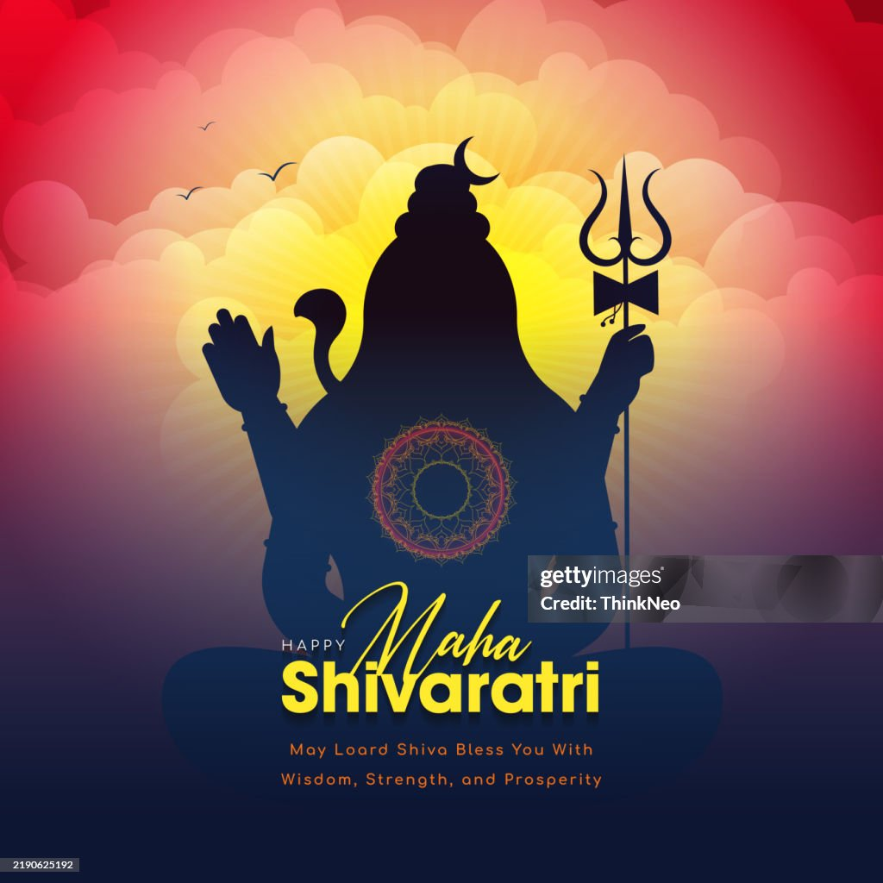
Maha shiv ratri
This Hindu festival is celebrated to honor the destroyer Lord Shiva in different ways.
The meaning of the festival Shivratri- the night of Shiva, takes place on the day prior to the new moon.
On this great night of Shiva, every devotee remembers the powerful Lord Shiva by fasting, chanting prayers, doing charity work etc.

Slide 49
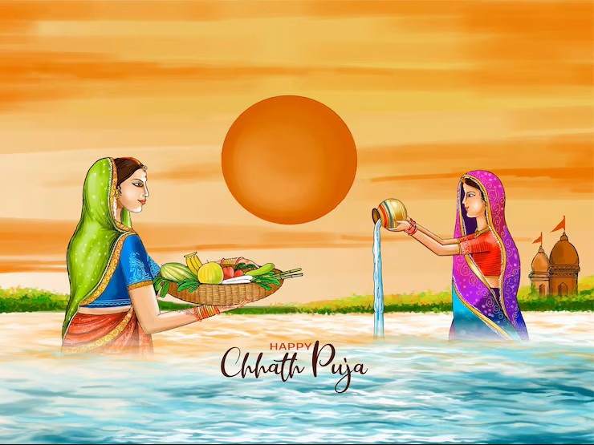
Chatt puja
Originally from the Indian states of Bihar, UP, West Bengal, Jharkhand, Chatt puja is an ancient Hindu festival.
The puja is dedicated to the sun God or Surya dev, as a way of offering gratitude and thankfulness to the sun deity for bestowing a bountiful life on earth.
It is celebrated 6 days after Diwali.
According to the environmentalists, Chatt is one of the most eco-friendly religious festivals in the world.
The rituals including bathing, abstaining from drinking water, fasting, standing in water offering prayer etc.

Slide 50
Bihu festival
The Bihu festival of Assam is one of the most prominent festivals in the subcontinent that is primarily observed by the local Assamese people.
During the peak winter month of January, Bihu takes place as a set of 3 major Assamese festivals of Rongali, Kongali and Bhogali .
Normally the term Bihu only signifies the Assamese Dance form, but is way more than that.
Every aspect of this festival and its rituals reflect influences from the South East Asia and Sino-Tibetian cultures.

Slide 51
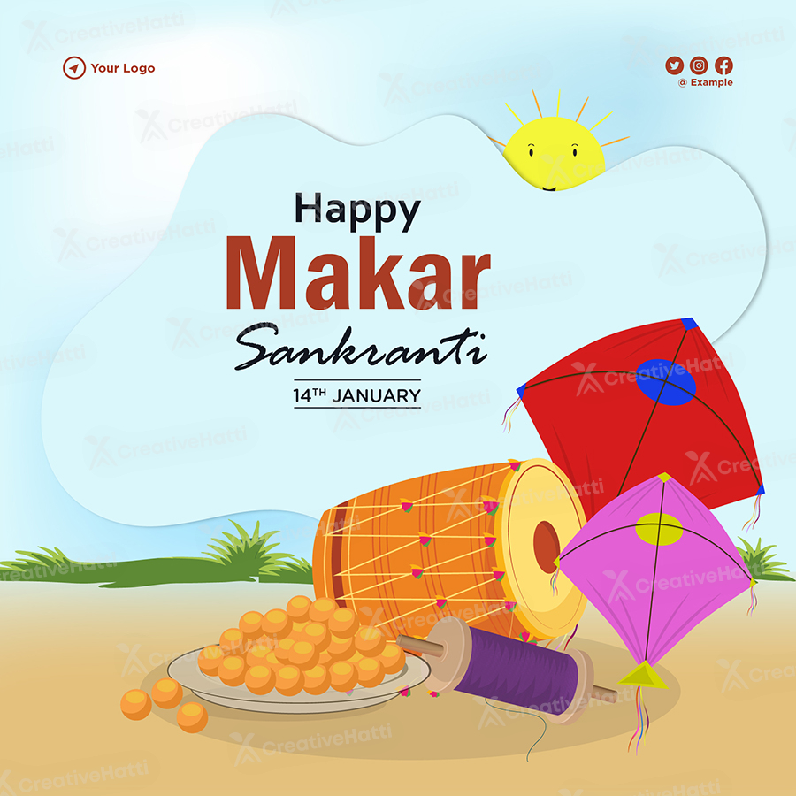
Makar sankranti
It is also referred as the Til Sankranti. This day is an important event in the year.
The day Makar Sankranti is celebrated traditionally marks the transition day of the sun into Capricorn.
Depending on the area, Makar Sankranti is known by several names. For instance, it is called Uttarayan in Jammu and Uttar Pradesh, Pongal in Tamil Nadu, Sakraat in Rajasthan and so forth.

Slide 52
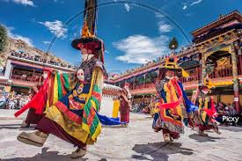
Hemis festival
The Hemis festival takes place in Hemis Monastery in Ladakh.
It is one of the most important Buddhist festivals as it marks the birth of Guru Padmasambhava.
The Hemis Gompa turns into a grand stage where people participate in the Cham and mask dance performances with Tibetian usical performances and more.
The festival takes place on the 10th day of the 5th month of the Tibetian calendar.

Slide 53
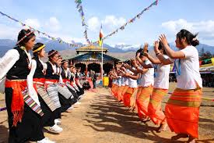
Losar festival
The followers of Tibetan Buddhist celebrates this event as the Tibetian New Year.
The festival has its roots in the incense burning custom of the bon religion.
This event is marked with ancient ceremonies and practices representing the struggle between good and evil.
The dance movements and theatrical performances that takes place in the coutryard of the monasteries is a mesmerizing sight to hold.

Slide 54
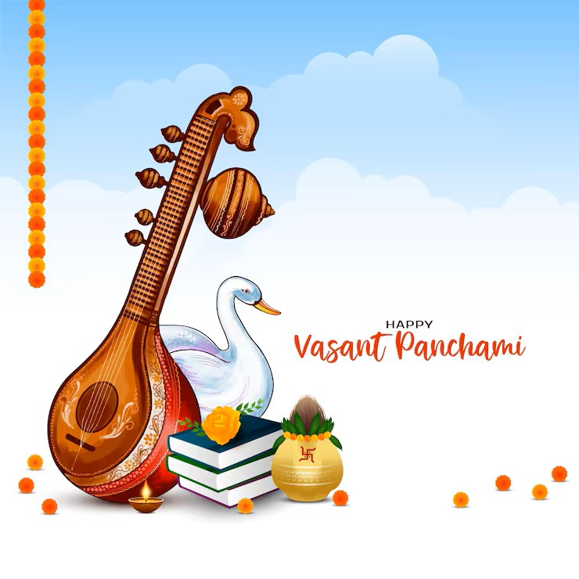
Vasant Panchami/Saraswati puja
In north India, it is celebrated as Vasant Panchami.
This festival is a marker for the arrival of spring season.
This puja honors Saraswati Mata, the goddess of knowledge, music and all arts for her blessings.
Saraswati Mata symbolizes creative energy, power, longing and love.
People dress up in yellow cloths and yellow foods as well.

Slide 55
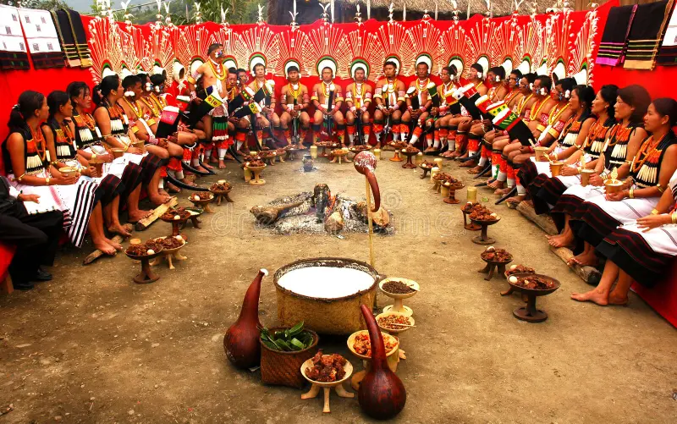
Horn bill festival
This festival is organized each year by the government of Nagaland.
The festival is a way of restoring and preserving the culture, faith and traditions of our Naga neighbours that are tucked away in the deep core hills of North Est India.
The various tribes of Nagaland perform their local dance, musical and theatrics acts.
With great passion and enthusiasm, every Festival of Nagaland is celebrated.
This festival is the perfect celebration of local culture and heritage throughout the centuries.

Slide 56
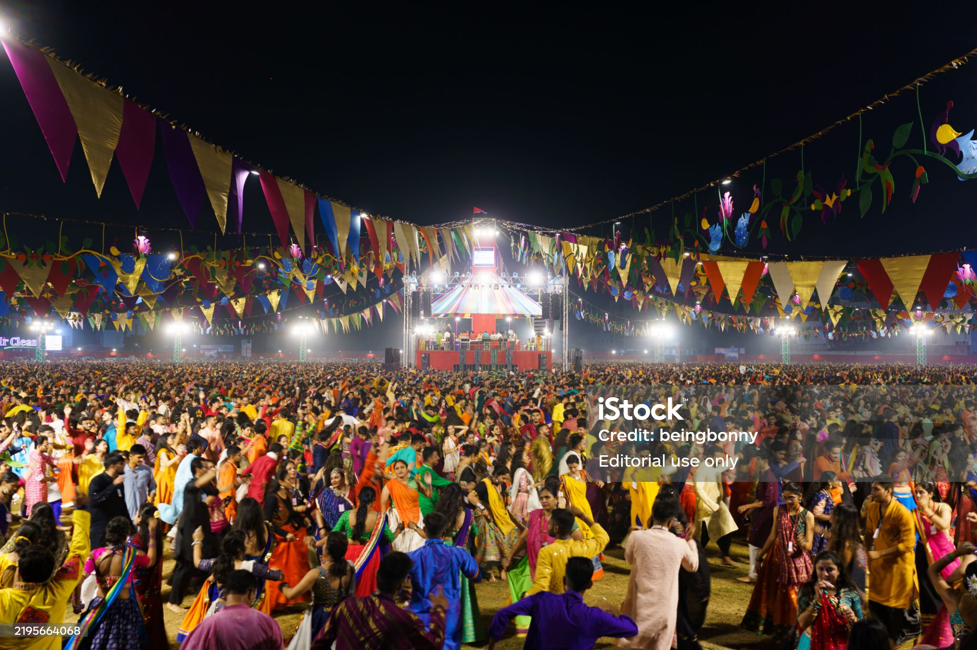
navratri
In India, Navratri has to be undoubtedly one of the most awaited celebrations that spans over a duration of 9 days.
These 9 holy nights are dedicated to the 9 different forms of Goddess Durga.
The term Navratri literally translates into 9 nights where Nav means 9 and Ratri means night.
The celebration includes the dance with traditional and devotional songs, enacting story and chanting mantras from scriptures.
Navratri is one of the most fun filled festival experiences in India.

Slide 57

Teej festival
There are two variations of the Teej festival celebrated in India, namely, Hariyali sand Hartalika.
It is celebrated by the girls and married women of the Hindu community to welcome the monsoon season.
They sing, dance, observe fast, offer prayers meditate and listen to devotional music.
This festival is dedicated to goddess Parvati and her reunion with lord shiva.
Women wear 16 Shringar and put Mehendi to honor their marital status.
The festival is mainly observed in the North Indian states and Nepal.

Slide 58

ramnavami
Ram Navami is one of the most iconic Hindu festivals in India.
It is the celebration of the birth of Lord Rama, the 7th avatar of Vishnu. This festival is a part of the Chaitra Navratri in the spring.
The day is marked by Ram Katha recitals or the chanting of the stories involving the greatness of lord Rama.
This also includes the recitation of the Hindu epic Ramayana.
This festival mainly takes place in Ayoddha and also other temples across India that are dedicated to Lord Rama.

Slide 59

Karva chauth
This festival is celebrated by the married Hindu women of north and west India.
This festival traditionally fals on the 4th day of the full moon.
During this day, married women keep a fast, without drinking water, fo the whole day from sunrise to moonrise. Locally this festival is followed by the people in the states of Delhi, Punjab, Rajasthan, Haryana, UP, Himachal Pradesh, Madhya Pradesh etc.
The term ‘Karwa’ another word for a pot and Chauth means fourth.
Women set up Puja ki Thali, Put Mehendi, and dress up in traditional married women’s attire and break their fast by looking through av sieve to their husband.

Slide 60

Dree festival
This festival mainly takes place in the Zero valley in Arunachal Pradesh.
It is celebrated by the Apatanis of this region.
Dree is an agricultural festival which is considered as the highlight for the agricultural cycles.
As a part of the festival the people worship and offer their honors to the 5 primary deities namely Tamu, Metii, Meder, Mepin and Danyi. All these gods help with a healthy growth of crops and create a favourable environment, free of pests and insects, to grow a good quality of crops.

Slide 61

Mahavir jayanti
It is celebrated by the Jain community of the subcontinent and the festival marks the birth anniversary of the founder of Jainism.
On this festival people come together to observe peace, harmony and spread the teachings of Mahavir, the 24th Jain Tirthankar.
The celebration includes carrying out the idol of Lord Mahavir on an ornate chariot called a Rath Yatra.
The idol is given a ceremonial Abhishekam and during the day, many Jain people engage in giving and charity activities.

Slide 62

Saga dewa festival
It is a famous and biggest festival in Sikim. The festival is considered to be incredibly sacred and prominent for the followers of the Mahayana sect of Buddhism.
The occasion celebrates the auspicious moment when Buddha had attained his enlightenment that in turn had set forth the wheel of dharma.
This festival offers the perfect platform of visual treat for various religious ceremonies sand street processions.
It is one of the main festivals celebrated among the Hindu Nepalese community of Sikim that takes place in the month of October.

Slide 63


National celebration days
Republic Day celebration
Independence Day celebration

Slide 64


Celebration of the birthdays of our national leaders
Netaji Subhas Chandra Bose
Mohandas Karamchand Gandhi

