Slide 1
Introducing India (Part-one)
Dr. Sanchali Banerjee
Assistant professor
Department of Philosophy
Bejoy Narayan Mahavidyalaya

Slide 2
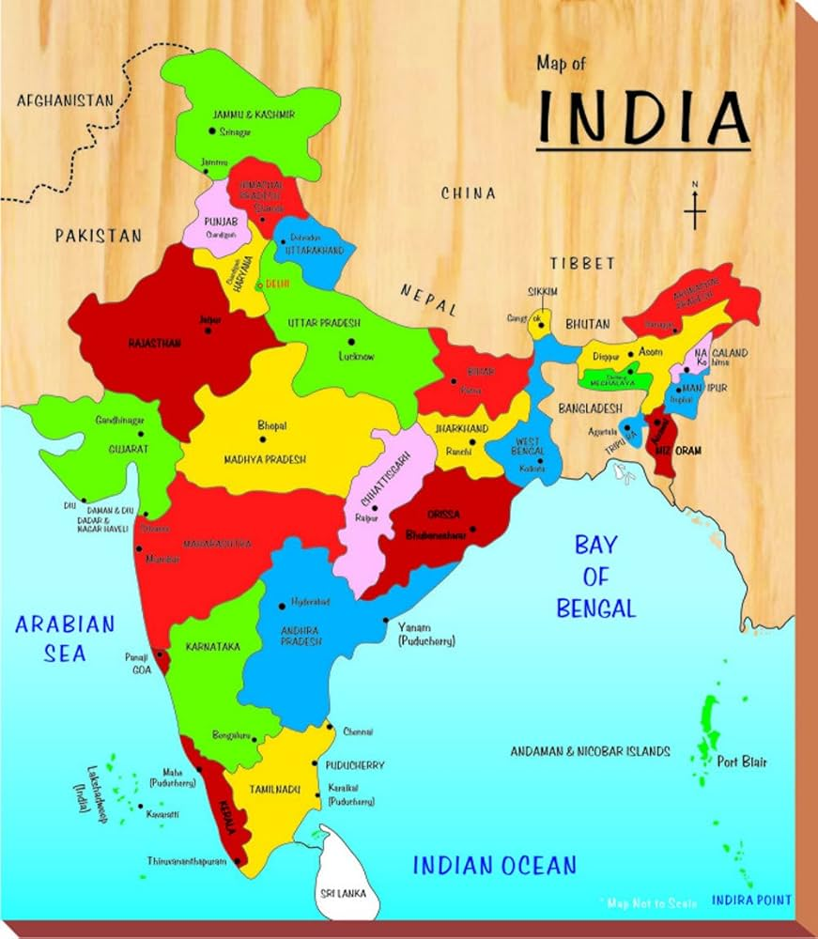
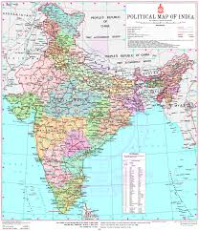
India

Slide 3
Introduction
India/Bharat officially the republic of India is a country in south Asia.
It is the seventh largest country in the world and from the time of its independence in 1947, the world’s most populous democracy.
It has 28 states and 8 Union Territories.
It has 22 official languages.
The forms of Government- Federal Republic.

Slide 4
Introduction
India is a large country located in the South of the Asia continent.
In Southwest Asia, countries such as Pakistan, Afghanistan, Iraq, Iran, Saudi Arabia, Syria, Jordan, Kuwait, Israel etc. are located to the west of India.
The region of India, Pakistan, Bangladesh, Sri Lanka, Nepal and Bhutan is collectively known as the Indian subcontinent.
The Himalayans to the north, the Sulaiman Range to the West, and the Patkai Naga Lusai Range to the East separate this entire region from the rest of Asia. To the South lie the blue waters of the Indian Ocean.

Slide 5
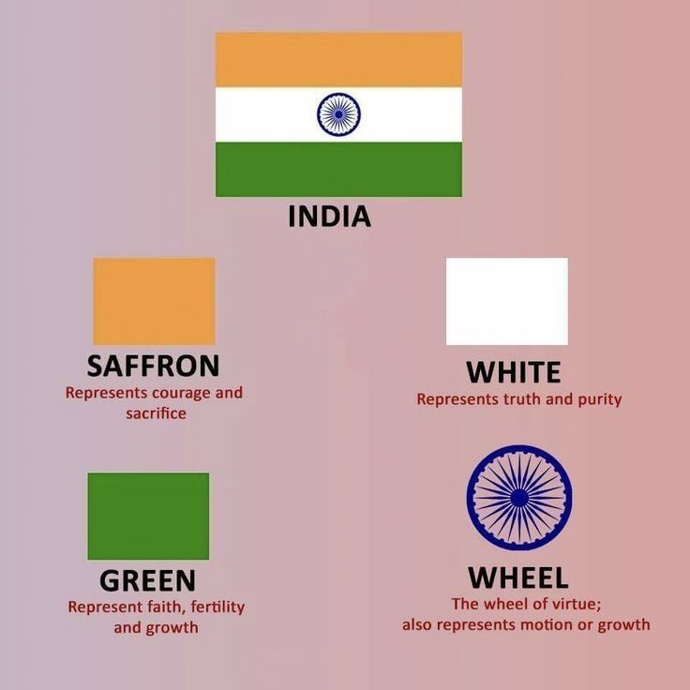
Tricolour of National Flag

Slide 6
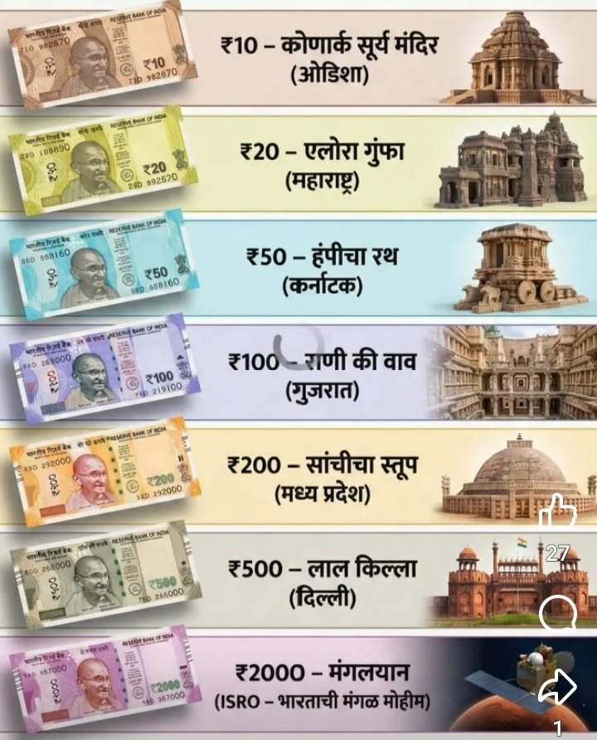
Indian currency

Slide 7
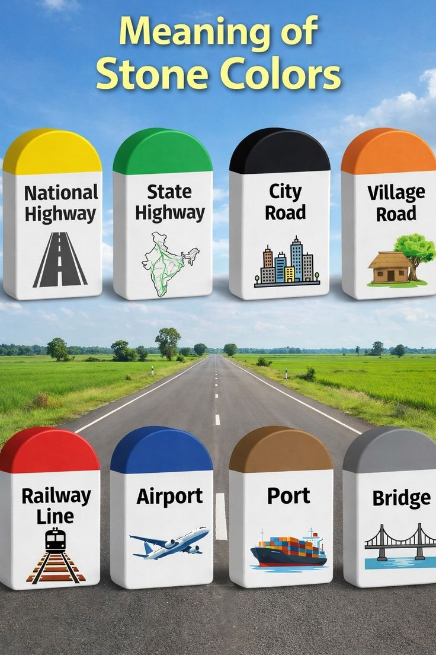
Meaning of Stone colours

Slide 8

India-as a subcontinent
The diversity in this country, in terms of geography, climate, plants, soil, people and their language and way of life is so great that it is almost equivalent to a continent.
On one side are the world’s highest Himalayans mountains and the towering Karakoram mountain range, while on the other side the vast Indus-Gangetic Plain stretches across a vast expanse of land.
Despite all this diversity, uniqueness and isolation, a unified India has emerged.

Slide 9
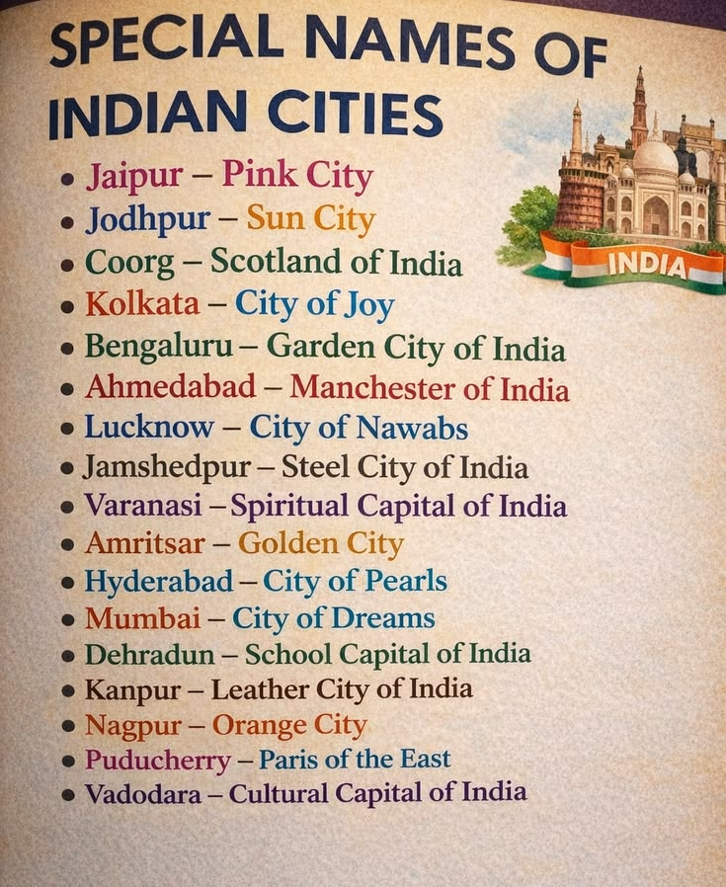
Special Names of Indian Cities

Slide 10
Mountains and Rivers of India
India’s mountains have a massive role tom play in the lives of its people. They have stood guard against invaders for centuries, and even given birth to rivers that feed the country. Some truly magnificent wildlife roams in their forests.
People believe that some of India’s several gods have their homes on the icy mountaintops.
When you think of the mountains in India, you think of the Himalayas. But apart from the Himalayas, there are multiple ranges spread across the country. Its almost as if they hold the land together-like how bones hold our bodies together.

Slide 11
According to the following physiographic forms, the physical structure of India can be divided into six broad categories
The Himalayan Mountains
Northern Plains
Indian Desert
Coastal Plains
Peninsular Plateau
Islands

Slide 12
What mountains do for us?
They help rainfall (because as we all know, warm, moisture-filled air pushes up along slopes of mountains and comes down as rain)
They give birth to rivers.
They stop harsh winds from blowing across the land and thereby manage the weather for us.
The water that comes crashing down mountainsides helps us generate electricity.
Forests are home to some of the world’s most amazing wildlife.
They play a crucial role in countering the effects of global warming.
They give us sights of majestic beauty and are wonderful places to holiday in.

Slide 13
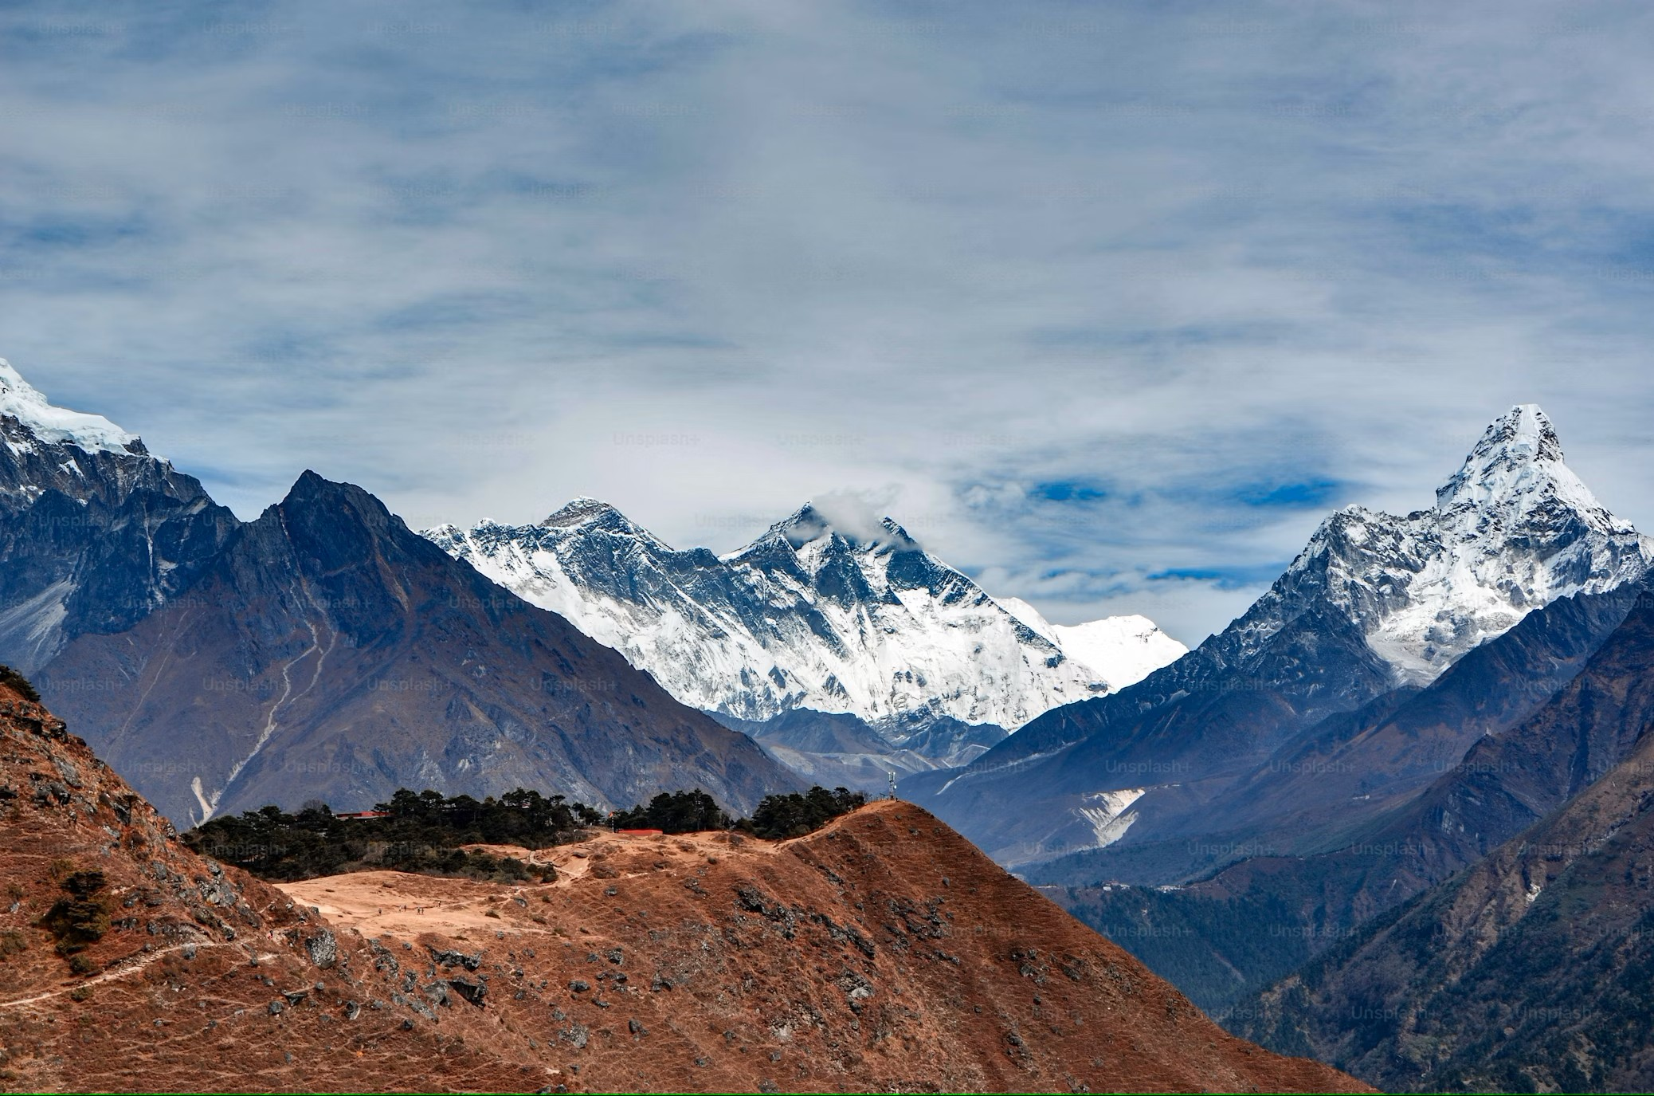
The Himalayan Mountains
The Himalayas, which form a crescent-shaped mountain range on the northern border of India, extend from Kashmir in the west to the Eastern border of Arunachal Pradesh in the east. They are one of the highest mountain ranges in the world and one of the most fragile mountain ranges.
The Himalayas are made of a number of massive mountains with some truly breathtaking peaks.
All the Himalayas are not snow covered.

Slide 14
Mountains of Many Parts
The magnificent Himalayas are actually a series of four parallel mountain belts-each quite unique in its own way. If you go from south to north, this is the way you’d see them:
First are the outer Himalayas, which are mainly made of the Siwalik range;
Second, the Lesser or Lower Himalayas;
Finally the Great Himalayas. A large part of the great Himalayas is in Nepal and Tibet.
The Indian Himalayas are not confined to one state. It pass through ten Indian states and union territories. Its journey begins from Jammu & Kashmir and it make its way through Himachal Pradesh, Sikkim, Arunachal Pradesh, Meghalaya, Nagaland, Mizoram, Tripura, Assam and West Bengal.

Slide 15
The Ghats: The Eastern Ghats and the Western Ghats
‘Ghat’ in Sanskrit means ‘steps’. In India, most holy rivers have steps called ghats leading to the riverbank, allowing pilgrims to bathe. It also means ‘mountain pass’ in some Indian languages.
The Eastern and Western Ghats are like two slices of bread and the Deccan plateau is like the cheese in between. The Western Ghats run parallel to the Arabian Sea in the West, while the Eastern Ghats run parallel to the Bay of Bengal in East.
The Eastern Ghats are a collection of hills that make their way from the north-east to the south-west, in line with the Bay of Bengal. They create a rather narrow range that journey through the states of Odisha, Andhra Pradesh, Telengana and Tamil Nadu. A small parts spills into Kerala and Karnataka too. The topography of the hills in each state is different. On average, the hills reach a height of 2000 feet above sea level. Only a few peaks reach close to 4000 feet.

Slide 16
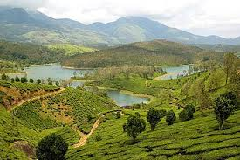
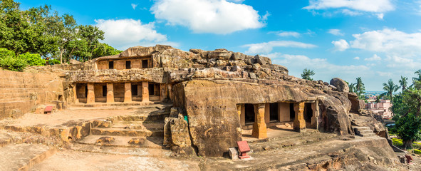
Eastern Ghats: There are different hills in the various states, each has av different name and topography. Mahendragiri, Ramgiri and Udaigiri are some in Odisha; Galikonda, Madgol and Chintapalli some in Andhra Pradesh; and the Bodhamalai and Panchamalai are some in Tamil Nadu.
Bodhamalai in Tamil Nadu
Udaigiri, Khandagiri in Odisha

Slide 17

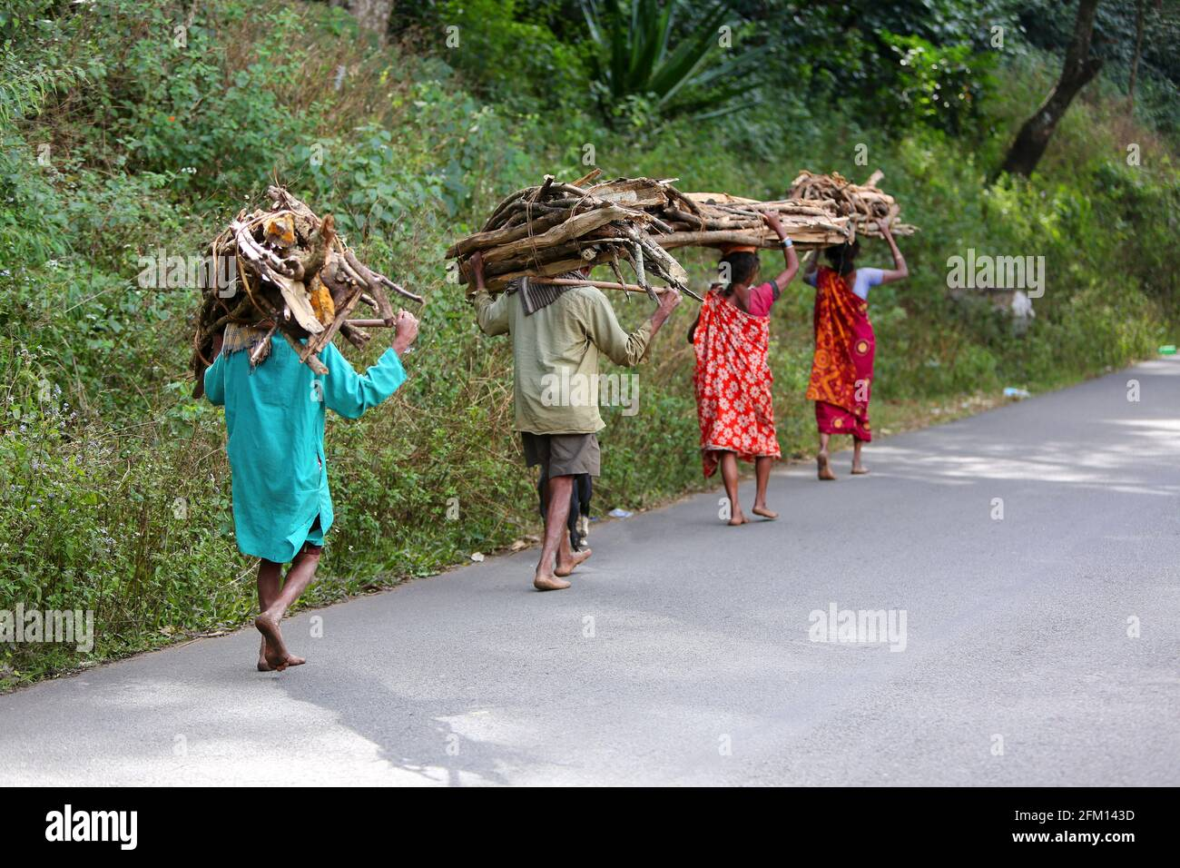
Jungle Story & Tribal Tales of Eastern Ghats: There are different types of jungles & forests in the hills that make up the Eastern Ghats. Depending on their highs & their location, the forest covers on these hills varies. Scores of tribals have roamed the hills of the Eastern Ghats for generations. Though some tribes have modernized, most still lead fairly nomadic & primitive lives.
Tribals in Galikonda (Andhra Pradesh)
Susunia Forest in Bankura (West Bengal)

Slide 18
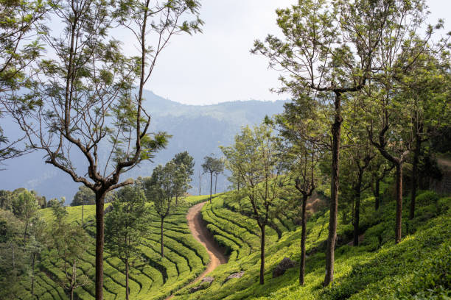
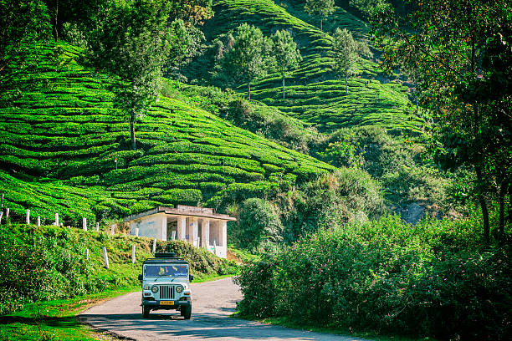
Western Ghats: Along India’s west coast, the Western Ghats rise sharply towards the sea. At several locations, they rise to a height of 3000 to 5000 feet above sea level. The hills have deep slashes and cuts caused by valleys and streams. A portion of Gujrat, Maharashtra, Goa, Karnataka, Kerala and Tamil Nadu are traversed by this lengthy mountain range. In Maharashtra & Gujrat, the Western Ghats are also known as the Sahyadris.
Coonoor Nilgiri Hills (Tamil Nadu)
Munnar tea Plantation (Kerala)

Slide 19
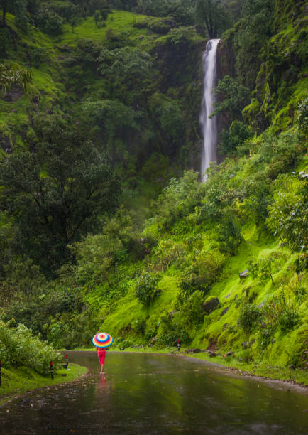
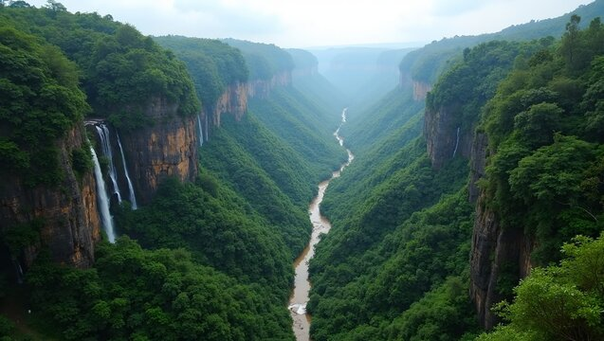
The monsoon pattern in India is thought to depend on the Western Ghats. The Western Ghats halt the rain-filled monsoon clouds that wash in from the Arabian Sea. The most significant tropical monsoon systems in the world are reportedly found in the Western Ghats. The Western Ghats are an important supply of water because of the rains they get, and important rivers are formed there.

Slide 20
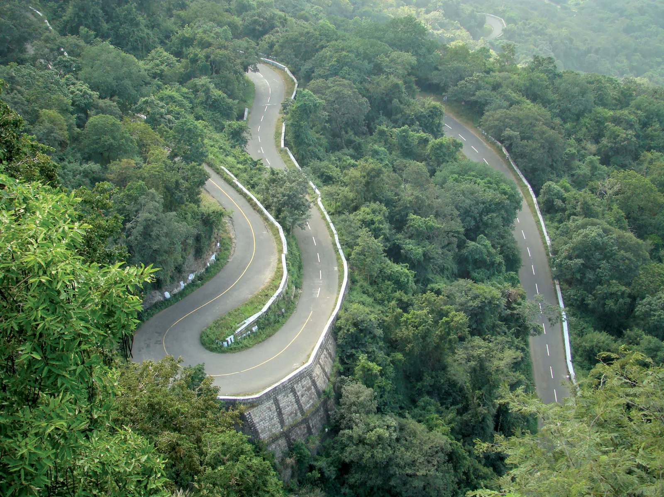
Annamalai Hills
Annamalai Hills are known as the Elephant Mountains, are located in the Southern Western Ghats, spanning the boarder between Tamil Nadu & Kerala in South India.
There are lots of dense forests in these hills. Rosewood, sandalwood, teak & sago palm trees are some of the trees that drop the slope.
Gaur, elephants, tigers, panthers, south bears, pangolins, black-headed orioles, crocodiles, civet cats, dhole & the highly endangered lion-tailed macaques roam these forests.

Slide 21
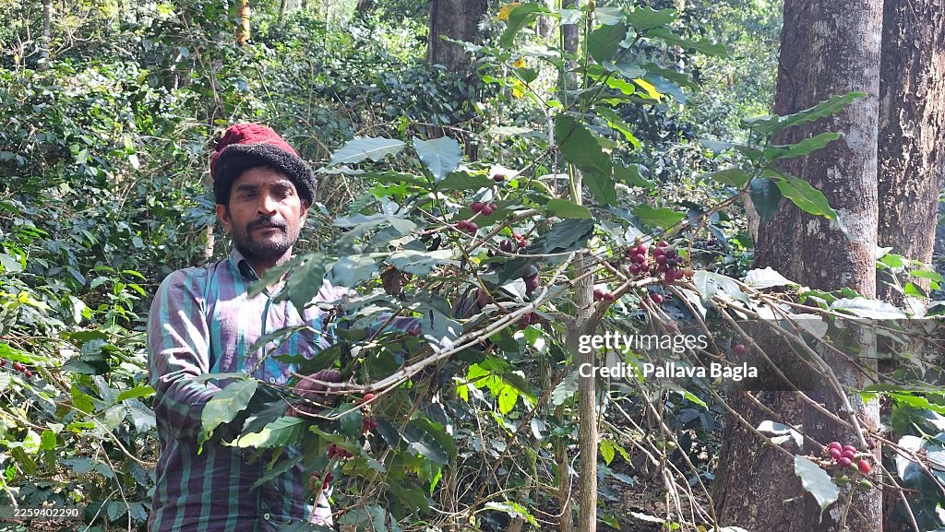
Coffee or Tea, anyone?
The rich soil of the slopes of Western Ghats or Annamalai hills is terrific for growing tea or coffee.
There is a lot of activity among the tribes and locals who live amid these hills. Many of them are employed on coffee or tea plantations.
Munnar is one of the most famous spots in Annamalai Hills, it is well known for its majestic tea plantations.

Slide 22
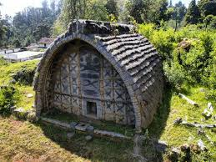
Original Residents of the Tribes
The original residents of the Nilgiri Hills were the tribes called Toda, Badaga, Kota, Irula and Kurumbas. Most of these tribes still live there, but now some of them are occupied in jobs on tea estates and other more modern activities like tourism.

Slide 23
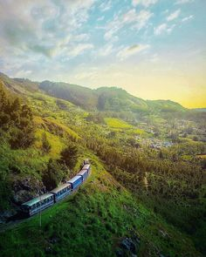
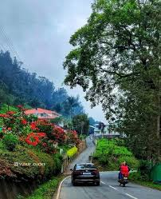
The British were constantly looking for locations in the Nilgiri hills that provide the same chilly, rainy weather as their home. In the upper Nilgiris, they built towns like Ooty or Coonoor.
Udhagamandalam (Ooty)
(Coonoor)

Slide 24
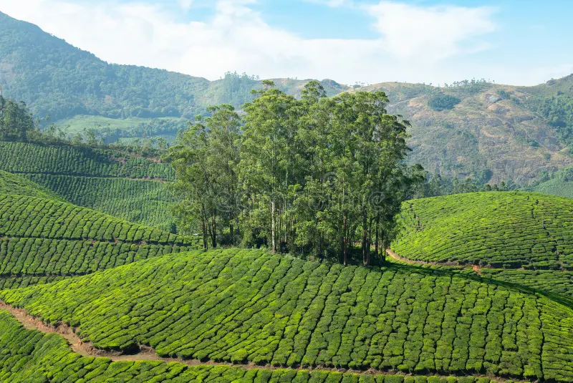
Nilgiri Hills or Blue Mountain
The Nilgiri Hills, at the southernmost tip of the Western Ghats, are famous for their stunning landscapes. They have a more than twenty-four tall peaks, the highest of which is called Doddabetta, soaring at a height of 8500 feet above the sea level. These hills are much colder and wetter than the plains surrounded them.
The Nilgiri hills earned the name ‘Blue Mountain’-because of a beautiful blue flower-Neelakurunji, that blooms once in 12 years.
The fragrent Eucalyptus tree grown in plenty in the Nilgiri area. People make oil from this tree as it is said to be highly medicinal.

Slide 25
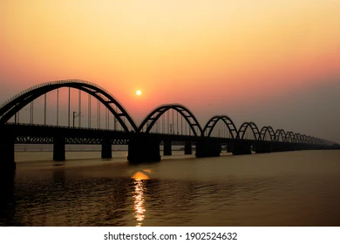
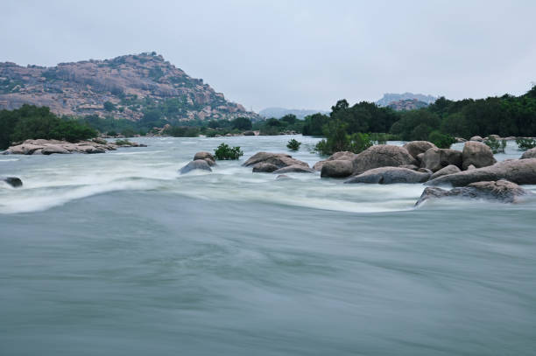
Rivers are born from Western Ghats: The Godavari, the Kaveri, the Krishna & the Tungabhadra are some of the rivers that are born in the Western Ghats. Along with their tributaries, these & the other rivers make this area fertile; the conditions are perfect for tress and forests to grow.
Godavari River
Tungabhadra River

Slide 26
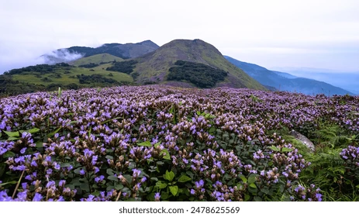
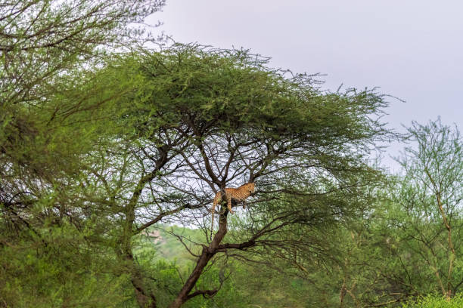
A hotspot for Bio Diversity: The Western Ghats are listed by UNESCO as a biodiversity hotspot that must be preserved forever. Biodiversity means the number and types of animal & plant species a region has. Forests of Western Ghats have a vast & diverse collection. This range has the rarest types of trees and plants along with some highly endangered animals & birds & rare reptiles too.
Neelakurinji, the flower that blooms once in 12 years (Kerala)
Bandipur National Forest (Karnataka)

Slide 27
Rivers
Since the beginning of times, humans and animals have made their homes near rivers and other water bodies. Naturally! Water, apart from air, is the most important element we need to survive.
India has hundreds of rivers-both large and small-that go around the vast country, watering it, feeding the crops and sustaining its over billion people.
There are numerous ice-bound glaciers in the Himalayas that are the birthplaces of some of Asia’s most important rivers. The largest of these is the Gangotri, one of the sources of the Ganges.
There are other glaciers too that do not fall within the boundaries of India, but which feed its rivers.

Slide 28
Why are rivers so important?
They help farmers by watering fields.
They provide drinking water to us and to plants and animals
They help us generate electricity through the dams we build on them.
They help carry goods and equipment up and down their streams.
There is precious wildlife and fish that live in them.
They help plants, trees and the environment in a hundred different ways.
In India, rivers are also considered as Gods, and people pray to them.
India is an enormous country. If the mountains are like the bones of India, the rivers function like arteries and veins, criss-crossing busily across the land.

Slide 29
Rivers of India
There are two kinds of main rivers in India.
The Himalayan Rivers: These are created by melting snows and glaciers, and so these flow right through the year.
The Peninsular Rivers: These are born in India’s peninsula and flow either east into the Bay of Bengsal, or West into the Arabian Sea. Many are fed by rains and can run dry during a bad monsoon.
Typically, rivers in India are referred to as Mother. For example, people say Ganga Ma or Saraswati Ma. That’s because they know that rivers give them so much, just like a mother. People believe that the Ganga is so pure that its water helps people get rid of their sins.

Slide 30
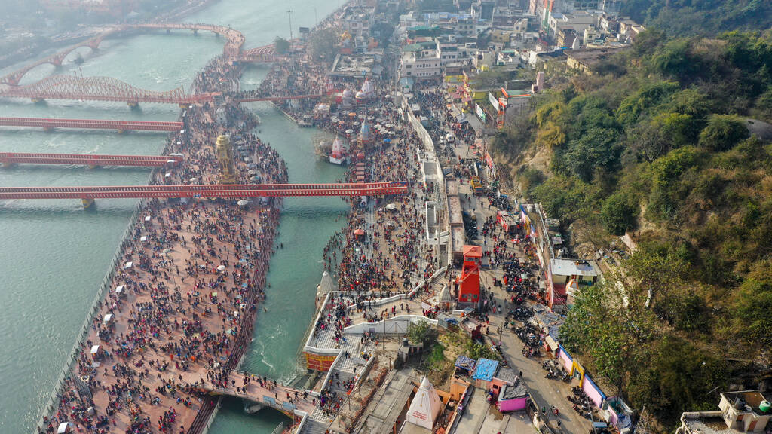
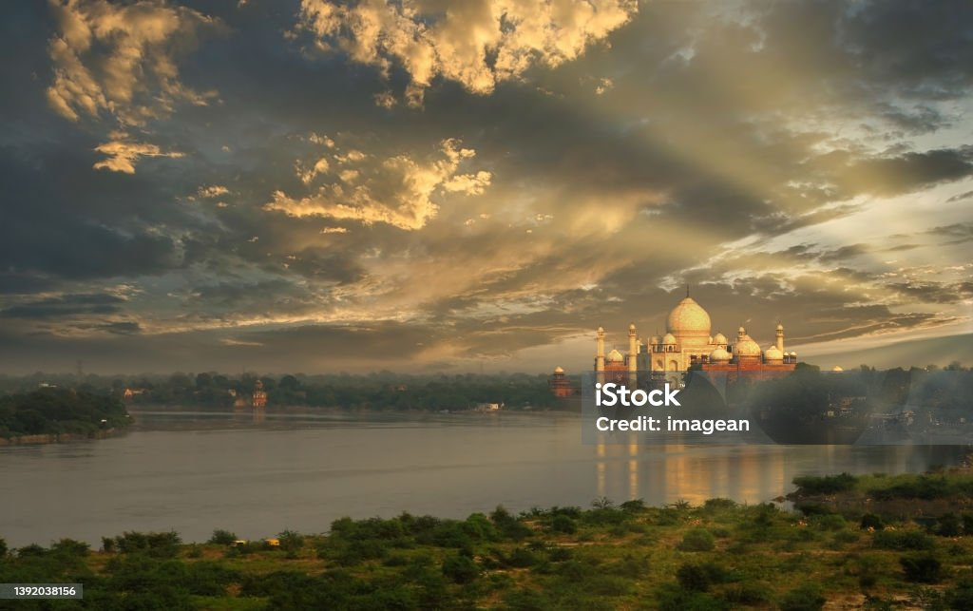
Holier than Holy: Ganga and Yamuna

Slide 31
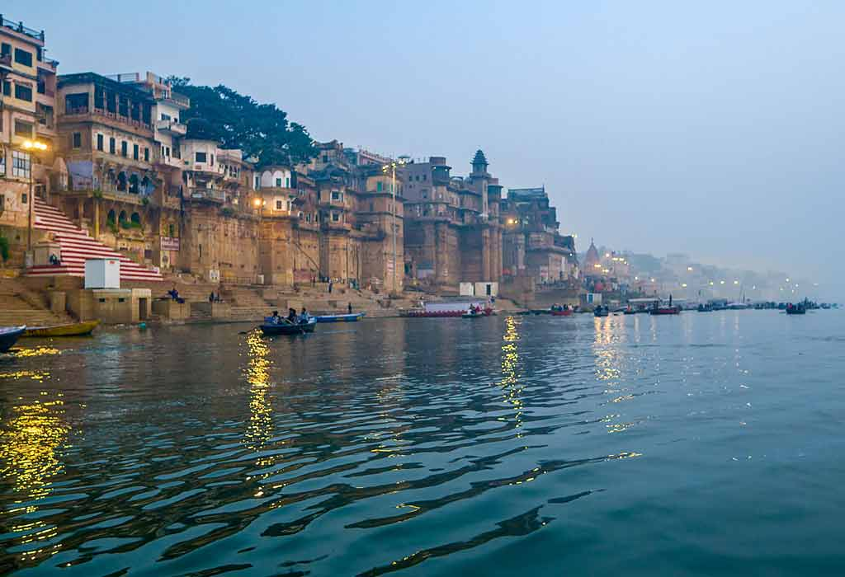
The Ganges
The river Ganges-or Ganga is known by India’s most religious and important river.
It is worshipped as a goddess by millions.
The Ganges is born in the Gangotri Glacier, high up in the Himalayas. The Gaumukh (meaning mouth of a cow) is a glacier cave, and it is said to be the very spot that the Ganges begins. Millions of pilgrims visit it to pray to the Ganges. The river comes crashing down about 14000 feet down steep valleys and cliffs. It travels more than 2500 km before finally emptying itself into the Bay of Bengal.

Slide 32
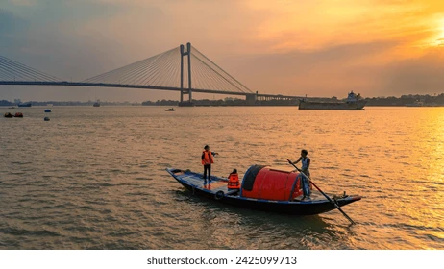
Hooghly River
India’s trade long depended heavily Hooghly River. In the state of West Bengal, it is created when the Bhagirathi and Jalangi rivers converge.
The Hooghly River travels a fairly congested path. It is surrounded by towns and industries, the most significant of which being Kolkata and Howrah. As a matter of fact, it’s one of the few rivers that ocean-going ships can navigate all the way to Kolkata.
Particularly when it gets closer to the Bay of Bengal, there are sections of the Hooghly river that are entirely enriched by mud and sandbanks.
During the various periods that European traders settled in this area, they built some lovely mansions & buildings. A few of these (eg, Howrah Bridge) still exist along the banks of the Hooghly.

Slide 33
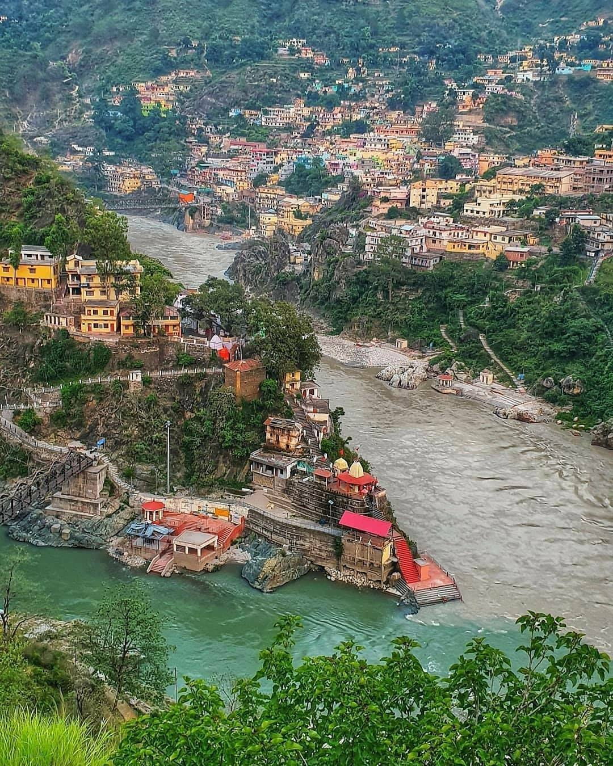
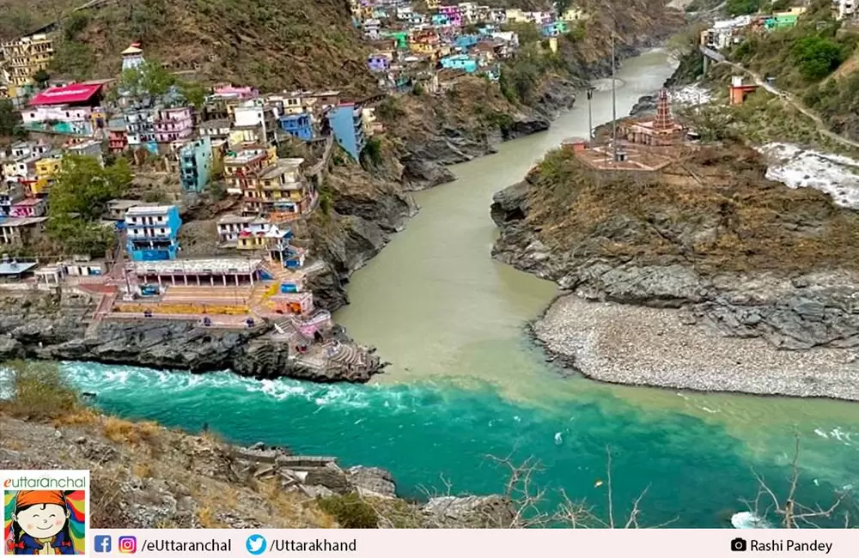
Tributaries and offshoots: Devprayag and Rudraprayag

Slide 34
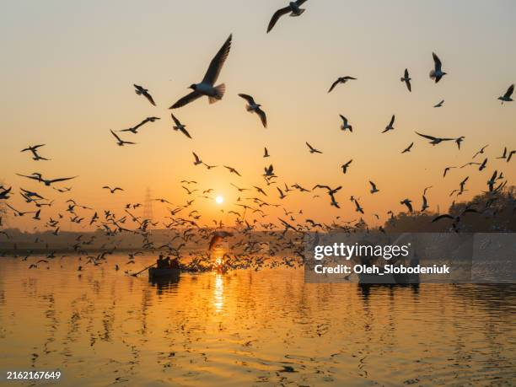
The Yamuna
The birthplace of the river Yamuna is called Yamunotri. It comes crashing down steep mountainsides and makes its way through the states of Uttarakhand and Uttar Pradesh over a distance of over 1300km.
There are a large number pf important and lively towns located on the banks of the Yamuna. Delhi, Agra, Prayagraj, Mathura, Noida and Etawah are some.
Yamuna is joined by some important tributaries like the Chambal, the Sindh, the Betwa, the Ken the Tons, and the Giri. Near Prayagraj (once known as Allahbad), it merges with the Ganges. In fact, this confluence is called Triveni Sangam, meaning ‘the meeting of the trinity’. The Ganges and the Yamuna are said to join a third river, the mythological Saraswati River, at this point.
The world –famous Taj Mahal sits on one of the banks of the Yamuna.

Slide 35
The Brahmaputra
The Brahmaputra is one of the few ‘male’ rivers in India. The name means the ‘son of Brahma’, the creator of the universe.
The majestic Brahmaputra is one of the India’s most powerful rivers. It’s born in the Himalayas and travels about 1800 miles. It enters India through Arunachal Pradesh, where it is called Siang or Diang. It then travels through Assam before completing its final journey with the Ganges-where the mixed waters of both rivers pour into the Bay of Bengal
The river is so massive and wide that it is known as a ‘moving ocean’ in Assam. Its river basin is so massive that it covers four countries: Bhutan, India, Tibet and Bangladesh.

Slide 36
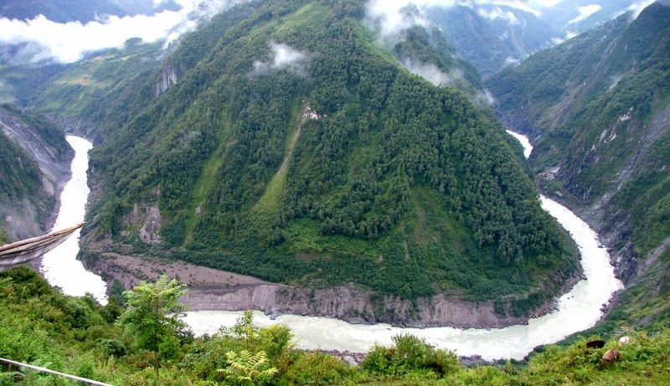
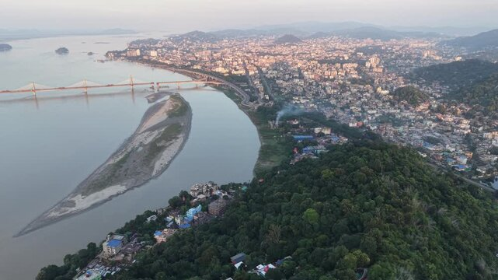
Brahmaputra : It is known by different names in the various countries it meanders through-the Tsangpo in Tibet, the Yarlung Zangbo Jiang in Chaina, and Jamuna (not to be mixed up with Yamuna) in Bangladesh.
India to Chaina with Brahmaputra River
Guwahati town & Brahmaputra river

Slide 37
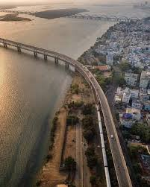
Godavari River
The Godavari is one of India’s longest rivers. It is born in Trimbakeshwar, in the Nashik district of Maharashtra. It travels through Maharashtra, Telengana, Andhra Pradesh, Chattisgarh and Odisha and finally pours into the Bay of Bengal through two mouths, the Gautami Godavari and the Vasistha Godsavari.
Dandakaranya, the forest where Lord Rama went during his exile, is said to be close to the Godavari in the Nashik region.
The Godavari river delta is home to the Coringa mangrove forests as well as some thick deciduous forests.

Slide 38
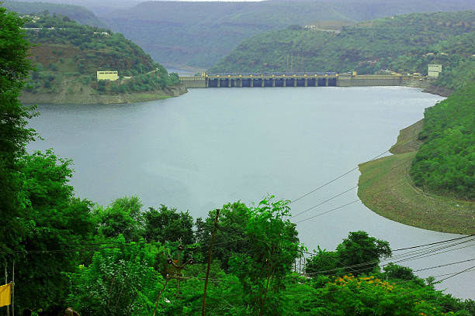
Krishna River
The Krishna River flows in the southern & central parts of India and is among India’s longer rivers. It rises among the hills of the Western Ghats in Maharashtra. It cuts through the Eastern Ghats and finally meets the Bay of Bengal. It crosses the states of Maharashtra, Kanataka, Telengana and Andhra Pradesh.
The seasonal monsoon rains fills up the Krishna.
Some major cities have grown along the Krishna over the decades. Two of the most important are Sangli in Maharashtra (known as the turmeric city) & Vijaywada in Andhra Pradesh.

Slide 39
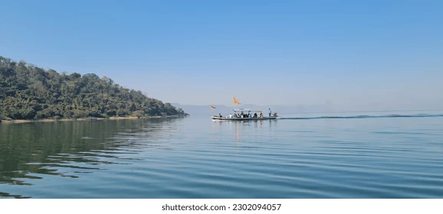
Mahanadi River
The name Mahanadi literally means great river. This river rises in the hills of Chattisgarh in central India. It then makes its way eastward, entering the state of Odisha. It finally empties its waters into the Bay of Bengal through smaller channels & streams.
The Hirakud Dam, built on Mahanadi, is India’s longest earthen dam. It makes water available to vast tracts of land. It also supplies massive amounts of hydroelectric power to the state of Odisha.
The cities of Sambalpur & Cuttack, still very prominent, were important trading hubs in ancient times. The town of Puri, at one of the mouths of the river, is a very famous & religious spot, where millions come to pray at the twelfth century CE temple of Jagannath.

Slide 40
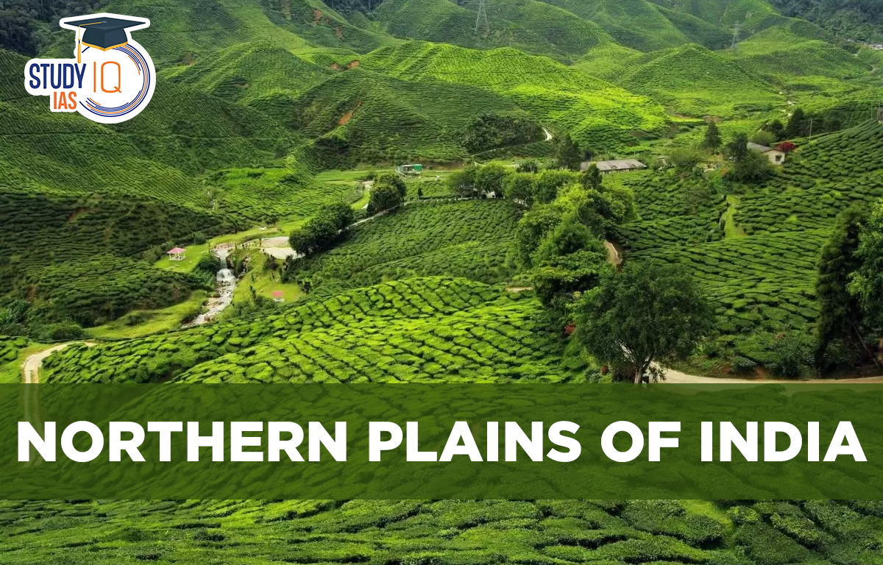
Northern Plains
Along with their tributaries India’s three major river systems -Indus, Ganga and Brahmaputra fed the Himalayan foothills.
Due to the abundance of alluvial deposits left by these glacial rivers, these river basins became fruitful over the course of several centuries, eventually giving raise to the Northern Plains.
In addition, the Northern Plains can be separated into three major regions once more.
The Punjab Plains
The Ganga Plains
The Brahmaputra Plains

Slide 41
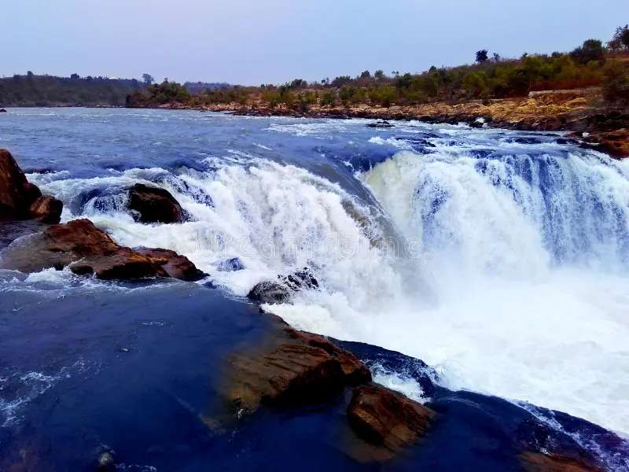
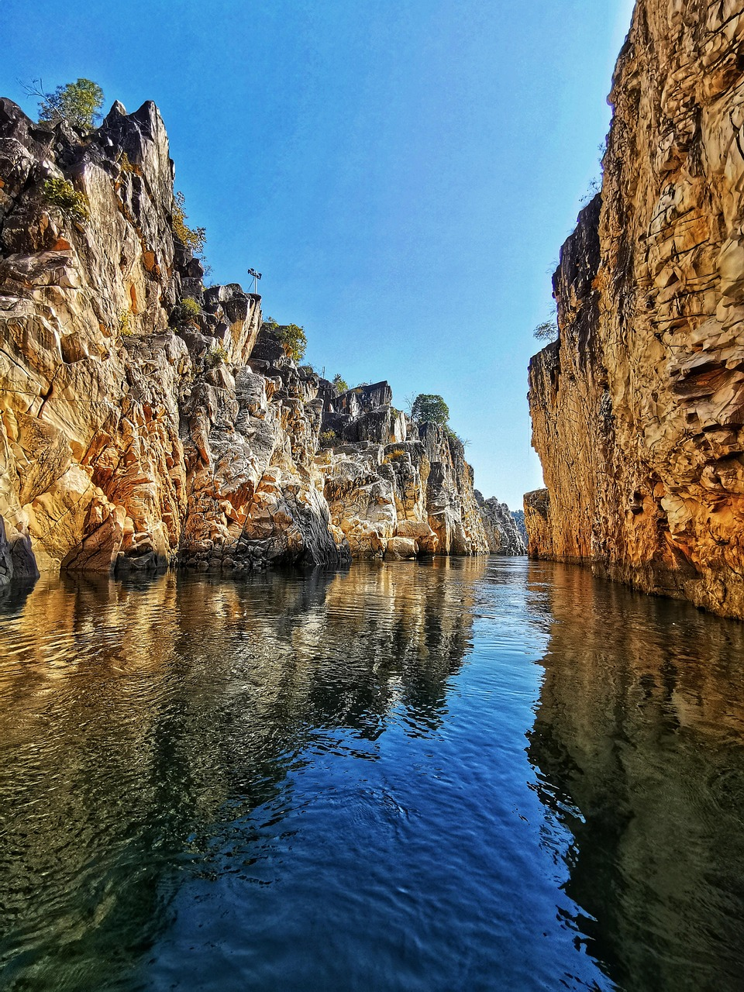
The Narmada: A river that flows mainly through central India, is an important route between Ganges river valley & the Arabian Sea. It is born in the Maikal Range in Madhya Pradesh. It slices through the Vindhya & Satpura ranges, creating some dramatic waterfalls along the way. Hindus regard Narmada as sacred river.
Dhuandhar waterfalls (Jabalpur-M.P.)
Marbel Rock on Narmada River

Slide 42
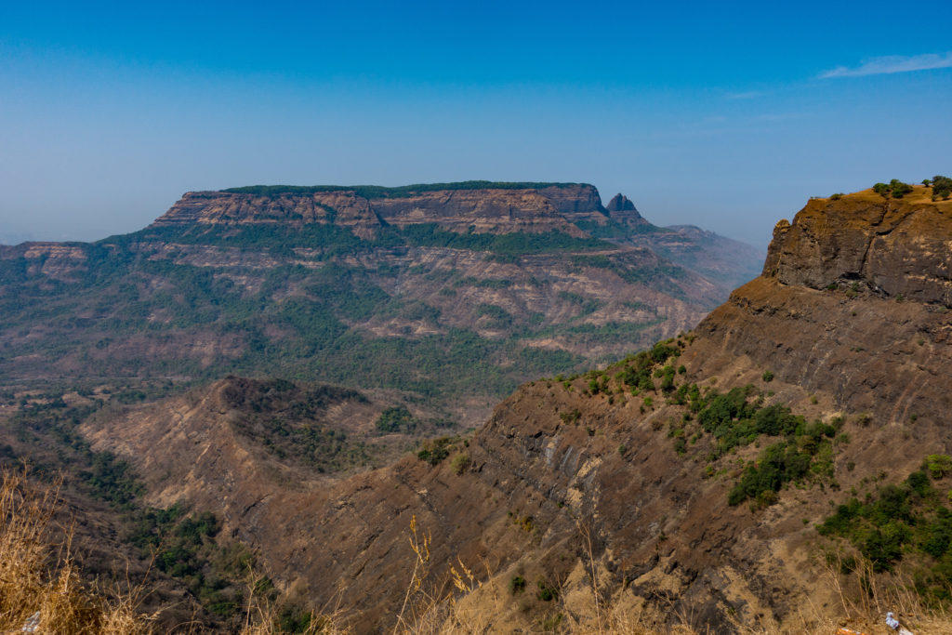
Peninsular Plateau
The oldest landmass of India, the Peninsular Plateau was the result of the tectonic shifts of the Gondwana Land. This massive plateau area is further divided as –
The Central Highlands- i.e. lying on the north of the Narmada River and covering a large part of the Malwa Plateau.
The Deccan Plateau- It is a triangular landmass lying on the south of the Narmada River. The Eastern Ghats and the Western Ghats border the Deccan Plateau on its eastern and western sides respectively.

Slide 43
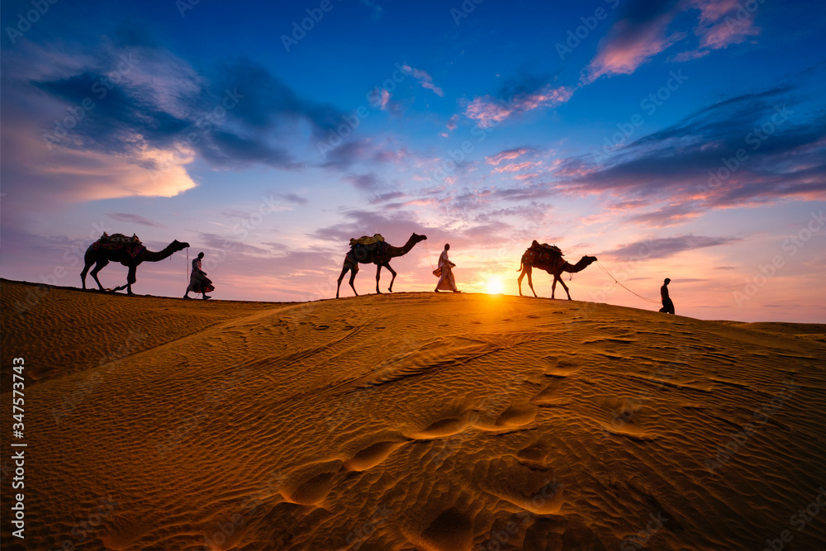
Indian Desert
The Indian desert is made up of the sand-dune-covered, rolling sandy plains on the western edges of the Aravali hills.
The desert region id made up of the states of Rajasthan and the northwest portion of Gujrat.

Slide 44
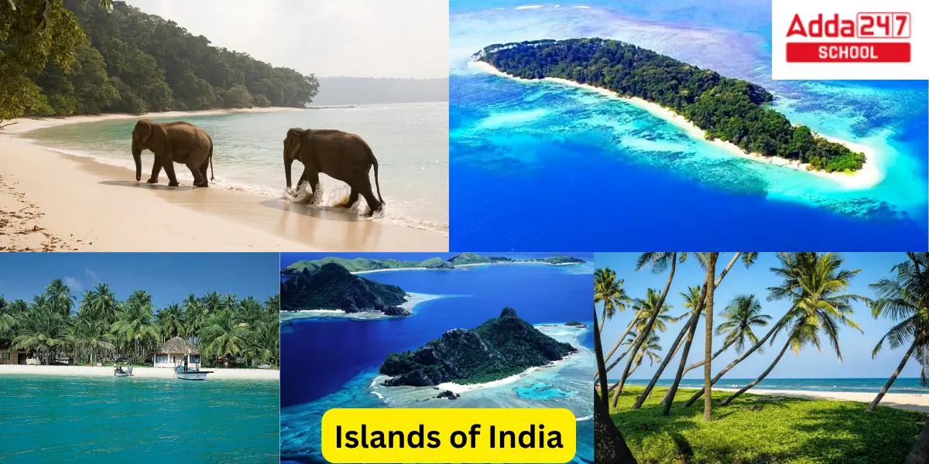
Islands
Two groups of islands lie on the two oceans surrounding the main landmass of the subcontinent. These most likely complete the physical features of India.
The Lakshadweep, which lies closer to the Malabar Coast and
The Andaman and Nicobar Islands which are off the Bay of Bengal and lie on the Indian Ocean. These group of islands are larger in size than their western counterparts and have rich biodiversity.

Slide 45
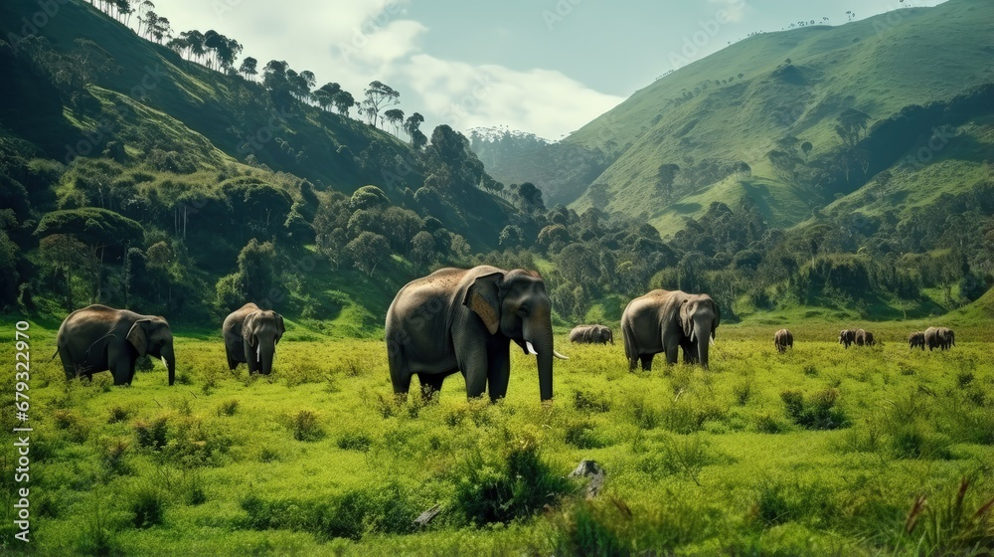
Forest of India
Forest is an ecosystem consisting of trees which support innumerable life forms and it is an important part of environment. These are there to clean the air and cool it on hot days and conserve hat at night. Our rain fall also depends on forest. It is an excellent means to keep our environment balanced.
Types of forests in India fall into six major groups. These include most tropical, dry tropical, Montana sub tropical, Montana temperature, sub alpine, and alpine.

Slide 46
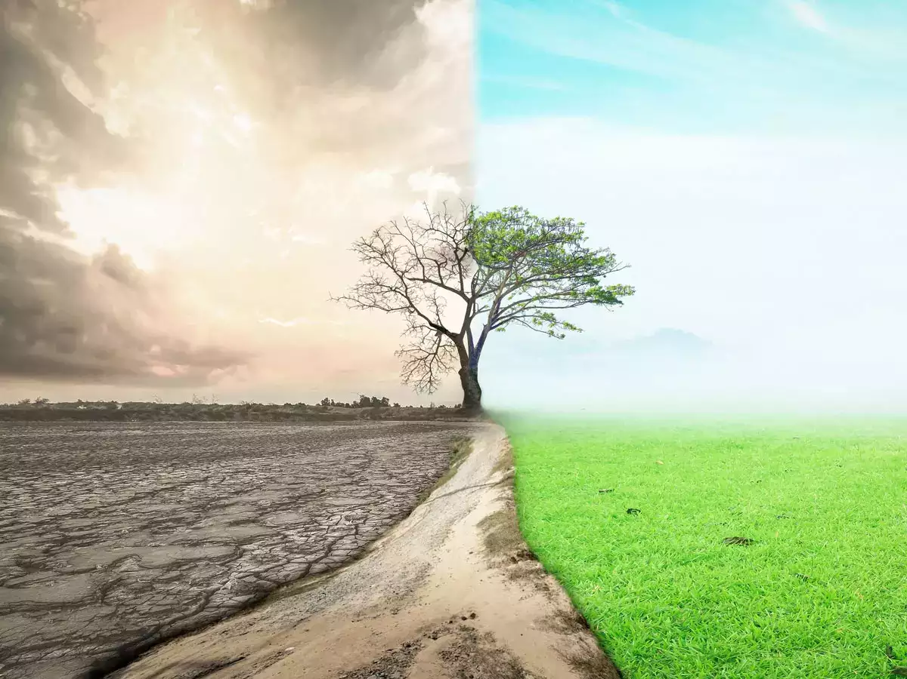
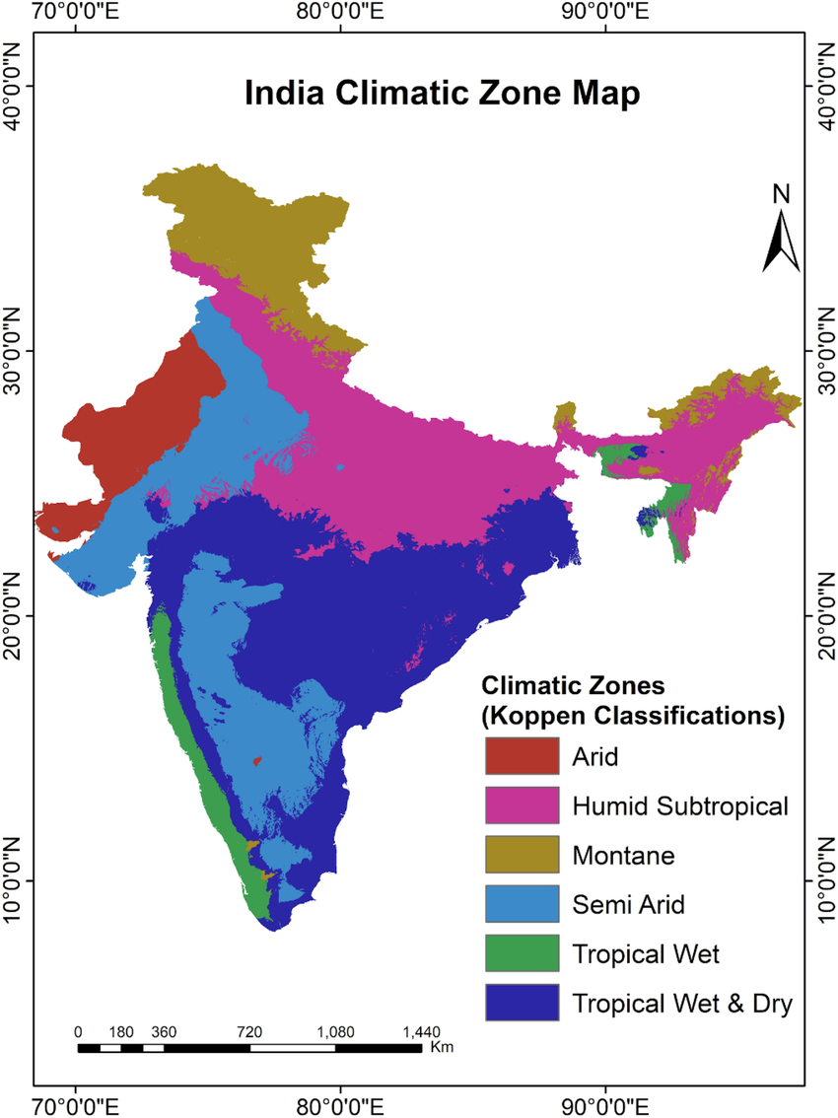
The climate of India may be broadly described as tropical monsoon type. The India’s climate is affected by two seasonal winds- the north east monsoon and the south west monsoon.

